Slide 1

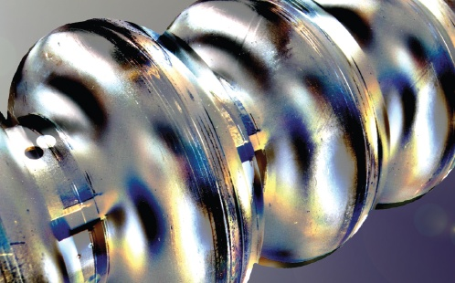

Surface Evolution of Nb(100) due to Thermal/Gas Treatments as applied to SRF Cavities
Review and recent results at DESY
A. Dangwal Pandey, G. D. L. Semione, C. Bate, S. Kulkarni, T. Keller, H. Noei, V. Vonk, J. Schaffran, M. Wenskat, D. Reschke, H. Weise, and A. Stierle
MML
From Matter to
Materials and Life

Slide 2
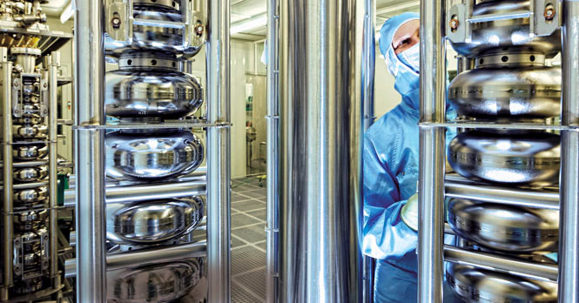
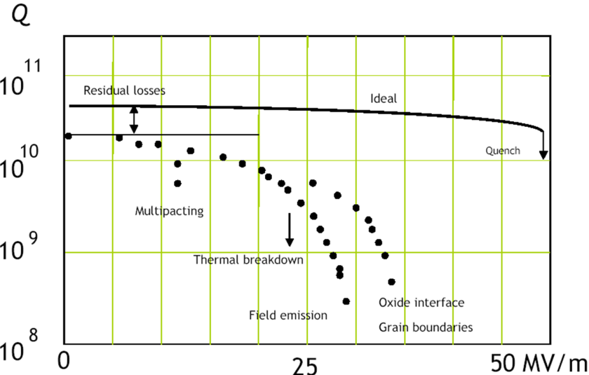

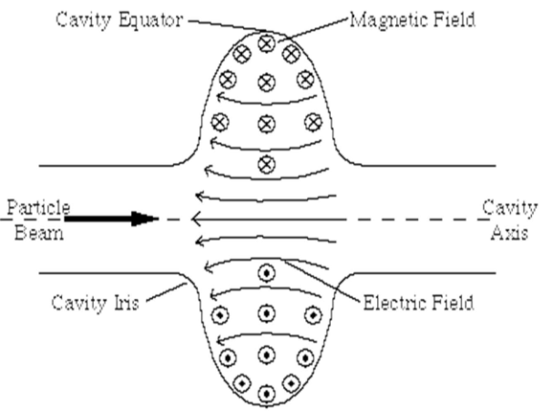

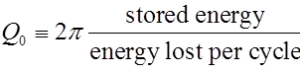
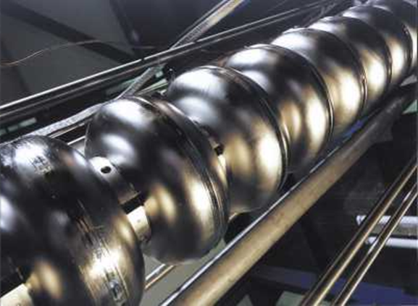
Superconducting radio frequency (SRF) Nb cavities
Goal: - attain higher efficiency (Q), and max. E_{acc}
T_{operating} = 2 K, Nb: T_{c}= 9.3 K,
Why??
Higher efficiency of the cavities directly reduce the cryogenic load
  Realization of the continuous wave operation of European-XFEL
  Cost reduction in large future projects, International linear collider (ILC) (approx. 17000 cavities)
Notes:
EP mixture of 1 volume part HF (48 %) and 9 volume parts H2SO4 (96 % - 98 %)
Why CW? - For synchrotron like experiments profiting from high coherence and intensity

Slide 3
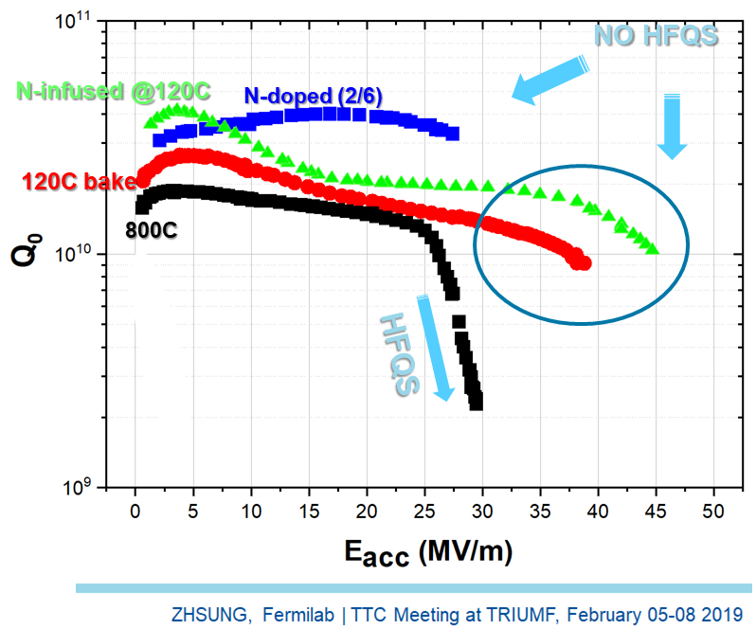
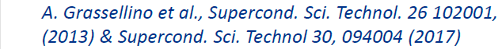
Why do specific surface treatments lead to substantial changes in SRF cavity performance?
  Final thermal treatment of SRF Nb cavities, reviewed here:
Low-T bake: @120 °C (48 hrs)
N-infusion: 800 °C (3 hrs) + @120 °C (48 hrs) in N₂
  RF penetration depth lies within top 100 nm
A systematic investigation of Nb surface is needed
to understand the physics behind these processes,
to recognize the key parameters in surface treatments
  A ‘reproducible’ recipe for Nb surface preparation
  Any change must happen at the surface.

Slide 4
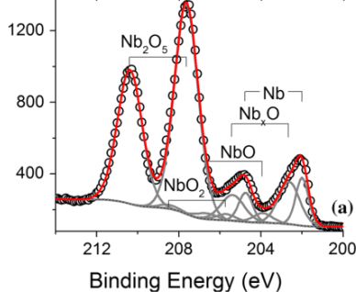
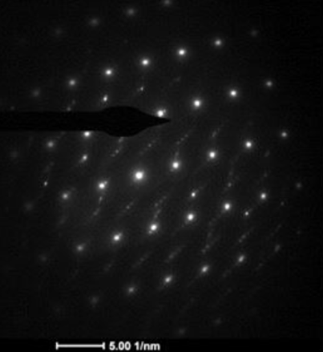
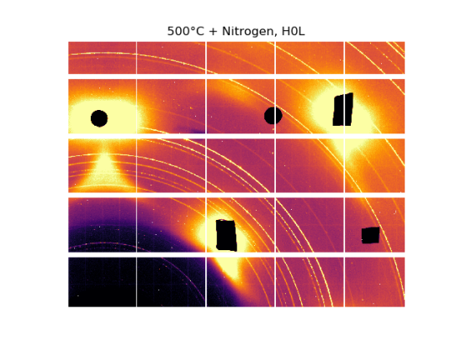
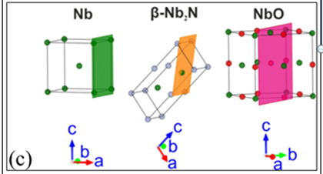
Extensive Nb sample R&D worldwide
Towards cavities with highest quality factors (at high gradients)
  Surface study of Nb with atomic details
Commonly used characterization methods:
Microscopy: secondary electron microscopy (SEM),
      transmission electron microscopy (TEM),
        atomic force microscopy (AFM) etc.
Spectroscopy: x-ray photo e spectroscopy (XPS),
secondary-ion mass spectroscopy (SIMS)
positron annihilation spectroscopy (PAS) etc.
Diffraction: grazing incidence x-ray diffraction (GIXRD),
        nano electron diffraction (NED) etc.
  Different strategies:
  Ex-situ characterization: investigation after surface treatment
Cavity cut-outs
Samples treated with cavities
Samples treated similar to cavities
  In-situ experiments: investigation during surface treatment
  Samples treated similar to cavities

Slide 5
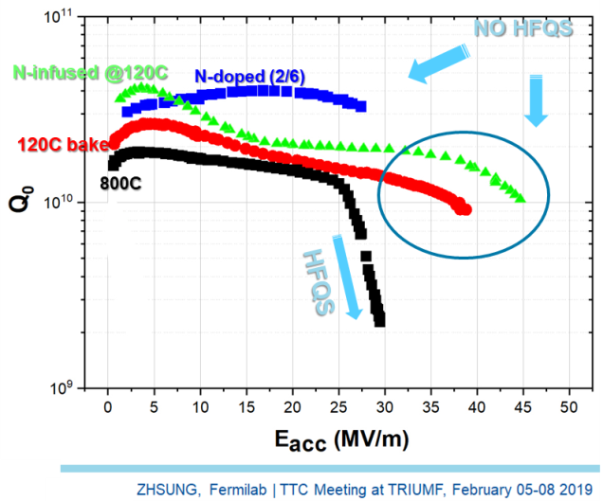
Extensive Nb sample R&D worldwide
Review of results reported from different labs within last 4 years
  Nb samples investigated:
  Thermal treatments
  N-treatments
  Nb-carbide precipitates and grain boundary segregation

Slide 6

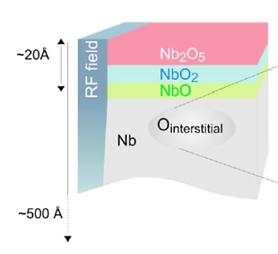
Surface evolution of Nb(100) in UHV @ DESY
Low -T bake at 120 °C as applied to superconducting RF cavities
Nb₂O₅, NbO₂, NbO, Nb_{x}O, Nb
In-situ surface monitoring using XPS:
Nb(100) model system of ultra-pure single crystal and cavity-grade material
120°C bake:
  Dissolution of Nb₂O_{5,}
  growth of NbO₂ and NbO,
  stable surface achieved after 12 hrs baking
  Longer cavity baking of 48 hrs can be shortened
120 °C
15 hrs
120° C
12hrs
120°C
2 hrs
RT
M. Delheusy, et al., Appl. Phys. Lett . 92, (2008)

Slide 7
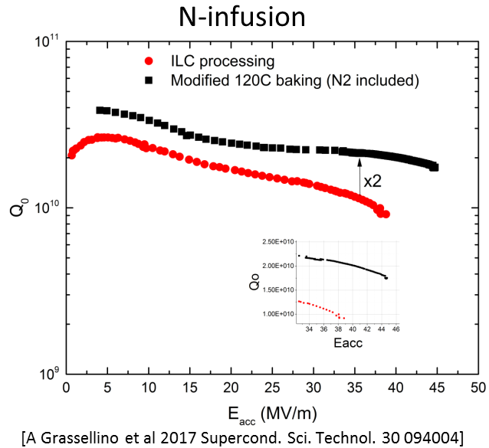
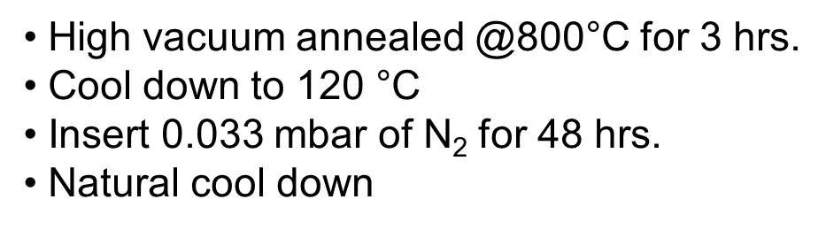
Extensive Nb sample R&D worldwide
Review of results reported from different labs within last 4 years
  Nb samples investigated:
  Thermal treatments
  N-treatments
  Nb-carbide precipitates

Slide 8
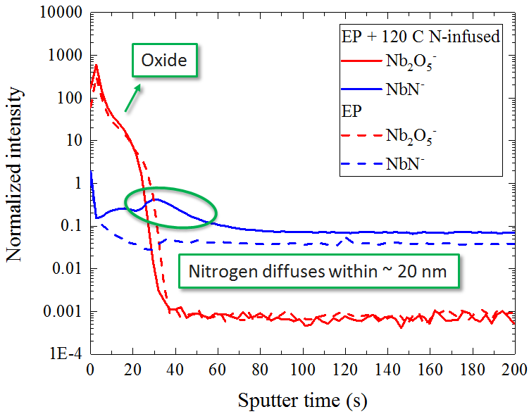
Cut-outs of several cavities @ FNAL
TEM, SIMS, Cryo-AFM: identified NbH phases, confirmation of ‘N’ at metal-oxide interface, nanohydride segregation
800°C/3hrs + 120°C in 25 mTorr (0.03 mbar) N₂ /48hrs
Secondary Ion Mass Spectroscopy (SIMS):
TEM SAED
Nb
oxide
Protective layer
- A. Romenenko, TTC meeting Riken Japan 2018
Electro polished (EP) Nb
Y. Trenikhina et al, J. Appl. Phys. 117,154507(2015)
‘N’ present in N-infused Nb – N interstitials favorably trap H – suppress NbH segregation and thus suppress HFQS
A. Romanenko et al., IPAC 2018
M. Checchin et al., IPAC 2018
[A. Grassellino talk this session]

Slide 9
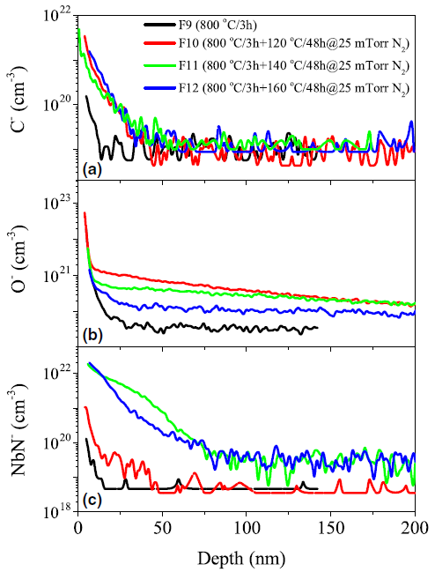
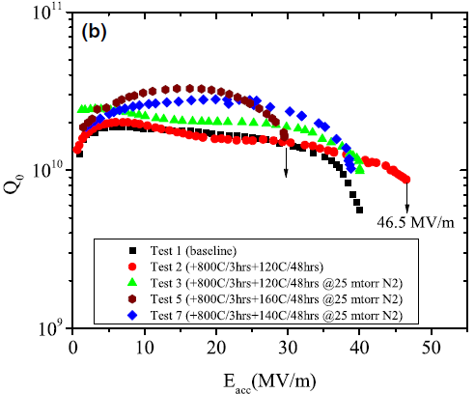
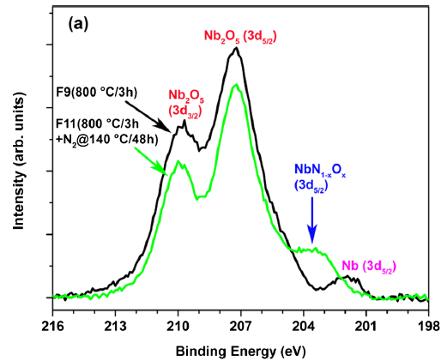
N-infusion at varying T @ Jlab
Fine grain Nb samples treated similar to cavities: XPS/SIMS/AC susceptibility measurements, ‘N’ containing phase
800°C/3hrs + inject N₂ @290°C + 120-160°C in 25 mTorr N₂ /48hrs
SIMS
XPS
P. Dhakal et al. Phys Rev. Accel and Beams 21 (2018)
a new chemical component observed, N excess within top 50 nm,
in-line with level of dirtiness observed by AC susceptibility measurements
Nb oxy-nitrate phase present on Nb surface after 140°C -160°C N-infusion
[P. Dhakal talk SRF2019]

Slide 10
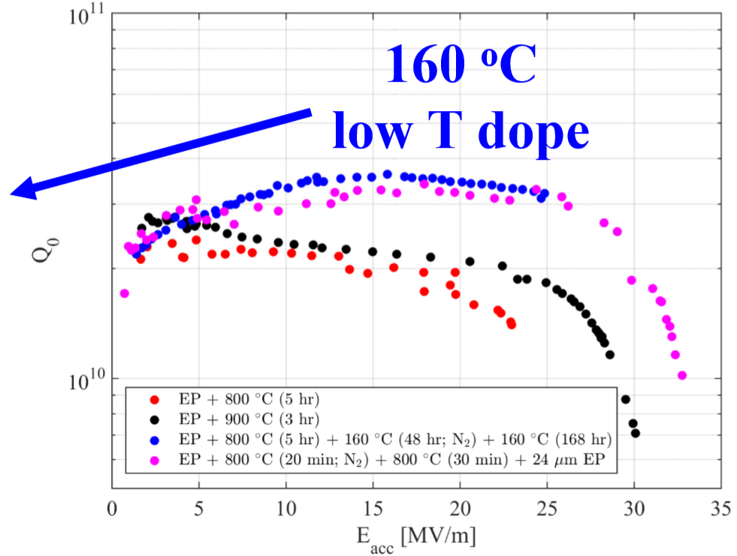
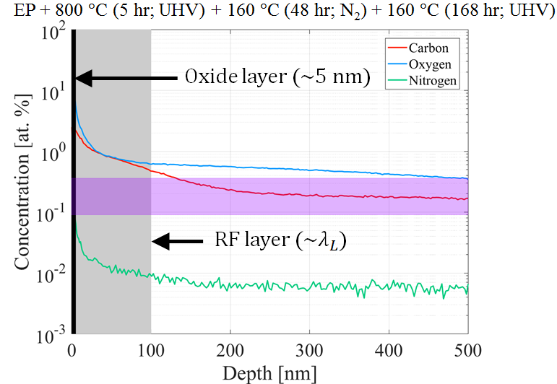
160°C N-infusion @ Cornell
Large grain Nb samples treated with cavities: SIMS, interstitials diffuse in to lattice, much higher C compared to N
800°C/5h + 160°C/48hrs in 40mTorr N₂ + 160°C bake 168 hrs
SIMS
160 °C low- T dope
P. N. Koufalis, M. Liepe, J. T. Maniscalco, TUXBA01, SRF2017.
‘N’ observed only in top 5 nm, much higher C conc. in near-surface region
[J. T. Maniscalco talk SRF2019]

Slide 11
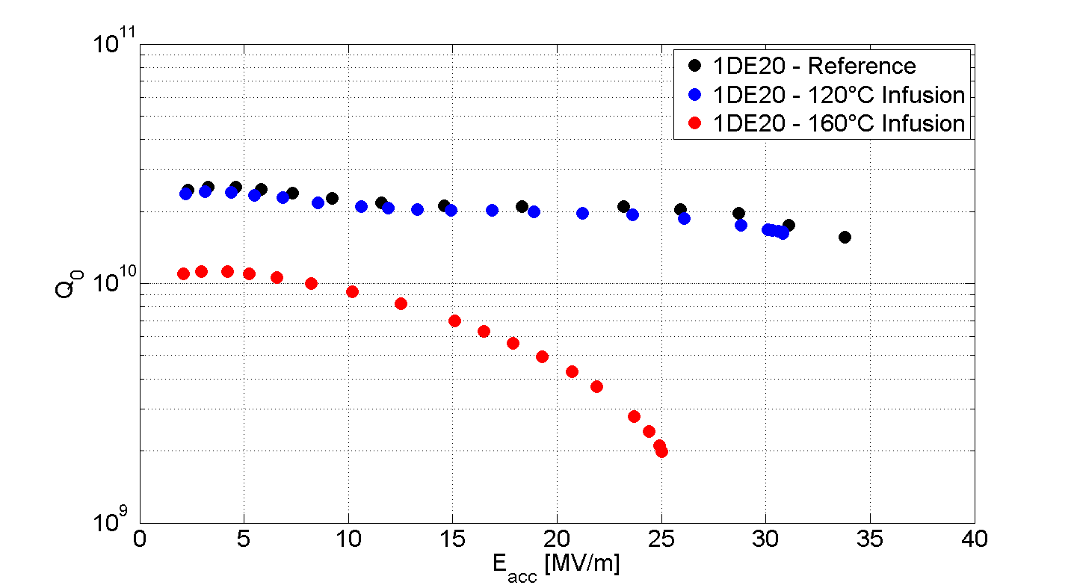
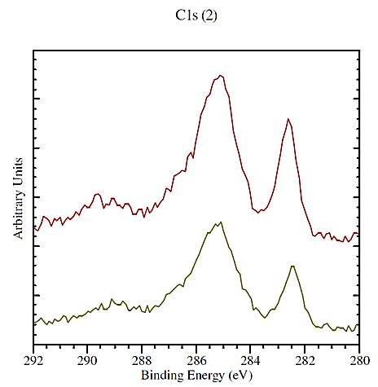
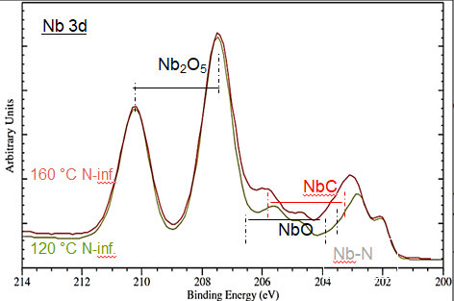
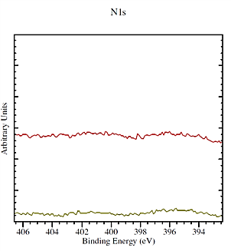
N-infusion of fine-grain Nb at varying T @ DESY
Samples treated with cavities: SIMS/ SEM/ XPS, more carbides on 160°C infusion, no indication of NbN
800°C/3 hrs + 120°C/25 m Torr N₂/ 48hrs ■
800°C/3 hrs + 160°C/25 m Torr N₂/48hrs ▲
XPS
C 1s
Nb-C
Nb 3d
Nb₂O₅
160 °C N-inf.
120 °C N-inf.
160 °C N-inf.
120 °C N-inf.
NbC
10 µm
NbO
Nb-N
N 1s
Nb-N
SEM: carbon rich precipitates for N-infused samples at 120 °C and 160 °C
XPS: more Nb-C content for infusion @ 160 °C, no Nb-N bonding observed
SIMS: more C for 160 °C infusion, no NbN identified
Higher carbide content for N-infusion at higher T to be related to failed cavity treatment

Slide 12
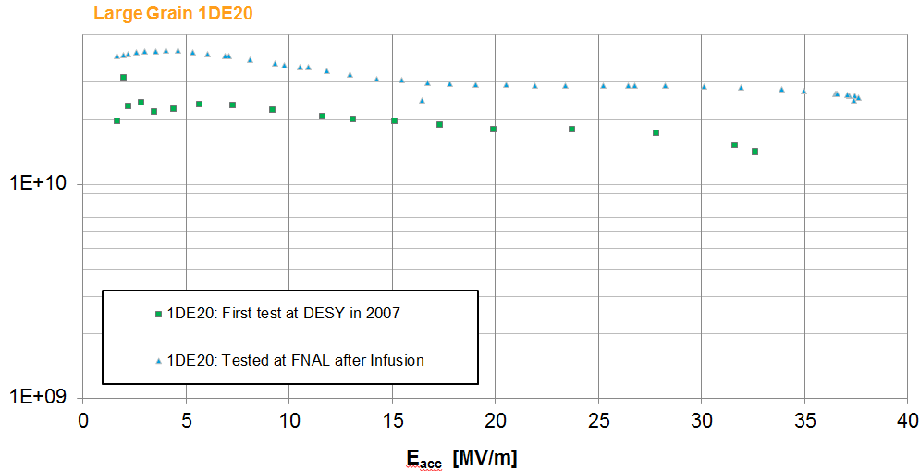
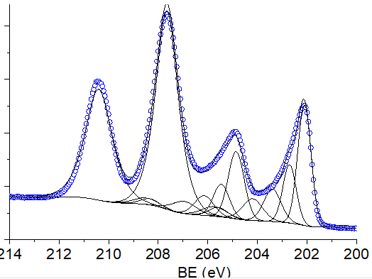
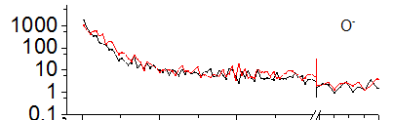
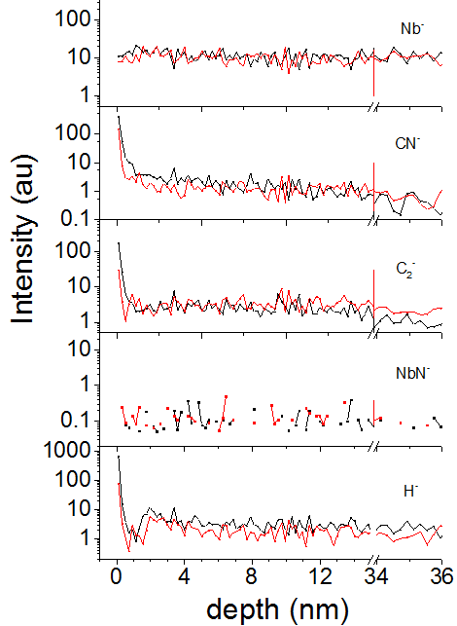
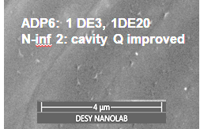
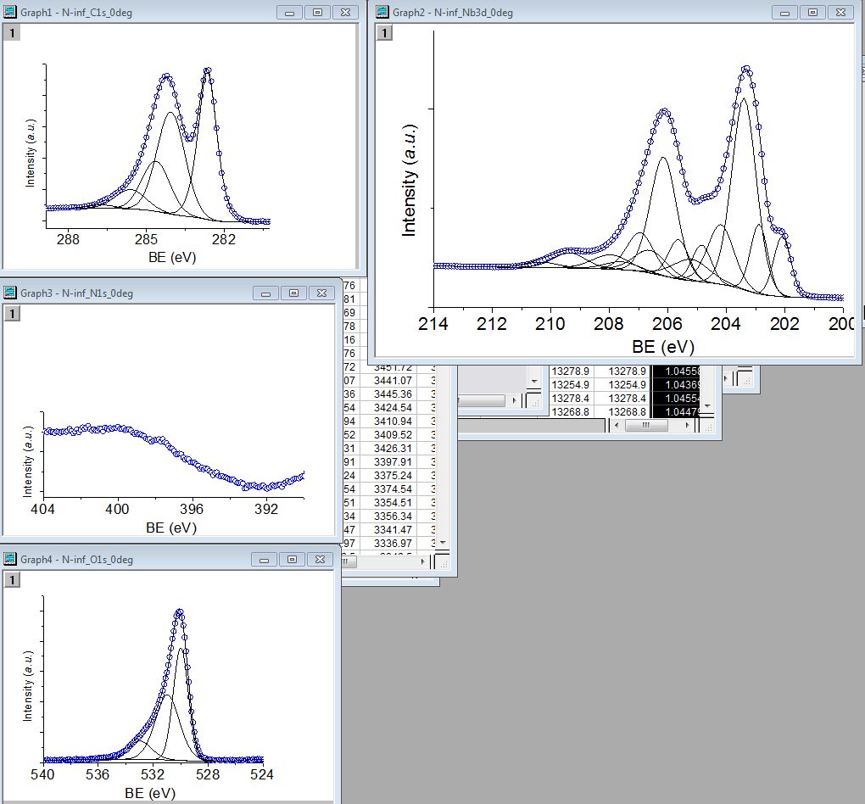
N-infusion of Nb(100) in FNAL, investigation @ DESY
SEM/XPS, shallow NbC precipitates, absence of Nb-N
800°C/3hrs + 120°C in 25 mTorr N₂ /48hrs
XPS
SIMS
Nb 3d
Q₀
after N-infusion
Nb₂O₅
baseline
Nb-C
NbO₂
NbO
Nb_{x}O
C 1s
N 1s
Sample corresponding to a successfully infused cavity:
C-precipitates visible
No signature of ‘N’ containing phase

Slide 13
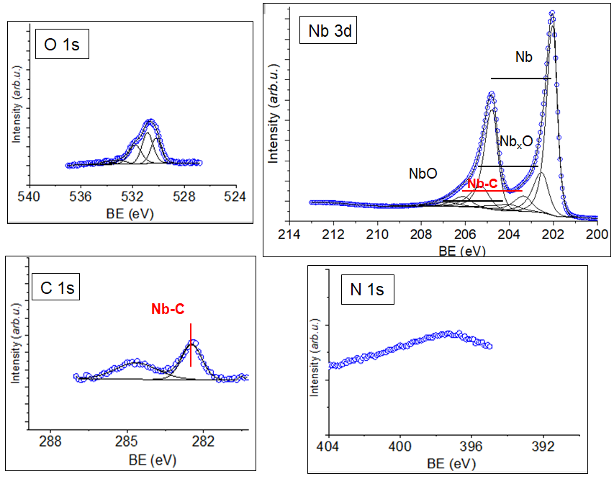
N-infusion of Nb(100) in UHV chamber @ DESY
in-situ XPS experiment
800 °C + 120°C/12 hrs in UHV (no N₂)
NbO, NbC present on surface
No Nb-N observed

Slide 14
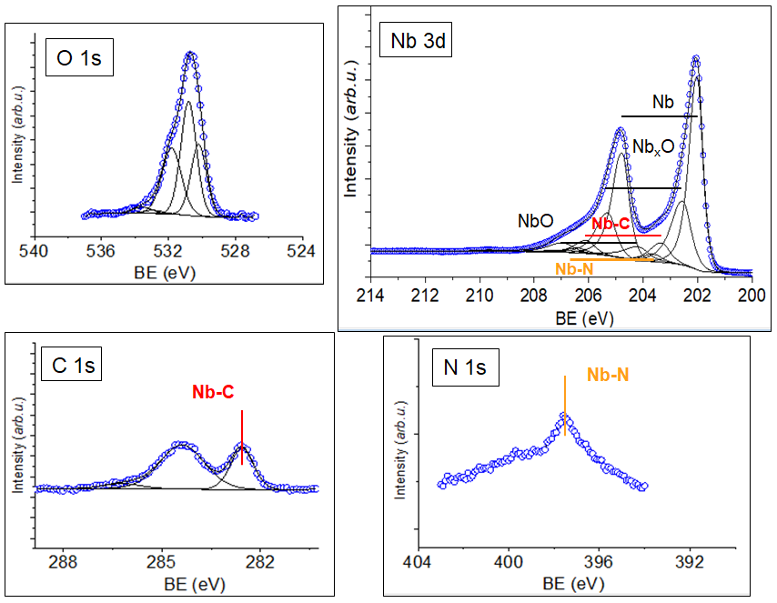
N-infusion of Nb(100) in UHV chamber @ DESY
in-situ XPS experiment, Nb-N observed
800 °C + 120°C/12 hrs in UHV (no N₂)
NbO, NbC present on surface
No Nb-N observed
+ 120 °C in N₂ (0.004 m Torr)/13 hrs
NbO grows further
NbC still visible
Nb-N observed in top 10 nm surface

Slide 15
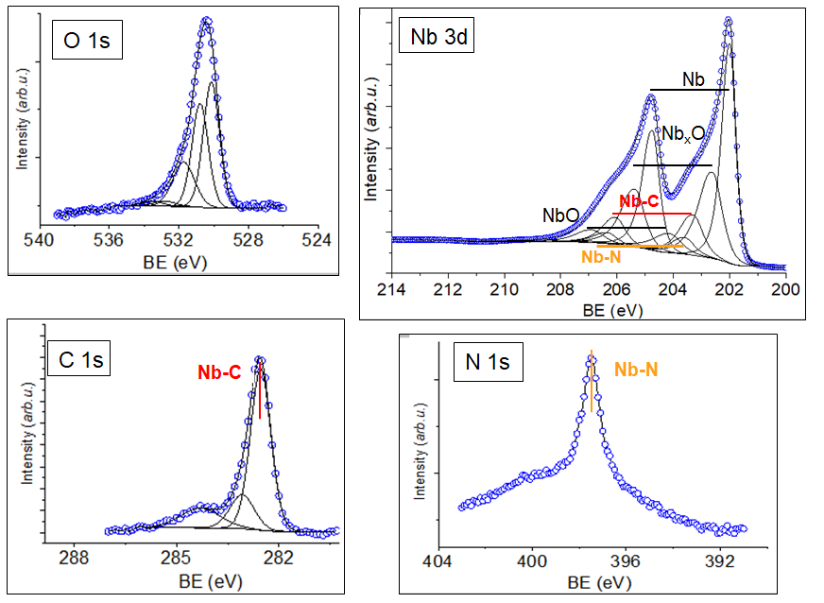
N-infusion of Nb(100) in UHV chamber @ DESY
in-situ XPS experiment, Nb-N observed
800 °C + 120°C/12 hrs in UHV (no N₂)
NbO, NbC present on surface
No Nb-N observed
+ 120 °C in N₂ (0.004 m Torr)/13 hrs
NbO grows further
NbC still visible
Nb-N observed in top 10 nm surface
@ 500°C heated in UHV to remove N
+ 260°C 12 hrs
+ 260°C in N₂ (0.004 mTorr)/15 hrs
397.3 eV
Nb-N peak got intense by
N-infusion at 260 °C

Slide 16
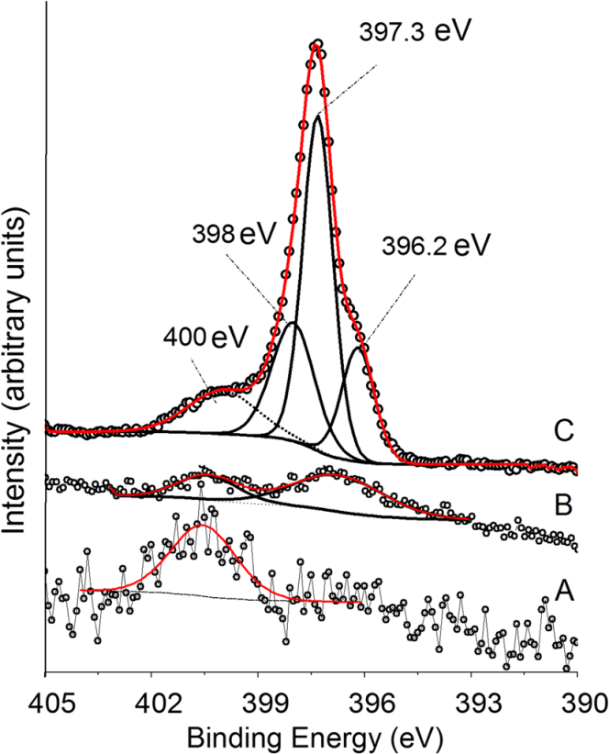
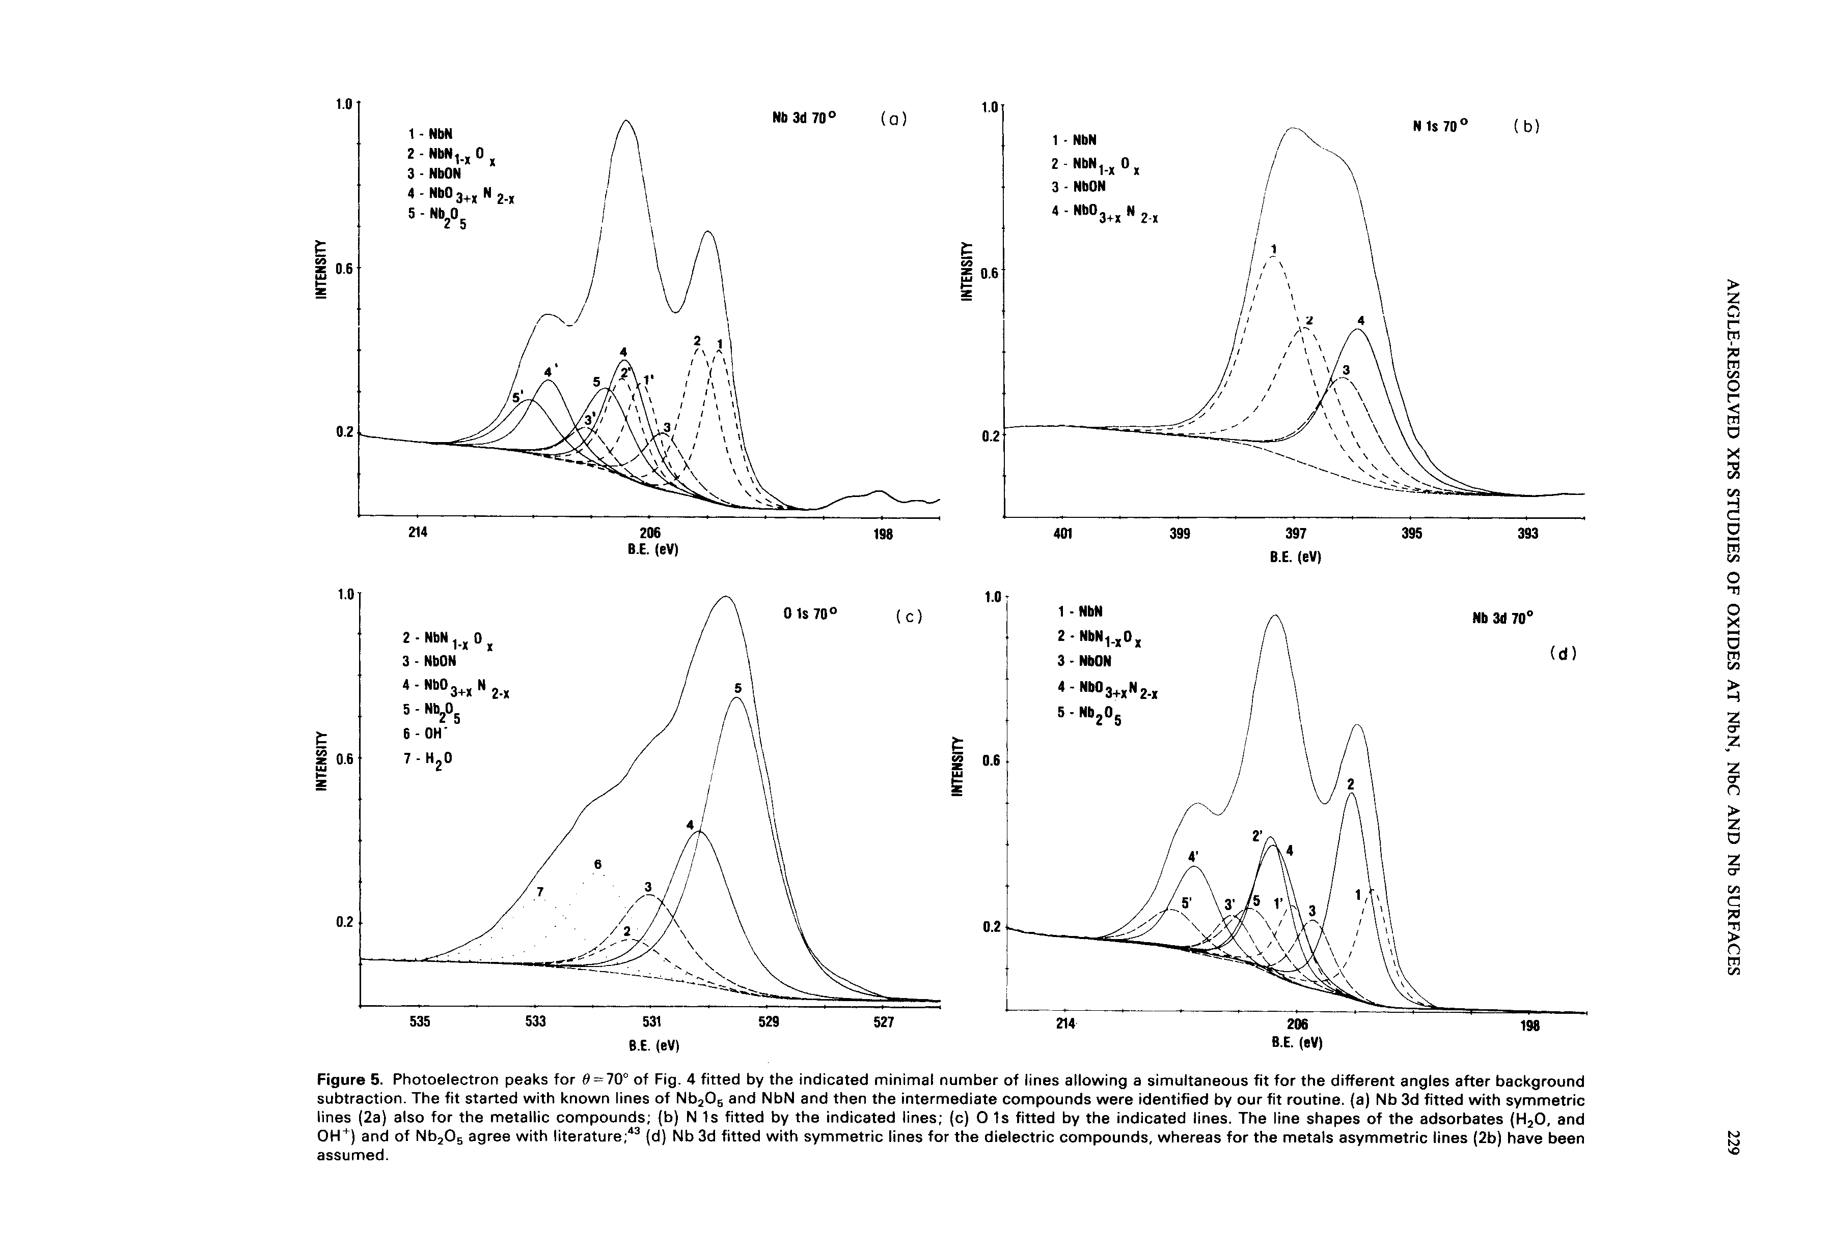
N-infusion at very low N₂ pressure @ DESY
Nb (100) sample: in-situ XPS experiment, Nb-N observed
A. Dangwal Pandey et al.,
J Material Science (2018) 53:10411
In-situ XPS:
NbN: formed by nitridation of fine-grain Nb @ 900°C,
Oxidized in air for few months.
NbN: formed by nitridation of large grain Nb @ 620°C,
Oxidized in air for 30 min.
800 °C + 120°C/12 hrs in UHV (no N₂)
N 1s
no peak at binding energy position for Nb-N bond
NbN
+ 120 °C in N₂ (0.004 m Torr)/13 hrs
120°C in 0.004 m Torr N₂
formation of Nb-N phase within top 10 nm surface by N-infusion at 120 °C
NbON
900°C N-doped
@ 500°C heated in UHV to remove N
+ 260°C 12 hrs
+ 260°C in N₂ (0.004 mTorr)/14 hrs
397.3 eV
800°C N-doped
A. Darlinski, Halbritter,
surface and interface analysis (1987) 10:223
initial
Nb-N peak got intense by
N-infusion at 260 °C
260°C in 0.004 m Torr N₂
Fully covered surface oxide layer suppresses signals from material underneath in earlier XPS investigations performed ex-situ.
Clear indication of NbN phase formed in 0.004 mTorr N₂ partial pressure at 120°C

Slide 17
Extensive Nb sample R&D worldwide
Review of results reported from different labs within last 4 years
  Nb samples investigated:
  Thermal treatments
  N-treatments
  Nb-carbide precipitates/ grain boundary segregation

Slide 18
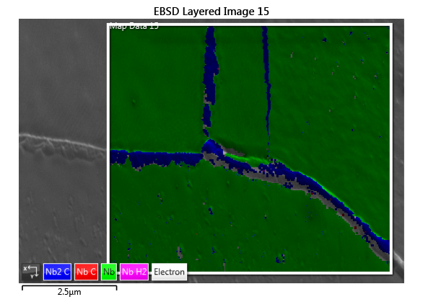
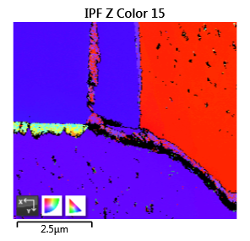
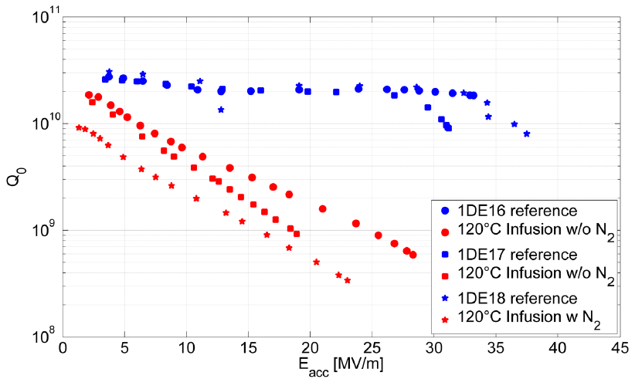
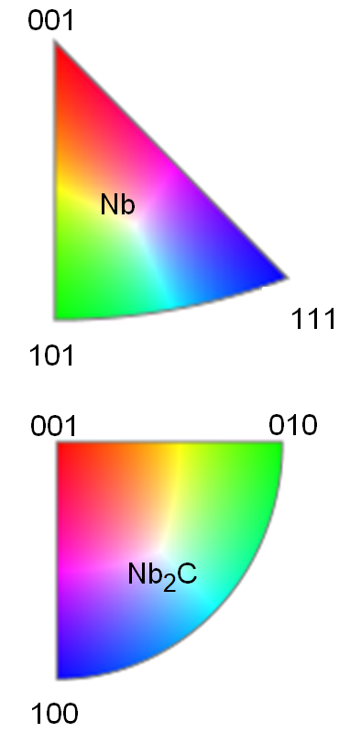
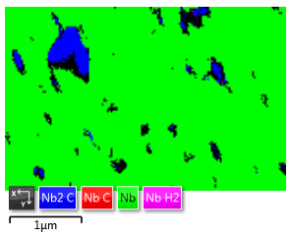
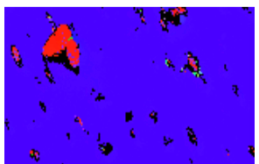
Cavity cut-outs @ DESY: case study of failed runs
EBSD: Carbide segregation and grain boundary segregation
(111)
(001)
EBSD confirmed excessive grain-boundary segregation and precipitation of Nb₂C

Slide 19
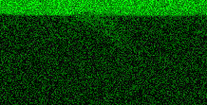
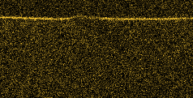
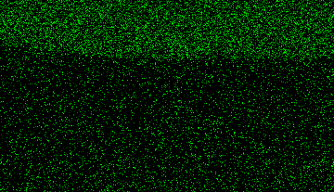
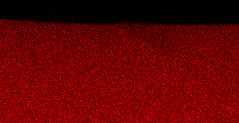
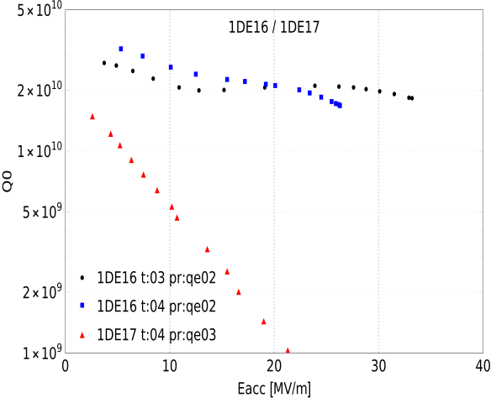
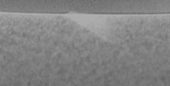
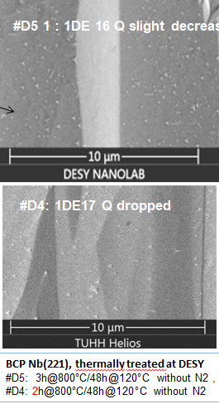










Carbon-rich precipitates on cavity related samples
FIB lamella, Energy dispersive x-ray analysis, Electron backscatter diffraction (EBSD)
Nb
Cavity improved after N-infusion @FNAL
C
O
N
1DE20 large grain Nb
Baseline test at DESY (2007)
Test at FNAL after N-infusion (2019)
Still good cavity performance after heat treatment 800 °C +120°C @DESY
C
O
N
Highly deteriorated cavity after heat treatment 800 °C +120°C @DESY
C
O
N
Larger and deeper saw-tooth like precipitates on heavily deteriorated cavities
Nb₂C phase confirmed
Posiible sources of C: surrounding environment, dirty furnace etc,
Notes:
Electron backscatter diffraction (EBSD) is a Scanning Electron Microscope based microstructural-crystallographic characterisation technique

Slide 20



Summary:
Review of Nb surface analysis after thermal /gas treatments by in-situ and ex-situ methods
N-infusion: contradictory findings on presence of Nb-N from different labs by ex-situ meas.
  NbN signal reported by FNAL (20 nm), Jlab (50 nm), Cornell (5 nm) using SIMS,
  could not be observed by KEK and DESY in ex-situ XPS and SIMS, and in-situ XRD experiments
  BUT… different experimental conditions, different infusion recipes, and different Nb material
Low-T bake @ 120 C without Nitrogen
  Dissolution of Nb₂O_{5,} growth of NbO₂ and NbO,
  stable surface achieved after 12 hrs baking compared to 48 hrs long baking time for cavities
Confirmation of N bound to Nb after 120°C N-infusion at low pressure by in-situ XPS
  N₂ partial pressure three orders of magnitude lower than that used for cavities
  Nb-N is formed at the interface ? role of N?
Carbide segregation on decayed cavities
  Observed on samples treated with cavities as well as on cavity cut-outs
  larger and deeper precipitates <-> worse cavity performance
  Excessive Nb₂C segregation at grain boundaries confirmed for lossy area of cavities
Clean conditions necessary for suppression of carbides!

Slide 21
Acknowledgements
Colleagues at Cornell, FNAL, Jlab, KEK for the collaboration
BEEM (electron microscopy) group at TUHH
DESY Nanolab team and MSL/MPL group at DESY
Thank you very much for your attention!

Slide 22






N-doped Nb single crystals @ DESY
Nb(100) treated similar to cavities: ex-situ SEM/EDX/ XPS
N-doped Nb @ 800°c , 900°C
A. Dangwal Pandey et al., J Material Science (2018) 53:10411–10422
XRD
XPS
N 1s
EDX
900°c
Nb-N
SEM
800°c
AFM
Nb₂O₅
NbO₂
NbO
Nb
Notes:
X-ray photoelectron spectroscopy , Our observation:
NbN : 203.8 eV, NbC : 203.3 eV, NbO: 204.0 eV

Slide 23
Surface evolution of Nb
during thermal and gas treatments as applied to superconducting RF cavities
My research
To investigate key surface properties related to significant improvements in cavity performance after particular treatments
Nb(100) model system of ultra-pure single crystal and cavity-grade material
In-situ surface monitoring using XPS:
120°C bake: Dissolution of Nb₂O_{5,} growth of NbO₂ > NbO, stable surface achieved after 12 hrs baking compared to 48 hrs long baking time for cavities
N-infusion: direct observation of Nb-N bond formation pointing to possible ‚role of nitrogen‘ in better cavity performance.
I. Low -T bake at 120 °C:
II. N-infusion :
800 °C +120°C/12 hrs (no N₂)
+ 120 °C in N₂ (5e-6 m bar)/13 hrs
Nb₂O₅, NbO₂, NbO, Nb_{x}O, Nb
120 °C
15 hrs
120° C
12hrs
120°C
2 hrs
RT

Slide 24




Bulk Niobium: Specification for European XFEL cavities
Technical specifications of niobium applied to the fabrication of 1.3 GHz superconducting cavities for the XFEL
(residual resistivity ratio)
ASTM 6

Slide 25

XPS of NbN
A. Darlinski, Halbritter, surface and interface analysis (1987) 10:223
Notes:
X-ray photoelectron spectroscopy , Our observation:
NbN : 203.8 eV, NbC : 203.3 eV, NbO: 204.0 eV

Slide 26









Cavity cut-outs:
2nd sound measurements and temperature maps of 1DE 16
Quench-spot from 2nd sound
Hot-spots from T-maps @ 1.5 K and 2 K
Samples measured at Nanolab:

Slide 27


Cavity cut-outs @ DESY:
[Arti Dangwal Pandey]
Case study of a failed infusion : XPS
Nb 3d
C 1s
O 1s
Cavity treatment: 800°C 3 hrs + 120°C 48 hrs
Hot spot
202.7 eV
Nb-O
Nb-C
Cold spot
Quench spot
2 µm
Nb_{x}O/ Nb_{x}C ?
Defective oxide interface

Slide 28



Cavity cut-outs @ DESY
Case study of a failed infusion– SEM/SIMS/EBSD - Nb-carbide precipitates
Cavity treatment: 800°C 3 hrs + 120°C 48 hrs
Quench spot
2 µm
Cold spot
2 µm
Hot spots and quench spots:
SEM: Niobium Carbides are denser and larger
SIMS: higher Carbon-Signal in the first ~20nm
Size and density of carbides detrimental for RF performance

