Slide 1


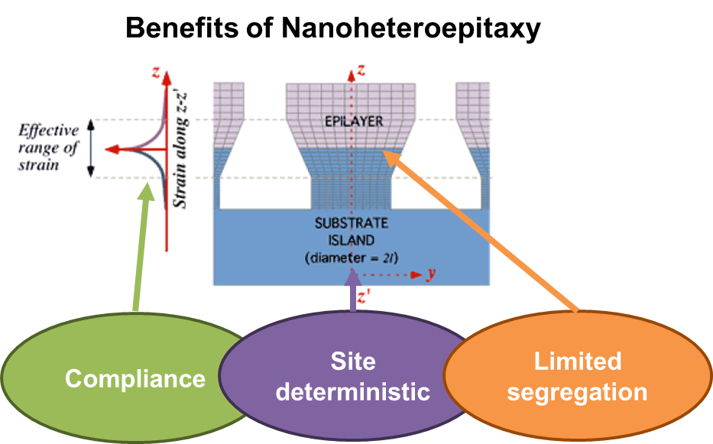
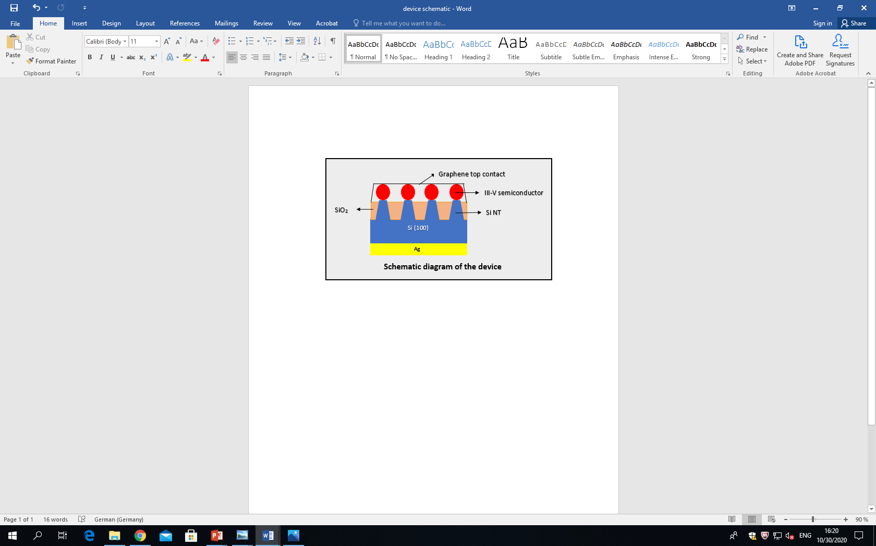
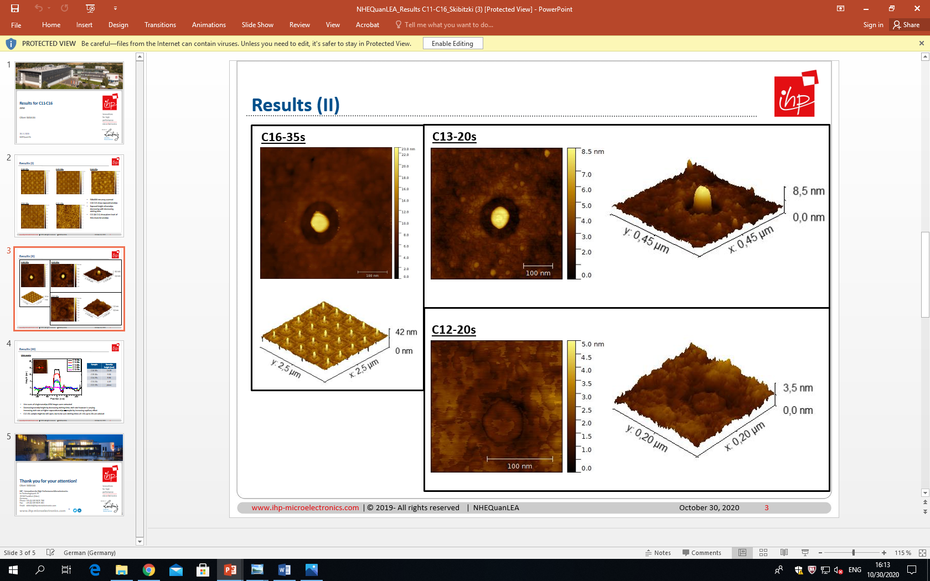
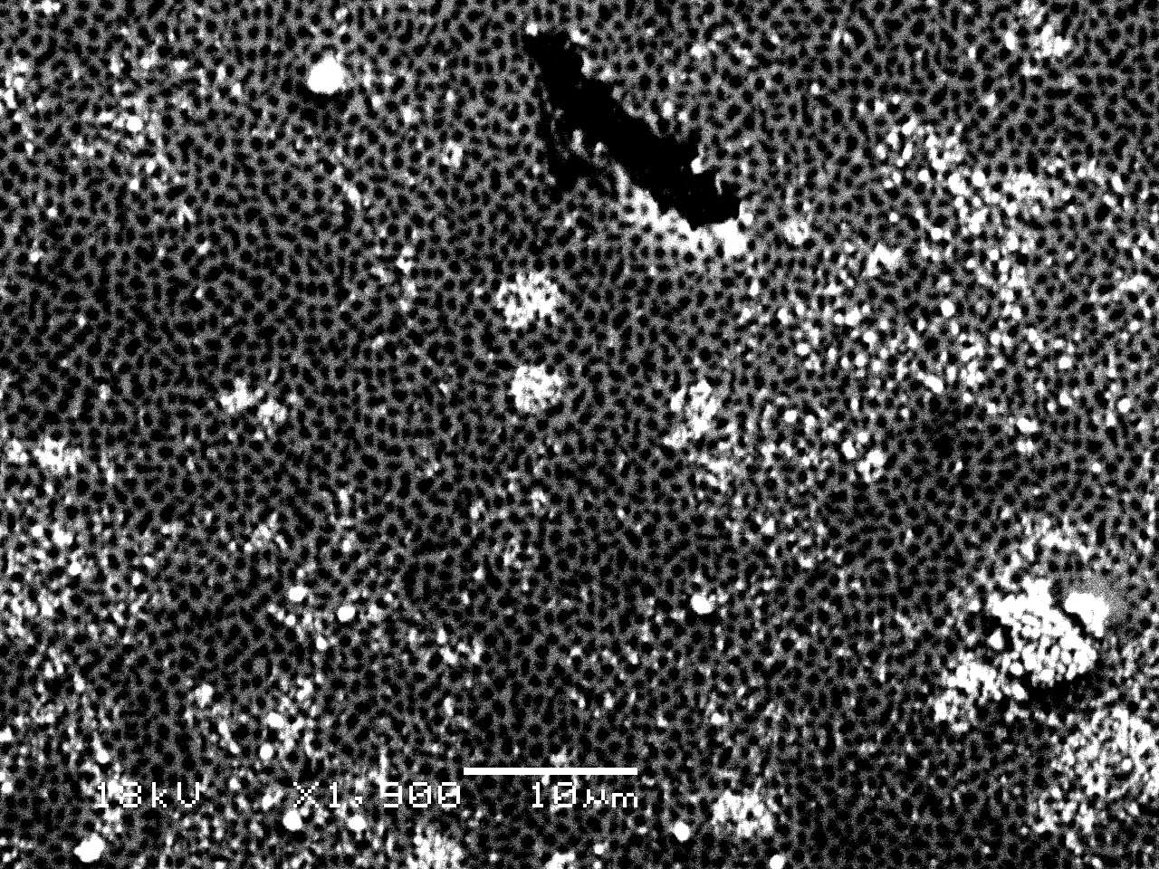
A promising approach for monolithic integration of
III-V semiconductors on Si
Anagha Kamath, and Fariba Hatami
Institut für Physik, Humboldt-Universität zu Berlin, Newtonstrasse 15, 12489 Berlin, Germany
Oliver Skibitzki
Innovations for High Performance Microelectronics, Im Technologiepark 25, 15236 Frankfurt (Oder)
MOTIVATION
We present a distinctive approach “nanoheteroepitaxy”, to monolithically grow high quality, defect free III-V semiconductors (InP and GaP) on arrays of Silicon nanotips (Si NT’s) embedded in SiO₂ matrix using Gas Source Molecular Beam Epitaxy (GS-MBE).
NANOHETEROEPITAXY
METHODOLOGY
Fabrication of Si NT embedded in SiO2 matrix at IHP
SiO2:Si etching in 5 ml of 0.5% HF solution and 500 ml distilled water for 17 s
Prebaking the sample in the intro-chamber of MBE system
Epitaxial growth of III-V semiconductor on Si NT
Desorption (oxide-off) process in the growth-chamber of MBE system at T= 750º C for 15 mins
RESULTS
SEM result of the array of Si NT with 0.5 µm × 0.5 µm pitch distance embedded in SiO2 matrix.
Line scans of single Si NT for different etching time
Growth of GaP on the substrate with TG= 558º C, ØPH3= 3 sscm and growth rate 0.3 ML/s
AFM images of single Si NT indicating its exposed height with etching time t= 20 s
Growth of InP on the substrate with TG = 500º C, ØPH3= 3 sscm and growth rate 0.3 ML/s
CONCLUSION
ACKNOWLEDGEMENT
The SiO2 : Si etching conditions have been optimized for growth.
The selective growth of III-V semiconductors on Si NT’s still needs to be accomplished.
This research project is supported by German Research Society (DFG) and DAAD Research Grant.
The SEM measurements were performed by
Christian Golz, M.Sc., HU Berlin.

