Slide 1
CLUSTER OF EXCELLENCE
QUANTUM UNIVERSE
The ESSvSB Workshop
(Towards a participation of the German physics community
in a long-baseline neutrino project in Europe)
Tamer Tolba
Universität Hamburg
October 8 – 9, 2020
Workshop Webpage:
https://www.conferences.uni-hamburg.de/event/129/overview

Slide 2
Workshop Objective
The observation of massive neutrinos was one of the crucial scientific findings that opened a new era for the physics beyond the SM.
The recent T2K experiment claim on the CP-violating phase in neutrino oscillation, where they disfavored almost half of its possible values at the 99.7% (3σ) confidence,
paved the way for the next generation neutrino experiments where the exploration of all related parameters at the highest precision scales became their fundamental goal, especially the long-baseline accelerator-based projects.
Germany plays a significant role in the fields of particle and astroparticle physics, especially neutrino physics.
German particle/astroparticle physics activities*
cover wide range of fundamental high-energy, particle and astroparticle physics disciplines e.g. LHC-HEP, rare decays, DM, neutrino, heavy ions, anti-matter, cosmic rays, …,
hosts/participate-in world class experiments in the field of neutrino physics e.g. KATRIN, ICECube, HESS, CTA, MAGIC, GERDA, Double Chooz, JUNO, T2K, XENON, …
However, … NOT involved in any of the next-generation long baseline experiments!
The objective of this workshop is…
➔ Establish communication between the German particle physics community and the scientists of the ESSvSB project
➔ Discuss new and world-leading programme of intensity Frontier Particle Physics
* sources:
https://indico.cern.ch/event/489996/contributions/2299386/attachments/1343195/2023670/Zeitnitz.pdf
https://www.desy.de/~schleper/talks/RECFA_KET_Schleper.pdf

Slide 3
Workshop Agenda
Day 1 (Thu. 8 Oct 2020, 10:00)
➔ Morning session:
Introduction to the workshop.
Theoretical insight to the v-oscillation phenomenology.
Introduction to the ESS facility.
Introduction to the ESSvSB project.
Two afternoon sessions:
Introduction to and updates on the role and activities of the ESSvSB work groups.
Short summary of the first day.

Slide 4
Workshop Agenda…
Day 2 (Fri. 9 Oct 2020, 09:30)
➔ Two morning session:
Introduction to and updates on the German involvements in neutrino projects that are related and/or of a technological interest to the ESSvSB project.
Afternoon session #1:
The future opportunities with ESS that are related to the ESSvSB experiment.
➔ Afternoon session #2:
Summary on the status of the ESSvSB project.
Open discussion. (Please suggest discussion topics/questions and send them to me directly before the 2nd afternoon session)

Slide 5
Some zoom meeting regulations
All audience, please mute your microphones and cameras during the talks, unless you are speaking.
…

Slide 6
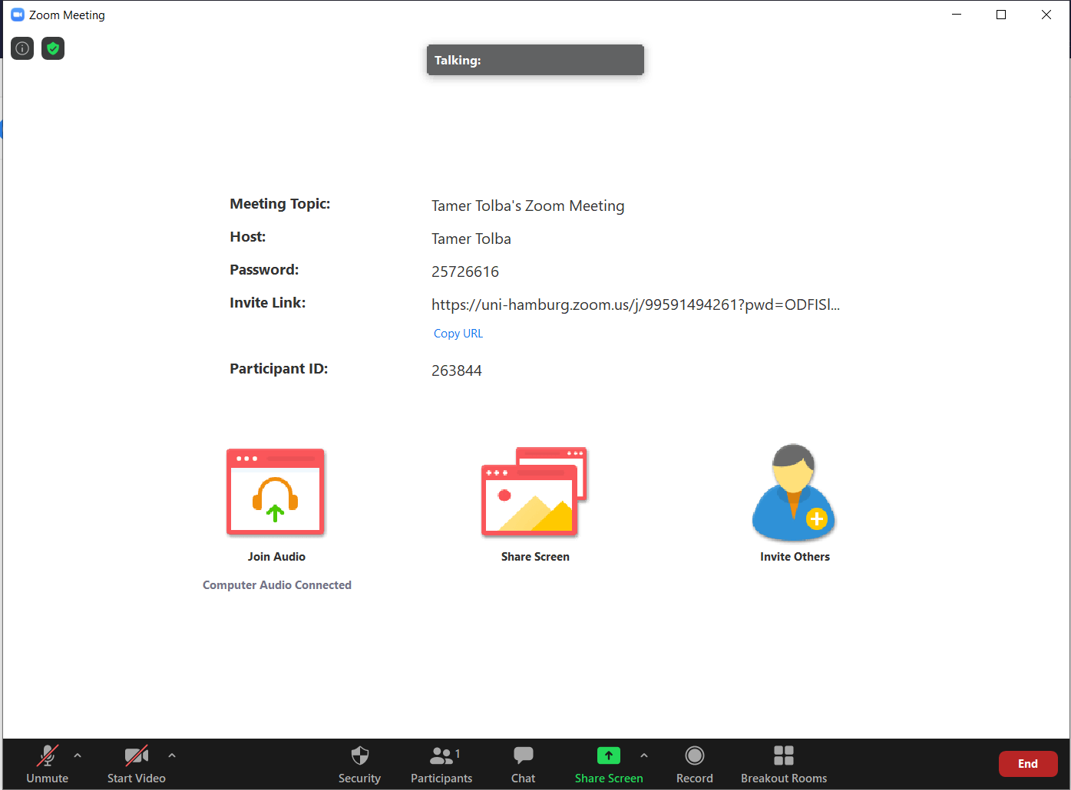
Some zoom meeting regulations
All audience, please mute your microphones and cameras during the talks, unless you are speaking.
…

Slide 7
Some zoom meeting regulations
All audience, please mute your microphones and cameras during the talks.
For questions, please use the “Raise Hand” button from the “Participants” list. You might also open your camera.
…

Slide 8
Some zoom meeting regulations
All audience, please mute your microphones and cameras during the talks.
For questions, please use the “Raise Hand” button from the “Participants” list. You might also open your camera.
The workshop will be video recorded. The record will be uploaded to the workshop webpage.
…

