Slide 1
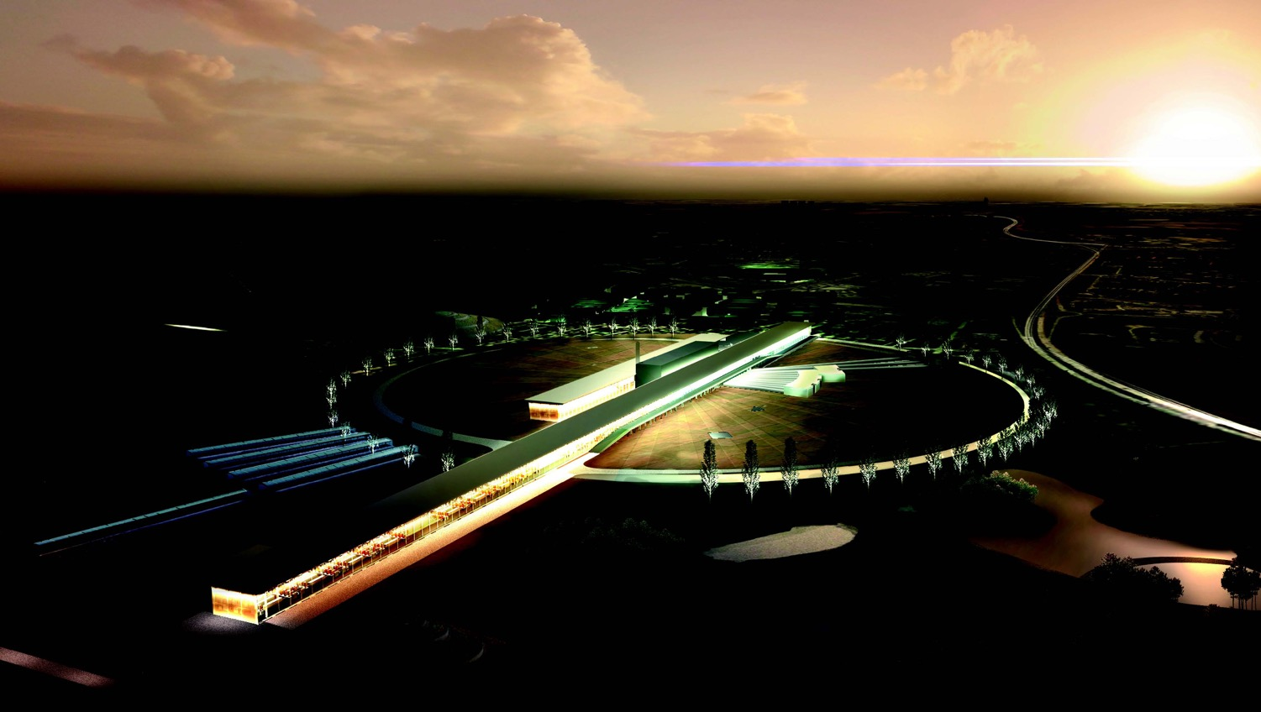
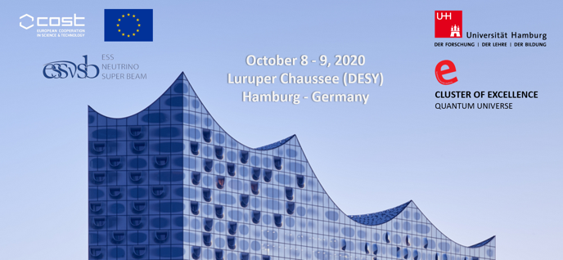
The European Spallation Source neutrino Super Beam
Marcos Dracos
IPHC-Strasbourg

Slide 2
European Spallation Source as Neutrino Facility for CP violation observation
(2nd Oscillation maximum)
ν_{μ}→ν_{e}

Slide 3
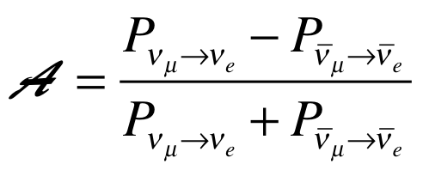
Oscillation probability
(neutrino beams)
"atmospheric"
"interference"
"solar"
matter effect
for antimatter: δ_{CP} →-δ_{CP} and a→-a
fake matter/antimatter asymetry due to matter effect
δ_{CP} dependence,
sizable matter effect for long baselines
Matter-antimatter asymmetry

Slide 4

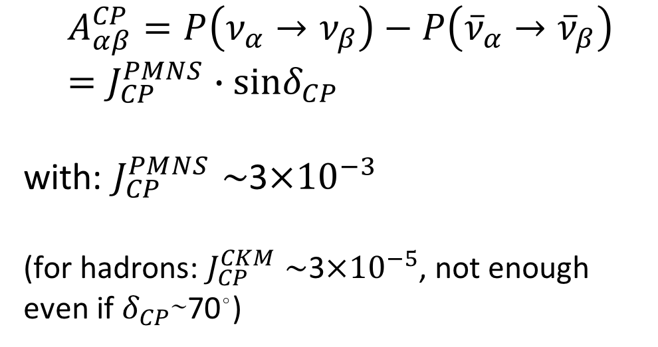
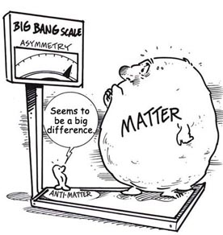
δ_{CP} and Matter-antimatter asymmetry magnitude
(Jarlskog invariant)
(from the already observed CP violation in the hadronic sector)
Theoretical models predict that if |sinδ_{CP}|≳0.7 (45°<δ_{CP}<135° or 225°<δ_{CP}<315°), this could be enough to explain the observed asymmetry.
(Nucl.Phys.B774:1-52,2007, arXiv:hep-ph/0611338)

Slide 5
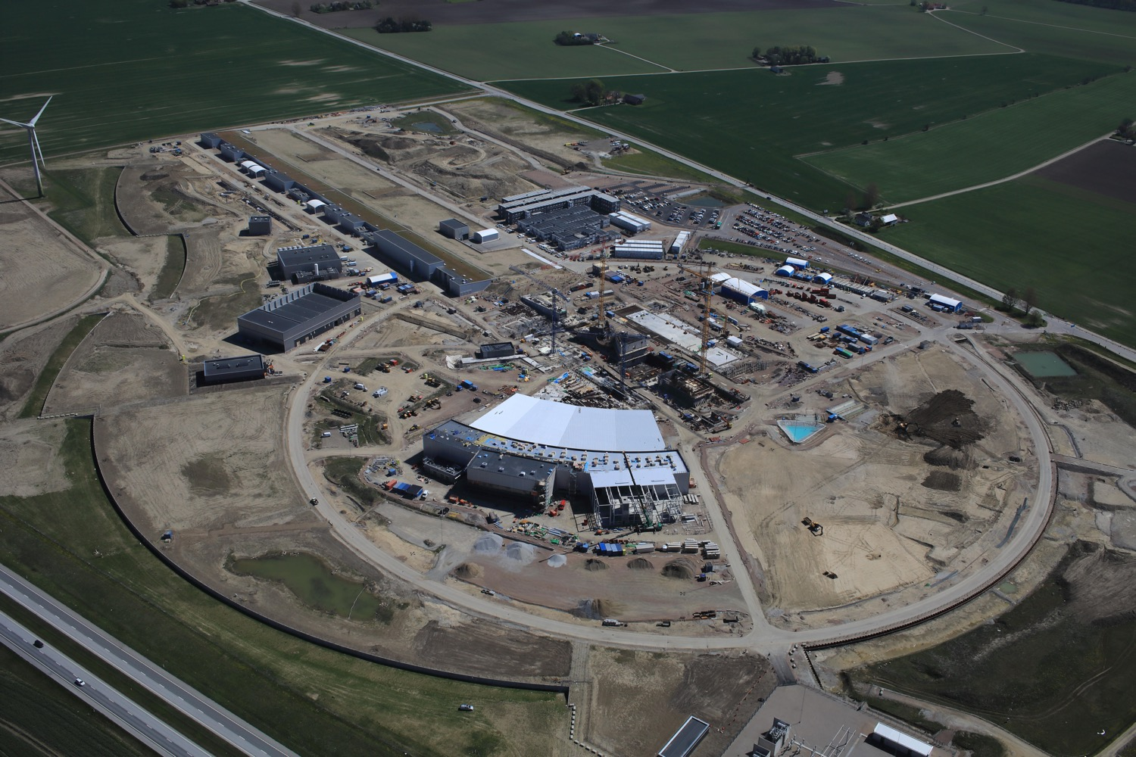
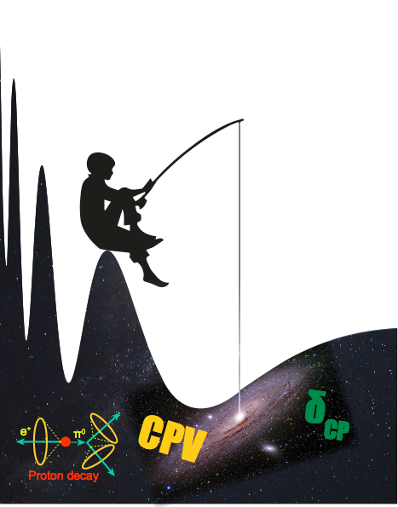
Use all the ESS linac power to go to the second oscillation maximum
but why?

Slide 6
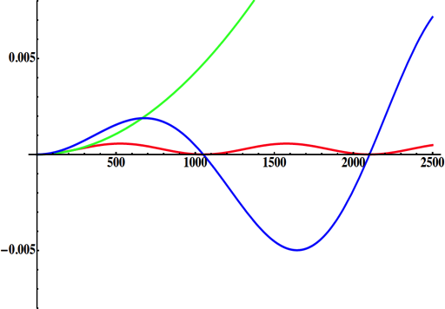
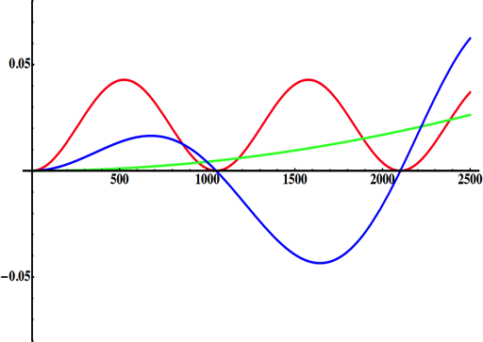
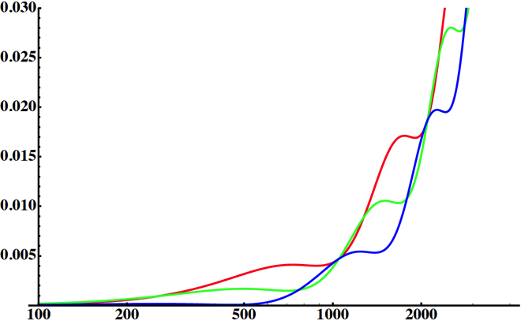
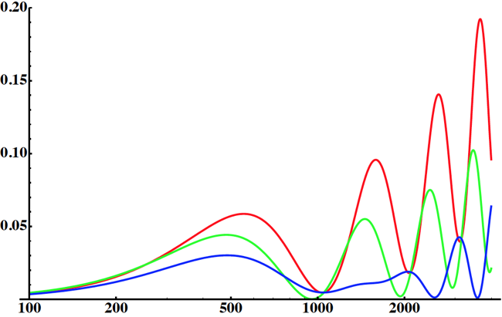
Neutrino Oscillations with "large" θ₁₃
solar
atmospheric
for "large" θ₁₃ 1st oscillation maximum is dominated by atmospheric term
for small θ₁₃ 1st oscillation maximum is better
atmospheric
solar
L/E
L/E
CP interference
(arXiv:1110.4583)
θ₁₃=1º
CP interference
θ₁₃=8.8º
solar
2nd oscillation maximum
P(ν_{μ}→ν_{e})
1st oscillation maximum
θ₁₃=1º
("small" θ₁₃)
δ_{CP}=-90
δ_{CP}=0
δ_{CP}=+90
θ₁₃=8.8º
("large" θ₁₃)
L/E
L/E
1st oscillation max.: A=0.3sinδ_{CP}
2nd oscillation max.: A=0.75sinδ_{CP}
more sensitivity at 2nd oscillation max.
(see arXiv:1310.5992 and arXiv:0710.0554)

Slide 7
Having access to a powerful proton beam…
What can we do with:
5 MW power
2 GeV energy
14 Hz repetition rate
10¹⁵ protons/pulse
>2.7x10²³ protons/year
proton beam
decay tunnel
p
hadrons
physics
π
ν
⨂B
target
hadronic collector
(focusing)
Detector
conventional neutrino (super) beam

Slide 8
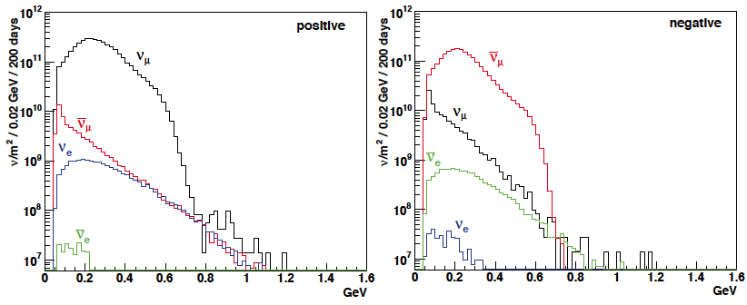
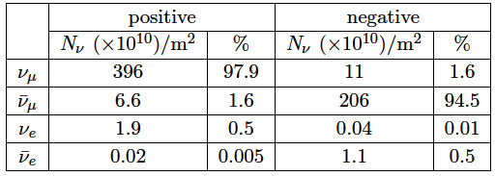
ESSνSB ν energy distribution
neutrinos
anti-neutrinos
almost pure ν_{μ} beam
small ν_{e} contamination which could be used to measure ν_{e} cross-sections in a near detector
at 100 km from the target, per year (in absence of oscillations)
(Nucl. Phys. B 885 (2014) 127)

Slide 9
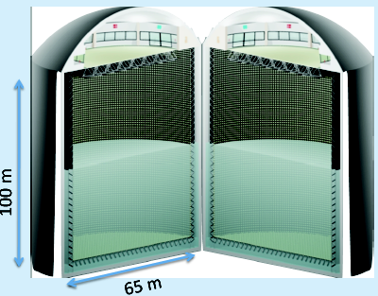
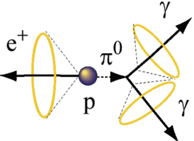
Can we go to the 2nd oscillation maximum using our proton beam?
Yes, if we place our far detector at around 500 km from the neutrino source.
MEMPHYS like Cherenkov detector
(MEgaton Mass PHYSics studied by LAGUNA)
(arXiv: hep-ex/0607026)
Neutrino Oscillations
Proton decay
Astroparticles
Understand the gravitational collapsing: galactic SN ν
  Supernovae "relics"
Solar Neutrinos
Atmospheric Neutrinos
500 kt fiducial volume (~20xSuperK)
Readout: ~240k 8” PMTs
30% optical coverage
New 20" PMTs with higher QE and cheaper (see JUNO), the detection efficiency will improve the detector performance keeping the price constant, not yet taken into account.
see Budimir's presentation

Slide 10
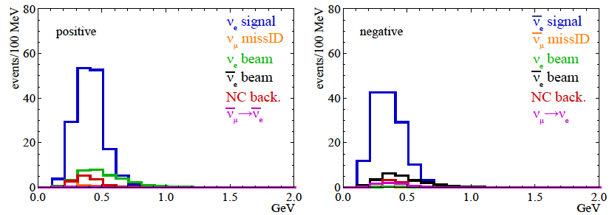
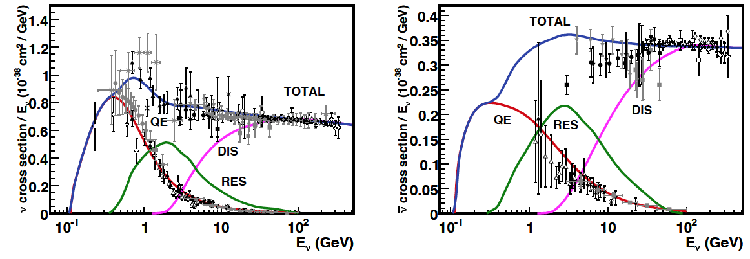
Neutrinos in the far detector
540 km (2 GeV), 10 years
neutrinos
anti-neutrinos
δ_{CP}=0
2 years
8 years
Below ν_{τ} production, almost only QE events, not suffering too much by π⁰ background.
But, no X-section measurements around 300 MeV ⇒ large systematic error
  need of a performant near detector

Slide 11
2nd Oscillation max. coverage
2nd oscillation max.
well covered by the ESS neutrino spectrum
ν_{μ}→ν_{e}
1st oscillation max.

Slide 12
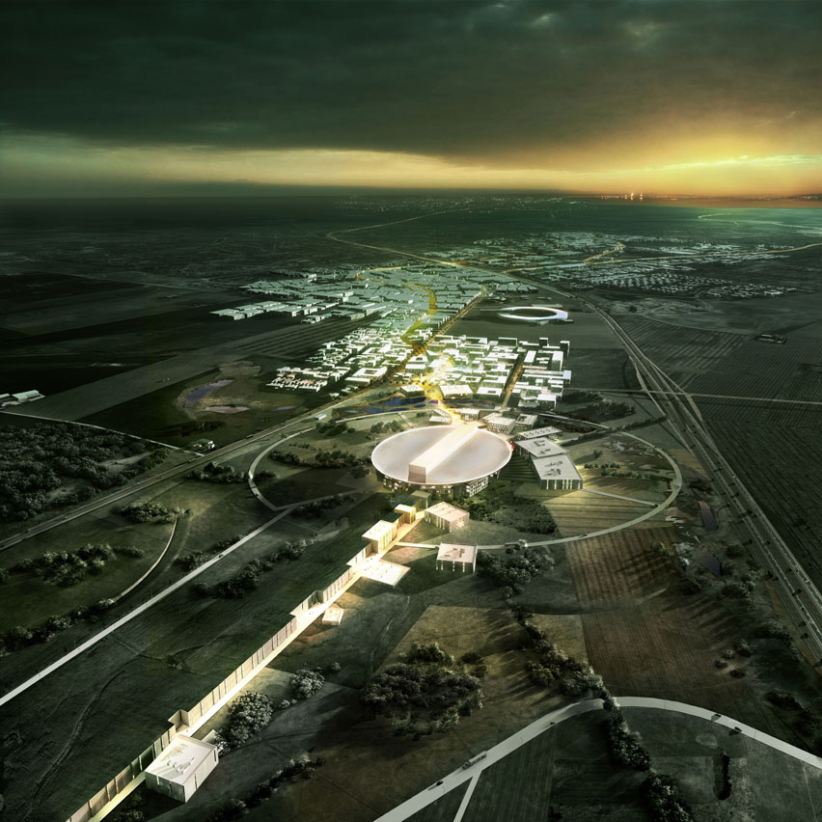
ESS Linac modifications to produce a neutrino Super Beam
European Spallation Source Linac

Slide 13
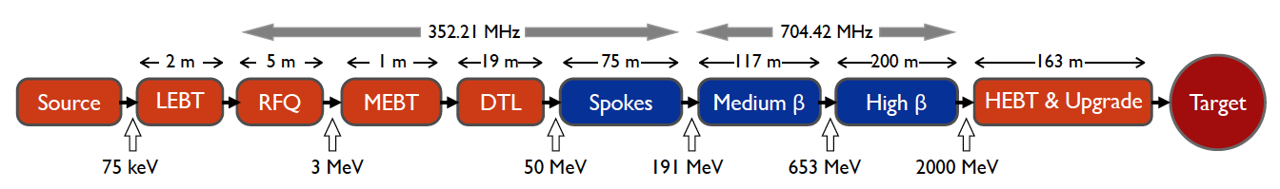
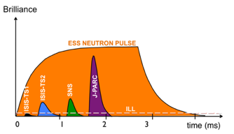
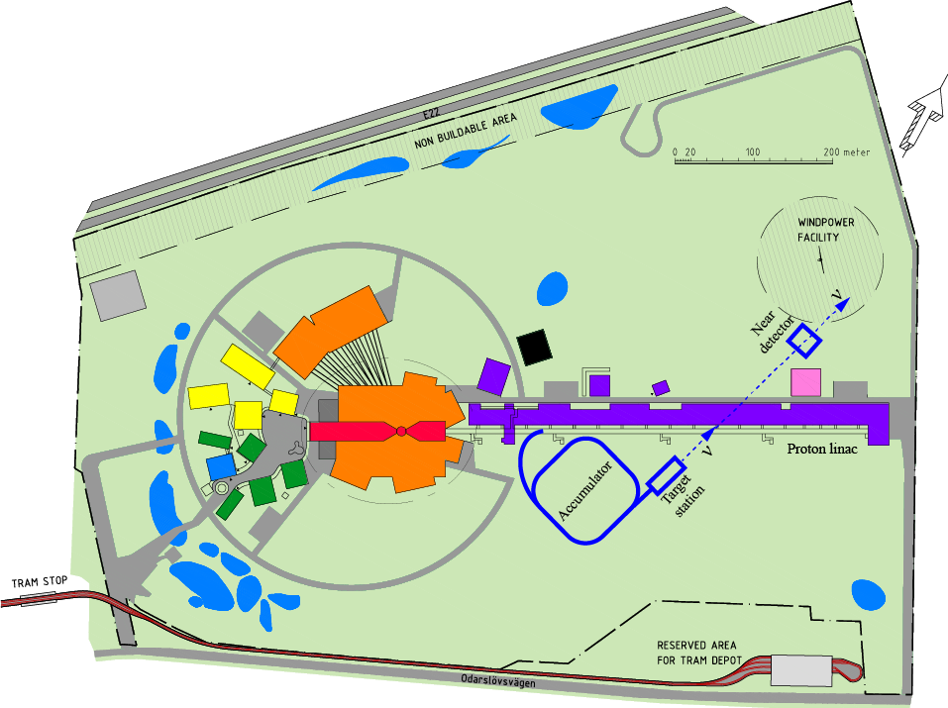
How to add a neutrino facility on top of the neutron one?
The neutron program must not be affected and if possible synergetic modifications.
Linac modifications: double the rate (14 Hz → 28 Hz) and bring the proton energy to 2.5 GeV.
Accumulator (C~400 m) needed to compress to few μs the 2.86 ms proton pulses, affordable by the magnetic horn (350 kA, power consumption, Joule effect) and reducing the atm. neutrino background,
  H⁻ source (instead of protons),
~300 MeV neutrinos.
Target station.
Underground detector.
Short pulses (~μs) will also allow DAR experiments using the neutron target.

Slide 14
ESSνSB
H⁻ stripping

Slide 15
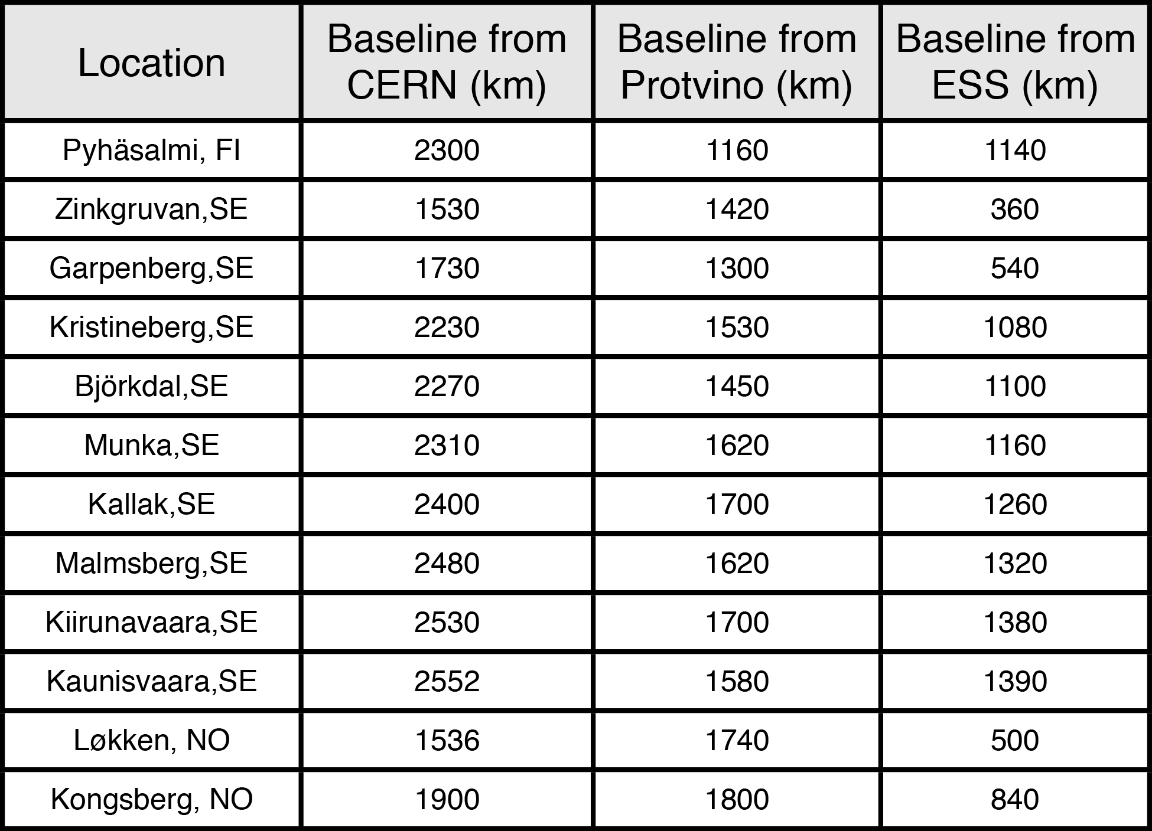
Possible locations for far detector
ESS
Kongsberg
Løkken
CERN
LAGUNA sites

Slide 16
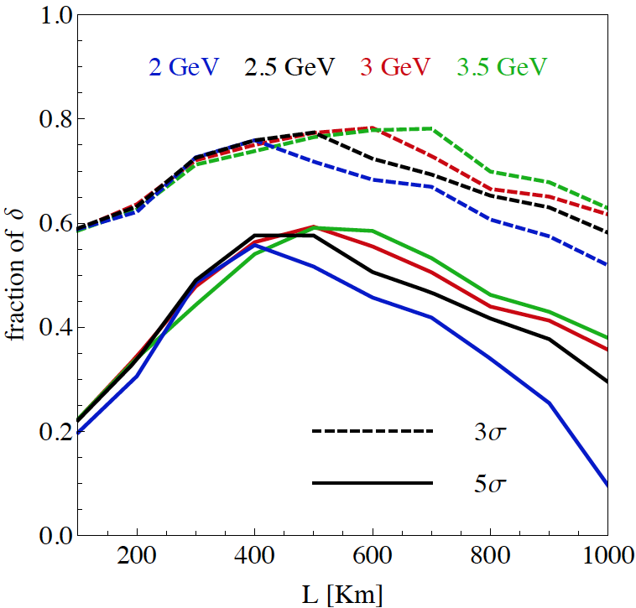
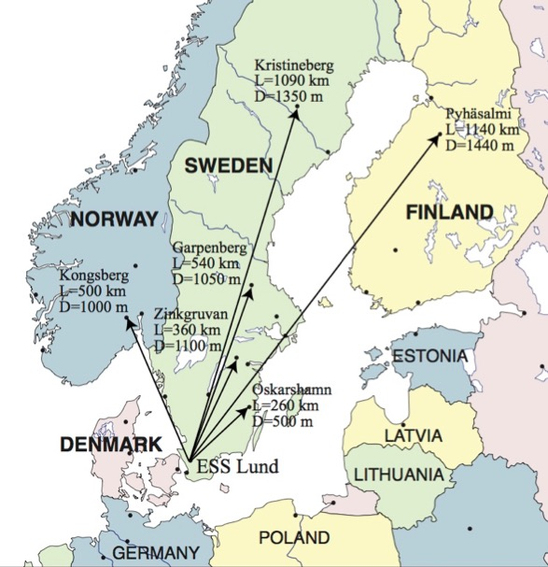
Which baseline?
CPV (Nucl. Phys. B 885 (2014) 127)
Garpenberg
Zinkgruvan
~60% δ_{CP} coverage at 5 σ C.L.
>75% δ_{CP} coverage at 3 σ C.L.
systematic errors: 5%/10% (signal/backg.)
Candidate active mines

Slide 17
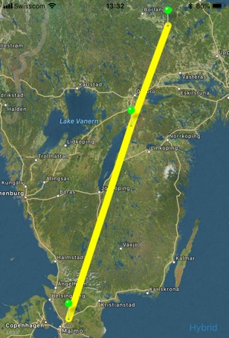
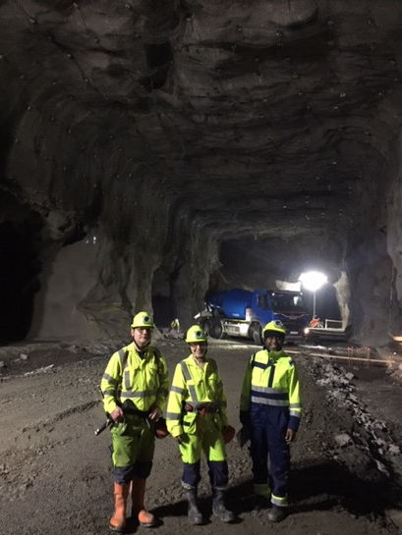
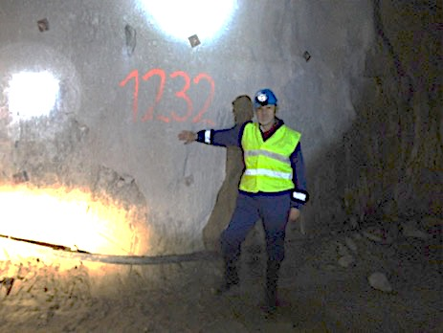
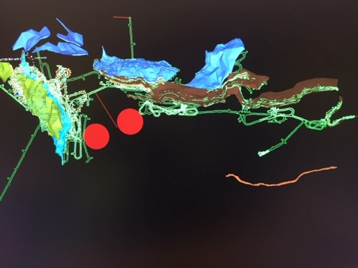
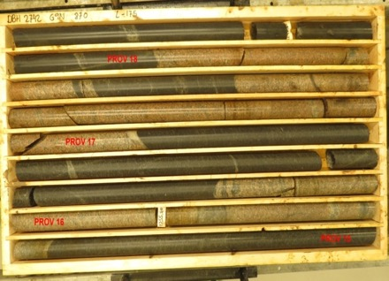
Candidate active mines
Garpenberg mine
  Distance from ESS Lund 540 km
  Depth 1200 m
  Truck access tunnel
Zinkgruvan mine
  Distance from ESS Lund 360 km
  Depth 1500 m
  Truck access tunnel
Garpenberg
(540 km)
Zinkgruvan
Zinkgruvan
(360 km)
Lund
possible location of MEMPHYS in
Zinkgruvan mine
Garpenberg
Granite drill cores

Slide 18
Physics Performance
540 km
little dependence on mass hierarchy,
δ_{CP} coverage at 5 σ C.L. up to 60%,
δ_{CP} accuracy down to 6° at 0° and 180° (absence of CPV for these two values),
not yet fully optimized facility,
5/10% systematic errors on signal/background.
5/5 yrs
see Salvador's presentation

Slide 19
Do we really need the accumulator
In case the hadron collector current problem is solved, do we still need the accumulator?
  YES, for physics performance reasons

Slide 20
Required modifications of the ESS accelerator for ESSνSB
Better to go to 2.5 GeV

Slide 21
The Linac modifications and operation
H⁻ source options
Into linac
P
_{H}⁻
_{H}⁻
_{H}⁻
_{H}⁻
P
_{H}⁻
_{H}⁻
_{H}⁻
_{H}⁻
14 Hz
100 µs
0.65 ms
Into ring
H⁻
H⁻
H⁻
H⁻
H⁻
H⁻
H⁻
H⁻
14 Hz
~1.4 kHz
~1 µs
~0.75 ms
Into horn
_{H}⁻
_{H}⁻
_{H}⁻
_{H}⁻
_{H}⁻
_{H}⁻
_{H}⁻
_{H}⁻
14 Hz
Horn 1
Horn 4
see Mamad's presentation
Horn 2
Horn 3

Slide 22
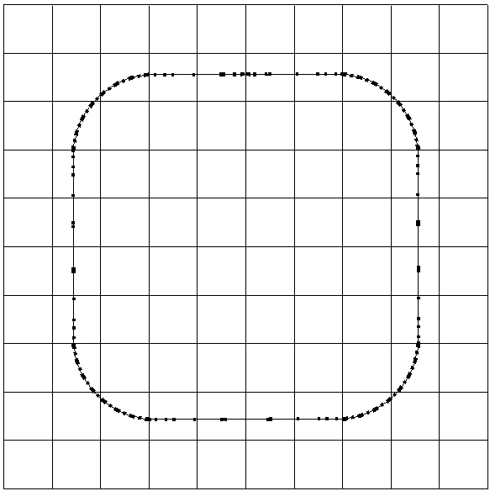
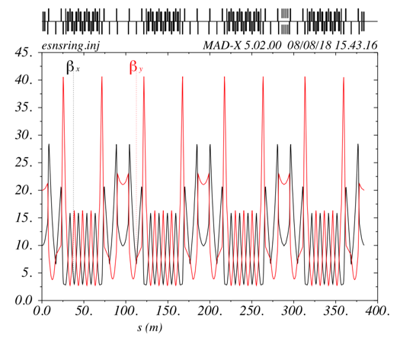
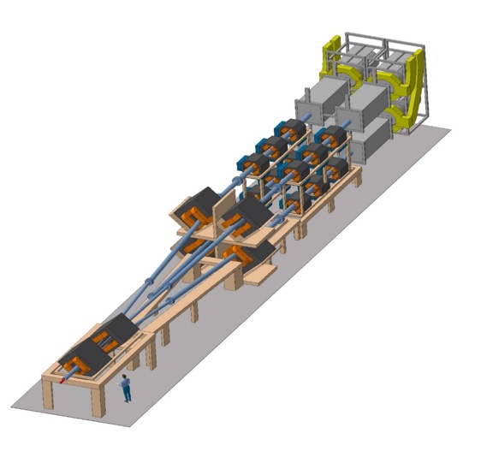
The Accumulator
lattice development
injection
4 superperiods
RF
extraction
FODO cells
H⁻ stripping
collimation
Dispersion-free straight sections
Switchyard
see Ye's presentation

Slide 23
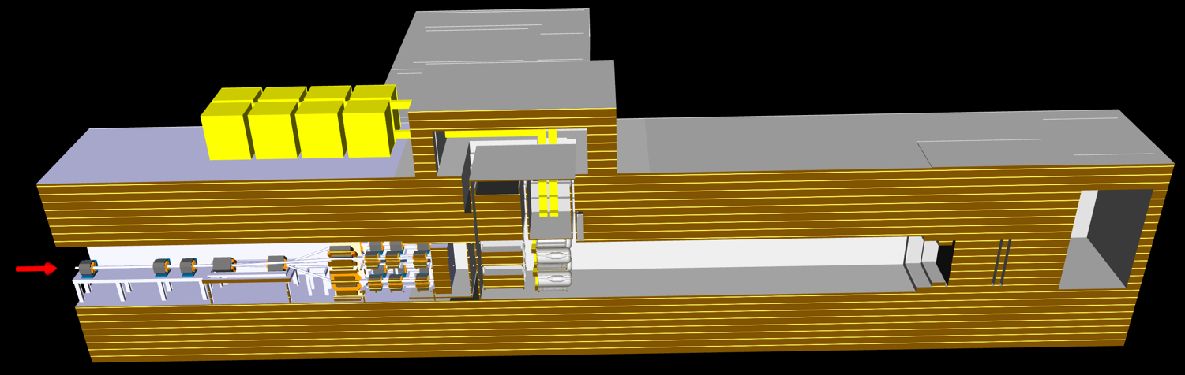
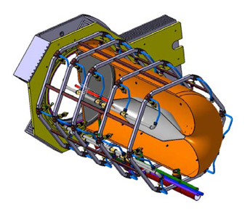
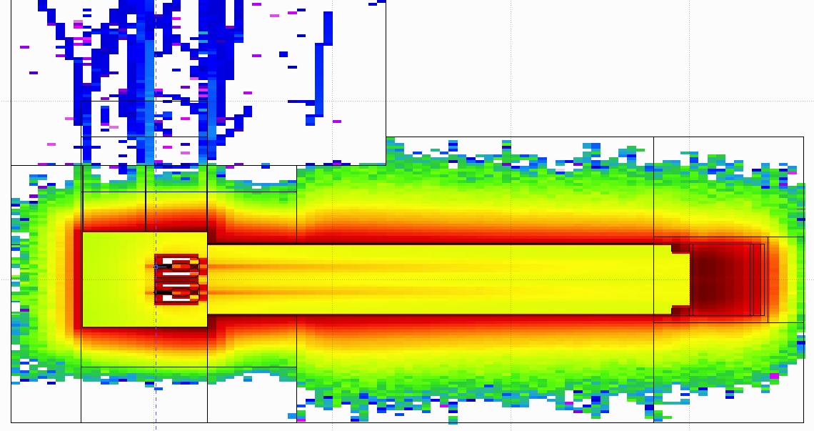
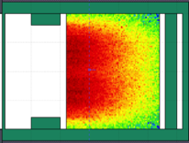
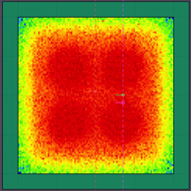
General Layout of the target station
Horns pulse generator
8 m concrete
Proton Beam
Switchyard
Horns and Targets
Decay Volume
(He, 4x4x25 m³)
Beam Dump
Collimators
see Eric's presentation
radiation studies

Slide 24
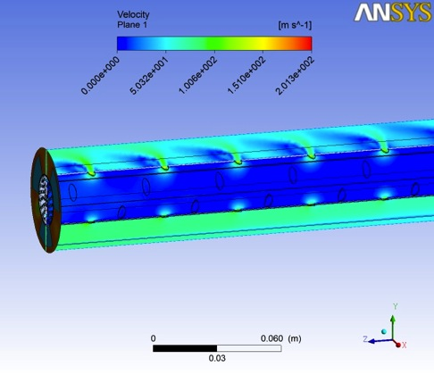
Target
Helium Flow
other configurations under study

Slide 25
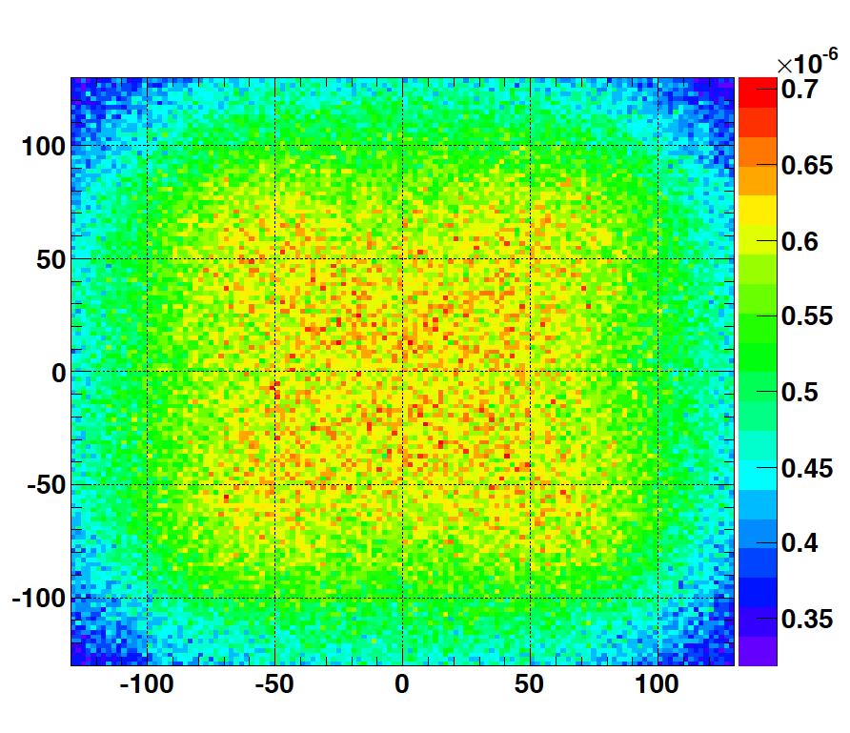
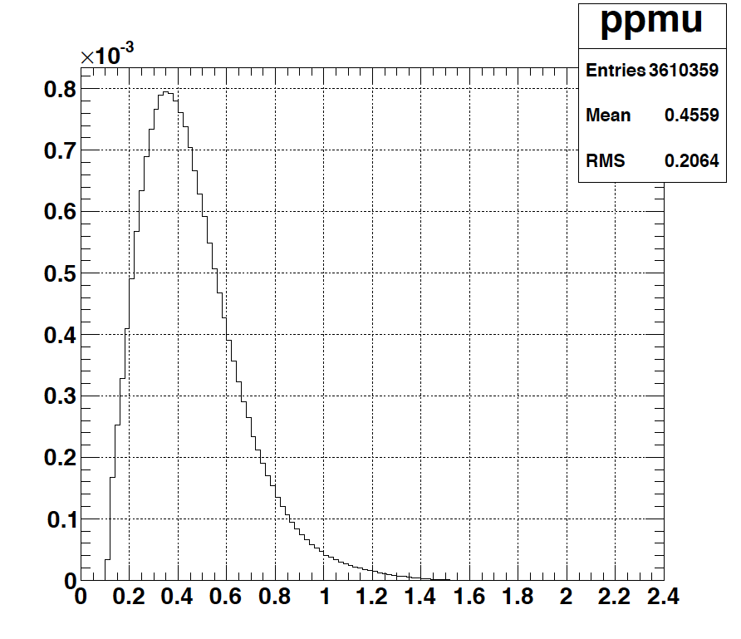
Muons at the level of the beam dump
2.7x10²³ p.o.t/year
y (cm)
muons at the level of the beam dump
(per proton)
more than 4x10²⁰ μ/year from ESSS compared to 10¹⁴ μ used by all experiments up to now (10¹⁸ μ for COMET in the future).
4.2x10²⁰ μ/year
(16.3x10²⁰ for 4 m²)
x (cm)
10⁻³
4.1x10²⁰ μ/year
input beam for future 6D μ cooling experiments (for muon collider),
low energy nuSTORM,
Neutrino Factory,
Muon Collider.
muons/proton
<E_{μ}>~0.46 GeV
<L_{μ}>~2.9 km

Slide 26
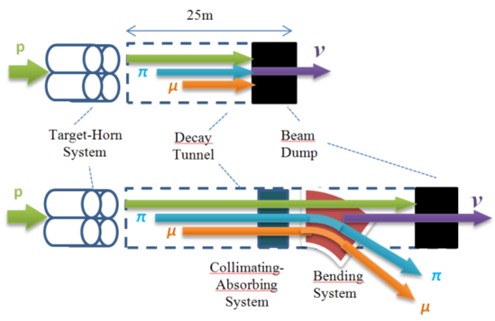
ESS neutrino and muon facility
muon extraction to be studied

Slide 27
ESSνSB and (R&D) synergies
Super Beam
nuSTORM
+Decay At Rest and Coherent scat.
(with short pulses)
Neutrino Factory
Muon Collider

Slide 28

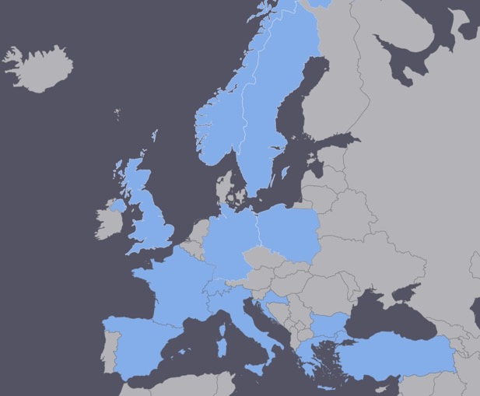
EuroNuNet
COST application for networking: CA15139 (2016-2020)
  EuroNuNet : Combining forces for a novel European facility for neutrino-antineutrino symmetry violation discovery (http://www.cost.eu/COST_Actions/ca/CA15139)
http://euronunet.in2p3.fr/
  Major goals of EuroNuNet:
    to aggregate the community of neutrino physics in Europe to study a neutrino long baseline concept in a spirit of inclusiveness,
    to impact the priority list of High Energy Physics policy makers and of funding agencies to this new approach to the experimental discovery of leptonic CP violation.
  13 participating countries
Finished in March 2020
At the end of this COST Action 10 k€ "bonus" have been obtained to produce a short film dedicated to the project targeting scientists: https://youtu.be/PwzNzLQh-Dw

Slide 29

ESSνSB at the European level
A H2020 EU Design Study (Call INFRADEV-01-2017)
Title of Proposal: Discovery and measurement of leptonic CP violation using an intensive neutrino Super Beam generated with the exceptionally powerful ESS linear accelerator
Duration: 4 years
Total cost: 4.7 M€
Requested budget: 3 M€
15 participating institutes from
11 European countries including CERN and ESS
6 Work Packages
Approved end of August 2017
ESSνSB
BENE (2004-2008)
ISS (2005-2007)
EUROν (2008-2012)
LAGUNA (2008-2010)
LAGUNA-LBNO (2010-2014)
COST Action CA15139 (2015-2019)

Slide 30
Design Study ESSνSB
(2018-2021)
More information on:
http://essnusb.eu/
CDR end of 2021
…and after?
partners: IHEP, BNL, SCK•CEN, SNS, PSI, RAL, Oslo, Hamburg

Slide 31
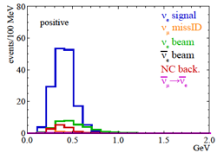
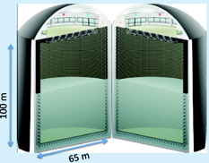
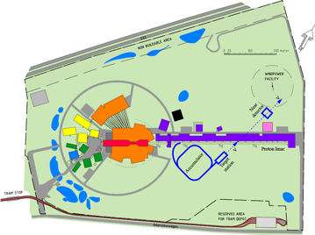
Possible ESSνSB schedule (optimistic?)
(2nd generation neutrino Super Beam)
2021: End of ESSνSB Design Study, CDR and preliminary costing
2012: inception of the project
2016-2019: beginning of COST Action EuroNuNet
2018: beginning of ESSνSB Design Study (EU-H2020)
2022-2025: Preparatory Phase, TDR
2025-2028: Preconstruction Phase, International Agreement
2028-2034: Construction of the facility and detectors, including commissioning
2035-: Data taking
2nd short film targeting general public: https://youtu.be/qAnvft0nAlg
Nucl. Phys. B 885 (2014) 127

Slide 32
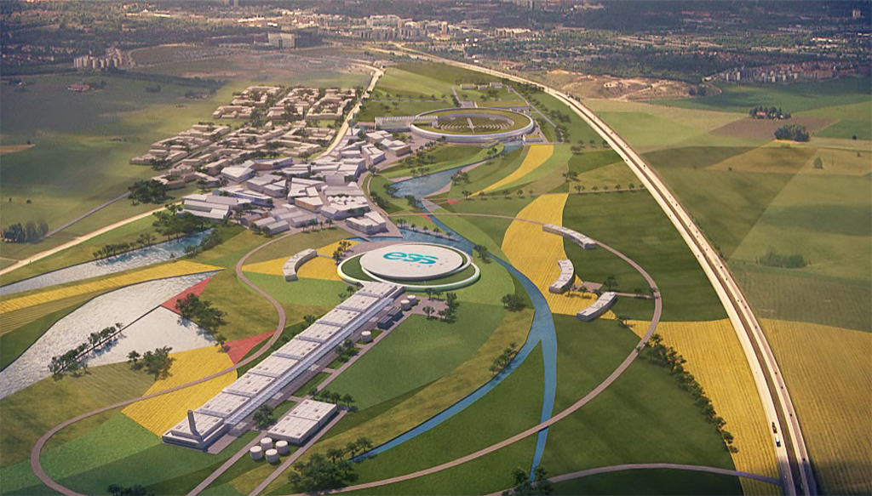
Conclusion
ESS will be soon the most powerful neutron facility for many applications.
ESS can also become a neutrino facility with enough protons to go to the 2nd oscillation maximum and increase the CPV sensitivity.
CPV: 5 σ could be reached over 60% of δ_{CP} range by ESSνSB with large physics potential.
Large associated detectors have a rich astroparticle physics program.
A preparatory phase is needed.
Rich muon program for future ESS upgrades.
COST network project CA15139 and a EU-H2020 Design Study support this project.

Slide 33
Backup

Slide 34
How the CPV coverage and resolution curves have been produced
T2HK:
  Same curves that Hyper-K has showed at the Neutrino Town Meeting at CERN and the one that was showed at Neutrino 2018.
  Systematics are said by T2HK to be between 3% to 4%.
  sin² 2θ₁₃ =0.1 and θ₂₃= π /2.
DUNE:
  Public globes file released by the DUNE collaboration with the CDR, the only change is to increase the number of years from 7 to 10.
  sin²2θ₁₃ =0.1 and θ₂₃=π/2, to be compatible with the T2HK line.
ESSnuSB:
  Instead of considering as usual “Opt. Snowmass errors" it is only assumed an overall 3% systematic error in the different signal and background channels, more in line with T2HK assumptions.
  sin²2θ₁₃ =0.1 and θ₂₃= π /2, to be compatible with the T2HK line.

Slide 35
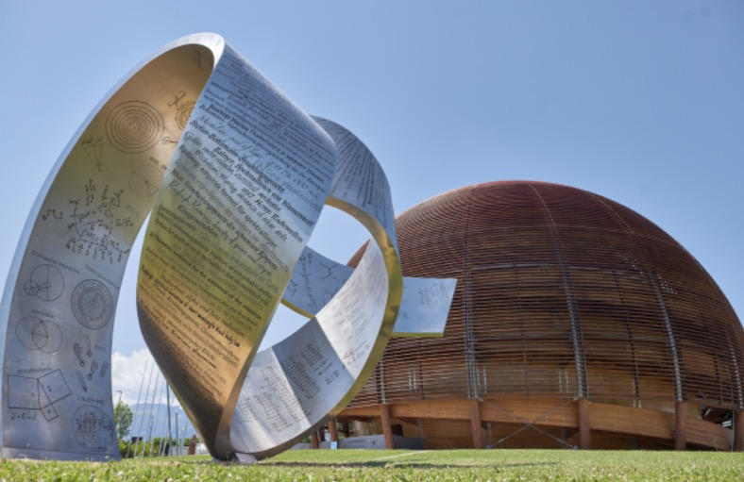
Beyond DUNE, JUNO, HyperK:
ESSνSB, P2O and Neutrino factory
European Neutrino "Town" meeting and ESPP 2019 discussion, CERN, 24.10.2018
Roumen Tsenov
Department of Atomic Physics, University of Sofia

Slide 36
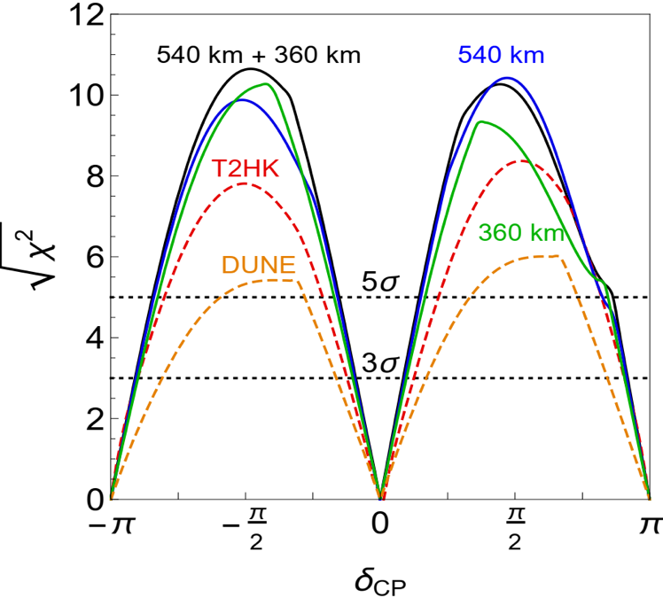
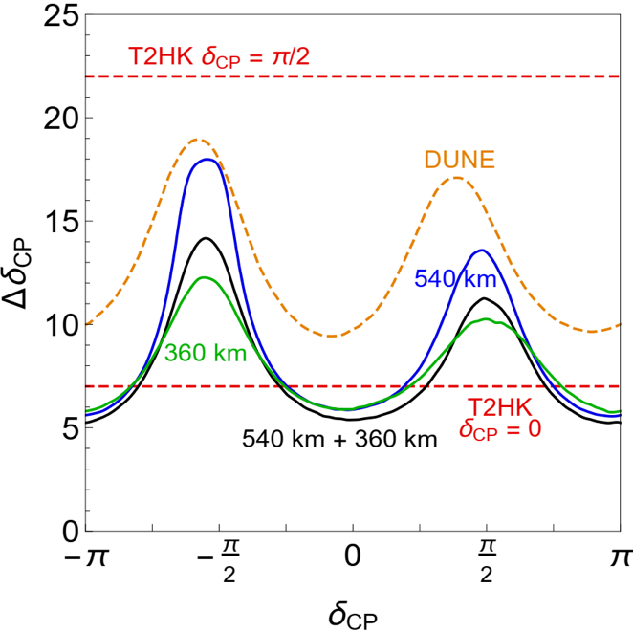
CPV performance comparison between ESSnuSB, DUNE and Hyper-K
assuming 3% systematic errors for ESSnuSB in line with the other two.
ESSνSB 500 kt tank at 540 km.
ESSνSB 500 kt tank at 360 km.
(degrees)
ESSνSB 250 kt tank at 540 km
and 250 kt tank at 360 km.

Slide 37
Fraction of δ_{CP}
Garpenberg
(540 km)
(E. Martinez-Fernandez)
Zinkgruvan
(360 km)
Lund
2 active mines aligned…
My personal opinion:
these scenarios are too optimistic for all facilities

Slide 38
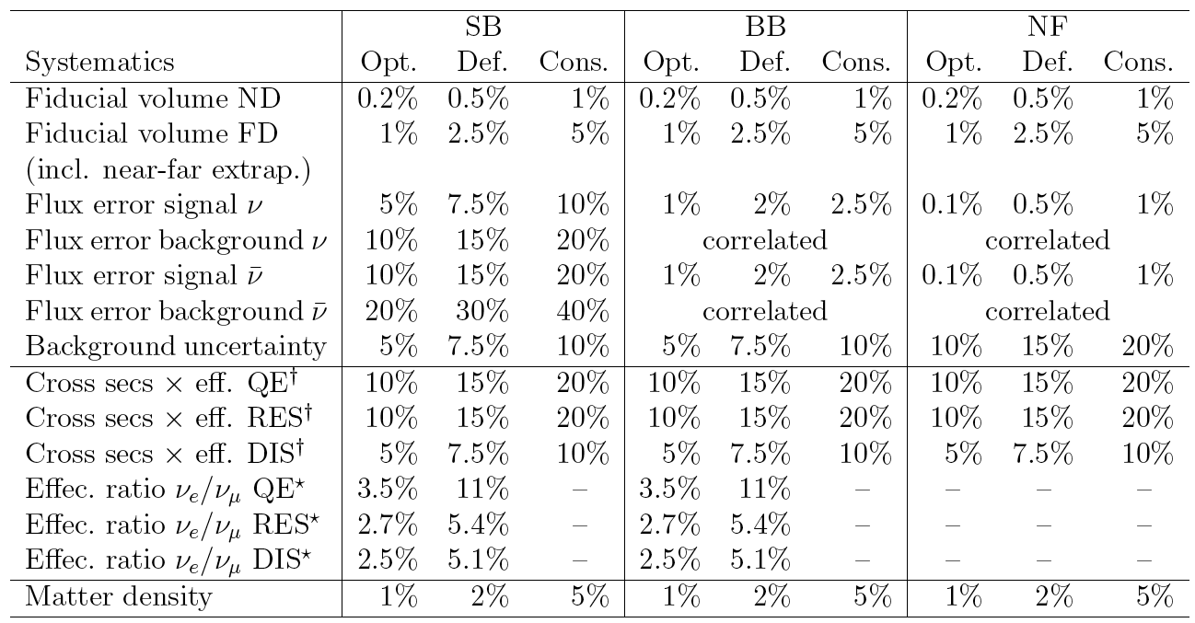
Systematic errors
Phys. Rev. D 87 (2013) 3, 033004 [arXiv:1209.5973 [hep-ph]]

Slide 39
Comparisons
Comparison using the same systematic errors
Phys. Rev. D 87 (2013) 3, 033004 [arXiv:1209.5973 [hep-ph]]

