Slide 1
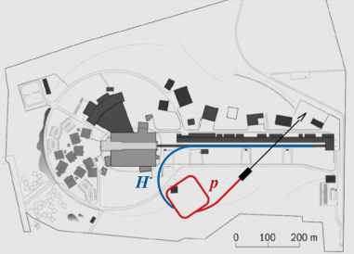
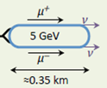
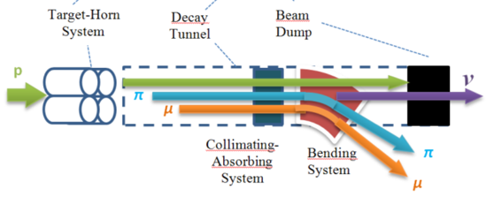
Prospects for Intensity Frontier
Particle Physics
with Compressed Pulses
from the ESS Linac
Open workshop at Uppsala University
2-3 March 2020
Program and registration at:
https://indico.cern.ch/event/849674/
2.7x10²³ p.o.t./year
Short neutron pulses
ESS 5 MW proton accelerator
Protons dump
ν_{μ} or ‾ν_{μ}
Long
Baseline
Detector
ESSnuSB
π decay
Accumulator Ring
Test Facility
μ⁺ or μ⁻
ν_{μ} + ‾ν_{e}
Short
Baseline
Detector
nuSTORM
Decay
channel or ring
4x10²⁰ muons/year of average energy ~0.5 GeV at the level of the beam dump
Front end
ν_{e} + ‾ν_{μ}
Recyling Linerar Acc.
Storage
ring
Neutrino
Factory
Cooling
Long
Baseline
Detector
Rapid Cycling
Synchrotron
Muon Collider
Collider
ring
→ ←
μ⁺ μ⁻

Slide 2
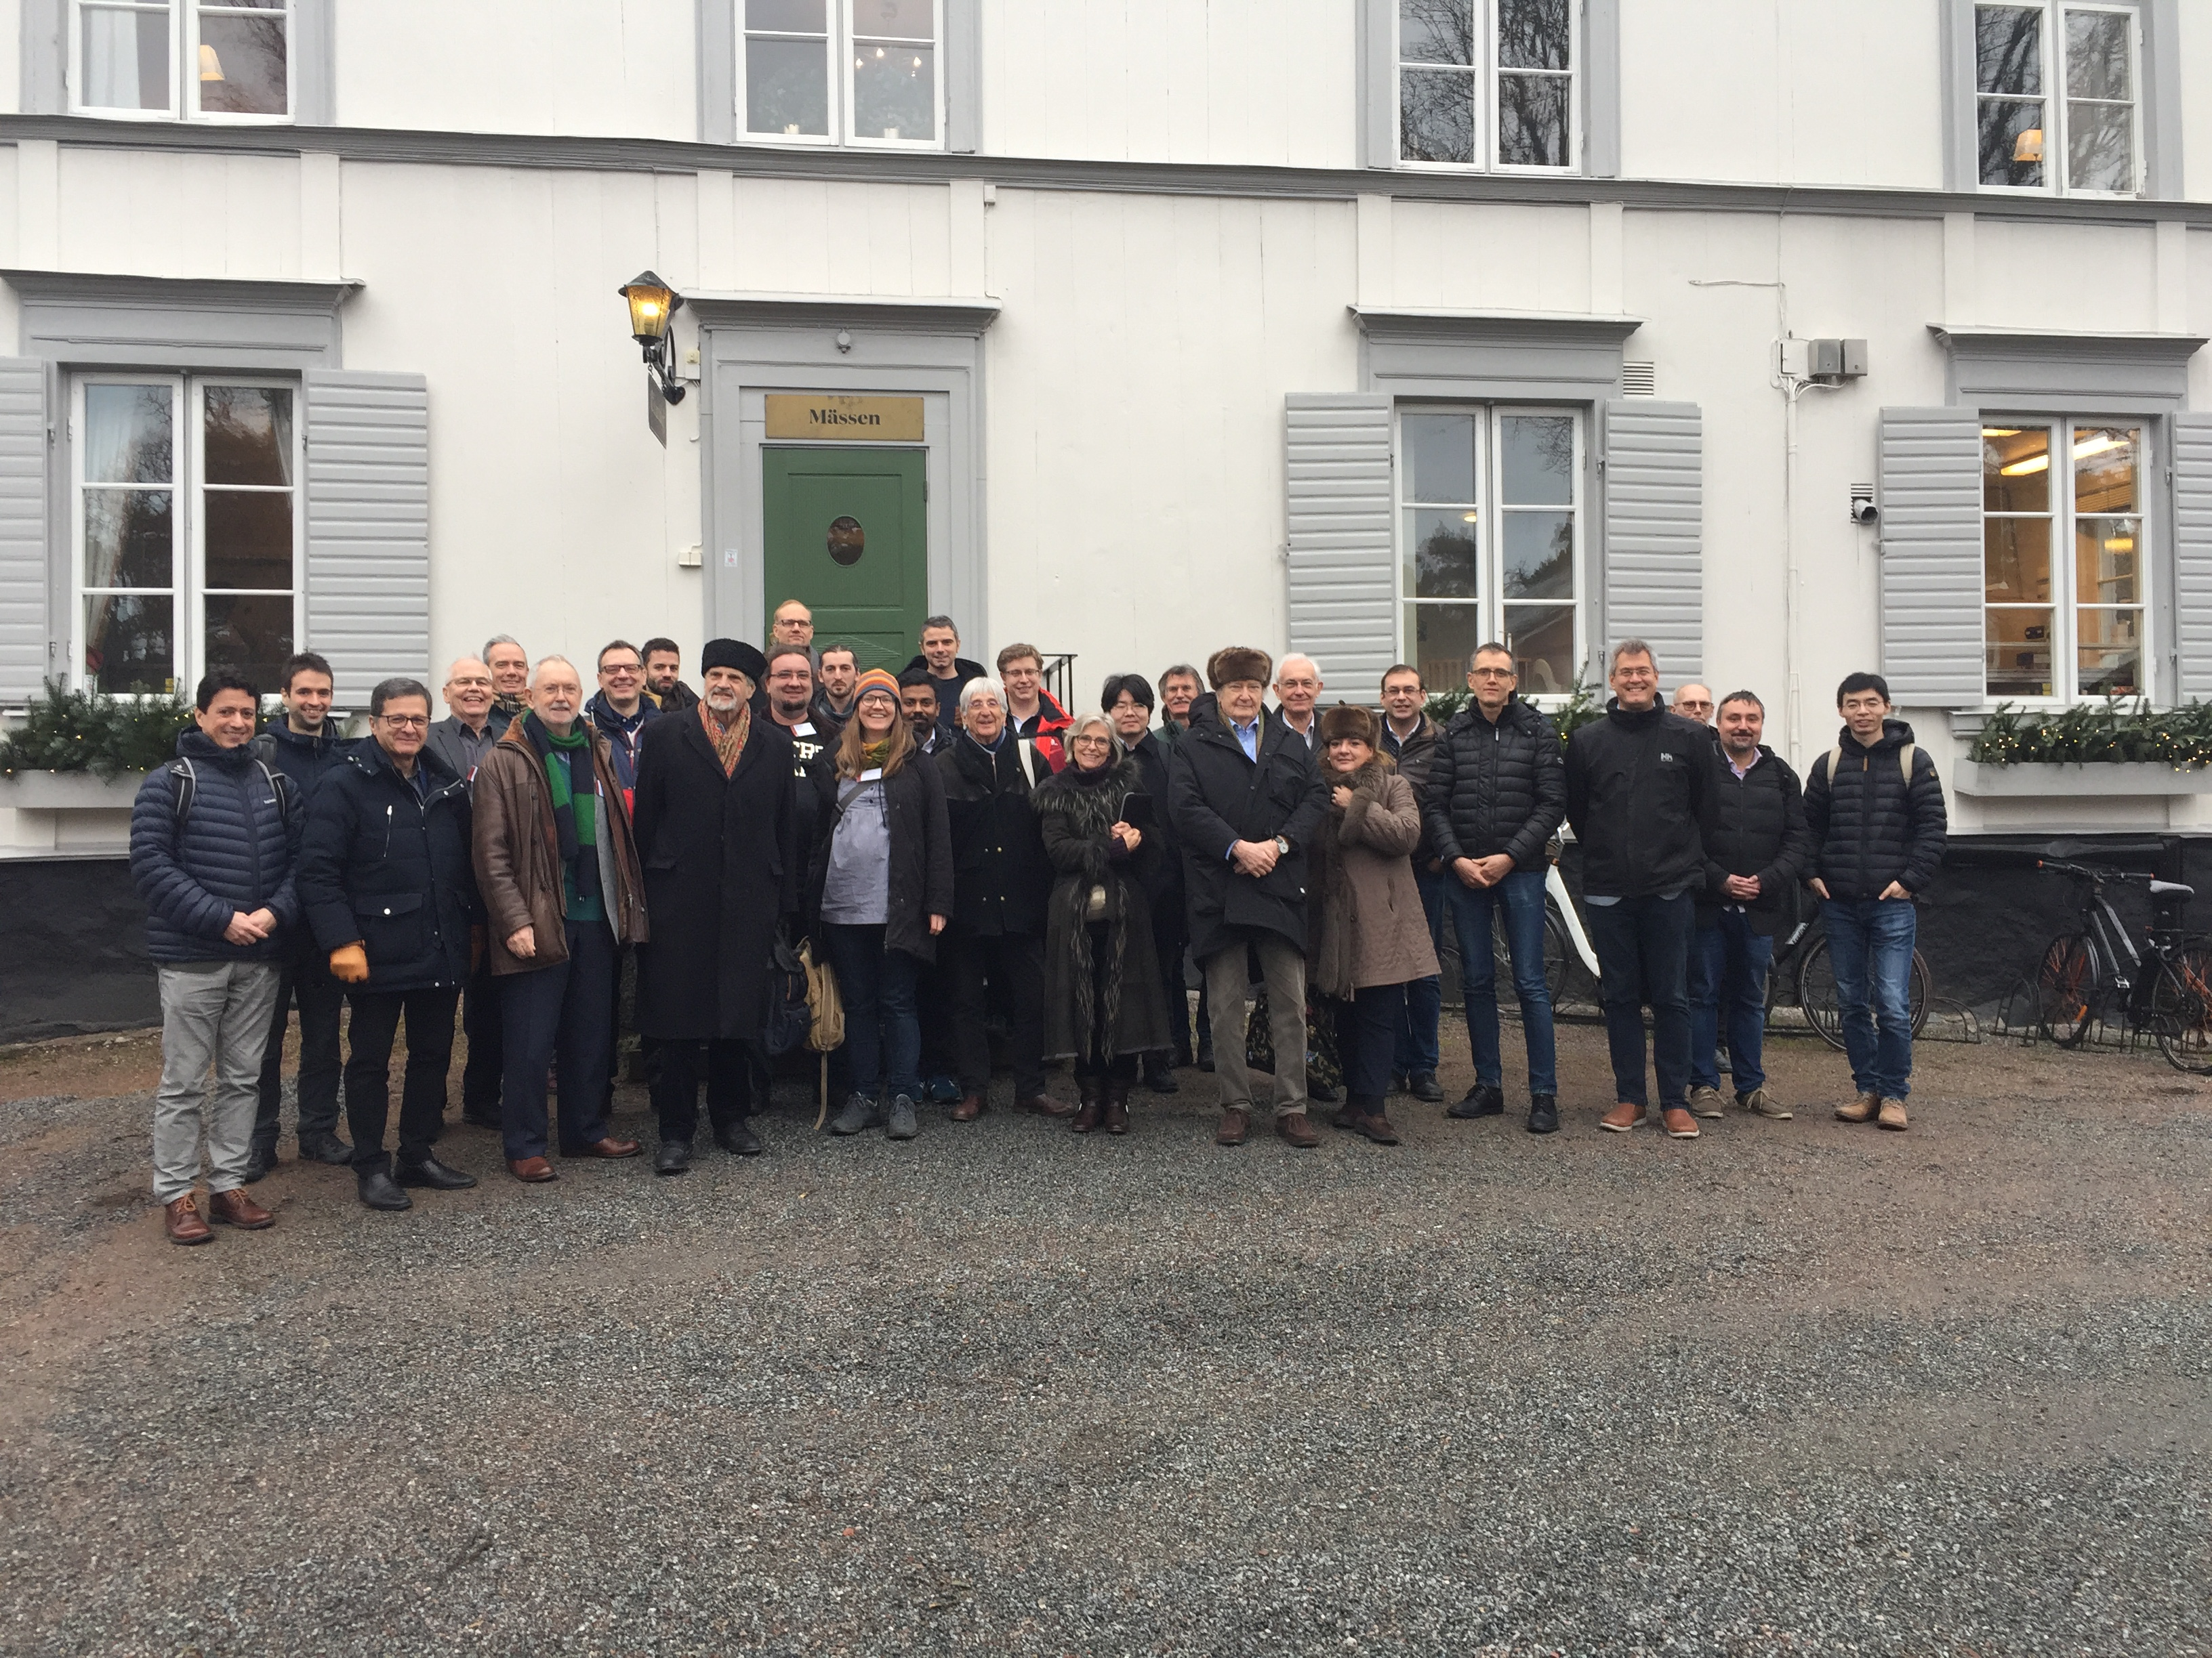
The participants in the Uppsala Workshop 2-3 March 2020

Slide 3
Summary of the motivation, programme and outcome of the workshop
‘Intensity Frontier Particle Physics with Compressed Pulses from the ESS Linac’
held at Uppsala University 2nd – 3rd March 2020
Quote from the introduction:
“The linear accelerator of the European Spallation Source, ESS, in Lund, Sweden will, with its 5 MW beam, be the world’s most powerful accelerator. Moreover, its duty-cycle at 5 MW is only 4%, which leaves room to increase the beam power and duty cycle to 10 MW and 8%, respectively. This would require an additional investment of less than ~20% of the total basic ESS accelerator investment of about 600 MEUR. This represents an outstanding opportunity for Europe, and Sweden as host country, to take a world lead, not only in Spallation Neutron Science - for which the currently specified 5 MW will be used as foreseen - but also in Intensity Frontier Particle Physics - for which the additional 5 MW will be used.“

Slide 4
Following the Uppsala workshop the following Contact Persons for the different projects were proposed:
For Muon Collider: Carlo Rubbia
For ESSnuSB: Marcos Dracos
For Short high intensity neutron pulses: Andrew Jackson
For nuSTORM and Neutrino Factory: Jaroslaw Pasternak
For Coherent Scattering and Decay at rest: Janet Conrad (TBC)
It was agreed to call a web meeting of these Contact Persons in May 2020 in order to set up a Research Plan to prepare for Horizon Europe fund applications for a HIFI design study project.

Slide 5
Draft Research Plan for the High Intensity Frontier Initiative (HIFI)
Below a summary of High Intensity Frontier Initiative (HIFI) design-goals
Neutrino Super Beams
The ongoing ESSnuSB Design Study, funded by the EU Horizon2020 INFRADEV-1 program, has already delivered a midterm status report and will deliver a final Conceptual Design Report in December 2021. The further study towards a Technical Design Report will pursued within the HIFI project.
Short high intensity neutron pulses
A design study of a slow-extraction system for the ESSnuSB accumulator capable of providing pulses of lengths around 50 µs will be performed. Existing neutron spallation-target designs will be examined to determine if they meet the requirements of neutron production with such pulses. Furthermore, science cases and technical concepts will be developed for neutron instrumentation suites that could make use of the high brightness short pulses thus produced.
nuSTORM
A conceptual design of the pion capture and transport system and of the nuSTORM racetrack storage-ring based on the use of the ESS accelerator and the ESSnuSB accumulator will be studied and its operation simulated.

Slide 6
Neutrino Factory
The generation of 120 ns pulses with 50 ns gaps in the ESS linac and a conceptual design of the Compressor ring as well as a dedicated target and pion capture solenoid together with the muon front end with RF cavities will be studied.
Muon Collider
The studies of the Muon Collider will be made in close relation to those of the Neutrino Factory. The requirements for 6D cooling process are particularly critical for the Muon Collider and will be studied in detail.
Neutrino Coherent Scattering
The improvement in the performance that will be obtained using the 1.3 µs proton pulses obtained using the accumulator ring will be studied in detail in the present project within the framework of the already ongoing design study of an ESS based Coherent Neutrino Scattering project, that till now has been based on the use of the 2.86 ms long pulses obtained directly from the ESS accelerator. The experiment will need a well shielded area near the target which will also be studied.
Neutrinos from Decay at Rest
The adaption of the K-PIPE design proposed for J-PARC to the ESS accelerator power and the 1.3 µs pulse length will be studied as well as an optimized decay-at-rest high-power target design.

Slide 7
Letter of Interest to Snowmass 2021 submitted 31 August 2020:
The ESS neutrino Super Beam Design Study (ESSnuSB) and the High Intensity Frontier Initiative (HIFI)
Reference NF/SNOWMASS21-NF1_NF10-AF2_AF0
Quote from the introduction:
“A crucial addition required for the realization of the full potential of this ESS accelerator power upgrade [from 5 MW to 10 MW] is that of a roughly 400 m circumference accumulator ring to be used to compress the duration of each accelerator pulse from ca 3 milliseconds to about 1 microsecond. Such a pulse-compressor ring, which is already being designed within the EU supported ESSnuSB neutrino Super Beam project for ESS, can also be used to benefit other intensity frontier projects.”
In what follows in this letter, ESS neutrino Super Beam ESSnuSB and the other High Intensity Frontire Initiative study projects, i.e. Short high intensity neutron pulses, nuSTORM, Neutrino Factory, Muon Collider, Neutrino Coherent Scattering and Neutrinos from Decay at Rest are described. The intent to apply to EU funding schemes for financial support is mentioned and the 23 collaborating institutions, among those 3 in the US, are listed.

Slide 8
The interested community active in the ESSnuSB design study and HIFI initiative is composed of more than 70 physicists affiliated to the following institutions:
Centre National de la Recherche Scientific at IPHC (Strasbourg) and at IJCLab (Orsay), France
Cukurova University, Adana, Turkey
Demokritos Center, Athens, Greece
Donostia International Physics Center, San Sebastian, Spain
European Organisation for Nuclear Research, Geneva, Switzerland
European Spallation Source, Lund, Sweden
Gran Sasso Science Institute, L’Aquila, Italy
Imperial College, London, UK
Institute of High Energy Physics, Beijing, China
Istituto Nazionale di Fisica Nucleare (INFN) at Bari, at Milano and at Padova, Italy
Lund University, Sweden
Massachusetts Institute of Technology, USA
University of Michigan, USA
Royal Institute of Technology, Stockholm, Sweden,
Rudjer Boskovic Institute, Zagreb, Croatia
Sofia University St. Kliment Ohridski, Sofia, Bulgaria
Universidad Autonoma de Madrid, Spain
University of Durham, UK
University of Hamburg, Germany
University of Science and Technology, Krakow, Poland
University of Oslo, Norway
University of Texas, Arlington, USA
University of Thessaloniki, Greece
Uppsala University, Sweden

Slide 9
Horizon 2020
INFRADEV-01-2019-2020: Design Studies
Design studies should tackle all the key questions concerning the technical and conceptual feasibility of new or upgraded fully fledged user facilities (proposals considering just a component for research infrastructures are not targeted by this topic). A design study proposal should demonstrate the relevance and the advancement with respect to the state-of-art of the proposed infrastructure. It should indicate the gaps in the research infrastructure landscape the new facility will cover as well as the research challenges it will make possible to address. All fields of research are considered.
The main output of a design study will be the 'conceptual design report' for a new or upgraded research infrastructure, showing the maturity of the concept and forming the basis for identifying and constructing the next generation of Europe's and the world's leading research infrastructures. Conceptual design reports will present major choices for design alternatives and associated cost ranges, both in terms of their strategic relevance for meeting today's and tomorrow's societal challenges, and (where applicable) in terms of the technical work underpinning the development of new or upgraded research infrastructures of strategic importance for Europe.
The Commission considers that proposals requesting a contribution from the EU of between EUR 1 and 3 million would allow this specific challenge to be addressed appropriately. Nonetheless, this does not preclude submission and selection of proposals requesting other amounts.

Slide 10
Horizon 2020
INFRADEV-02-2019-2020: Preparatory Phase of new ESFRI projects and early phase support to ESFRI high strategic potential areas
The preparatory phase aims to bring the project for the new or upgraded research infrastructure identified in the ESFRI Roadmap to the level of legal, financial, and, where applicable, technical maturity required for implementing it.
Proposal consortia should involve all the stakeholders necessary to move the project forward, to take the decisions, and to make the financial commitments, before construction can start (including, but not limited to, national/regional ministries/governments, research councils or funding agencies from the countries that have already declared their commitment in the application to ESFRI).
Technical work should be carried out when necessary to complete the final technical design, providing a sound technical base for establishing a cost baseline and detailed financial planning. The financial needs of the project should be mapped out to the extent necessary for funding agencies to establish their own medium- and long-term financial planning. Societal and economic benefits of the infrastructure should be analysed to carry out a Cost-benefit analysis.
The Commission considers that proposals requesting a contribution from the EU of up to EUR 4 million would allow this challenge to be addressed appropriately. Nonetheless, this does not preclude submission and selection of proposals requesting other amounts.

Slide 11
Horizon Europe
The rules for the new funding schemes of Horizon Europe, which will be in operation during the years 2021-2027, are still being discussed by representatives of the EU member Countries in a committee that will eventually be the committee that will evaluate and decide on the Research Infrastructure fund applications to Horizon Europe. This committee , currently called the Shadow Committee, has come quite far in forming its proposal, which will be handed to the EU DG for Research towards the end of 2020. The call for applications will be published soon after with a dead-line for application later in the spring 2021. The decisions will made towards the end of 2021.
There are the three following funding schemes to which it may be possible for us to apply for funding (text quoted from the Shadow committee draft):

Slide 12
Destination 1.1 RI concept development
(similar to the Horizon 2020 INFRADEV-1 Design Studies):
Scope: development of new concepts for the next generation of RI of European interest, single/multi sited, distributed or virtual, that none or few countries might individually be able to afford. All fields of research can be considered.
  Main features: RIs of European interest: able to attract users from MS/ACs other than the country where the infrastructure is located.
  RI concept development addresses technical and conceptual feasibility of new or upgraded fully fledged user facilities.
  Major upgrades of existing infrastructures: if the end result is significantly transformative/equivalent to a new infrastructure concept.
  Type of action: RIA

Slide 13
Destination 1.2 Preparatory phase of new Ris
(similar to the Horizon INFRADEV-2 Preparatory Phase)
Scope: preparatory phase of new ESFRI Research Infrastructure Projects (2021 ESFRI Roadmap update)
  Main features: RI preparatory phases address all key questions concerning legal, financial and technical issues leading to the establishment of a new RI and ensuring commitment of MSs/ACs to their long-term operation and use in all fields of science.
  Type of actions: CSA/RIA

Slide 14
Destination 4.1 R&D for the next generation of scientific instruments, tools and methods
(without direct correspondence in Horizon 2020)
Scope: deliver innovative scientific instrumentation, tools and methods to advance the state-of-art of European RIs and show transformative potential in RIs operation, thus leading RIs to support new areas of research and/or a wider community of users
  Main features: R&I activities, including technology validation and prototyping training of RI staff for the operation and use of new solutions.
  At least 3 world-class RIs: ESFRI RIs, ERICs and/or other world-class Research Infrastructures of European interest.
  Involvement of a wide set of RIs and other technological partners, including industry and SMEs, is expected.
  Type of action: RIA

Slide 15
ERC Synergy Grants
Who can apply?
A group of two to maximum four Principal Investigators (PIs) – of which one will be designated as the corresponding PI (cPI) – working together and bringing different skills and resources to tackle ambitious research problems. No specific eligibility criteria regarding the academic training are foreseen for ERC Synergy Grants. PIs must present an early achievement track-record or a ten-year track-record, whichever is most appropriate. Proposals will be evaluated on the sole criterion of scientific excellence which, in the case the ERC Synergy Grants, takes on the additional meaning of outstanding intrinsic synergetic effect.
Criteria
Applications can be made in any field of research. The ERC's grants operate on a 'bottom-up' basis without predetermined priorities. In the case of the ERC Synergy Grants, applications must demonstrate that the proposed research cannot be carried out by a single PI working alone.
How much?
Synergy Grants can be up to a maximum of € 10 million for a period of 6 years (pro rata for projects of shorter duration). An ERC grant can cover up to 100% of the total eligible direct costs of the research plus a contribution of 25% of the total eligible costs towards indirect costs.
Evaluation process
Proposals are evaluated by selected international peer reviewers who evaluate proposals on the basis of excellence as the sole criterion. It will be applied to the evaluation of both the research project and the Principal Investigators, taking into account the synergetic aspects of the proposed research.
Next call will be in Sept 2021, the dead-line in Nov 2021 and spending could start around autumn 2022

Slide 16
National Science Funding Agency grants
I all countries there are national funding agencies for scientific research like in Sweden VR, in France CRNS and IN2P3, in Italy INFN, in Germany BMFT and Humboldt Foundation, in the UK STFC etc.
It is important that the national ESSnuSB/HIFI national representatives complement our planned EU applications with applications to their respective national funding agencies.
Swedish National and Regional Development grants
EU is co-founding with its member-country governments projects to stimulate economic growth in the different regions in Europe. One category of such projects is research, technical development and innovation of a research infrastructures.
The application for a specific research infrastructure is to be filed with a governmental agency in the country where the research infrastructure is located. In Sweden this agency is the ‘Swedish Agency for Economic and Regional Growth’ (Tillväxtverket). We are investigating if we could apply to this agency for a grant to finance the development of HIFI at ESS.

Slide 17
What next?
As soon as the Horizon Europe calls are known later this fall we will analyze the final conditions for the three calls Destination 1.1, 1.2 and 2.1 and see to which of these calls – one or more - we shall apply for funding for our ESSnuSB and HIFI Design study projects. The current draft Research Plan for the High Intensity Frontier Initiative shall be edited such that it will fit the precise requirements of the calls.
This work will be made by the committee of the HIFI Contact Persons coordinated by Tord Ekelof and Marcos Dracos. Before submission to Horizon Europe, the draft(s) of the application(s) will be circulated for comments to all members of the ESSnuSB/HIFI collaboration to which, in particular, new German groups are most welcome to join in.
It is of fundamental importance that, at the same time, the ESSnuSB/HIFI groups make ESSnuSB/HIFI applications also to their national funding agencies.
I am confident that if we make a concerted and well planned effort, we shall manage to obtain the support we need from Horizon Europe, from national funding agencies and, later in 2022, from the European Research Council.

