Slide 1
The Muon Collider at the ESS
Carlo Rubbia
INFN and Gran Sasso Science Institute, L’Aquila, Italy
CERN, European Organization for Nuclear Research, Geneva, CH
Life long Member of the Senate of the Italian Republic

Slide 2
The muon collider as the optimal alternative
The Higgs sector (Ho) — no doubt — should follow the well-known previous observations of the Zo and the W’s, where the initial search and discovery with the P-Pbar collider has been followed by the systematic lepton studies with LEP.
The Zo and W’s are vectors, while the Higgs is a scalar (spin = 0) characterized by a much stronger coupling when initiated from muons rather than from electrons colliders.
A µ+ µ- collider is also highly preferable because of its small dimensions. However it demands a substantial R&D in order to produce adequate compression in 6D phase space of the muon beams.
Muons are unstable particles, quickly decaying into electrons and neutrinos. These backgrounds must be hampered.
The muon collider program here described is based on a reasonable extension of the ESS accelerator program.
.

Slide 3
Muon cooling
“Ionization Cooling” was first proposed by Budker and Skrinsky in the 60’s and early 70’s. However, there was little substance until Skrinsky and Parkhomchuk developed the idea.
The initial ideas in the US date from around 1980 due to Cline and Neuffer. A Snowmass feasibility study was presented in 1996 and a US collaboration with DOE organization and funding was formed in 1997.
As discussed already in 1994 for instance by Barletta and Sessler, muons may be produced by the two classes of processes:
(A) production from protons, subsequently decaying into muons
(B) µ+µ- pairs from electro-production.
During the following two decades Neuffer, Palmer, Cline and many others have greatly expanded ionization cooling of process (A).
These have been very important subsequent developments, but only very few verifying experimental tests have been performed.

Slide 4
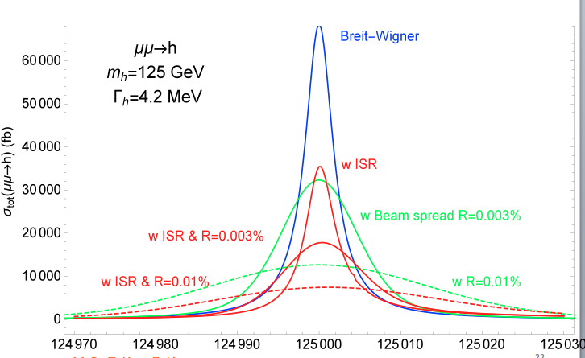
Comparing µ+µ- and e+e- at the Ho resonance peak
The narrow Ho width may be quantified convoluting the Breit–Wigner resonance with a gaussian Beam Energy Spread (BES) and the Initial State Radiation (ISR) QED effects.
1 femtobarn (fb)
= 10⁻³⁹ cm²
The µ+µ- cross sections are 71 pb for resonance profile alone and of 10 pb and 22 pb with both BES and ISR and energy resolution R = 0.01 % and R = 0.003 %. (1 pb = 10⁻³⁶ cm²)
The e+e− cross sections are 0.15 fb for both the BES and ISR effects and R = 0.01 %.
In these conditions, the µ+µ- is ≈ 100’000 times the e+e− cross section.
70’000 fb
Huge BES an ISR correctins

Slide 5
The ESS: the muon collider for Europe ?
The European Spallation Source, now in construction in Lund, with 5 MWatt of protons accelerated to a kinetic energy of 2 GeV at 14 Hz and 1.1 x 10¹⁵ p/p can be extended to provide intensity and repetition rate for the presently discussed collider program,
Several other accelerator programs at higher energies for µ+µ- factories have been described in the US (both BNL and FNAL) and elsewhere, but requiring substantial intensity improvements.
Amongst the many LHC upgrade programs which have been discussed, CERN had also considered the HP-HPL, a H- beam at 5 GeV kinetic energy with 50 Hz, 4 MWatt and 1.0 x 10¹⁴ p/ pulse.
However in 2010 CERN has decided on different alternatives and HP-HPL project has been cancelled. ESS remains the main option.

Slide 6
Future µ+ µ– alternatives
Two adequate alternatives of a μ+ μ− collider will be discussed:
the s-channel resonance at the Ho mass, to study with ≈ 40’000 fb and L > 10³² all the decay modes with small backgrounds
A higher energy collider, eventually up to √s ≈ 0.5 - 1 TeV and L > 10³⁴ to study all other Higgs related processes
The colliding beam rings can easily fit within existing locations:
For √s = 126 GeV the ring radius is ≈ 50 m (about 1/2 of the CERN PS or 1/100 of LHC) but with the resolution ≈ 0.003%
For √s = 0.5 TeV the corresponding ring radius is ≈ 200 m (about twice the CERN PS) and the resolution ≈ 0.1 %
Two μ+ μ− bunches of 2 x 10¹²ppp can likely be produced at the ESS by a high reepetition rate of a 2.0 GeV protons and a dedicated beam power of ≈ 5 Mwatt

Slide 7
The Higgs muon resonance at √s = 125.5 GeV
Signals and backgrounds for H → WW∗, and bb with energy resolution R = 0.003%. with a Gaussian energy spread ∆ = 3.75 MeV and 0.05 fb⁻¹/step and with detection efficiencies included.

Slide 8
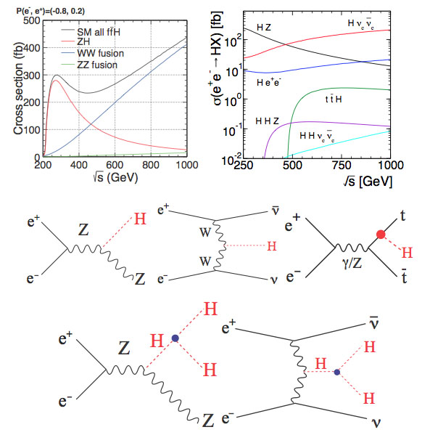
µ+µ- energies of up to ≈ 0.5 - 1 TeV are necessary
We need in addition :
Production cross sections of WW, ZZ, ZH (A) and production cross sections H + X (B) as a function of √s and preferably from μ+-μ-
The Higgs-strahlung diagram (Left), the W-boson fusion process (Middle) and the top-quark association (Right).
Double Higgs boson diagrams via off-shell Higgs-strahlung (Left) and W-boson fusion (Right) processes
(A)
(B)
100 km e+e- ring
The µ+µ- channel is preferably chosen rather than the e+e-

Slide 9
General accelerator set-up for the ESS
A practical μ+ −μ− Higgs factory as a next facility at the ESS consists of
1.- A high-intensity H⁻ source feeding p-compressor rings;
2.- A p–π −μ decay channel at a optimal muon momentum compression to about 220 MeV/c;
3.- A robust μ± ionization–cooling system, compressing the bunches in 6D;
4.- A fast recirculating LINAC acceleration system to bring muons to the required energy where collisions are recorded;
5.- A L ≈ 10³² cm⁻² s⁻¹ μ⁺−μ⁻ collider ring at the Higgs mass and a L ≈ 10³⁴ cm⁻² s⁻¹ μ⁺−μ⁻ collider in the sub-TeV range.
The required large ESS proton intensity is directly related to the relatively short muon lifetime

Slide 10
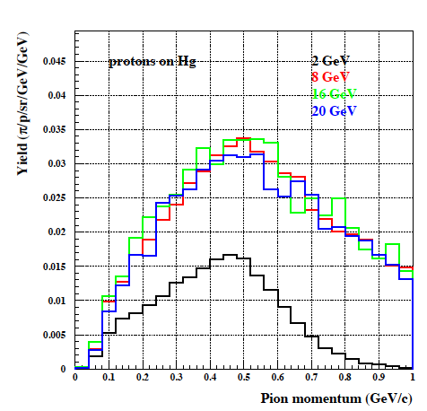
1.- The proton rings
The rate of the ESS- LINAC may be doubled to 28 Hz.
Two proton rings of 35 m radius, the “Accumulator” collects the LINAC pulse and the “Compressor” steers the bunch to 1.5 ns.
The beam transfer from the LINAC to the Accumulator is performed by a multi-turn injection of negative [p+2e-] ions, stripped at the entrance of the Accumulator ring, either with a thin absorbing carbon foil or of an appropriate LASER beam.
The pion spectrum produced by a given “proton power” (the number of protons inversely proportional to its energy) is nearly independent of proton kinetic energy between 8 and 20 GeV and a only a factor two lower for 2 GeV.
Yield (π/p/sr/GeV/GeV)
P. Sala: prediction
Pion momentum 300 MeV/c

Slide 11
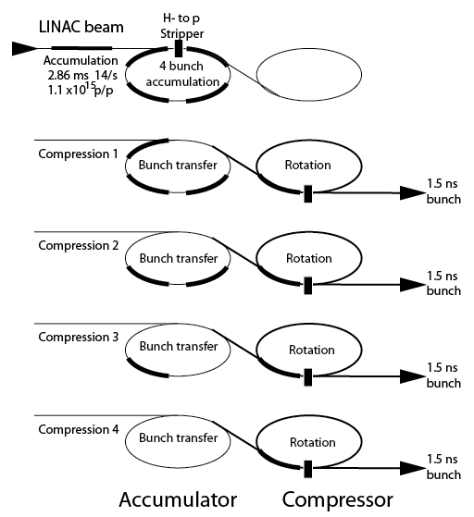
2.- Accumilator and compressor rings for H-
In order to make use of a 5 MWatt/pulse from the ESS and the requirement of 1.5 ns long proton pulses, 2 coupled rings (Accumulator and Compressor) may subdivide the beam pulse into four pulses and operate the secondary beam at 4 x 14 = 56 Hz and a 17.8 ms bunch rate.
Rings have 35 m radius, wth 4 pulses of 120 ns each separated by 50 ns.

Slide 12
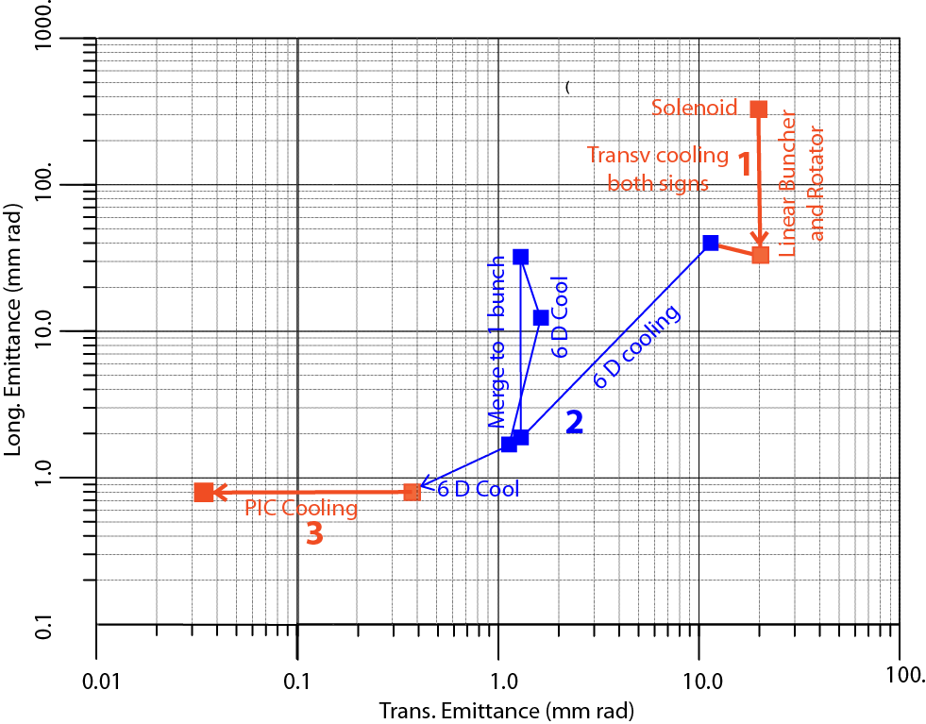
3.- The cooling process
Three successive steps are required in order to bring the muon cooling process at very low energies of about 220 MeV/c, after capture and bunching + rotation.
Linear transverse cooling of both signs and small Δp increase
Ring cooling in 6D with B brings the μ+ and μ- to a reasonable size Merging and cooling to single bunches
Parametric Resonance Cooling (PIC), where the elliptical motion in x-x' phase space has become hyperbolic
(

Slide 13
3a.- PIC, the Parametric Resonance Cooling
Combining ionization cooling with parametric resonances is expected to lead to muon with much smaller transverse sizes.
A linear magnetic transport channel has been designed by Ya.S. Derbenev et al. where a half integer resonance is induced such that the normal elliptical motion of particles in x-x' phase space becomes hyperbolic, with particles moving to smaller x and larger x' at the channel focal points.
Thin absorbers placed at the focal points of the channel then cool the angular divergence by the usual ionization cooling.
LEFT ordinary oscillations
RIGHT hyperbolic motion
induced by perturbations near an (one half integer) resonance of the betatron frequency.
x x’ = const
V. S. Morozov et al, AIP 1507, 843 (2012);

Slide 14
3b.- Details of PIC
Without damping, the beam dynamics is not stable because the beam envelope grows with every period. Energy absorbers at the focal points stabilize the beam through the ionization cooling.
The longitudinal emittance is maintained constant tapering the absorbers and placing them at points of appropriate dispersion, vertical β and two horizontal β’σ.
. Comparison of cooling factors (ratio of initial to final 6D emittance) with and without the PIC condition vs number of cells: about 10x gain
10 x

Slide 15
4.- Bunch acceleration to 62.5 GeV
Next, in order to realize a Higgs Factory at the known energy of 126 GeV, an acceleration system is progressively rising the energy of captured muons to m_{Ho}/2
Adiabatic longitudinal Liouvillian acceleration to p_{f}= 62.5 GeV/c.
Both µ+ and µ- are accelerated sequentially in the same LINAC with opposite polarity RF buckets
Two recirculating LINAC and 25 MeV/m with f.i. 5 GeV energy/step with 4 bi-directional passages to 63 GeV (≈ 200 m long)
A similar layout for the second phase with √s ≈ 0.5 TeV will require twice the passages and recirculating lengths (400 m)
d = 200 m
D. Neuffer, 2013

Slide 16
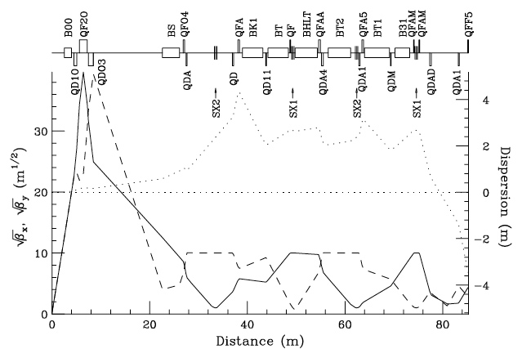
5.- Muons collide in a storage ring of R ≈ 60 m
Lattice structure at the crossing point, including local chromaticity corrections with β_{x} = β_{y} = β* = 5 cm.
Ankenbrandt et al. (1999)

Slide 17
Higgs luminosity at ESS
The luminosity is given by a formula where:
N⁺ = N⁻ = 2.5 x 10¹² µ/pulse
f is the number of effective luminosity crossings: 43 x 555 =23’865/s
ε _{rms} =ε _{N}/589.5 = 0.36 x 10⁻⁴ rad cm, with H₂
β∗ = 5 cm is beta at crossing in both dimensions
Luminosity is L = 5 x 10³¹ cm⁻² s⁻¹ at each collision crossing
The cross section at the maximum folded with a ΔΕ = 3.4 MeV is 1.0 x 10⁻³⁵ cm². Hence the Ho event rate is 1.2 x 10⁴ events for 10⁷ s/y . In 10 y and two crossings: 1/4 million Ho events
If novel Parametric Resonance Cooling (PIC) is successful, ε _{rms} is reduced by a factor 10 and with 1.2 x 10⁵ events/year/i.p.

Slide 18
Eatimated performance for the Hº-factory at the ESS
Two asymptotically cooled μ bunches of opposite signs collide in two low-beta interaction points with β*= 5 cm and a free length of about 10 m, where the two detectors are located.
with PIC cooling a peak collider luminosity of 4 x 10³² cm⁻² s⁻¹ is achieved
The bunch transverse rms size is 0.05 mm and the μ−μ tune shift is 0.086.
The SM Higgs rate is ≈ 10⁵ ev/year (10⁷ s) in each of the detectors.
An arrangement with at least two detector positions is recommended.
Without PIC
1.2 x 10⁴ ev/year

Slide 19
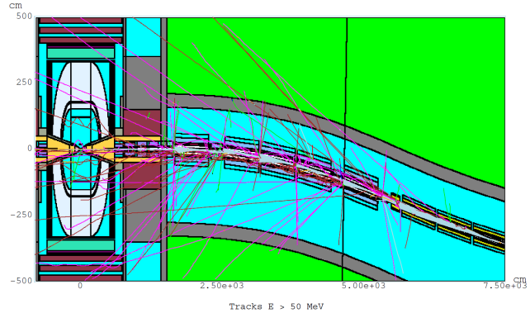
Muon related backgrounds
A major problem is caused by muon decays, namely electrons from µ decay inside the detector with ≈ 2x10³ e/meter/ns, however collimated within an average angle of 10⁻³ rad.
A superb collimation is required with the help of absorbers in front of the detector’s straight sections.This is an open problem
Drozhdin, Mokhov et al.

Slide 20
The realization of the Initial Cooling Experiment
Physics requirements and the studies already undertaken with muon cooling suggest that a next step, prior to but adequate for a specific physics programme could be the practical realization of an appropriate cooling ring demonstrator.
Indicatively this corresponds to the realization of an unconventional tiny ring of 20 to 40 meters circumference in order to achieve the theoretically expected longitudinal and transverse emittances of asymptotically cooled muons.
The injection of muons from pion decays at an average momentum of about 220 MeV/c every few sec may be produced from a tiny bunch of protons extracted from the ESS.
The goal is to prove experimentally the full 3D cooling according to the prediction of Slide 12.
The realization of the Hº-factory at the ESS could be constructed later and only after the success of the initial cooling experiment has been confirmed at a lowest cost.

Slide 21
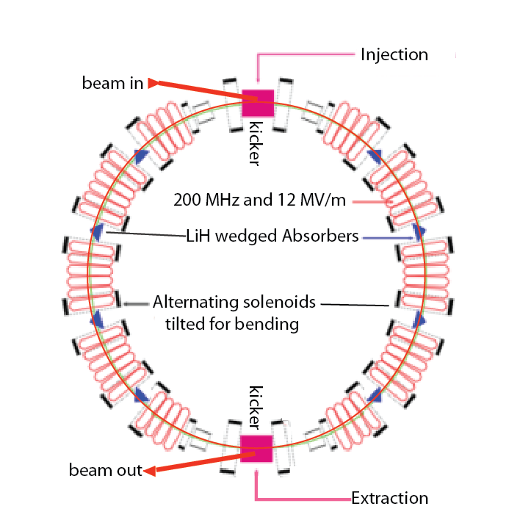
The RFOFO Ionization Cooling
The design is based on solenoids tilted in order to ensure also bending. The LiH absorbers are wedge shaped to ensure longitudinal cooling.
Two separate, 180* apart injection and extraction pulsed inflectors
Pulsed inflector

Slide 22
The Higgs production colliders
Advantages
Large cross sections σ (μ⁺μ⁻ → h) = 41 pb in s-channel resonance and µ⁺µ⁻ → ZH of 0.2 pb at √s = 500 GeV.
Small size footprint: it may fit within the existing ESS site
No synchrotron radiation and beamstrahlung problems
Precise measurements of line shape and decay widths
Exquisite measurements of all channels and tests of SM.
The cost of the facility, provided cooling will be successful, is less than 1/10 of one of the LHC.
Challenges.
A low-cost demonstration of muon cooling must be done first.
Muon 2D and 3D cooling needs to be fully demonstrated
Need ultimately very small c.o.m energy spread (0.003%)
Backgrounds from constant muon decay
Significant R&D required towards end-to-end design

Slide 23
Article from FORBES
Ethan Siegel, FORBES Senior Contributor
Aug 22, 2019
Forget About Electrons And Protons; The Unstable Muon Could Be The Future Of Particle Physics
https://www.forbes.com/sites/startswithabang/2019/08/22/forget-about-electrons-and-protons-the-unstable-muon-could-be-the-future-of-particle-physics/

Slide 24
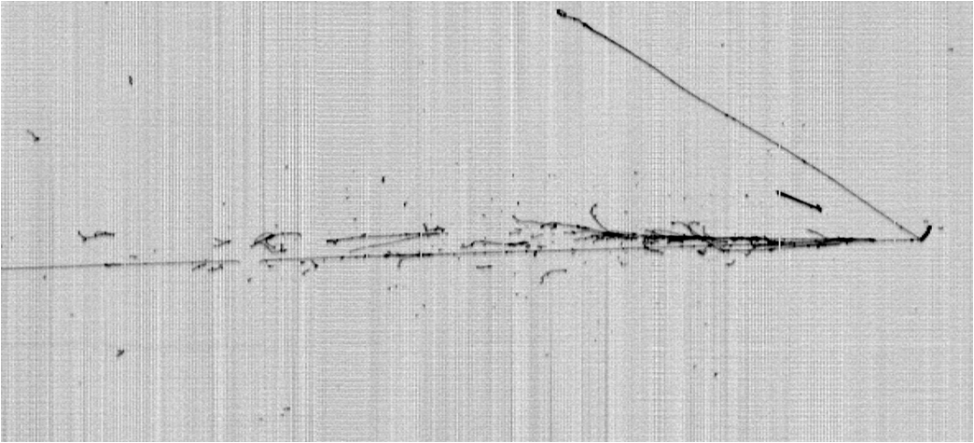
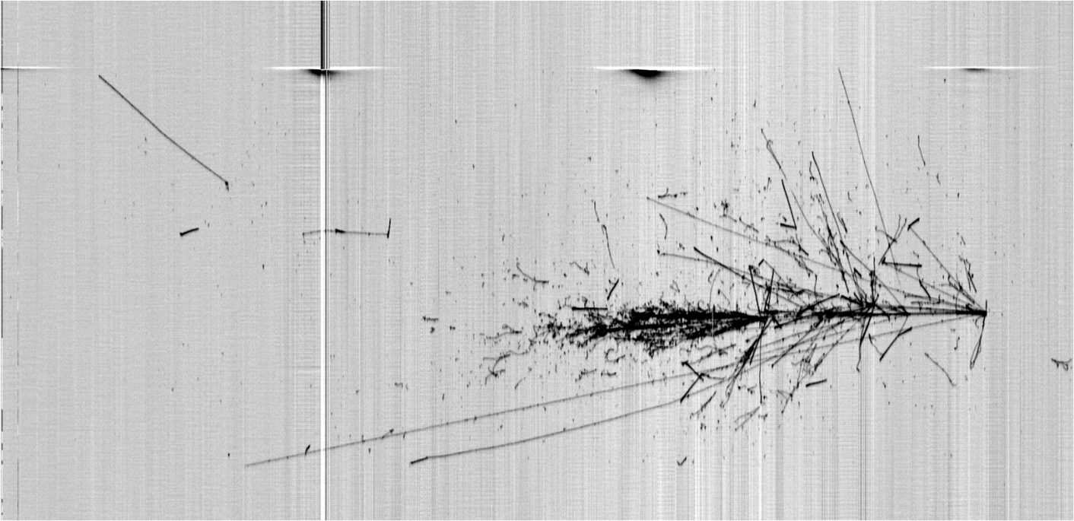
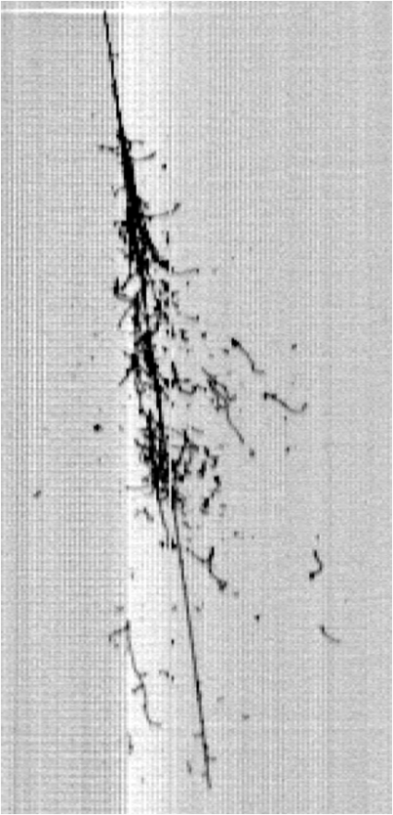
Thank you !
LNGS_May2011
Slide 24

