Slide 1







SEC-complex down approaches with functional O₂-affinity assay:
Correlation between the higher order structure of bird hemoglobin homologues and their function
Under supervision of Dr Hernandez-Alba Oscar and Dr Schaeffer-Reiss Christine

Slide 2

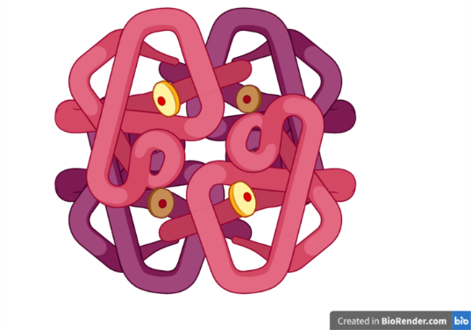
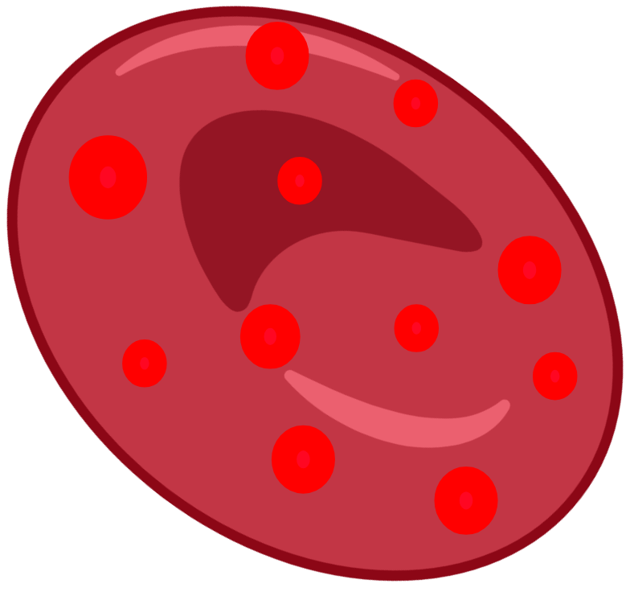


Introduction
Hemoglobin is a red blood cell protein that carries oxygen
Heme
Subunit and cofactor characterization
$α$-chain
$β$-chain
Structural
Study
Functional
Study
Red blood cell
$α$-chain
$β$-chain
1

Slide 3
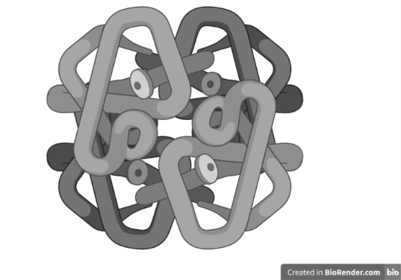
Introduction
Hemoglobin is a red blood cell protein that carries oxygen
?
Heme
Subunit and cofactor characterization
$α$-chain
$β$-chain
Structural
Study
Functional
Study
Red blood cell
$α$-chain
$β$-chain
1

Slide 4
Introduction
Hemoglobin is a red blood cell protein that carries oxygen
?
Heme
Subunit and cofactor characterization
$α$-chain
$β$-chain
Structural
Study
Functional
Study
Red blood cell
$α$-chain
$β$-chain
Environmental adaptability
Structure-function relation
Phylogeny
1

Slide 5
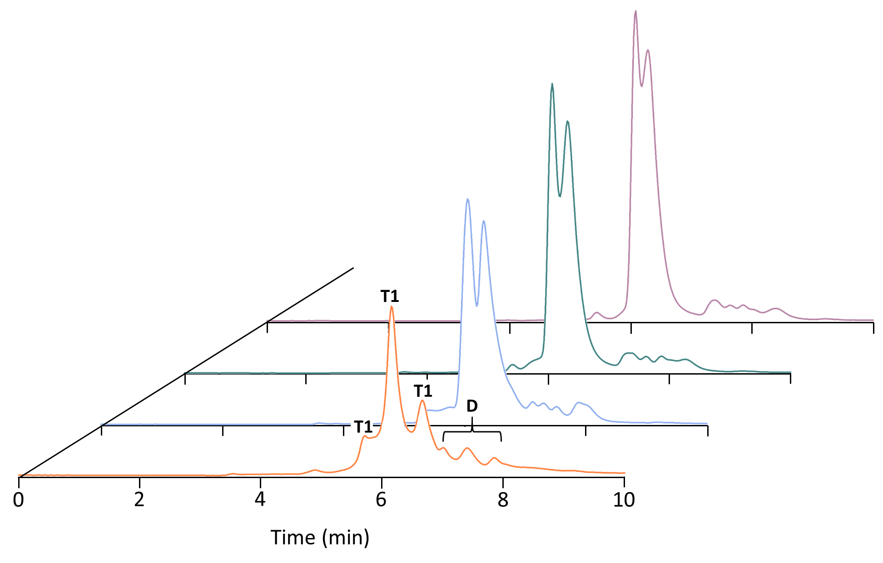
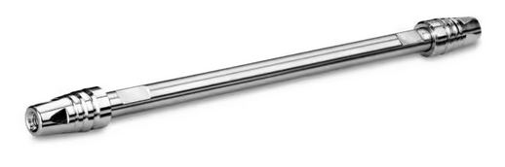
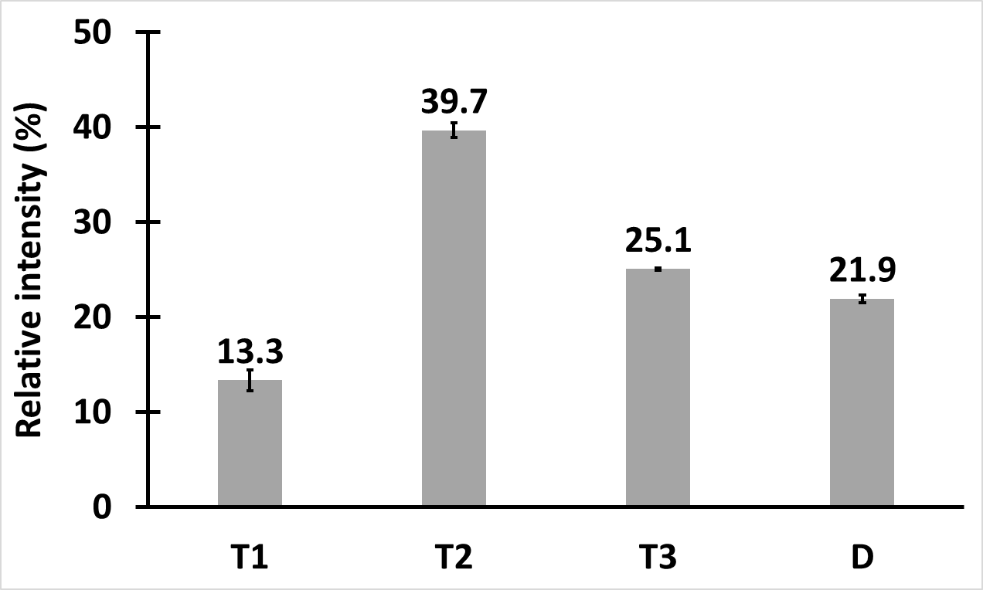
Chromatographic separation optimization
BEH SEC column (Waters),
4.6 x 150 mm, 1.7 µm, 200 Å
10 mM Ammonium Acetate (AmAc)
High ionic strength
T2
150 mM AmAc
100 mM AmAc
Low ionic strength
T3
T1
50 mM AmAc
10 mM AmAc
Only a concentration of 10 mM of AmAc allows the separation of tetramers.
Low energy analysis allows the transmission of intact tetramers, thus affording information on their molecular weight.
High energy analysis favours the subunit release of each tetramer.
→ binding stoichiometry of each tetramer
2

Slide 6
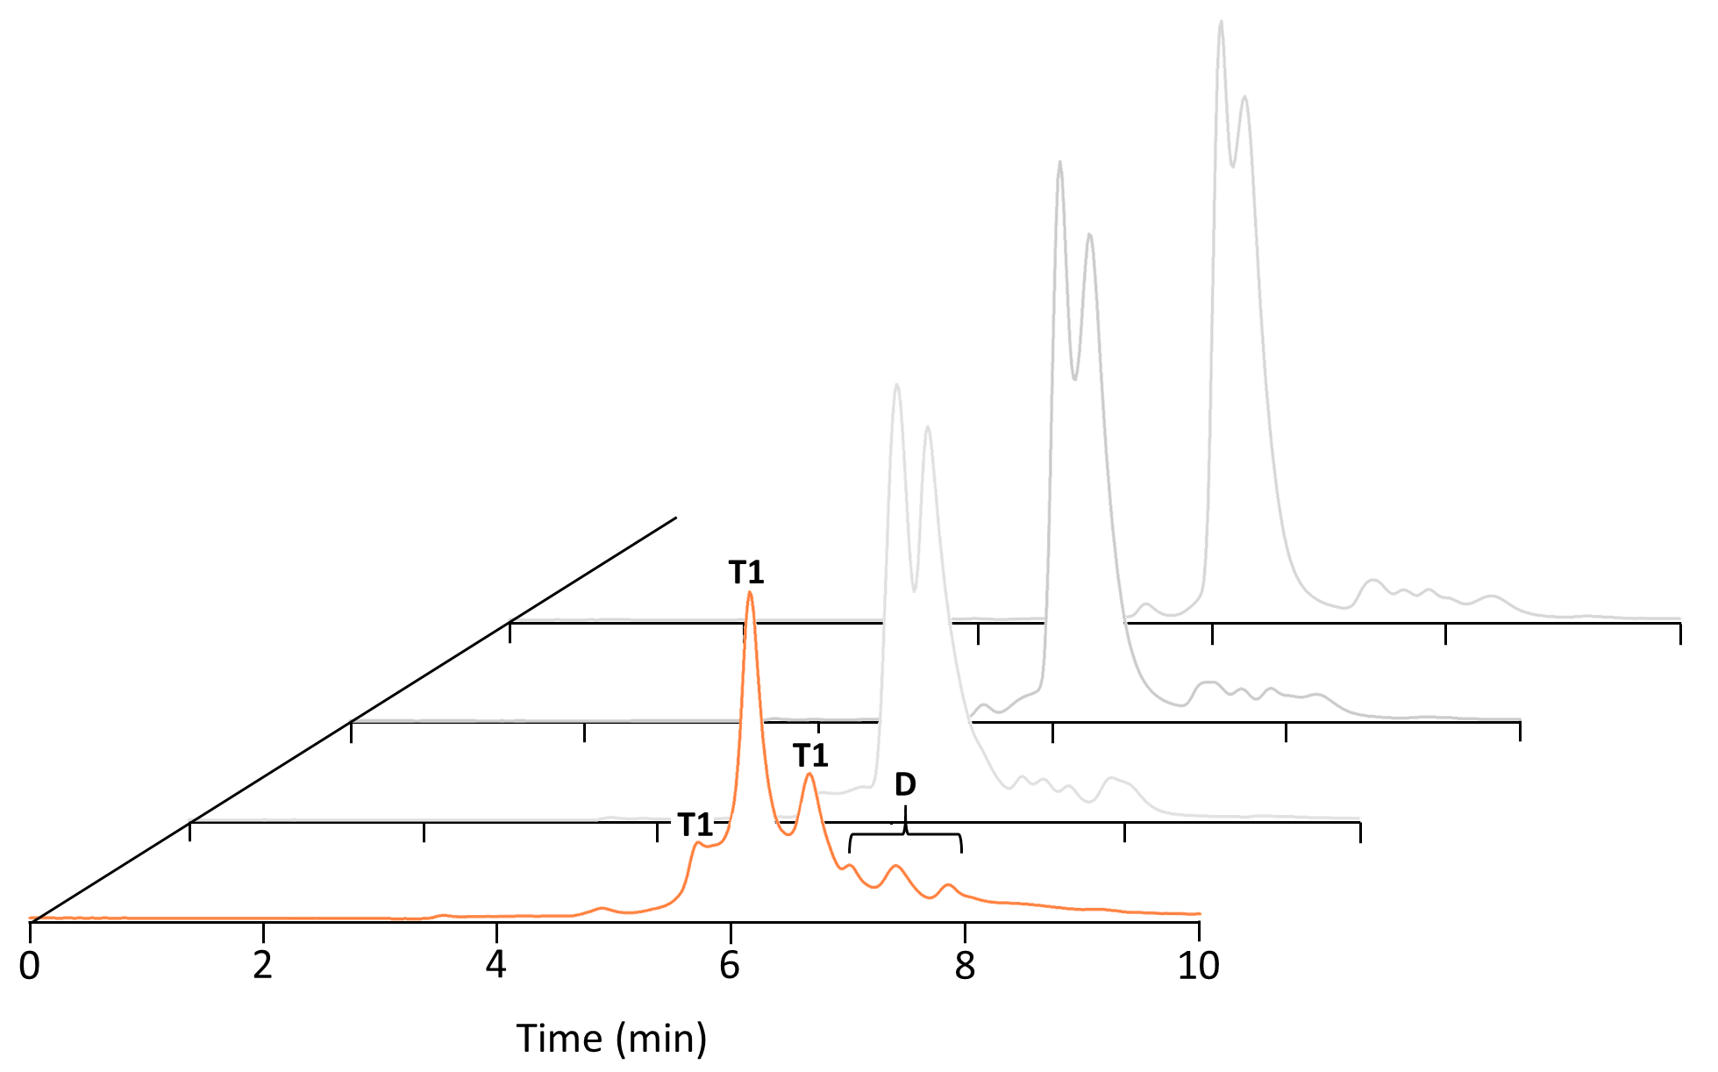

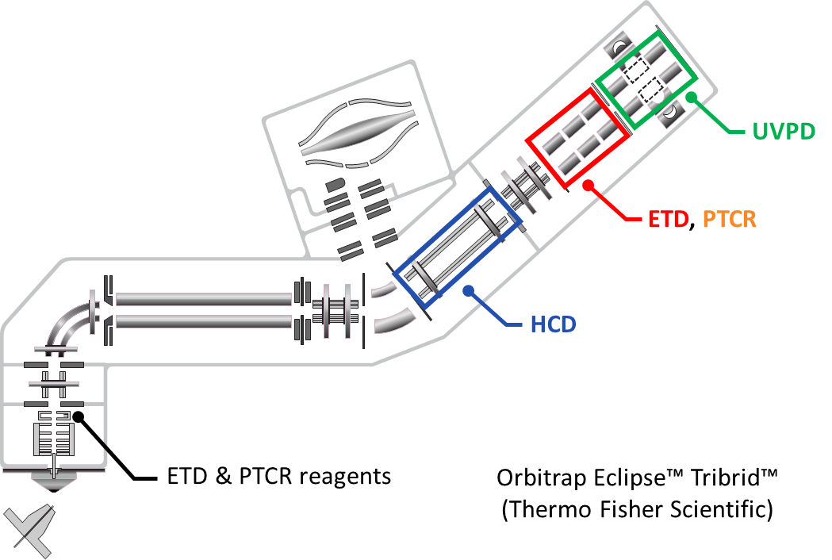
Identification of tetramers (MS1)
BEH SEC column (Waters),
4.6 x 150 mm, 1.7 µm, 200 Å
10 mM Ammonium Acetate (AmAc)
High ionic strength
T2
Low ionic strength
T3
T1
10 mM AmAc
Only a concentration of 10 mM of AmAc allows the separation of tetramers.
Low energy analysis allows the transmission of intact tetramers, thus affording information on their molecular weight.
High energy analysis favours the subunit release of each tetramer.
→ binding stoichiometry of each tetramer
2

Slide 7
Identification of tetramers (MS1) and subunits (pMS²)
BEH SEC column (Waters),
4.6 x 150 mm, 1.7 µm, 200 Å
10 mM Ammonium Acetate (AmAc)
High ionic strength
T2
Low ionic strength
T3
T1
10 mM AmAc
Only a concentration of 10 mM of AmAc allows the separation of tetramers.
Low energy analysis allows the transmission of intact tetramers, thus affording information on their molecular weight.
High energy analysis favours the subunit release of each tetramer.
→ binding stoichiometry of each tetramer
2

Slide 8
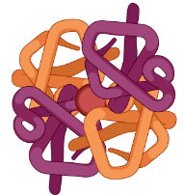
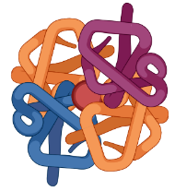
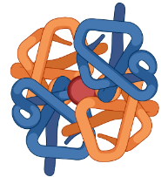

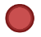
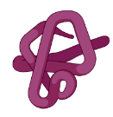
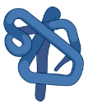

Structural Study
SEC-nMS
Tetramer composition (MS¹)
T1
T2
T3
Subunit release (pMS²)
pMS^{n} = pseudo MS^{n}
The difference among tetramers is only based on alpha chain.
?
A difference of 580 Da is found between calculation and experimental masses of tetramers

Slide 9
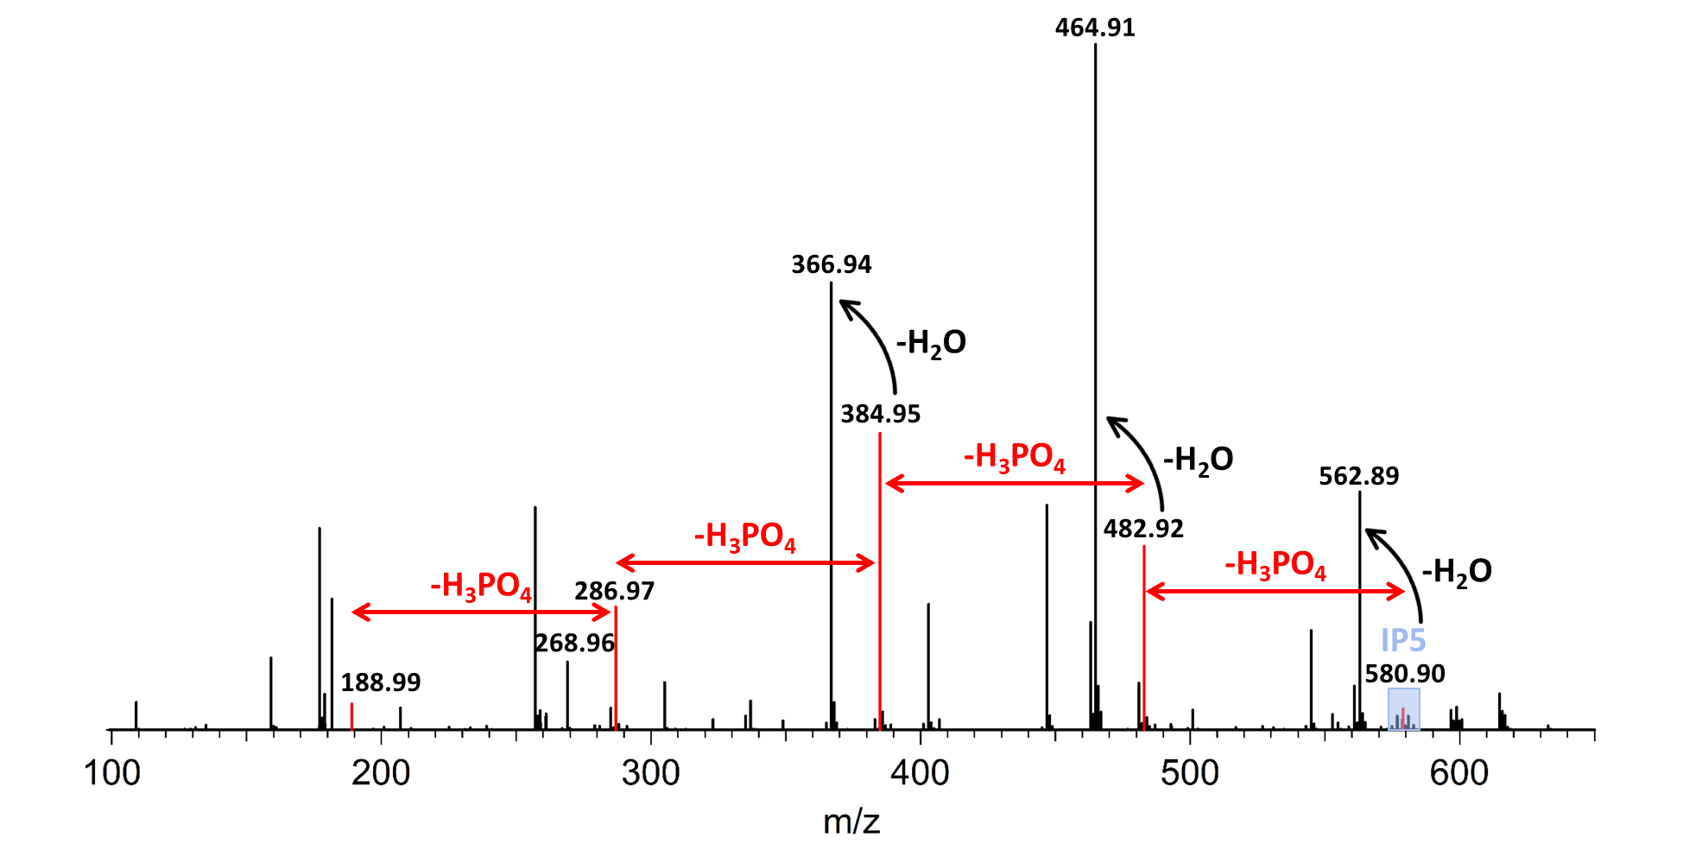
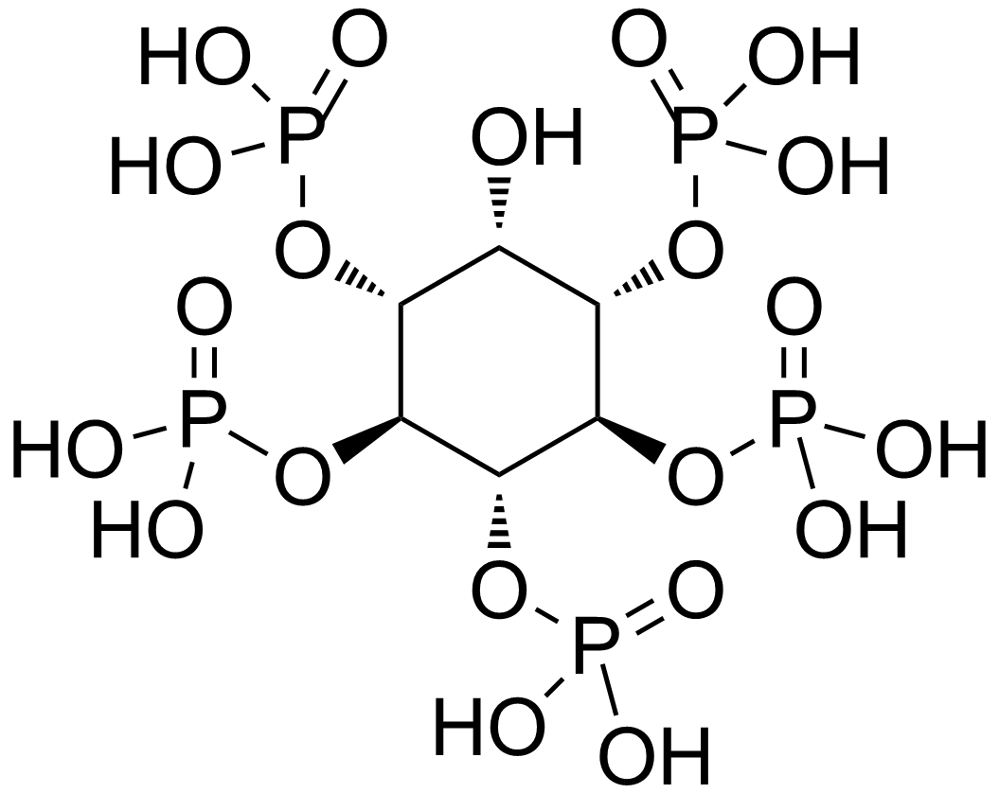
Structural Study
SEC-nMS
Cofactor characterization
SEC-TD-MS (pMS³)
Tetramer composition (MS¹)
Cofactor identification
IP5 structure
T1
T2
T3
Isolation
Subunit release (pMS²)
pMS^{n} = pseudo MS^{n}
The difference among tetramers is only based on alpha chain.
Presence of IP5 on tetrameric form of Zebra Finch hemoglobin is identified.
?
A difference of 580 Da is found between calculation and experimental masses of tetramers

Slide 10
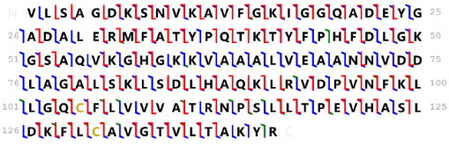
Structural Study
SEC-nMS
Subunit characterization
SEC-TD-MS (pMS³)
Tetramer composition (MS¹)
Cofactor identification
IP5 structure
T1
T2
T3
Isolation
HCD → Induced by collisions
Subunit release (pMS²)
EThcD → Induced by electrons
UVPD → Induced by photons
pMS^{n} = pseudo MS^{n}
Subunit characterization
The difference among tetramers is only based on alpha chain.
Presence of IP5 on tetrameric form of Zebra Finch hemoglobin is identified.
Sequence coverage > 90% is achieved for all subunits.
?
A difference of 580 Da is found between calculation and experimental masses of tetramers

Slide 11

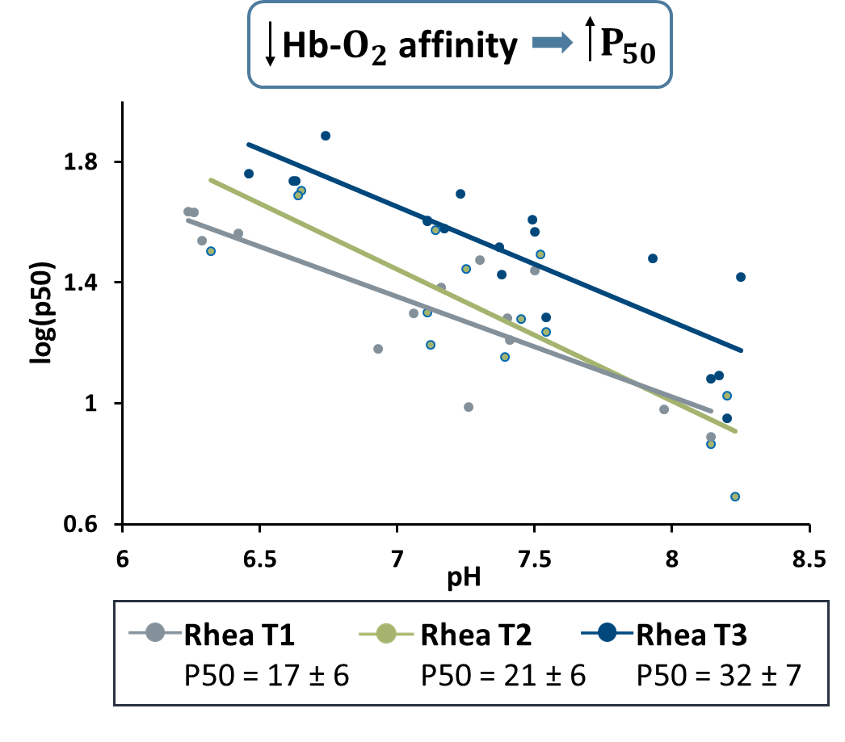
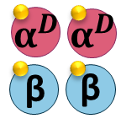
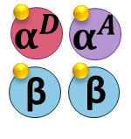
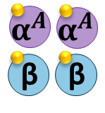


Structural Study
SEC-nMS
Subunit characterization
SEC-TD-MS (pMS³)
Functional Study
O₂-affinity Assays
Turkan
Nabiyeva
Tetramer composition (MS¹)
Cofactor identification
IP5 structure
T1
T2
T3
T1
T2
T3
HCD → Induced by collisions
Subunit release (pMS²)
EThcD → Induced by electrons
UVPD → Induced by photons
pMS^{n} = pseudo MS^{n}
>
>
Subunit characterization
The difference among tetramers is only based on alpha chain.
Presence of IP5 on tetrameric form of Zebra Finch hemoglobin is identified.
Sequence coverage > 90% is achieved for all subunits.
α_{D} has elevated $O_{2}$ affinity relative to α_{A}
?
A difference of 580 Da is found between calculation and experimental masses of tetramers

Slide 12

Conclusion
See you at 34
Subunits and cofactor
Subunit and cofactor characterization
Binding stochiometry
O₂-binding affinity
Structural
Study
Functional
Study
Thanks for your attention!

