Slide 1
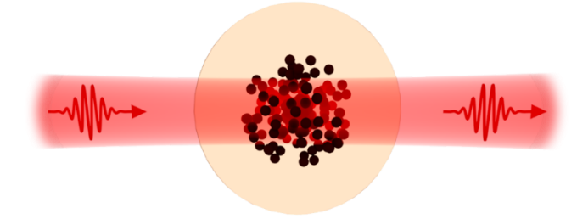

Cavity-Enhanced Rydberg
Nonlinear Optics
Benedikt Beck
Nonlinear Quantum Optics group

Slide 2
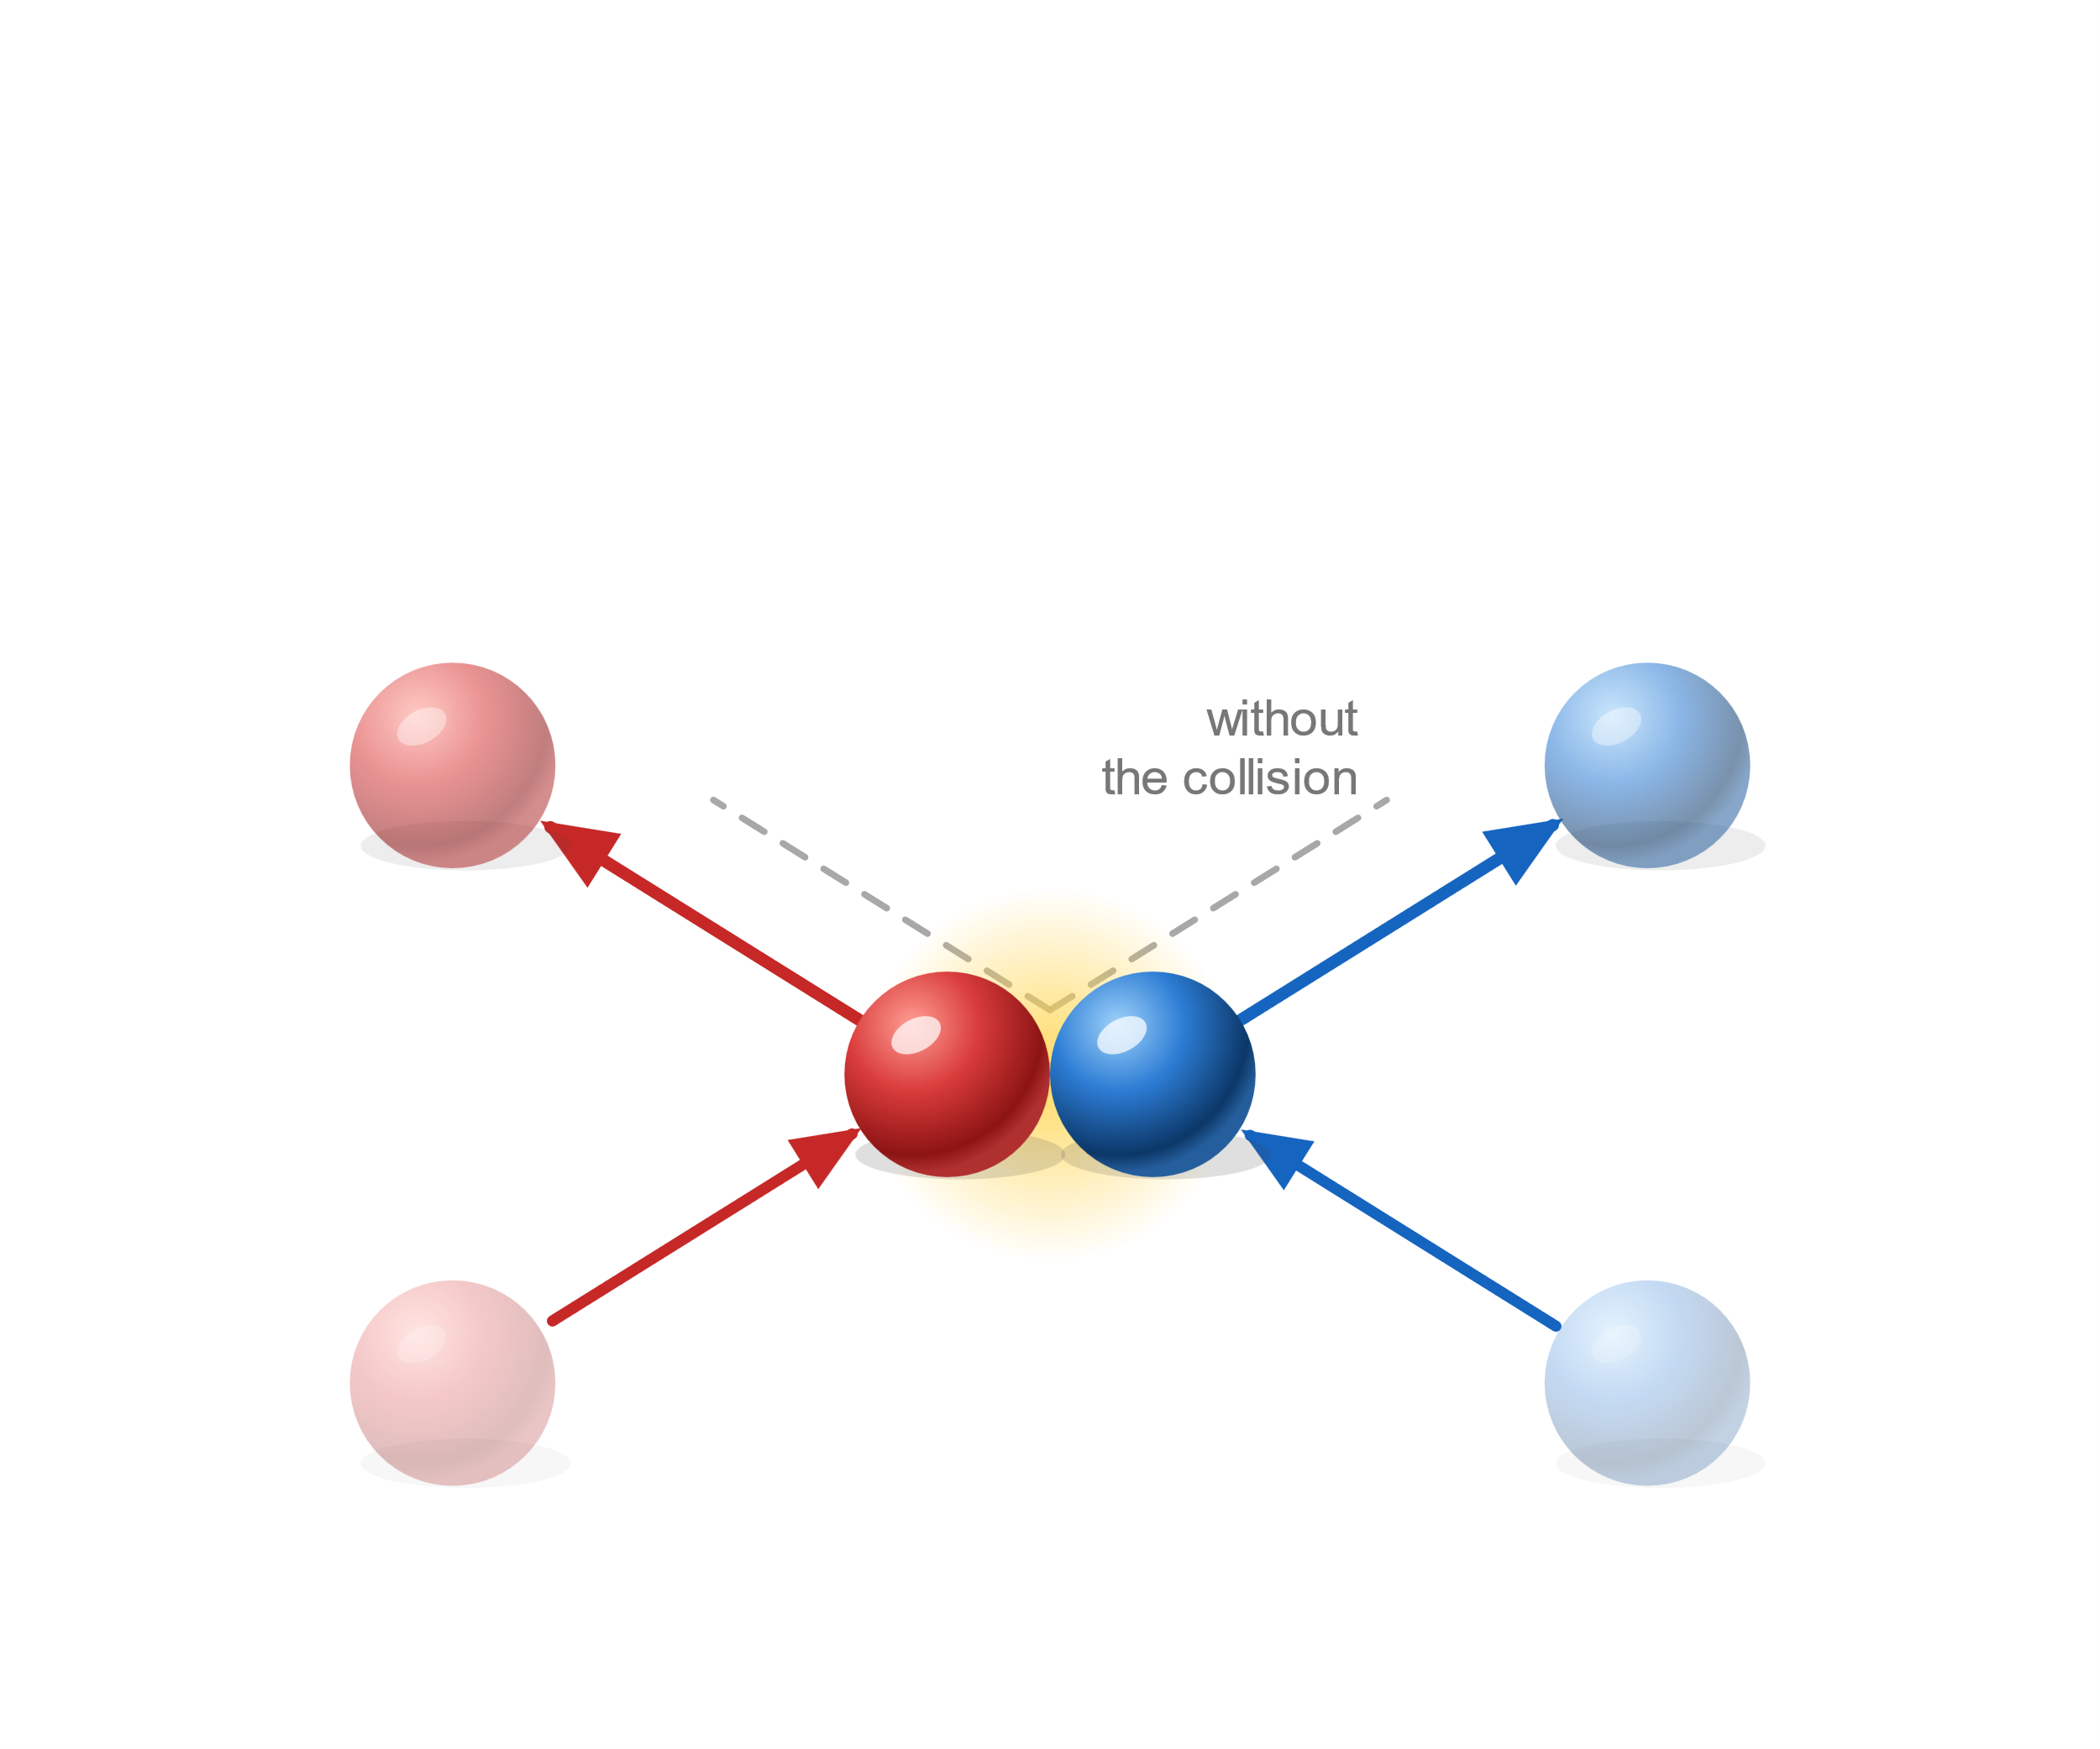
Nonlinear Quantum Optics
Colliding Billard balls

Slide 3
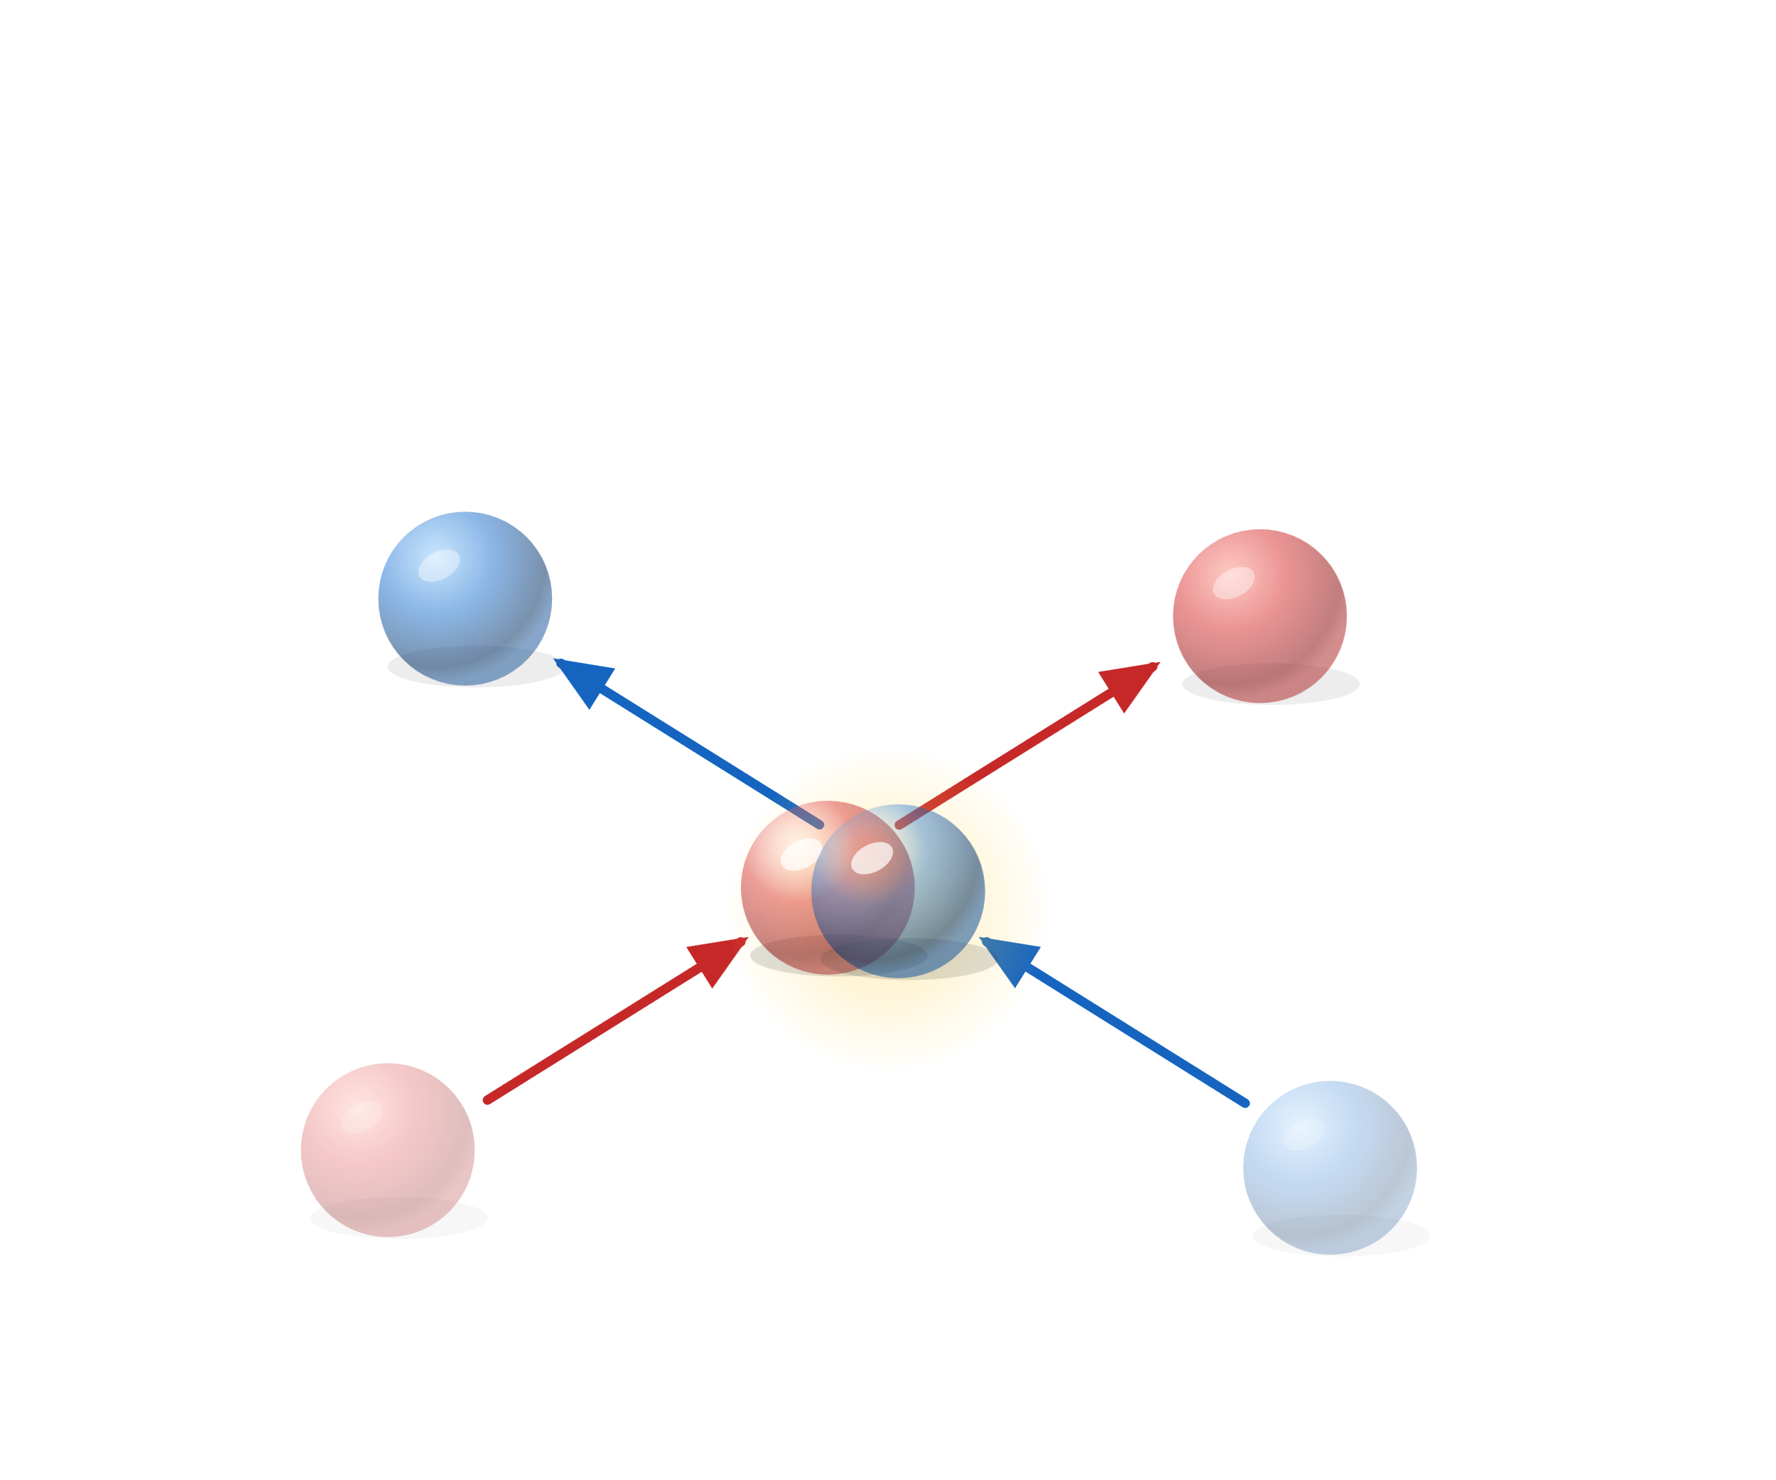
Nonlinear Quantum Optics
Photons as a platform for quantum technologies
Need a possiblity to realize interactions to be useful
Colliding Photons
Photons do not interact

Slide 4
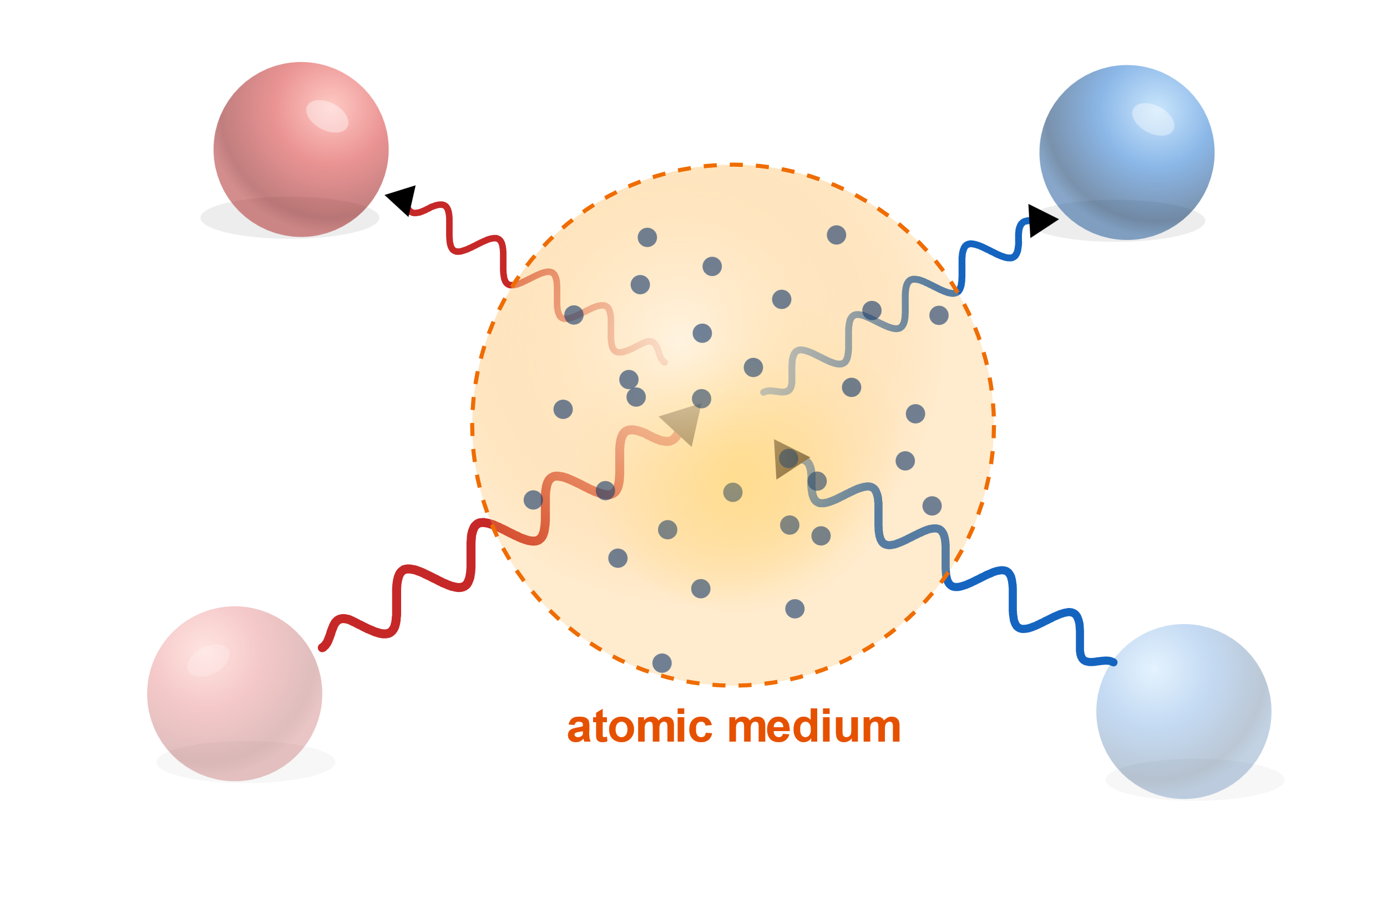
Atoms as interaction mediator
We need a medaitor for the interaction: a material whose polarisability is strongly nonlinear in the applied field, so strong that it changes on the single photon level

Slide 5
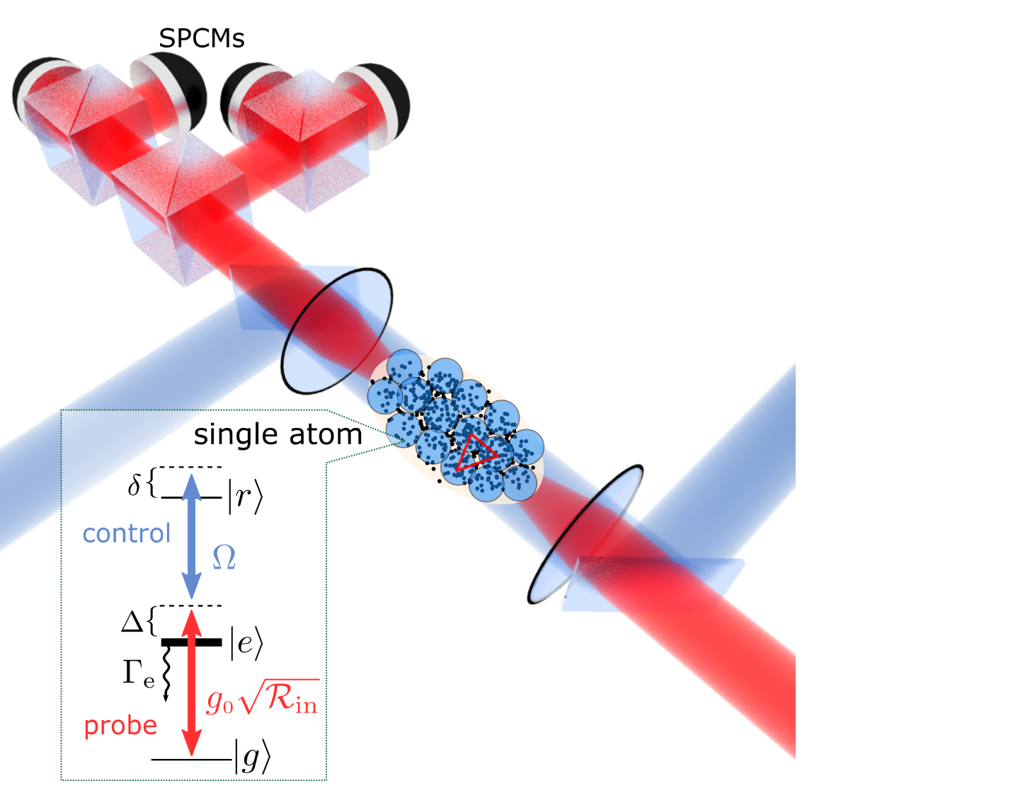


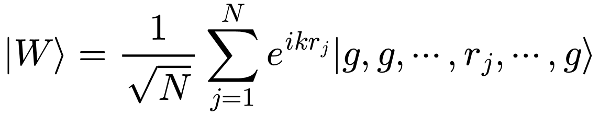


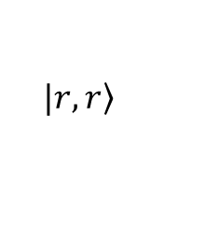
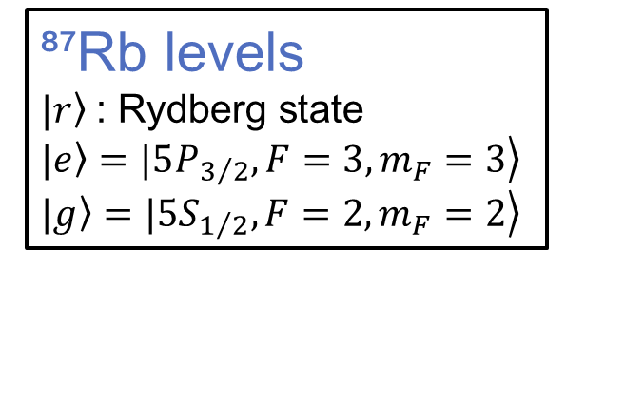
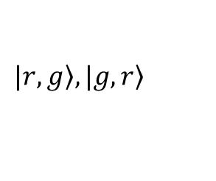
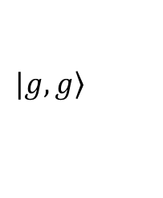
Current experiment scheme
Atom as a mediator/our experiment
Energy
$$V(R)=C6/R6$$
$$|\left.r,r\right\rangle$$
🚫
$$|\left.r,g\right\rangle ,|\left.g,r\right\rangle$$
$$|\left.g,g\right\rangle$$
$$R$$
⁸⁷Rb levels
$\left.|r\right\rangle$ : Rydberg state
$\left.|e\right\rangle =\left.|5P_{3/2},{F=3,m}_{F}=3\right\rangle$
$\left.|g\right\rangle =\left.|5S_{1/2},{F=2,m}_{F}=2\right\rangle$
Limitations

Slide 6
EIT
Photon does not get absorbed
|D⟩ ∝ Ω_c|g⟩ − Ω_p|r⟩

Slide 7
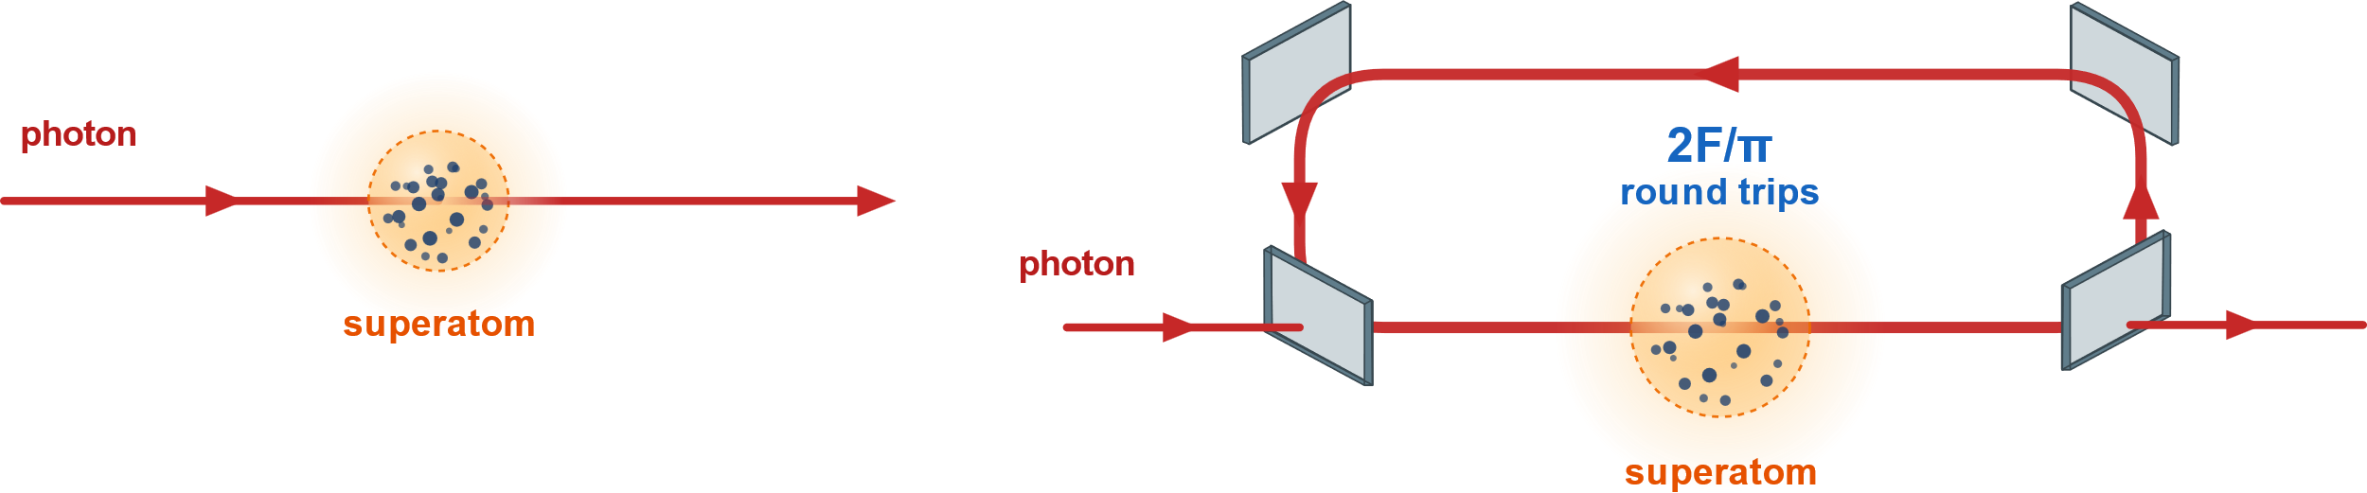
Cavity as an effective OD enhancement

Slide 8
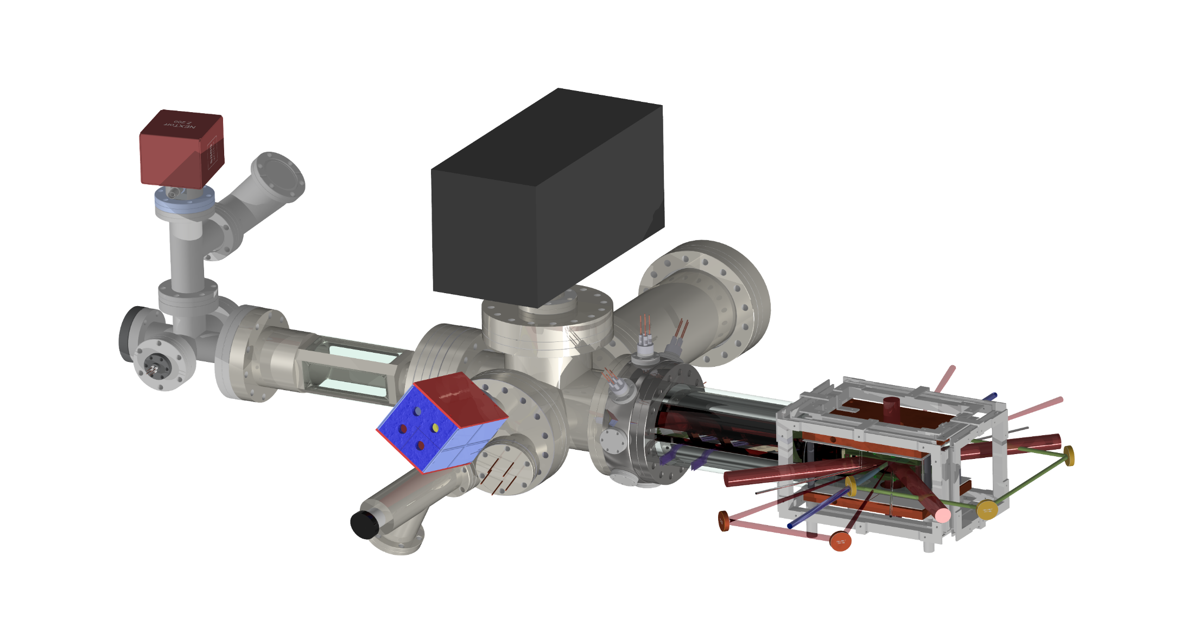
Experiment Upgrade
2D MOT
Chamber
Push beam
Science Chamber/
3D MOT
Rectangular Cavity out of vacuum

Slide 9
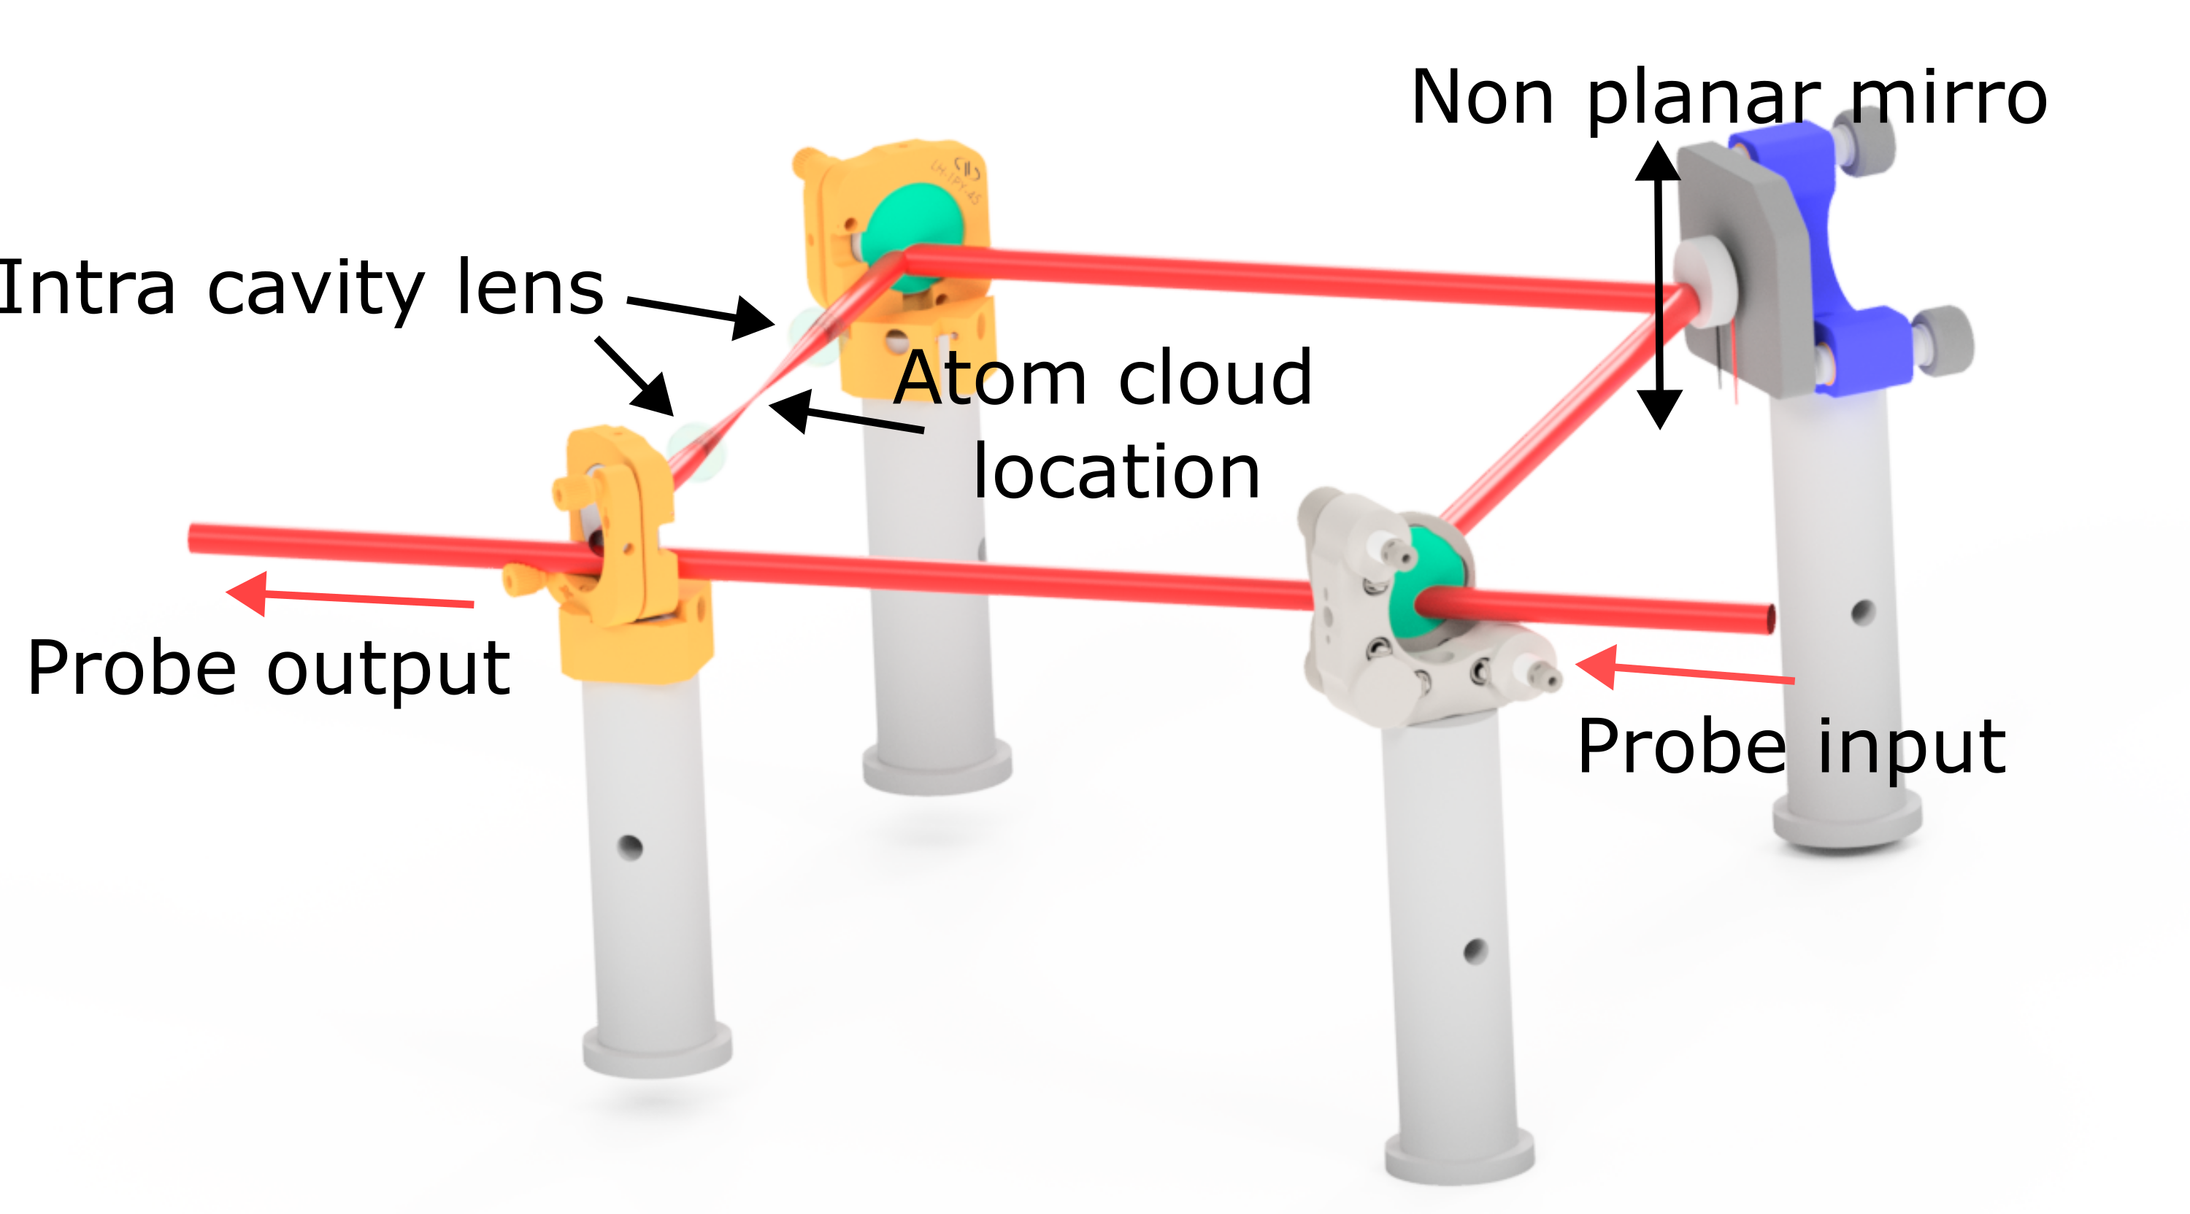

Slide 10
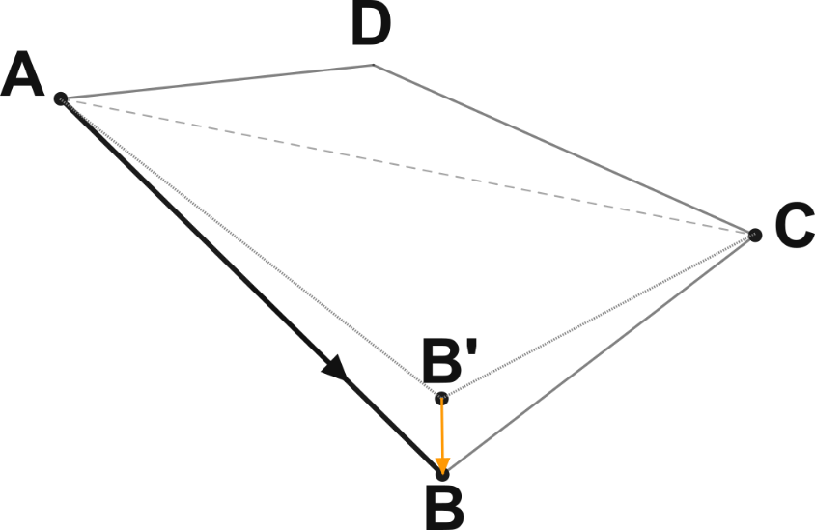
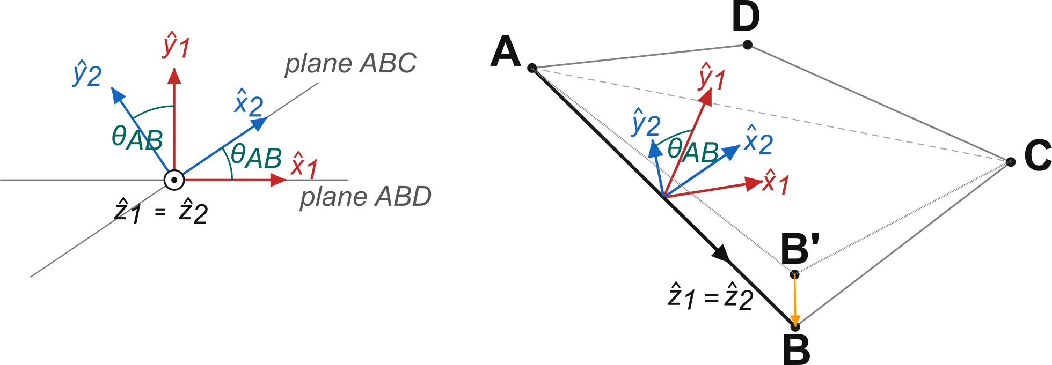
Non-planar ring cavity
Why do we fold the ring out of plane?
Planar ring => linear eigenpolarisations
The transition we want to drive requires sigma+ light
Folding adds a geometric phase => sigma+ is an eigenmode
A planar ring has linear eigenpolarisations, but the transition we drive needs circular light. λ/4 plates in the cavity would provide it at the cost of intracavity loss. Folding the ring out of plane instead adds a Pancharatnam–Berry phase, and the eigenmodes become almost circular polarized.
How does this work?
Coordinate system for reflections:
  y-axis is perpendicular
  x-axis is in the plane of incidence
Next round trip starts in the same coordinate system
  Cant just gauge away the residual rotation
Circular polarization can be decomposed into 2 orthogonal linear polarisations
  Rotation => Global phase
How do we get circular polarization?
The essential addition beyond the calculation for planar systems is the necessity to carry along a coordinate-system with us as we transverse the resonator. We use a coordinate system in which the y axis is perpendicular to the plane of incidence and does not change upon reflection while the x axis is in the plane of incidence.
Coordinate rotation between reflections
While coordinate transformations can be gauged away within a round-trip, we must start the next round-trip in the same coordinate system that we concluded the prior, so the rotation induced by non-planar reflections cannot be gauged away. Only circular polarisation allows us to choose a free angle of the two linear components if we add a global phase.

Slide 11
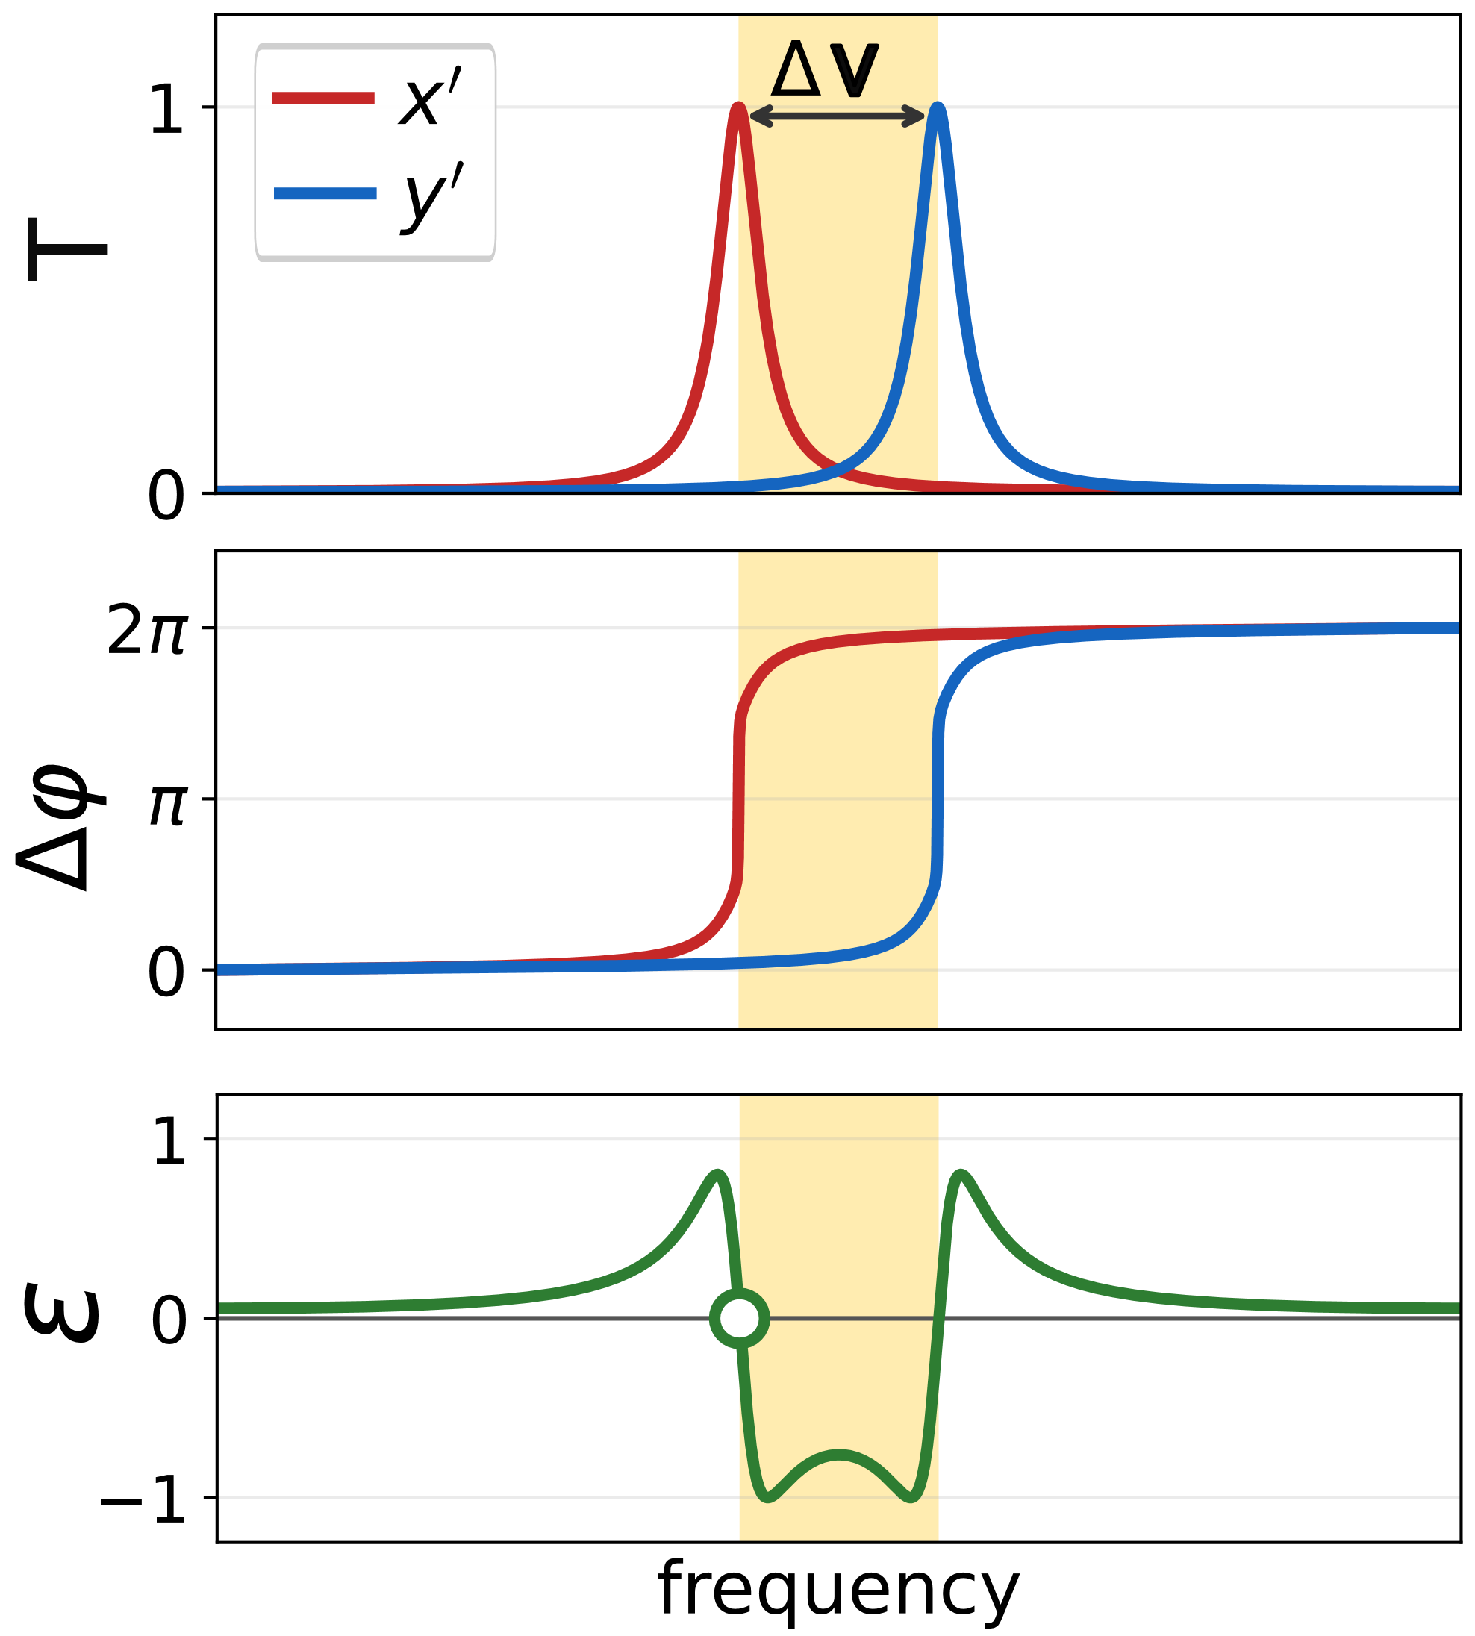
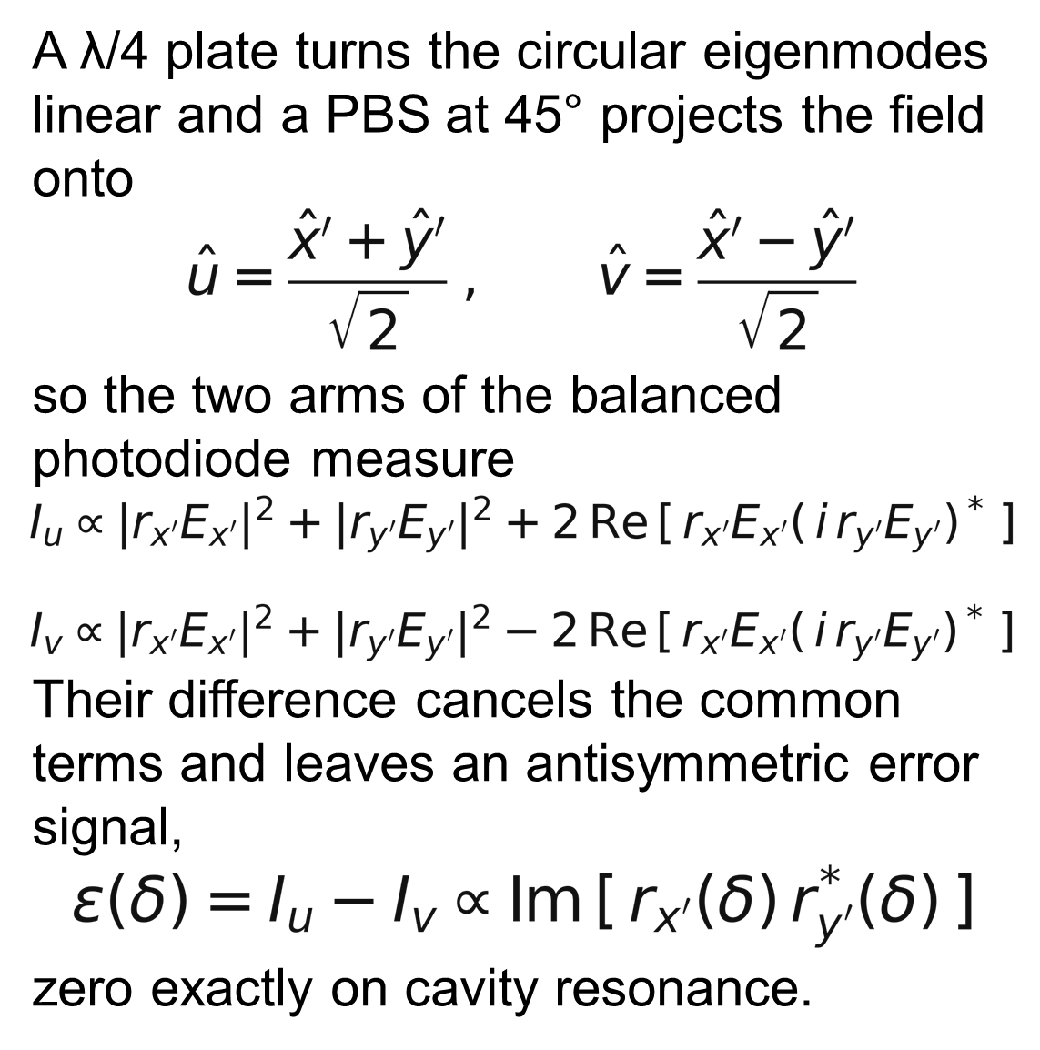
Hänsch–Couillaud lock

Slide 12
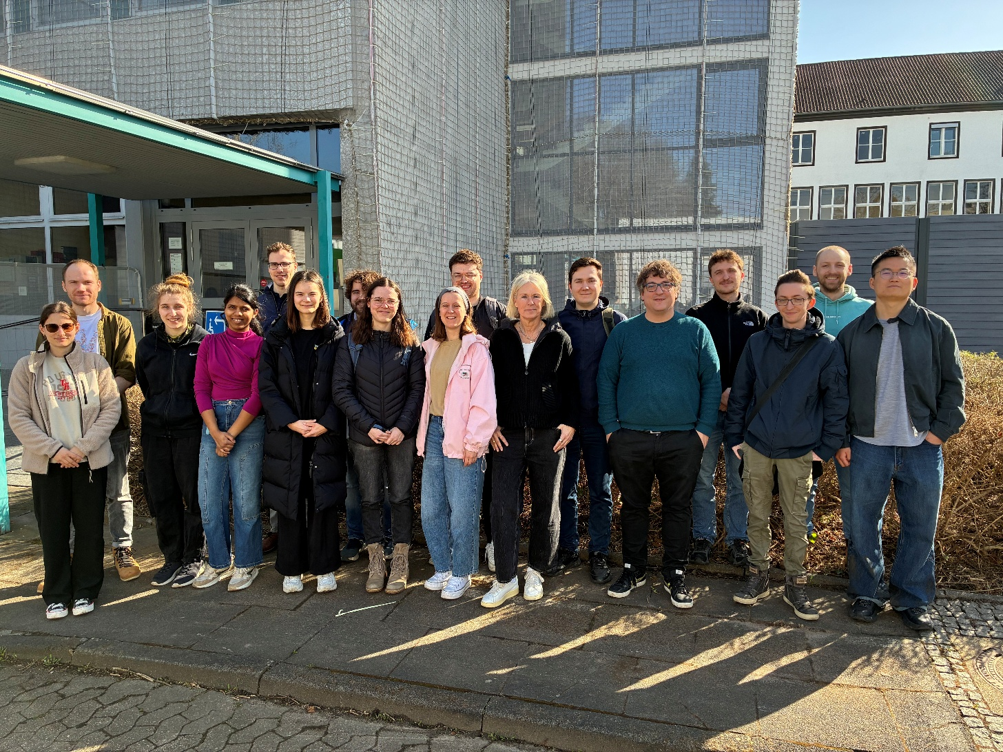
Nonlinear Quantum Optics group
www: nqo.iap.uni-bonn.de

