Slide 1
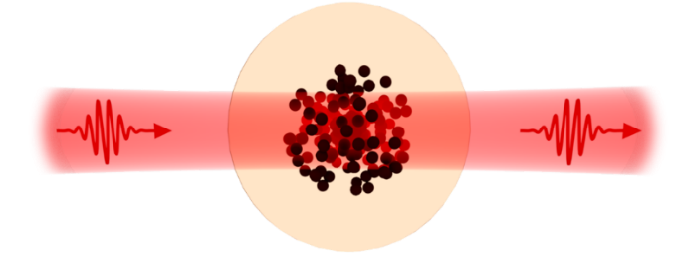

Cavity-Enhanced Rydberg
Nonlinear Optics
Thomas Benedikt Beck
Nonlinear Quantum Optics group
Notes:
Hello, I'm Benedikt from the Nonlinear Quantum Optics group. Today I'll show how we plan to make single photons interact, using Rydberg atoms inside an optical cavity.

Slide 2
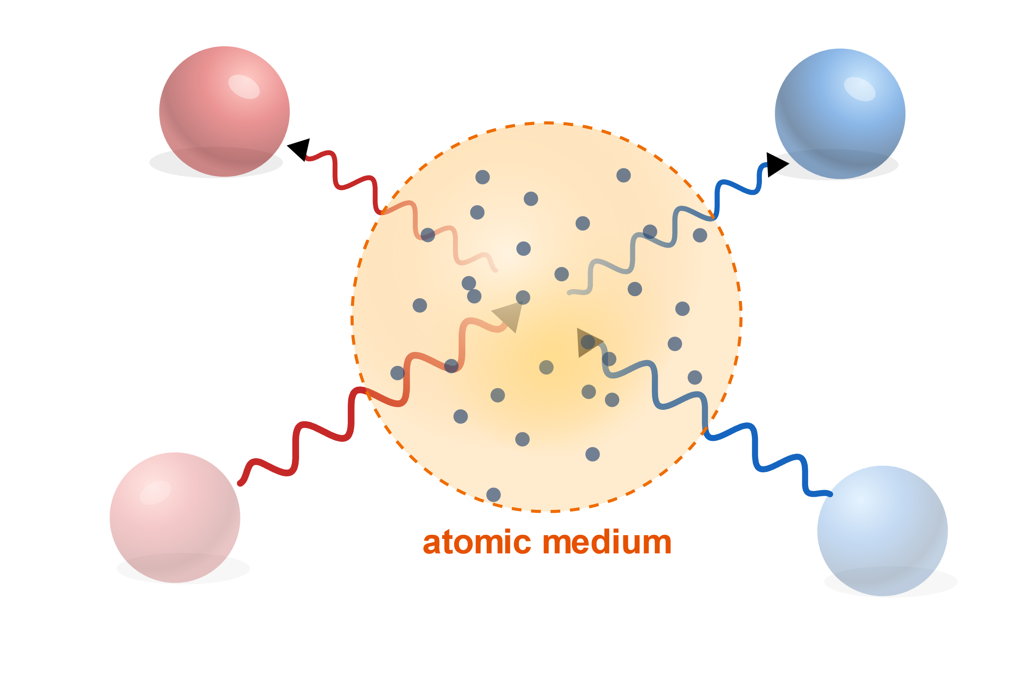
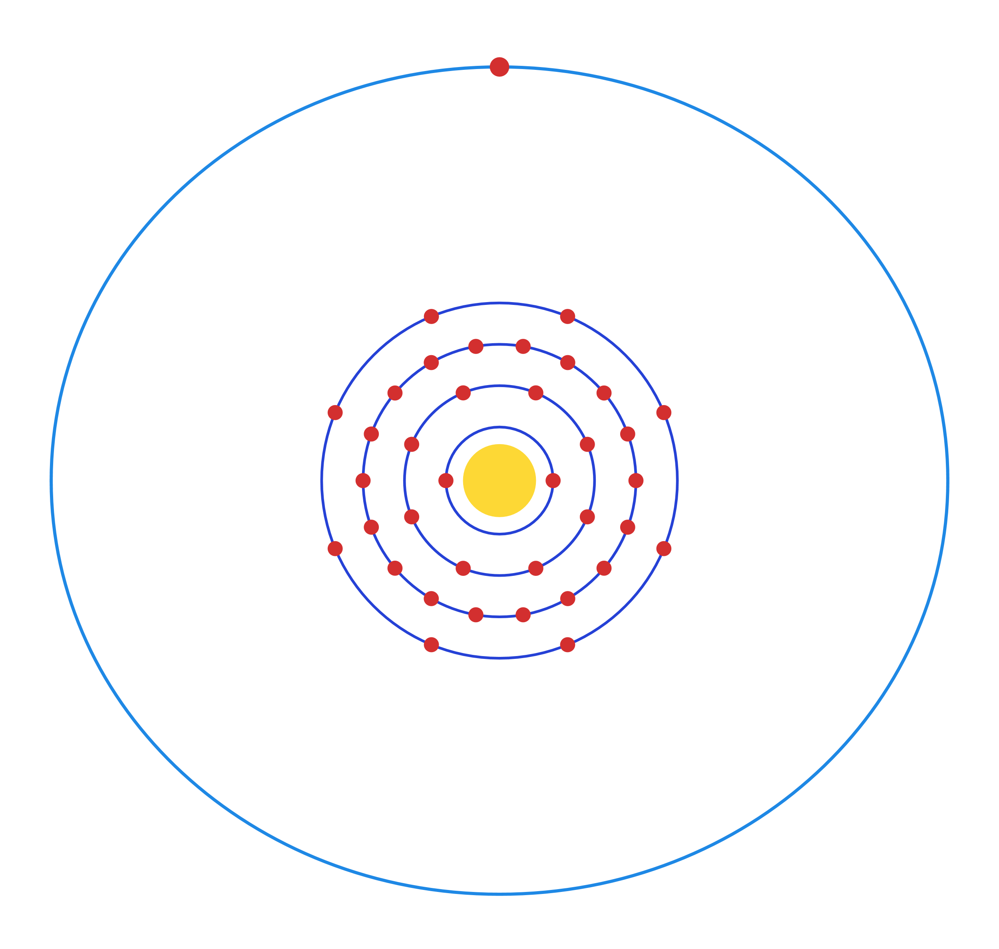
Atoms as interaction mediator
Photons do not interact with each other
We need a mediator: response is strongly nonlinear in the applied field, so strong that it changes at the single-photon level.
Far too weak in ordianary materials for single photons — Rydberg atoms change that
Photons are ideal carriers of (quantum) information
Without interactions there is no photonic quantum logic
Notes:
To make photons interact we need a medium whose response depends nonlinearly on the field - the higher-order terms in this expansion. In atomic vapours the second-order term vanishes by inversion symmetry, so the lowest nonlinearity is chi-3. In any ordinary material it is many orders of magnitude too weak to act on single photons. Rydberg atoms are how we fix that. Here the photons enter the atomic medium, interact through it, and leave on new paths - just like the balls.

Slide 3
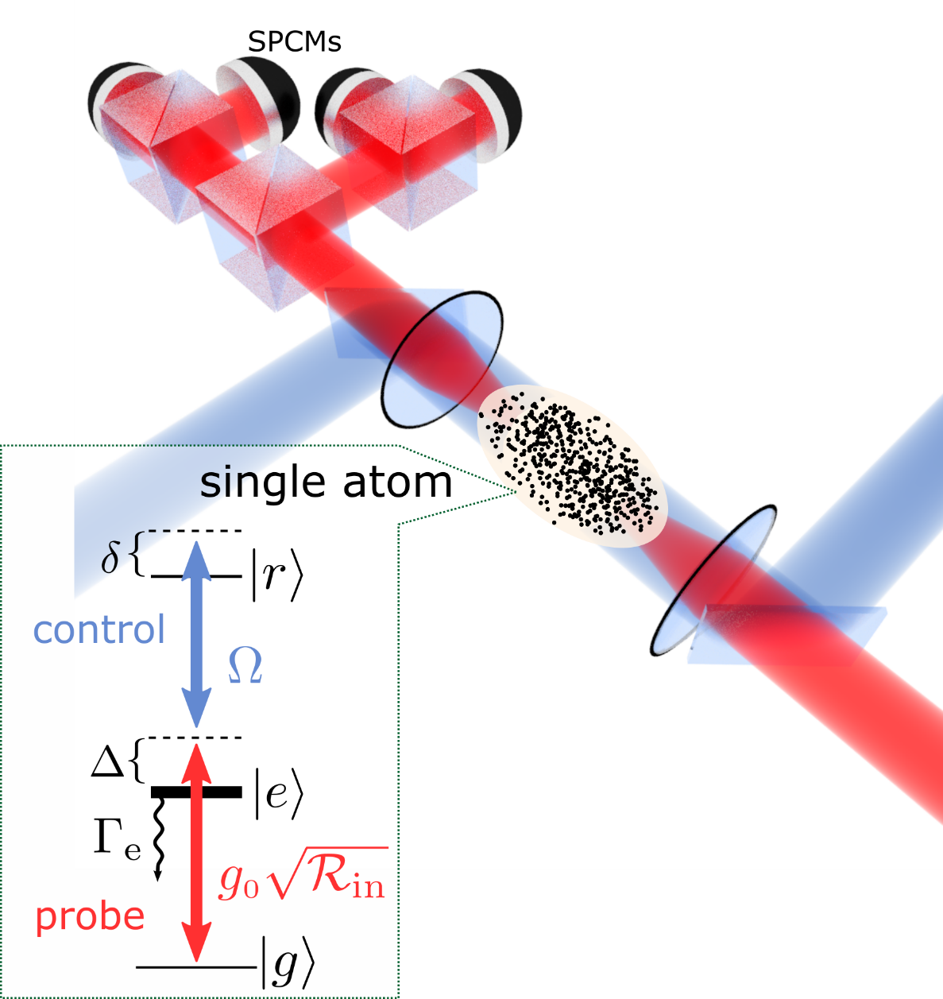


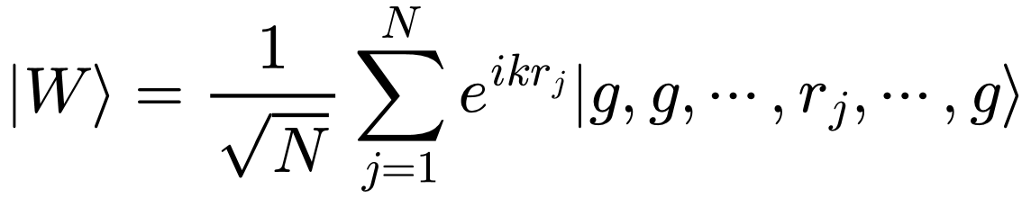

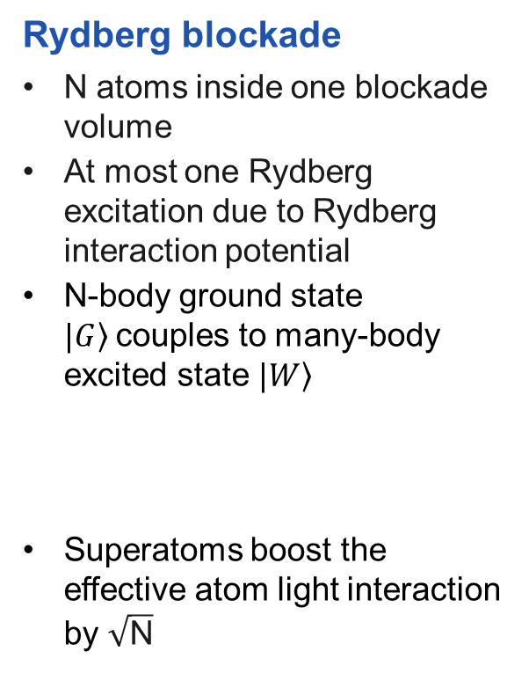

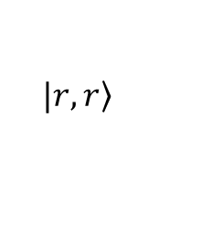
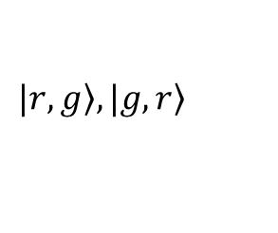
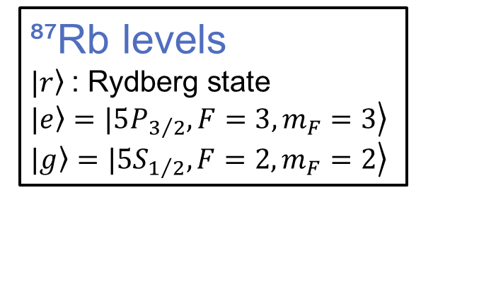
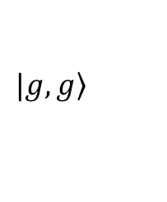
Current free space experiment
Energy
$$V(R)=C6/R6$$
Rydberg blockade
N atoms inside one blockade volume
At most one Rydberg excitation due to Rydberg interaction potential
N-body ground state $\left.|G\right\rangle$couples to many-body excited state $\left.|W\right\rangle$
Superatoms boost the effective atom light interaction by $\sqrt{\text{N}}$
$$|\left.r,r\right\rangle$$
🚫
$$|\left.r,g\right\rangle ,|\left.g,r\right\rangle$$
$$|\left.g,g\right\rangle$$
$$R$$
⁸⁷Rb levels
$\left.|r\right\rangle$ : Rydberg state
$\left.|e\right\rangle =\left.|5P_{3/2},{F=3,m}_{F}=3\right\rangle$
$\left.|g\right\rangle =\left.|5S_{1/2},{F=2,m}_{F}=2\right\rangle$
Notes:
Here is our current free-space experiment. A small cloud of rubidium atoms is focused so tightly that it fits inside a single blockade volume. Because only one Rydberg excitation fits in there, the whole cloud acts as one superatom: the excitation is shared as the collective W state, which couples to light square-root-of-N times more strongly than a single atom. Single photons are detected on the SPCMs. The limitation is the coupling itself: it is set by the optical depth, and if we try to raise it with a denser cloud, we run into dephasing and Rydberg molecule formation.

Slide 4
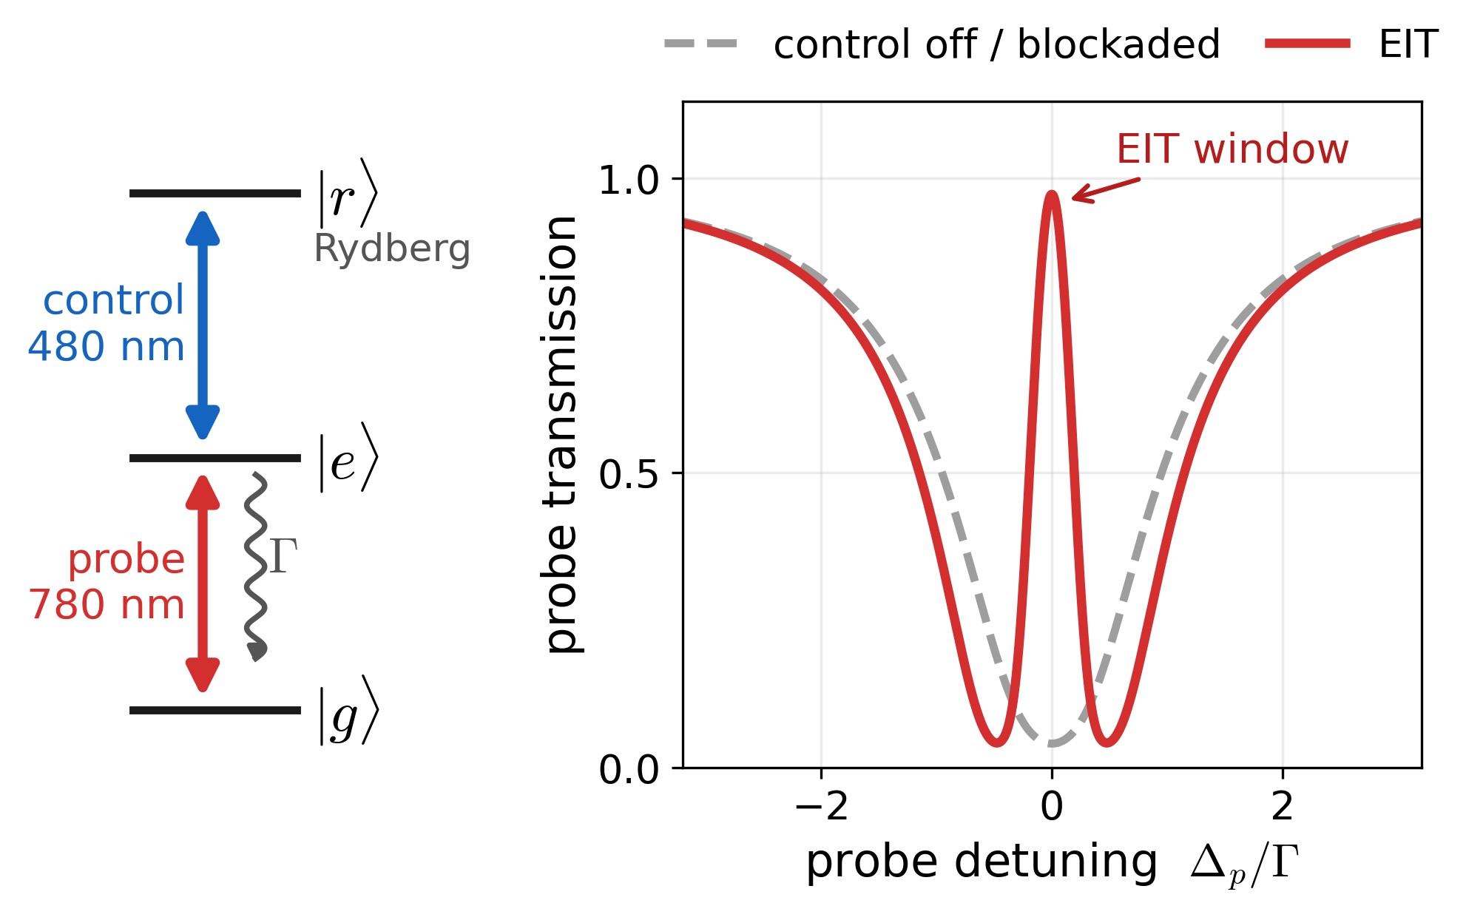
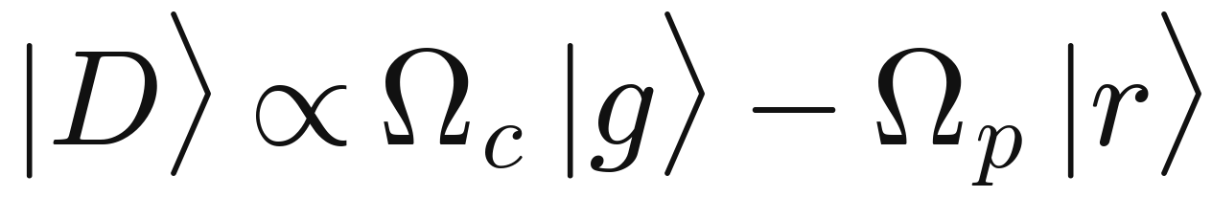

Electromagnetically Induced Transparency (EIT)
$$∆_{c}=0$$
3 level system introduces a dark state
(dissipative regime)
The photon travels as a dark-state polariton — part photon, part Rydberg excitation
Photons can gain Rydberg properties without beeing absorbed
Blockade effect: a second photon does not experience EIT effect and that photon is scattered
→ single photon transmission depends on the total photon number input
Notes:
How does a photon talk to a Rydberg atom? We use a ladder: the probe at 780 nm drives ground to excited state, and the control at 480 nm couples the excited state to a Rydberg state. With the control on, the two excitation paths interfere destructively and a narrow transparency window opens - the red curve. The atoms sit in a dark state with no excited-state component, so nothing is scattered, and the photon propagates as a dark-state polariton: part photon, part Rydberg excitation. Now the key point: if a second photon arrives within the blockade radius, its Rydberg level is shifted by the van der Waals interaction, EIT breaks, and that photon sees the grey two-level curve and is scattered. So the transmission depends on how many photons there are - that is our single-photon nonlinearity.

Slide 5
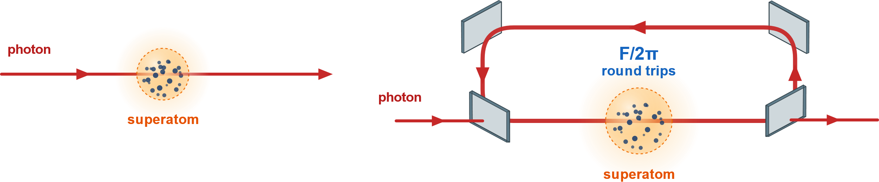
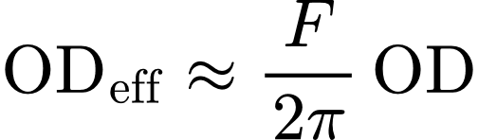
Cavity as an effective OD enhancement
Limitations
Limited single photon capabilities
Atom-light interaction strength is set by optical depth of the cloud
Increasing it by raising the density adds collisional dephasing and Rydberg molecule formation.
Free space
The photon crosses the cloud once
Ring cavity
The photon makes about F/2π round trips through the same atoms.
Notes:
Instead of adding more atoms, we send the photon through the same atoms many times. In free space the photon crosses the cloud once and the coupling is fixed by the optical depth. In a ring cavity of finesse F, the photon makes roughly 2F over pi round trips, so the effective optical depth grows by that factor - without raising the density. The aim is a collective coupling larger than both the cavity decay rate and the atomic linewidth, which is the strong coupling regime.

Slide 6
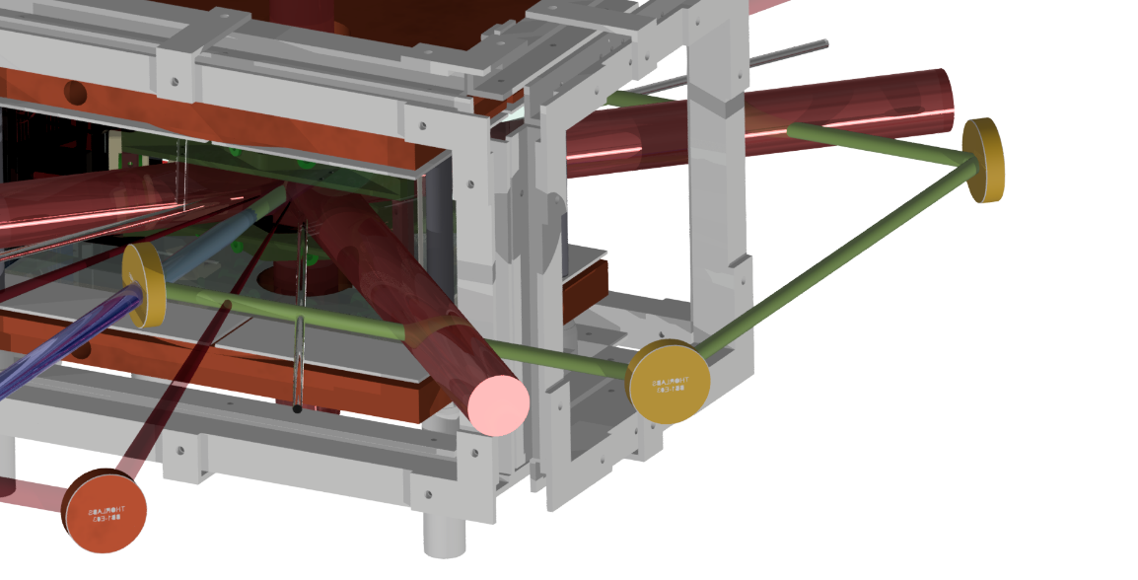

Experiment Upgrade
Science Chamber
Rectangular cavity (out of vacuum)
Probe beam
Notes:
This is the upgraded apparatus. A 2D MOT, loaded with the help of a push beam, delivers a cold atomic beam into the science chamber, where the 3D MOT sits. The rectangular ring cavity is built around the glass cell, outside the vacuum, which keeps the optics accessible for alignment.

Slide 7
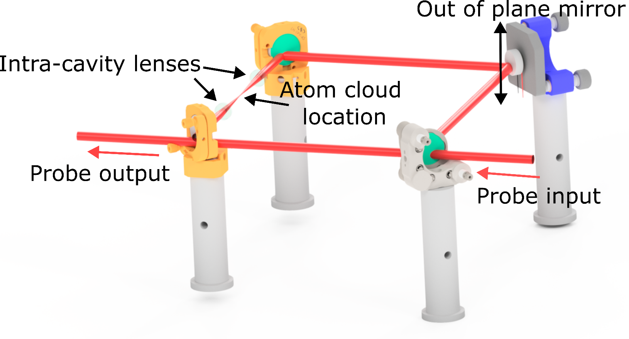
Ring cavity design
Four custom mirrors
Two intra-cavity lenses
Piezo-actuated mount and a linear piezo
One mirror raised out of plane: a non-planar ring
Notes:
Zooming in on the cavity. It is a four-mirror ring built from custom Laseroptik mirrors. Two intra-cavity lenses focus the mode down onto the atom cloud. One mirror is raised out of the plane of the other three, which makes the ring non-planar - I'll explain why on the next slide. One mount is piezo-actuated for fine alignment, and a linear piezo stabilises the length.

Slide 8
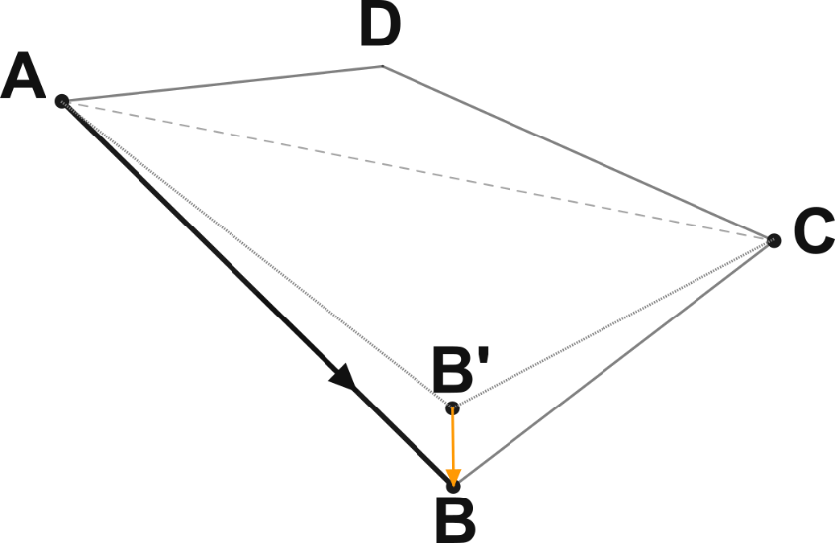
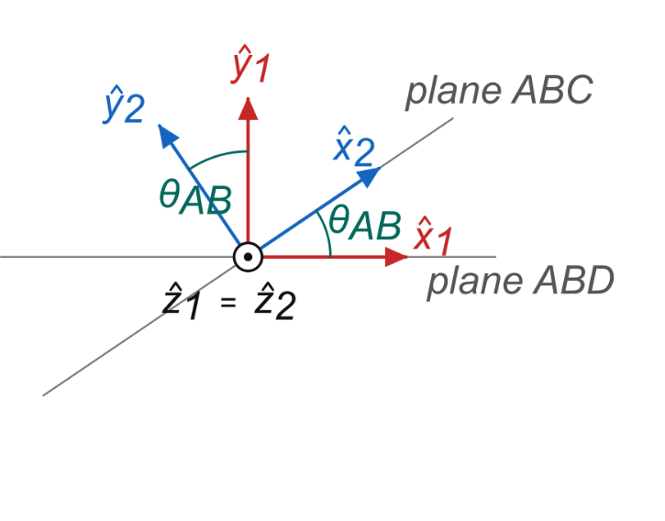
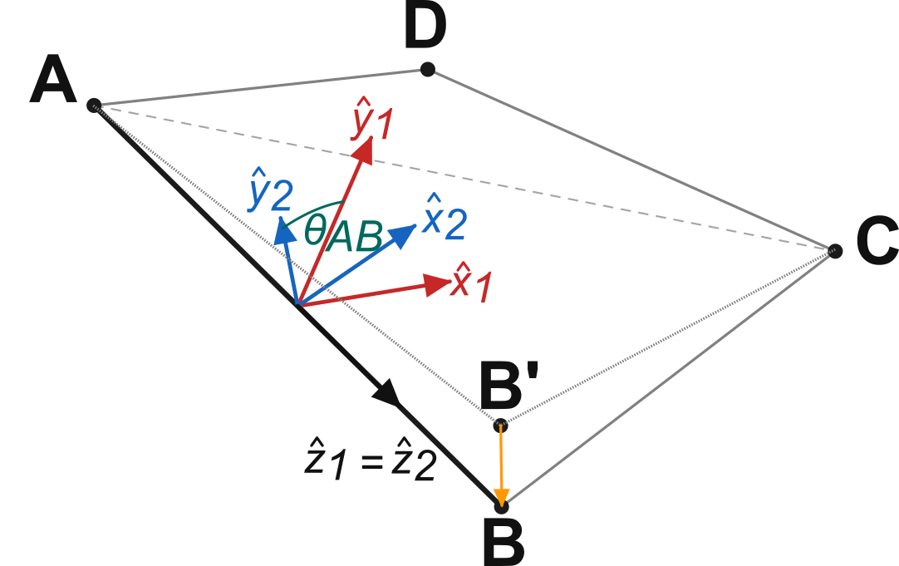
Non-planar ring cavity
Why fold the ring out of plane?
A planar ring has linear eigenpolarisations
The transition we drive needs σ⁺ light
Folding adds a geometric phase → σ⁺ becomes an eigenmode
How does this work?
Carry a coordinate frame around the ring:
y normal to the plane of incidence, x in it
The plane of incidence turns from mirror to mirror, so a rotation R(θ_{i}) links successive frames
The next round trip starts in the same frame:
the residual rotation cannot be gauged away
Circular light => two orthogonal linear components. Adding a global phase rotates the axis
Notes:
Why is the ring non-planar? A planar ring has linear polarisation eigenmodes, but the transition we drive needs circular, sigma-plus light. Lambda-quarter plates in the cavity would provide it, at the cost of intracavity loss. Folding the ring out of plane instead adds a Pancharatnam-Berry phase, and the eigenmodes become almost circularly polarised.
How do we see this? Beyond the planar calculation, we have to carry a coordinate system with us as we traverse the resonator. We choose y perpendicular to the plane of incidence - it does not change on reflection - and x in the plane of incidence. Top right: raising mirror B to B-prime tilts the planes of incidence. Bottom: along a leg the two frames are rotated by theta.
Coordinate transformations can be gauged away within one round trip, but the next round trip must start in the frame the previous one ended in, so the rotation from non-planar reflections cannot be gauged away. Only for circular polarisation is the angle between the two linear components free, so the rotation reduces to a global phase.

Slide 9
Summary & Outlook
Summary
Rydberg atoms can create single-photon nonlinearities
Free-space coupling is limited by the optical depth
A ring cavity enhances it by F/2π
Non-planar cavity creates σ^{+/-} eigenmodes
Outlook
Build and characterise the non-planar ring cavity
Integrate the cavity into the current experiment
Notes:
To summarise: photons do not interact on their own, but Rydberg atoms can mediate a nonlinearity at the single-photon level, via EIT and Rydberg blockade. In free space that coupling is capped by the optical depth, so we place the atoms in a ring cavity, which multiplies the effective optical depth by 2F over pi. The ring is non-planar so that sigma-plus light is an eigenmode, and we stabilise it with a modulation-free Haensch-Couillaud lock. Next we build and characterise the cavity, commission the 2D MOT, and aim for collective strong coupling.

Slide 10
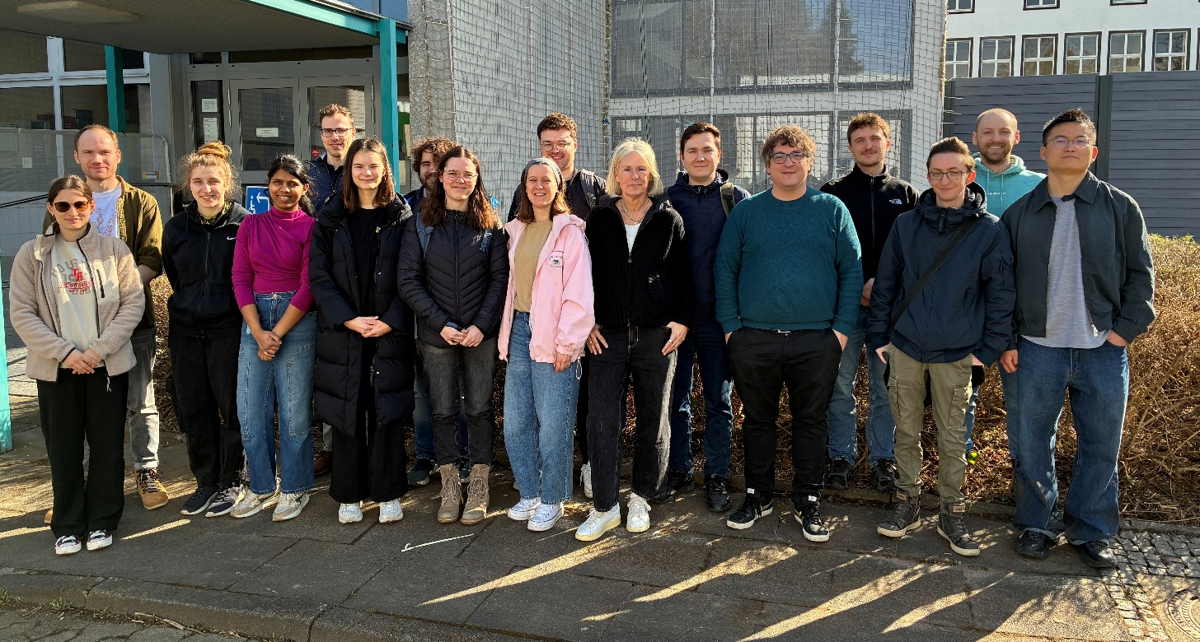
Nonlinear Quantum Optics group
www: nqo.iap.uni-bonn.de
Notes:
Thanks to everyone in the Nonlinear Quantum Optics group. I'm happy to take questions.

Slide 11
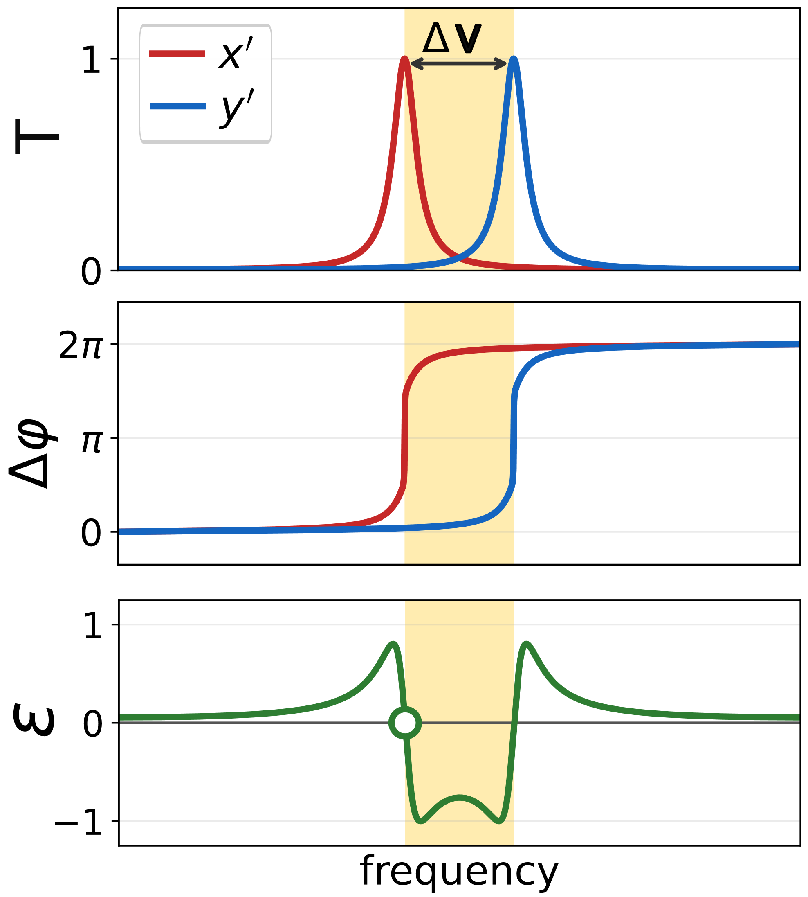
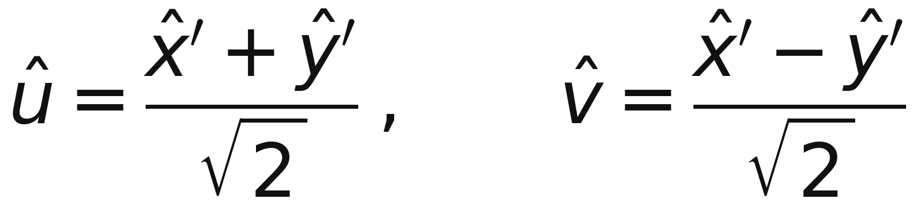
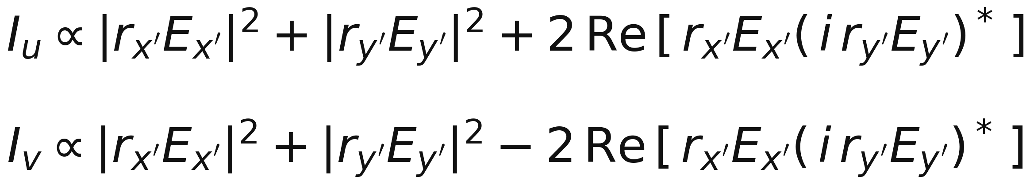
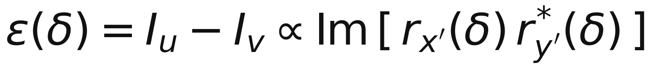
Hänsch–Couillaud lock
A λ/4 plate turns the circular eigenmodes linear and a PBS at 45° projects the field onto
so the two arms of the balanced photodiode measure
Their difference cancels the common terms and leaves an antisymmetric error signal,
zero exactly on cavity resonance.[2]
No modulation; intensity noise cancels in the balanced detector.
Notes:
To keep the cavity on resonance we use a Haensch-Couillaud lock. Because the cavity is polarisation non-degenerate, the two eigenmodes resonate at different frequencies - top panel. Near one resonance that mode's phase sweeps rapidly while the other stays flat and acts as a fixed reference - middle panel. A quarter-wave plate and a PBS at 45 degrees turn this relative phase into an intensity difference on a balanced photodiode, giving an antisymmetric error signal that crosses zero exactly on resonance - bottom panel. Unlike Pound-Drever-Hall we need no modulation, and laser intensity noise cancels in the balanced detection. We lock with light at 787 nm, chosen so the lock does not disturb the Rydberg atoms.

Slide 12
Non-planar ring cavity
Why fold the ring out of plane?
A planar ring has linear eigenpolarisations
The transition we drive needs σ⁺ light
Folding adds a geometric phase → σ⁺ becomes an eigenmode
How does this work?
Carry a coordinate frame around the ring:
y normal to the plane of incidence, x in it
The plane of incidence turns from mirror to mirror, so a rotation R(θ_{i}) links successive frames
The next round trip starts in the same frame:
the residual rotation cannot be gauged away
Circular light = two linear components, so the rotation is only a global phase
Notes:
Why is the ring non-planar? A planar ring has linear polarisation eigenmodes, but the transition we drive needs circular, sigma-plus light. Lambda-quarter plates in the cavity would provide it, at the cost of intracavity loss. Folding the ring out of plane instead adds a Pancharatnam-Berry phase, and the eigenmodes become almost circularly polarised.
How do we see this? Beyond the planar calculation, we have to carry a coordinate system with us as we traverse the resonator. We choose y perpendicular to the plane of incidence - it does not change on reflection - and x in the plane of incidence. Top right: raising mirror B to B-prime tilts the planes of incidence. Bottom: along a leg the two frames are rotated by theta.
Coordinate transformations can be gauged away within one round trip, but the next round trip must start in the frame the previous one ended in, so the rotation from non-planar reflections cannot be gauged away. Only for circular polarisation is the angle between the two linear components free, so the rotation reduces to a global phase.

Slide 13
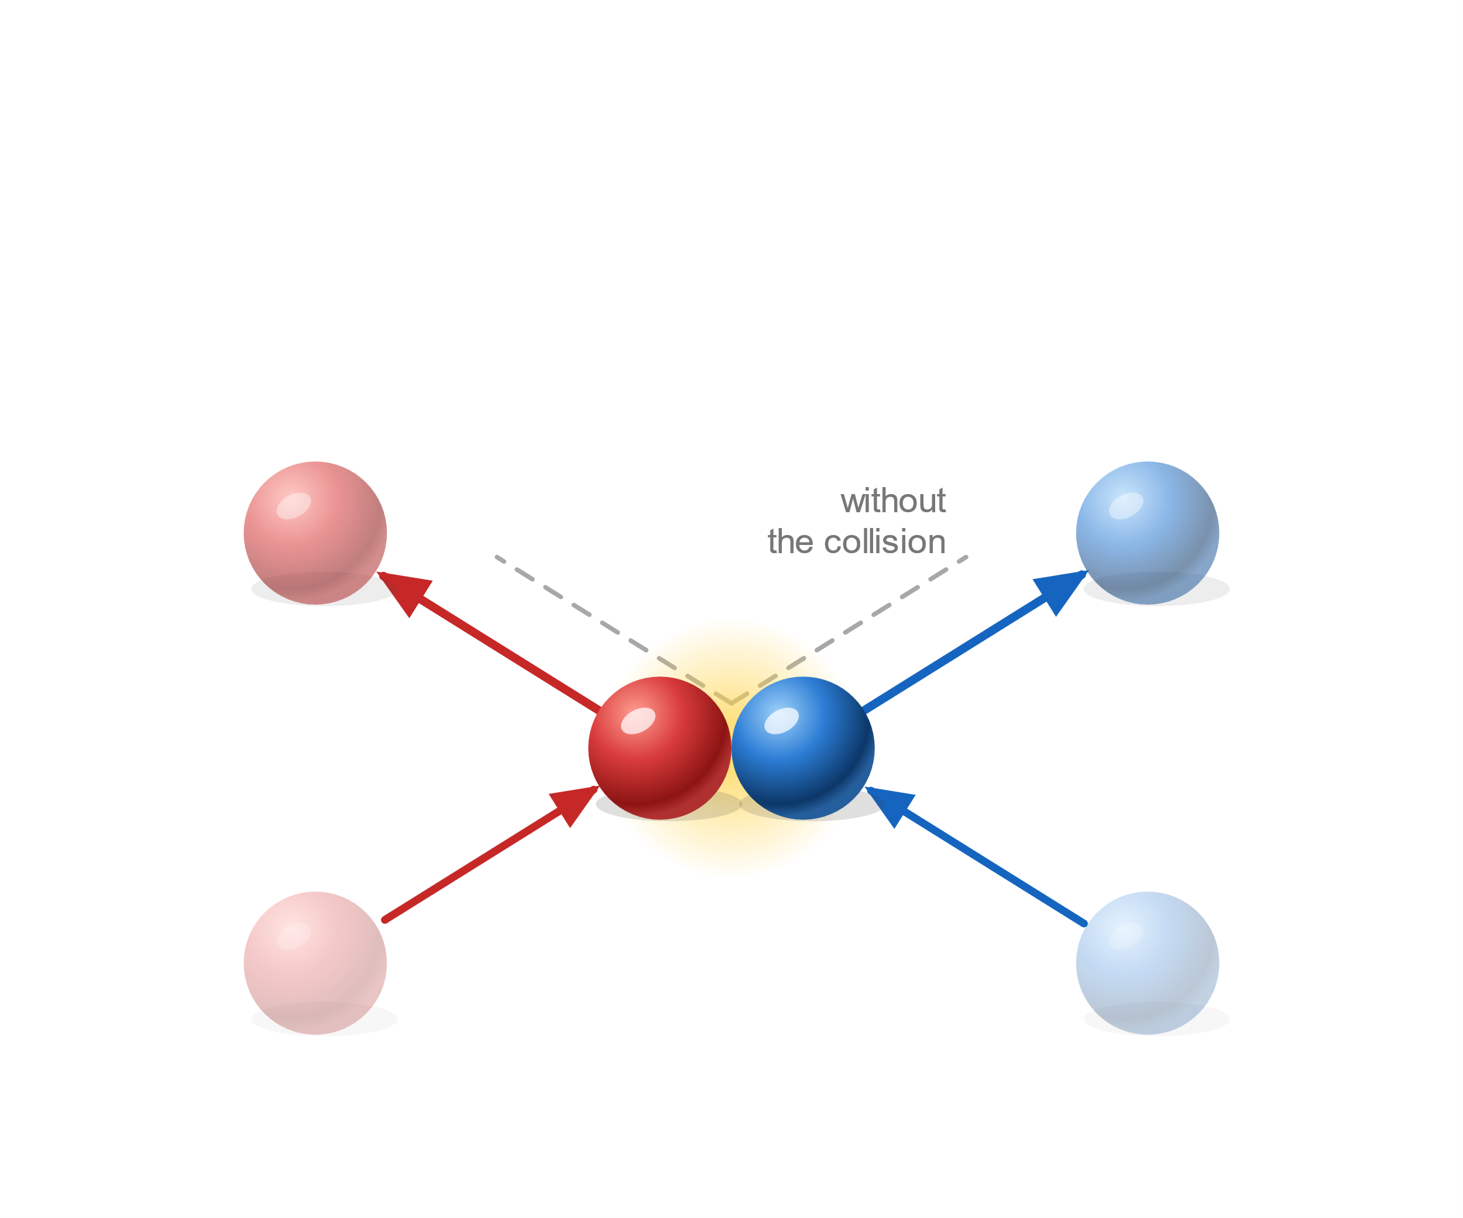
Nonlinear Quantum Optics
Colliding billiard balls
They interact:
each ball leaves on a new path.
Notes:
Let's start with a thought experiment. Two billiard balls roll towards each other and collide. They interact: momentum is exchanged and each ball leaves on a new path. The dashed lines show where each would have gone without the collision - keep those in mind for the next slide.

Slide 14
8Overview
Current free space experiment
Future cavity upgrade

Slide 15
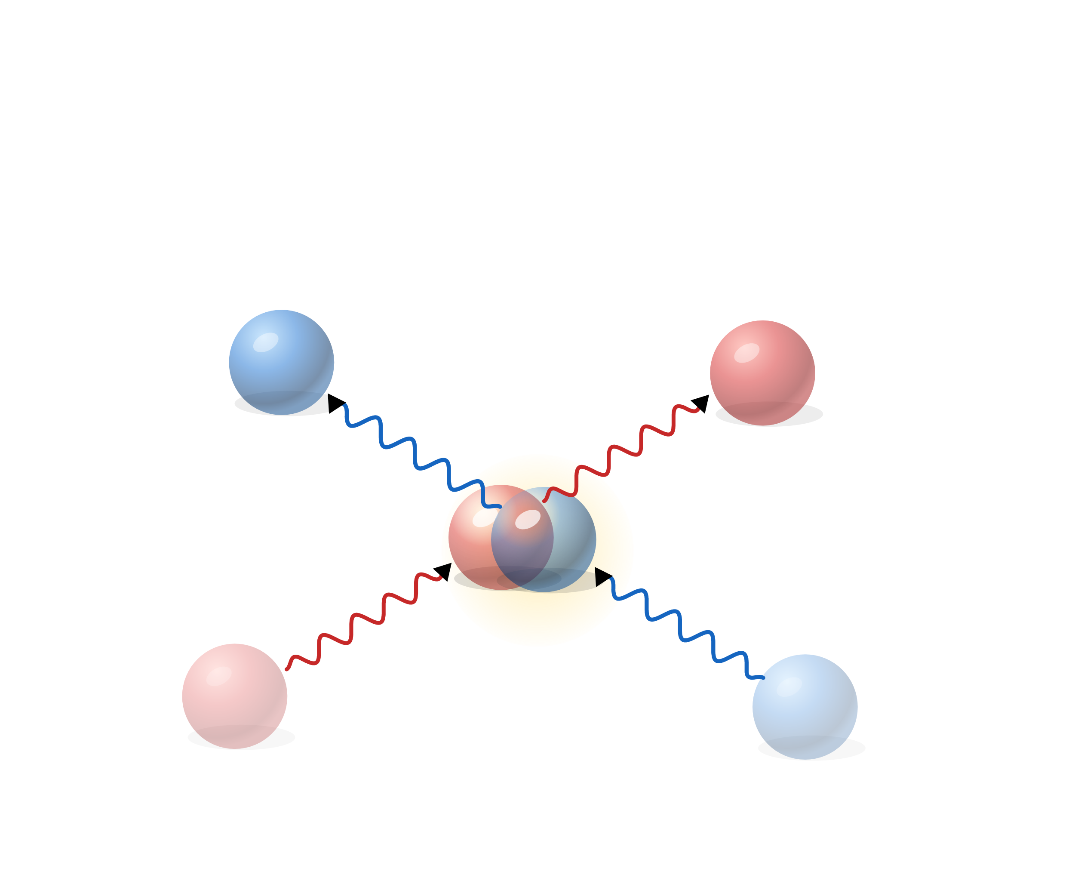
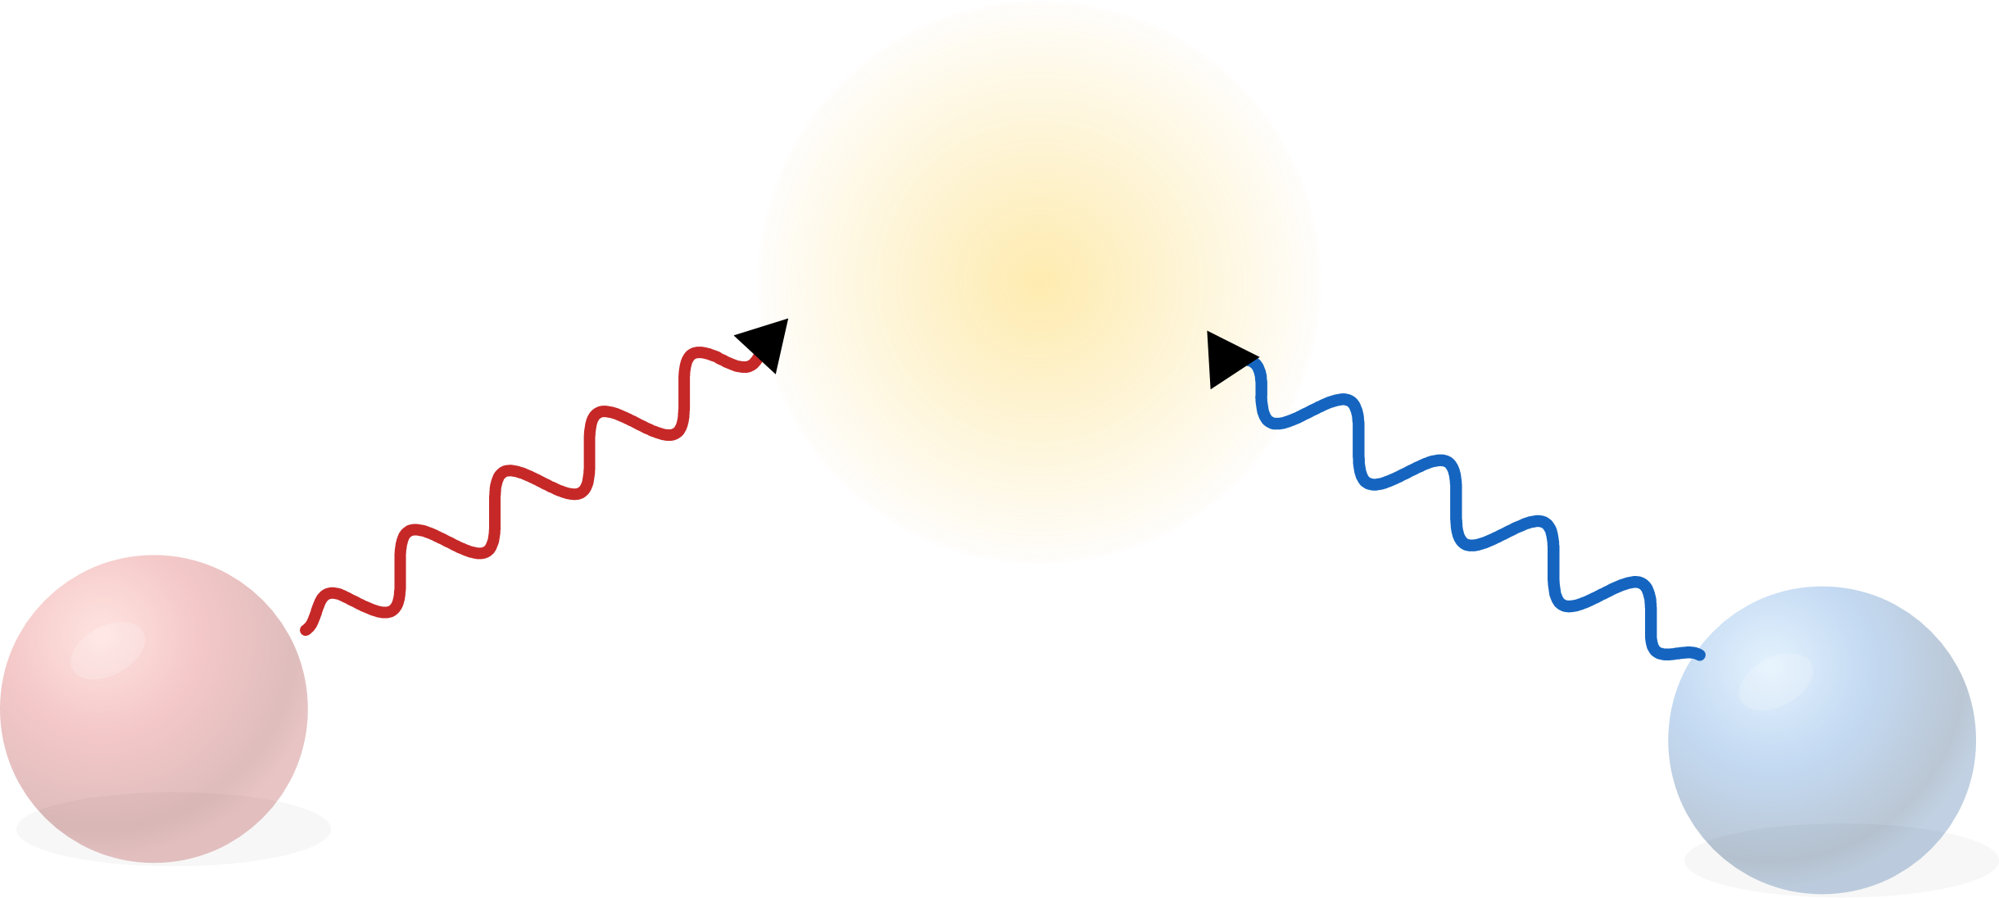
Thought experiment
"Colliding" photons
Notes:
Now replace the balls with photons, sent along exactly the same incoming paths. Nothing happens: they follow the dashed lines from before and pass straight through each other. That makes photons excellent carriers of quantum information - fast, and barely disturbed by their environment - but the same property means we cannot build photonic quantum logic unless something mediates an interaction.

