Slide 1

Non-hydrostatic effects on the steep continental slope
Alexey Androsov, Naum Voltzinger, Vera Fofonova and Ivan Kuznetsov
28-31 Januar 2020, Hamburg, Germany

Slide 2
Motivation
Numerical models have become an key tool for ocean and coastal flow modeling. Such models typically use the hydrostatic approximation based on the argument that their horizontal length scales are longer than the vertical length scales. Many of physical processes in oceans and coastal zones are adequately modeled with the hydrostatic approximation, but there are phenomena when vertical acceleration is proportional with horizontal, and sometimes and exceeding it and then accounting of non-hydrostatic pressure is necessary.
Interaction barotropic tides with baroclinic waves on sharp topography.
Upwelling of cold water from subsurface
Sinking of surface water
Cascading processes
…
Notes:
Finite volume
Fine resolution, hydrostatic, finite volume

Slide 3
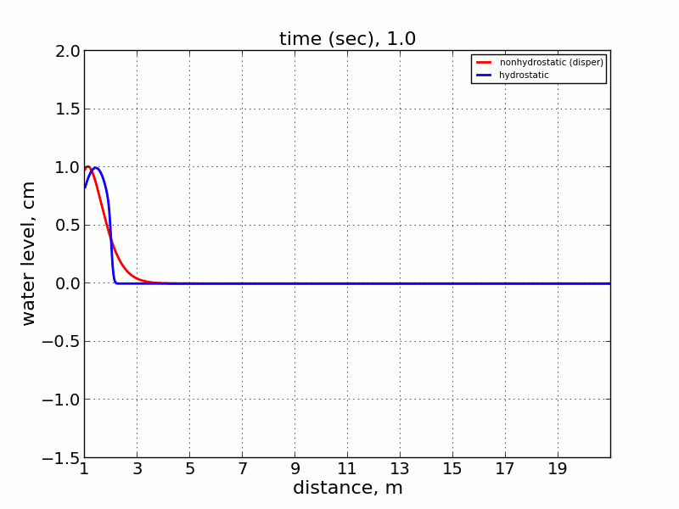
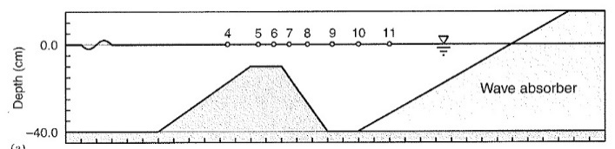
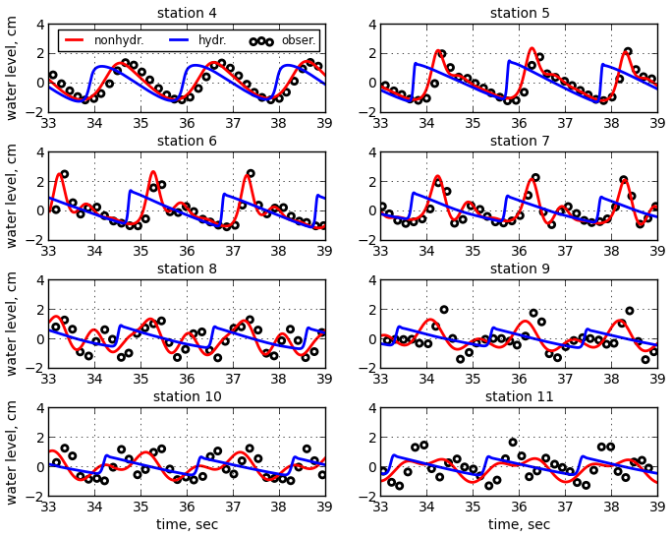
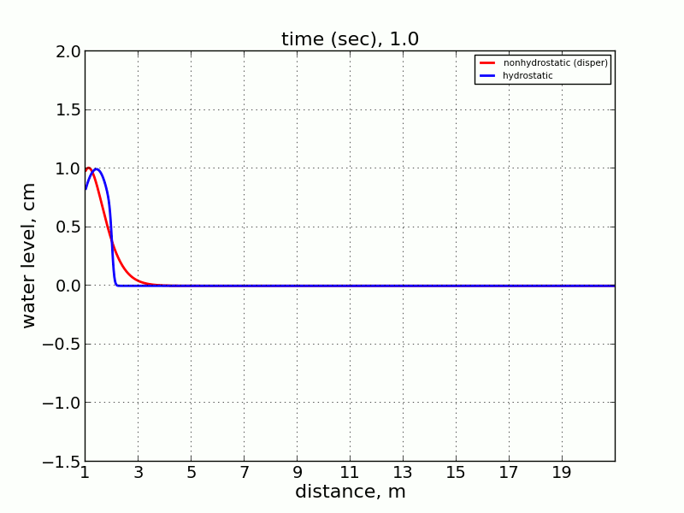
Hydrostatic & Non-hydrostatic
6
12
17
distance, m
Red line – non-hydrostatic;blue line - hydrostatic; circles - observations.
Notes:
Finite volume
Fine resolution, hydrostatic, finite volume

Slide 4
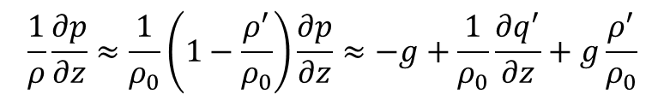



Poisson Equation (PE)
$$p=p_{0}+q^{′},$$
and
$$ρ=ρ_{0}\left(z\right)+ρ^{′}(x,y,z,t)$$
$$\frac{1}{ρ}\frac{∂p}{∂z}≈\frac{1}{ρ_{0}}\left(1−\frac{ρ^{′}}{ρ_{0}}\right)\frac{∂p}{∂z}≈−g+\frac{1}{ρ_{0}}\frac{∂q^{′}}{∂z}+g\frac{ρ^{′}}{ρ_{0}}$$
Predictor
Corrector
$divU^{k+1}=0$, $U=\left(U,V,\hat{W}\right)$
$${\left(Jg^{ij}q_{ξ^{i}}^{k+1}\right)}_{ξ^{i}}=\frac{ρ_{0}}{τ}\left[{\left(JU^{∗}\right)}_{ξ}+{\left(JV^{∗}\right)}_{η}+{\left(J{\tilde{W}}^{∗}\right)}_{σ}\right]$$
Notes:
Finite volume
Fine resolution, hydrostatic, finite volume

Slide 5
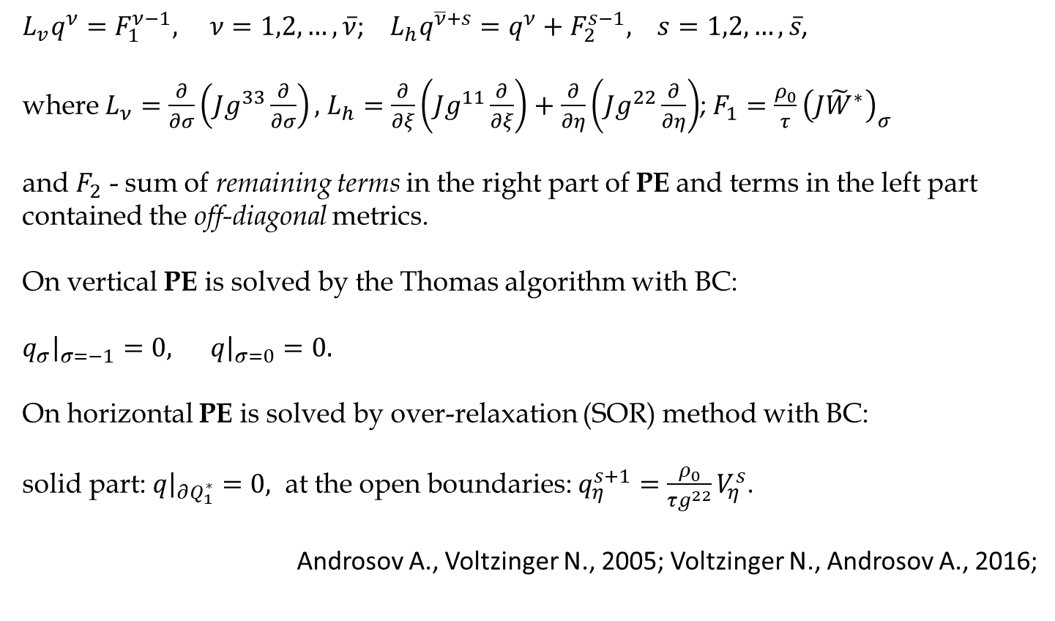
Numerical realization of the non-hydrostatic problem
PE for the Beltrami-Laplace operator is solved iteratively with a change of direction at each iterative step and realized in form:
$L_{v}q^{ν}=F_{1}^{ν−1}, ν=1,2,…,\overline{ν}$; $L_{h}q^{\overline{ν}+s}=q^{ν}+F_{2}^{s−1}, s=1,2,…,\overline{s}$,
where $L_{ν}=\frac{∂}{∂σ}\left(Jg^{33}\frac{∂}{∂σ}\right),$ $L_{h}=\frac{∂}{∂ξ}\left(Jg^{11}\frac{∂}{∂ξ}\right)+\frac{∂}{∂η}\left(Jg^{22}\frac{∂}{∂η}\right)$; $F_{1}=\frac{ρ_{0}}{τ}{\left(J{\tilde{W}}^{∗}\right)}_{σ}$
and $F_{2}$ - sum of remaining terms in the right part of PE and terms in the left part contained the off-diagonal metrics.
On vertical PE is solved by the Thomas algorithm with BC:
${\left.q_{σ}\right|}_{σ=−1}=0, {\left.q\right|}_{σ=0}=0.$
On horizontal PE is solved by over-relaxation (SOR) method with BC:
solid part: ${\left.q\right|}_{∂Q_{1}^{∗}}=0,$ at the open boundaries: $q_{η}^{s+1}=\frac{ρ_{0}}{τg^{22}}V_{η}^{s}$.
Androsov A., Voltzinger N., 2005; Voltzinger N., Androsov A., 2016;
Notes:
Finite volume
Fine resolution, hydrostatic, finite volume

Slide 6
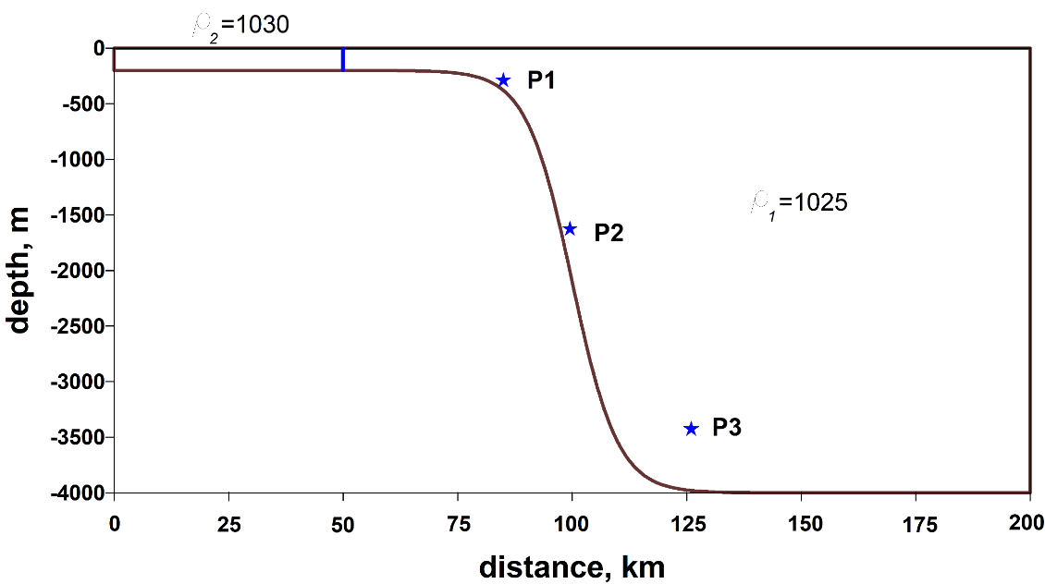
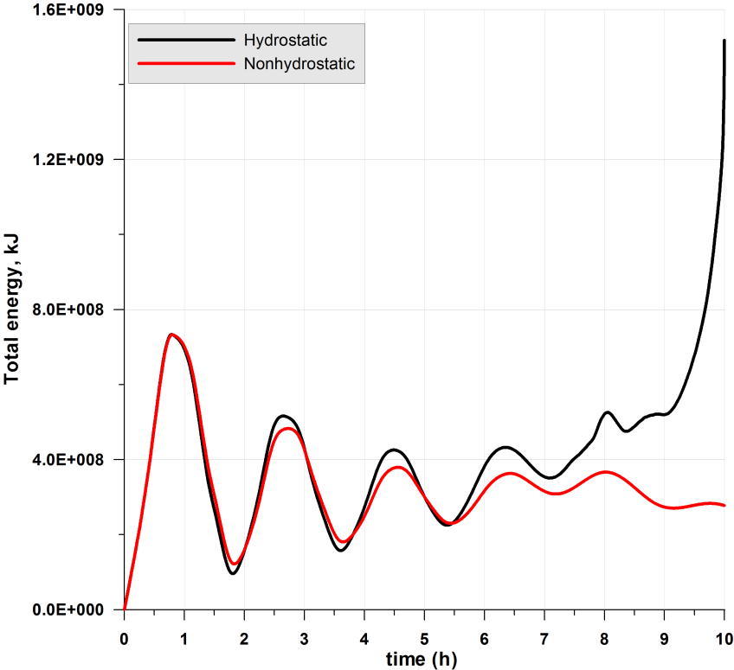
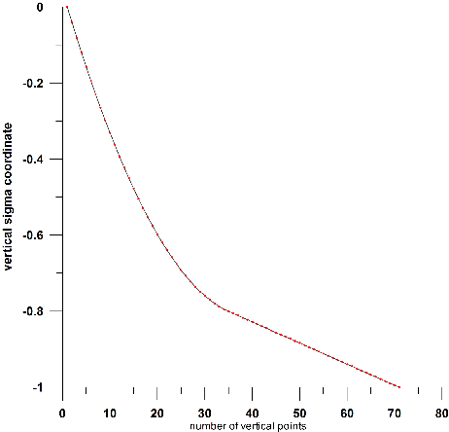
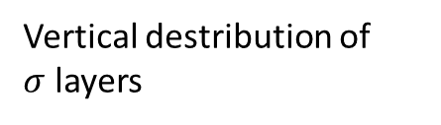
Lock-Exchange flow on the shelf break
Initialization: Heggelund et al., 2004.
Initial experiment configuration with location for three stations for analysis.
Vertical destribution of
$σ$ layers
Total energy for hydrostatic and non-hydrostatic simulation.

Slide 7
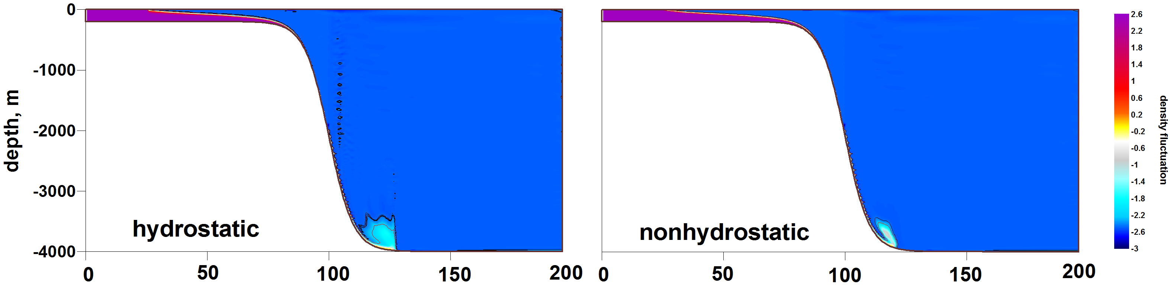
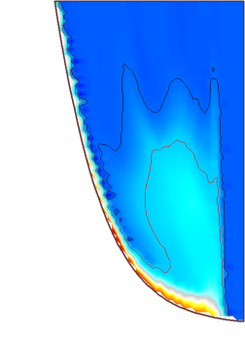
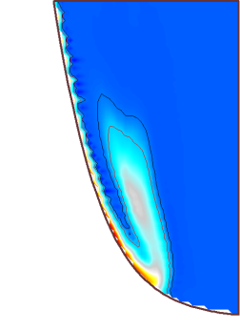
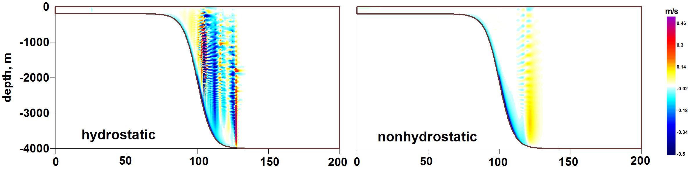
Lock-Exchange flow on the shelf break
Density fluctuations along the section at time=10h
Vertical velocity along the section at time=10h

Slide 8
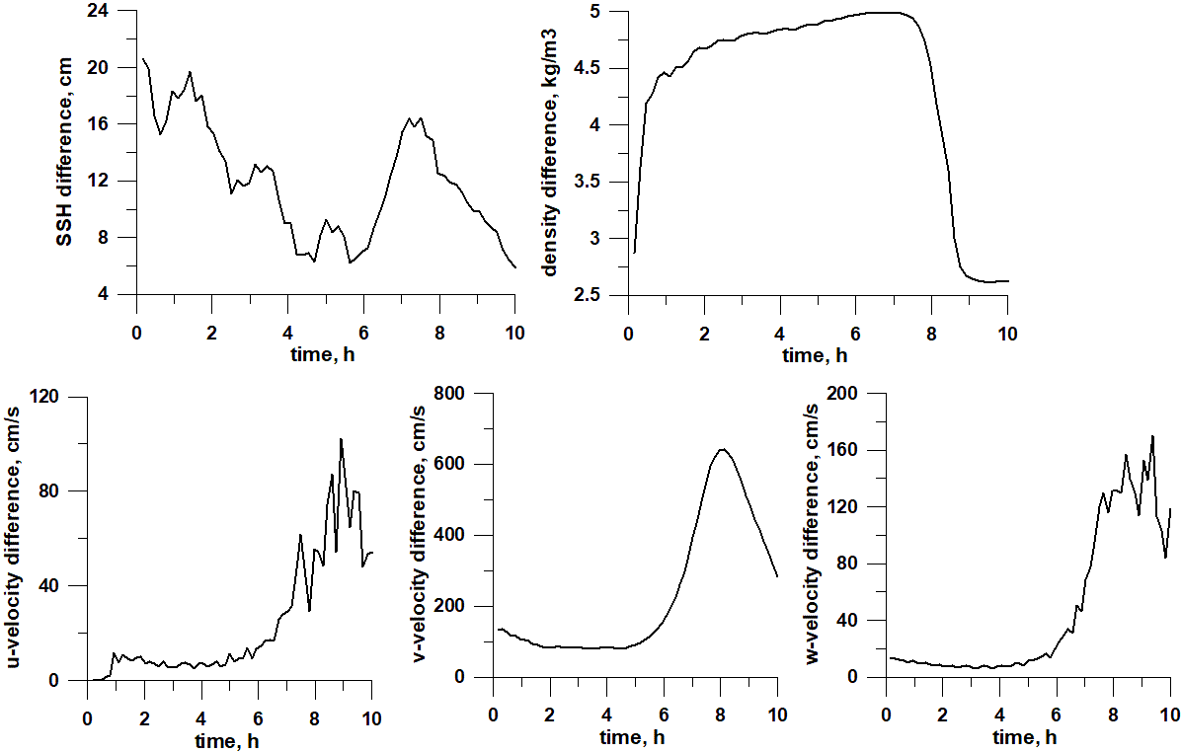
Lock-Exchange flow on the shelf break
Maximal Norme (B1) of difference for two simulations case. Non-hydrostatic & Hydrostatic.

Slide 9
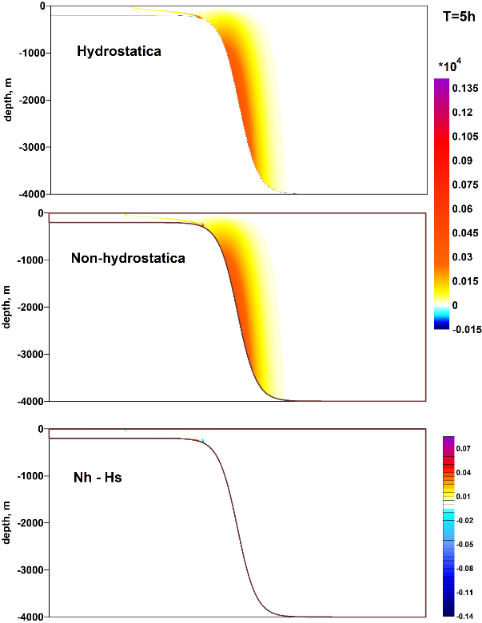
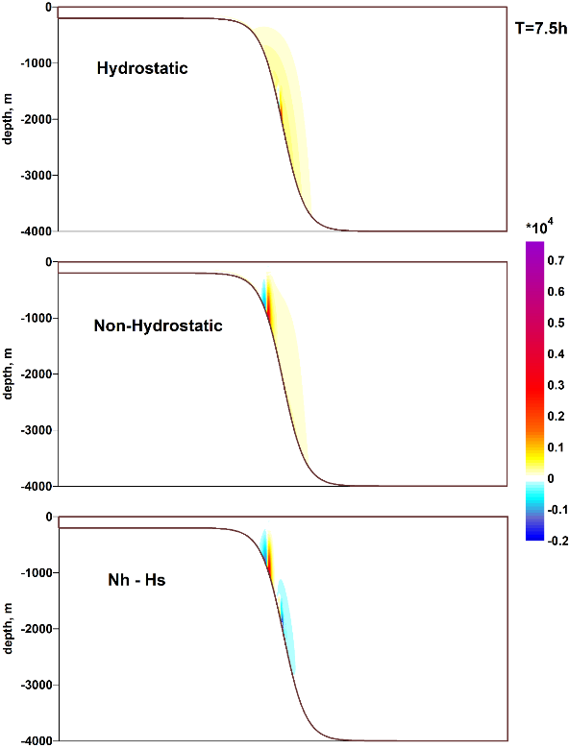
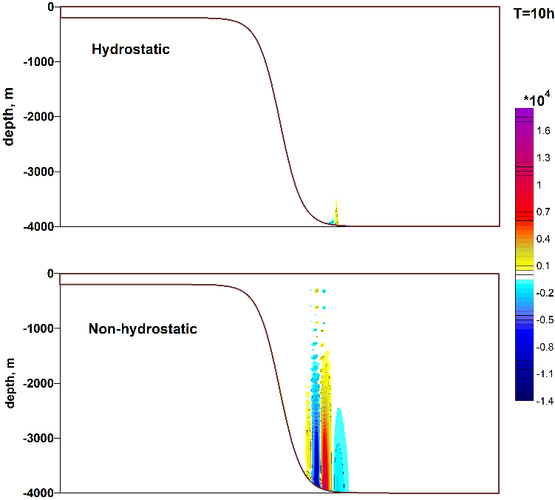
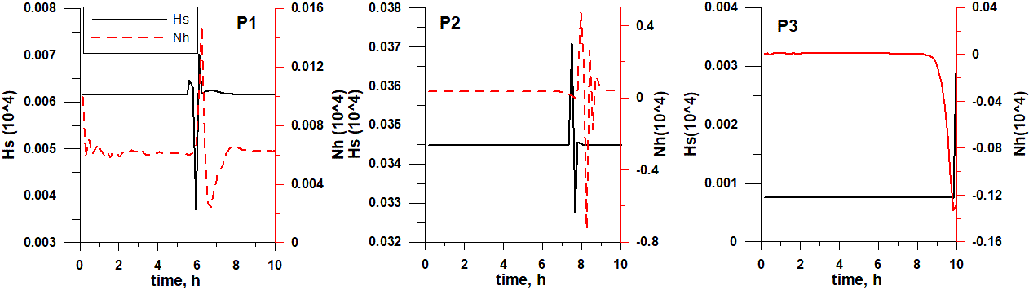
Lock-Exchange flow on the shelf break
Full pressure gradient. Left panel – 5 h; Middle panel – 7.5h ; Right panel – 10 h.
Hydrostatic and Non-hydrostatic pressure for three differnt points.

Slide 10
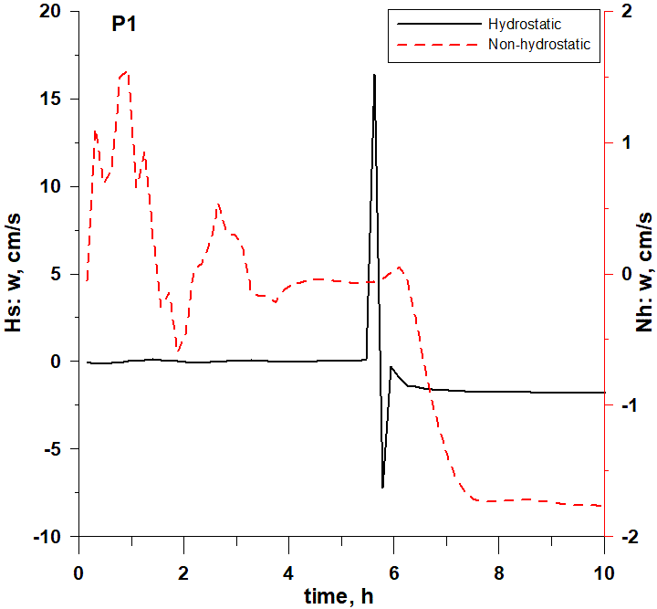
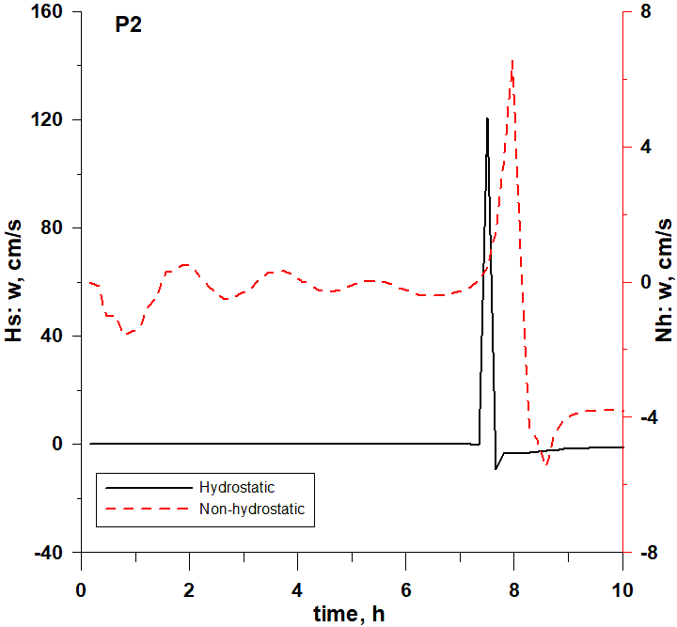
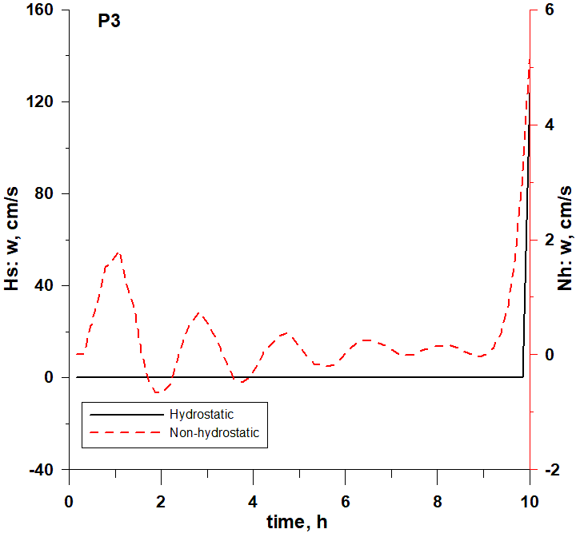
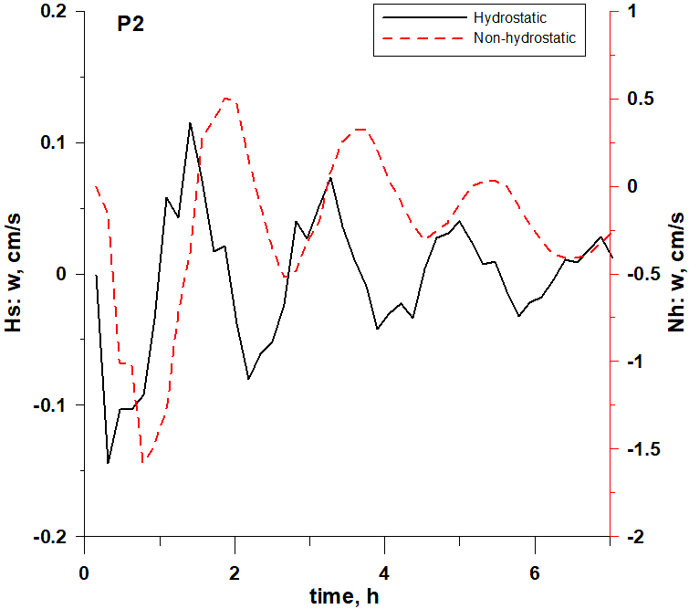
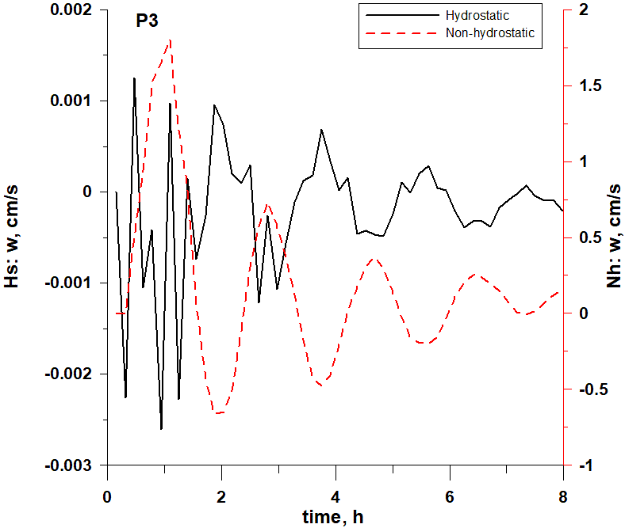
Lock-Exchange flow on the shelf break
Vertical velocity for two simulations for 10 hours simulations in the three points on the continental slope. Hydrostatic (back) & Non-hydrostatic (red).
Vertical velocity for two simulations in the two points on the continental slope. Hydrostatic (back) & Non-hydrostatic (red). Wave character of the flow in the Non-hydrostatic case.

Slide 11
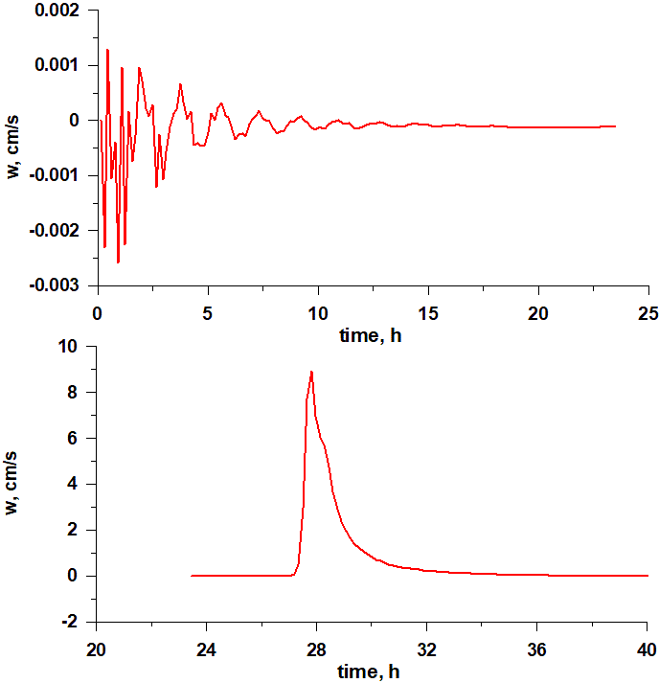
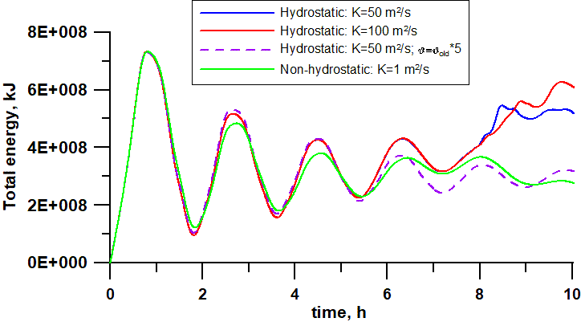
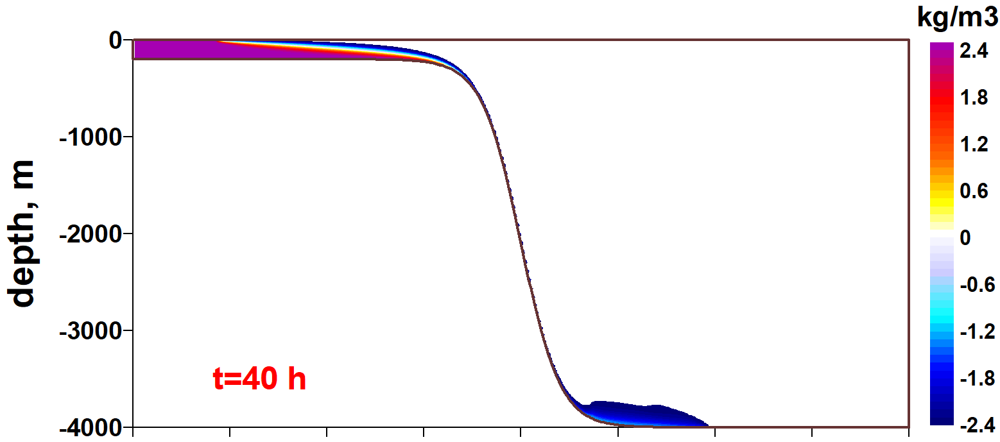
Lock-Exchange flow on the shelf break
Vertical velocity in P3 for hydrostatic experiment with high horizontal diffusion and vertical viscosity
Total energy for different experiments for testing diffusion and viscosity.
Hydrostatic experiment with high horizontal diffusion and vertical viscosity. Density fluctuations along the section at time=40 h

Slide 12
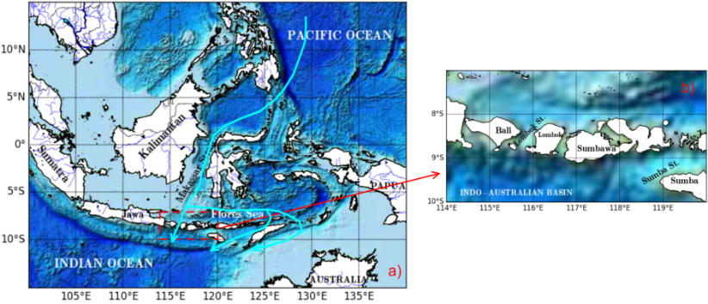
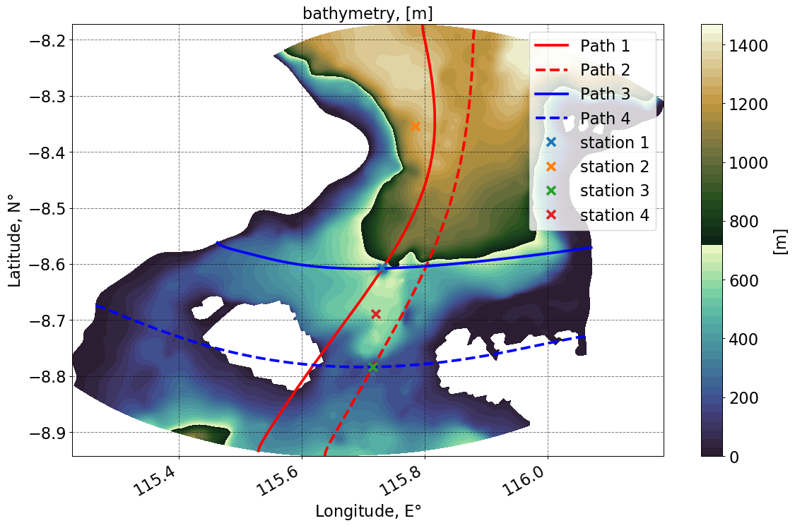
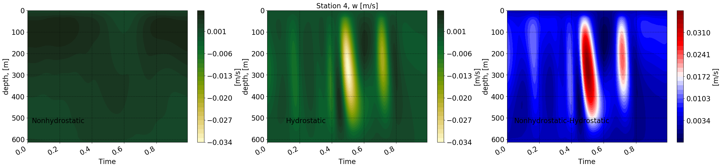
Lombok Strait: comparison hydrostatic and non-hydrostatic approaches
The Lombok Strait, which has a complex morphometric structure and is an important link in the water exchange between the Pacific and Indian Oceans.
Hoffmüller diagramm of the vertical velocity (Station 4). Left – non-hydrostatic; middle – hydrostatic; right – difference.
Notes:
Finite volume
Fine resolution, hydrostatic, finite volume

Slide 13
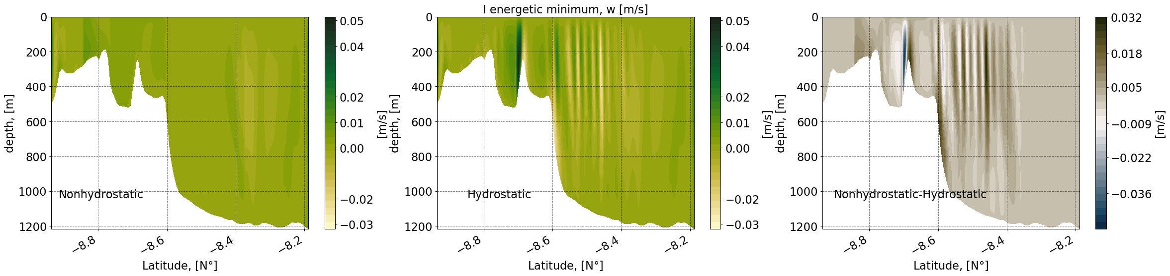
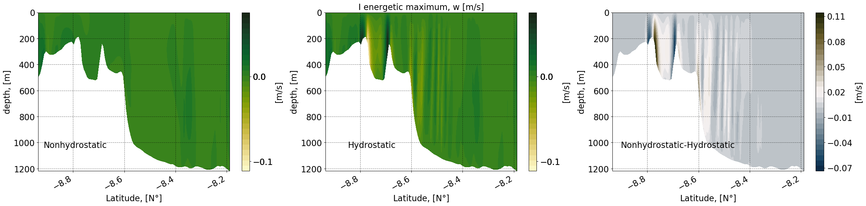

Lombok Strait: comparison hydrostatic and non-hydrostatic approaches
Vertical velocity along the section 2. Upper panel – I energetic minimum it the tidal cycle M2 wave; Bottom panel – I energetic maximum. Left – non-hydrostatic; middle – hydrostatic; right - difference
Notes:
Finite volume
Fine resolution, hydrostatic, finite volume

Slide 14
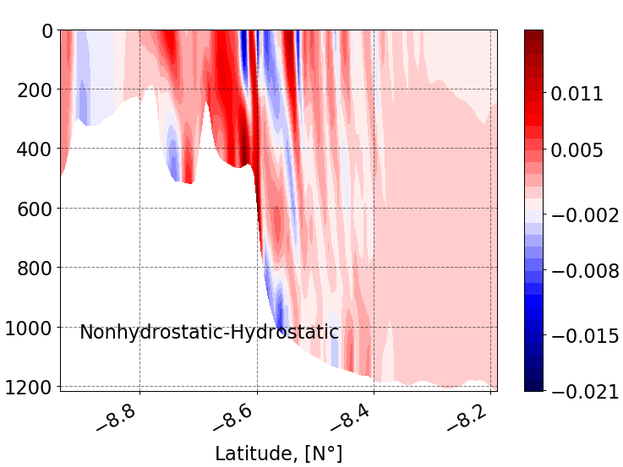
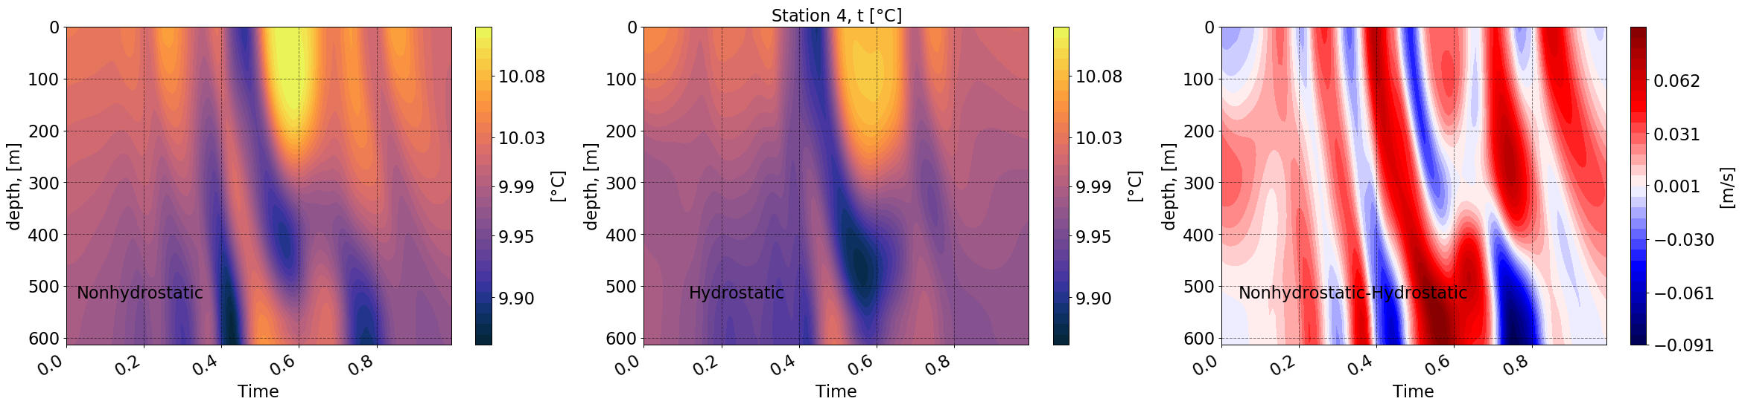
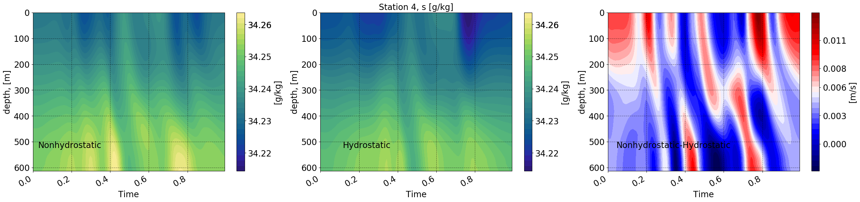
Lombok Strait: comparison hydrostatic and non-hydrostatic approaches
kg/m3
Difference dencity along the section 2.
Hoffmüller diagramm of the Temperature (upper panel) and Salinity (bottom panel) for Station 4. Left – non-hydrostatic; middle – hydrostatic; right – difference.
Notes:
Finite volume
Fine resolution, hydrostatic, finite volume

Slide 15
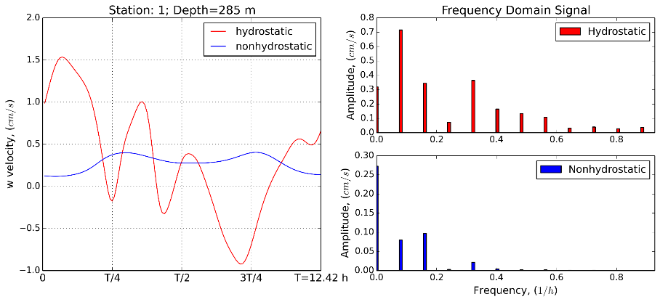
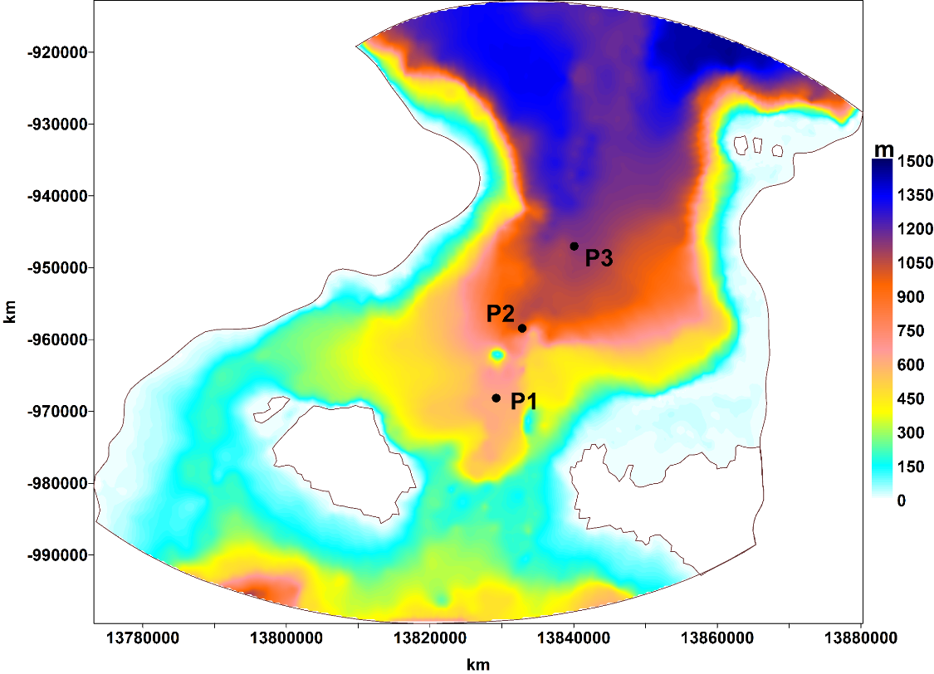
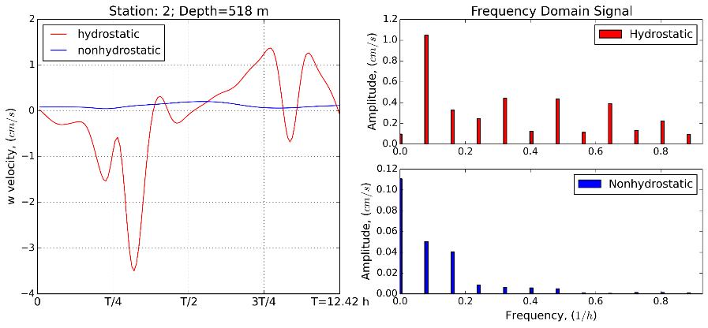
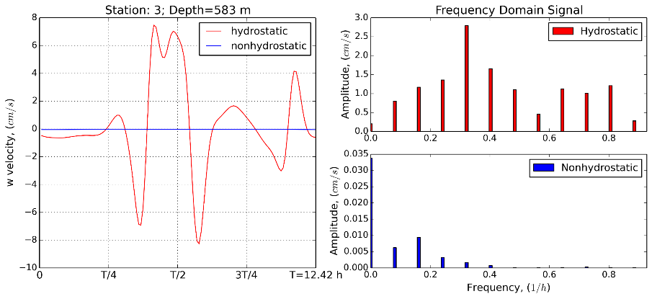
Lombok Strait: comparison hydrostatic and non-hydrostatic approaches
*St.6
Spectral analysis of vertical velocity in hydrostatic / non-hydrostatic formulations
Notes:
Finite volume
Fine resolution, hydrostatic, finite volume

Slide 16
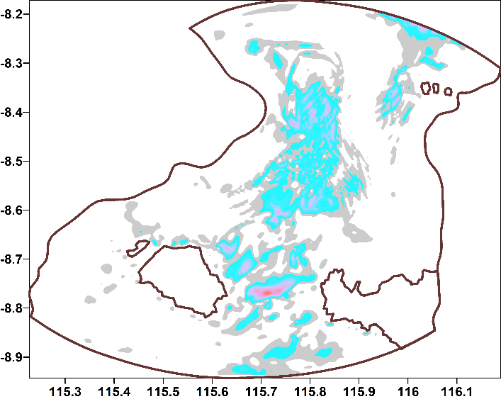
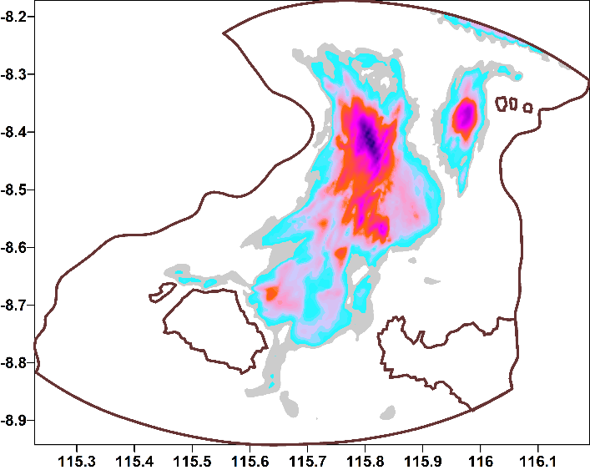
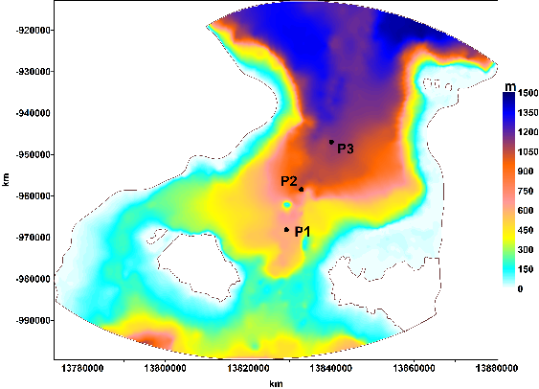
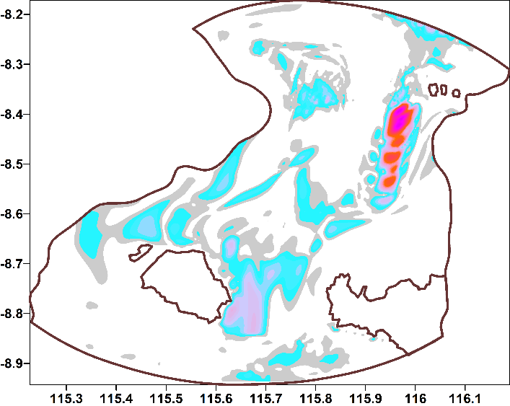
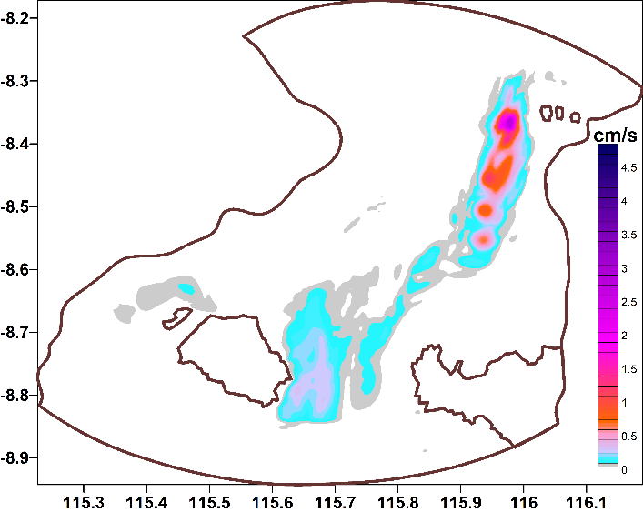
Lombok Strait: comparison hydrostatic and non-hydrostatic approaches
Hydrostatic simulation.
Left: amplitude vertical velocity on frequency M2 wave. Right: amplitude for all nonlinearity frequency.
Non-hydrostatic simulation.
Left: amplitude vertical velocity on frequency M2 wave. Right: amplitude for all nonlinearity frequency.
Notes:
Finite volume
Fine resolution, hydrostatic, finite volume

Slide 17
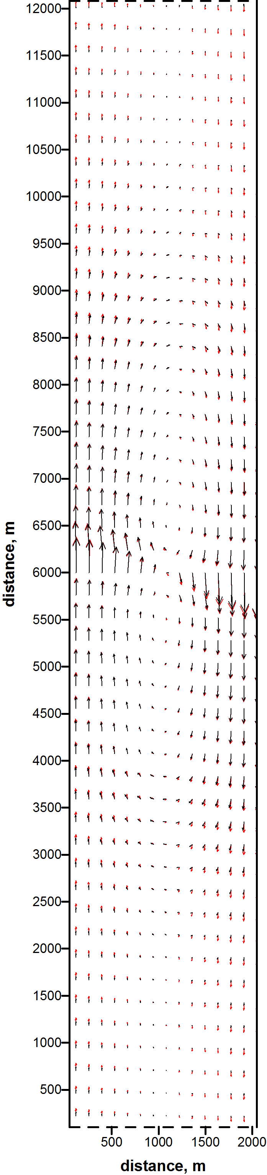
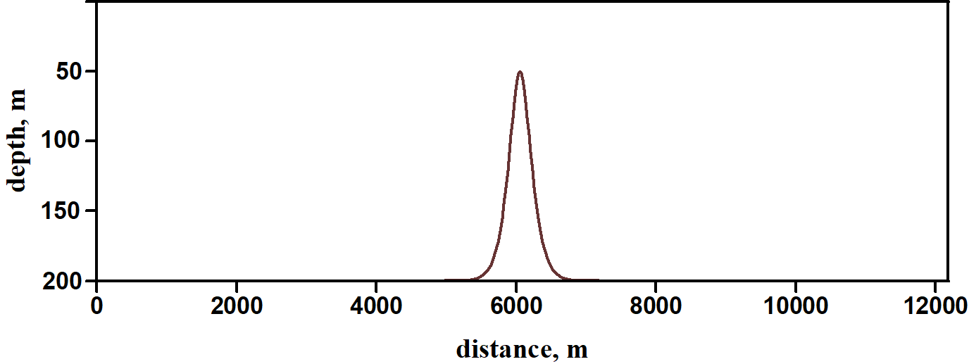
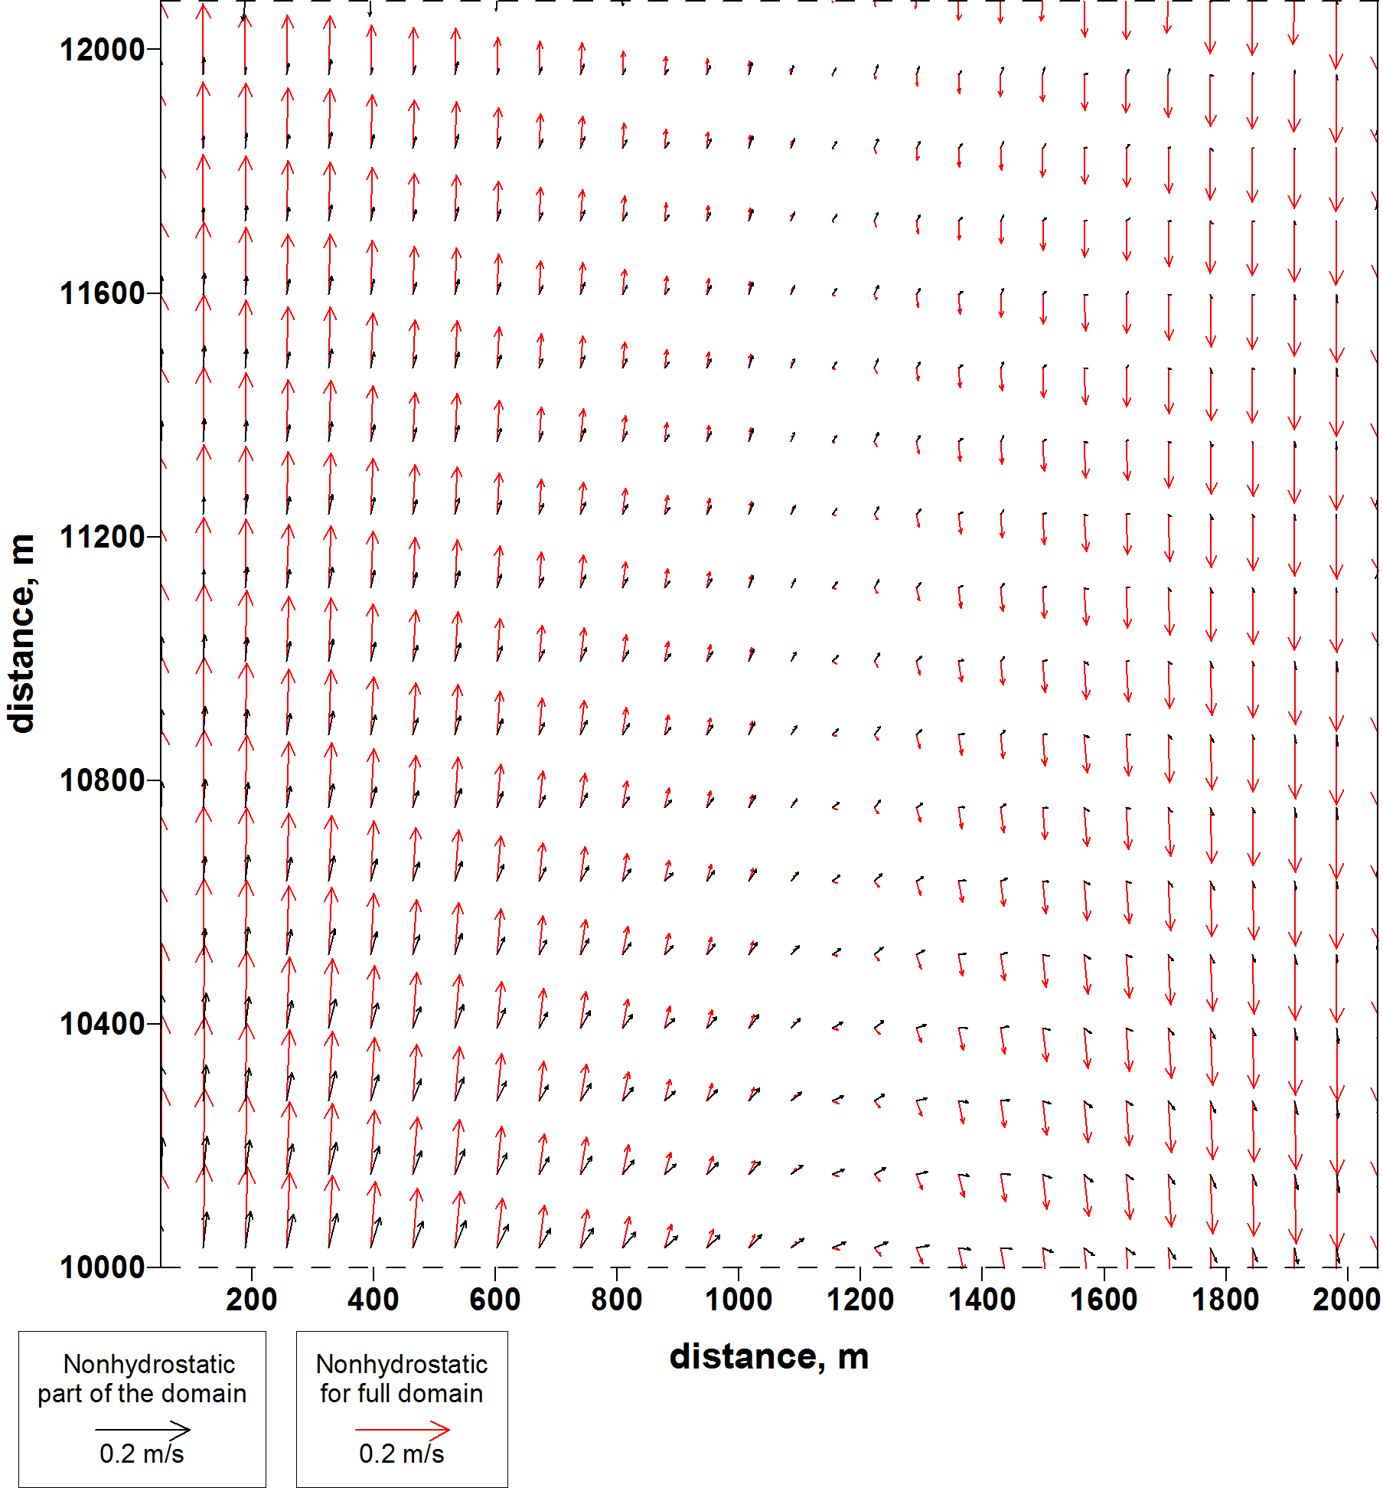
Can account for non-hydrostatic pressure “solve” the open boundary problem?
Residual circulation for full domain
Test experiment: 3D barotropic task for narrow channel with sharp underwater mountain. On the open boundary – M2 tide with 1cm amplitude with opposite phase.
Residual circulation for the north part of the channel. Red arrows – non-hydrostatic for full domain; black arrows – non-hydrostatic only in the region underwater mountain.

Slide 18
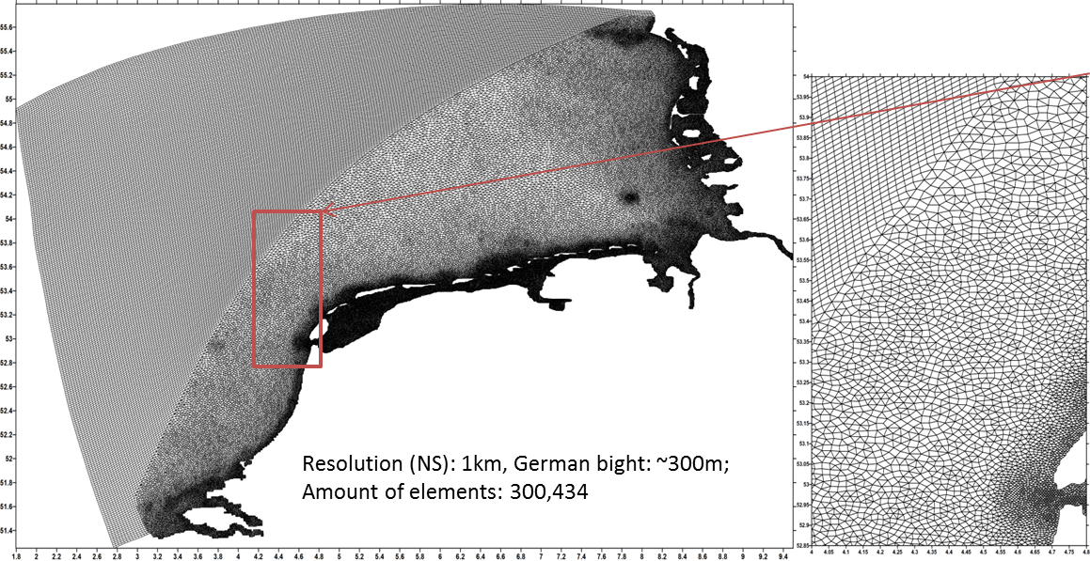
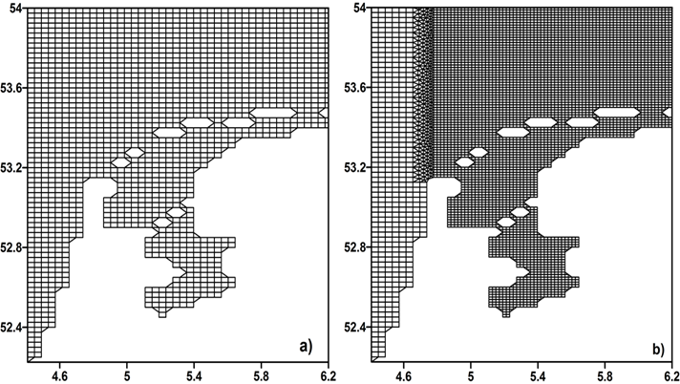
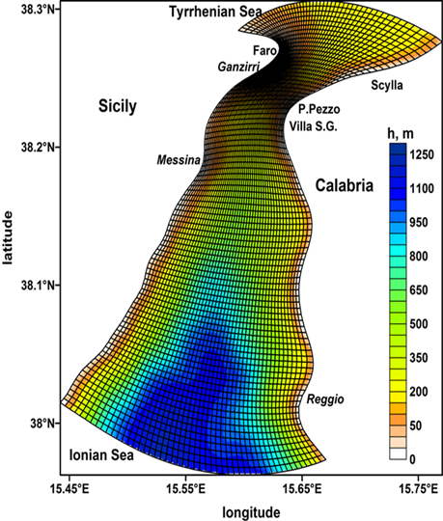
Future implementation
Quads, triangles and mixed meshes
FESOM-C* model
A coastal branch of the FESOM2 global model
FESOM2 and FESOM – C share a part of infrastructure
Easy coupling with global version
Easy implementation non-hydrostatic aproach from FD to FV.
*Androsov et al., GMD, 2019

Slide 19
Conclusions
The neglect of non-hydrostatic pressure in a hydrostatic model is problematic since non-hydrostatic pressure plays a significant role in internal wave evolution balancing nonlinear wave steepening.
Where non-hydrostatic pressure is neglected in a model it should not be surprising that the wave evolution may be poorly predicted.
It is shown that hydrostatic models may develop high wavenumber “soliton-like” features that are purely a construct of model error but may seem to mimic physical behaviours of the non-hydrostatic system.
Computation of complete equations for small regions with a strong influence of non-hydrostatics can significantly reduce problems with setting open boundary conditions.

Slide 20
Thanks for your attention

