Slide 1

Urs Schaefer-Rolffs and Erich Becker (Theory and Modeling)
Contributions: Rahel Knöpfel

Slide 2
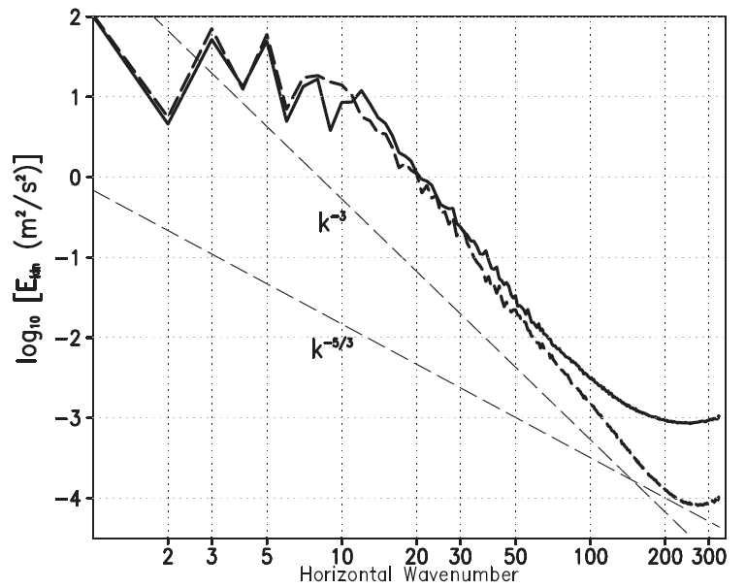
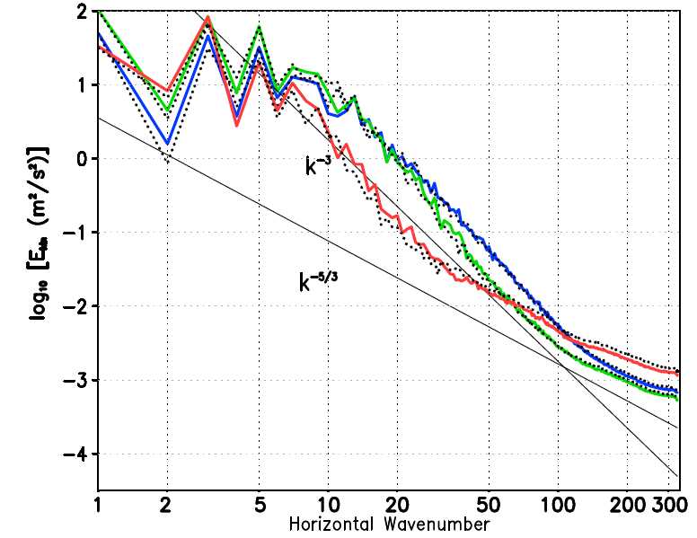




Motivation: How can I improve my parameterization?

Slide 3
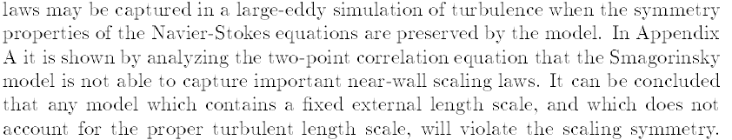
Motivation: How can I improve my parameterization?
What is the difference between Smagorinsky model and Dynamic Smagorinsky model (DSM)?
Good parameterizations by considering mathematical and physical consistencies
  Physical consistencies
    Represented by specific constraints (e.g., conservation laws) for particular quantities
    Examples: Conservation laws for mass, energy, constituents, …
  Mathematical consistencies
    Represented by mathematical properties (e.g. invariances) for set of equations
    Examples: Invariances with respect to time, translation, rotation, scaling …
Oberlack, 1997: Invariant modeling in large-eddy simulation of turbulence. – In: Annual Research Briefs, Center for Turbulence Research, Stanford, 3–22.

Slide 4

Which are the governing equations in global models? And does it matter?
Most general equations: Navier-Stokes equations
But: at global scales term with molecular viscosity is negligible → Euler equations
Does it matter? No influence on constraint from physical consistency
Mathematical consistency: Difference in scaling behavior ( ) of time and space
Euler equations Navier-Stokes
equations
two independent scaling symmetries one combined space-time scaling symmetry
c_{t}
c_{t}
c_{x}
c_{x}
c_{t} = 2c_{x}

Slide 5

Which are the governing equations in global models? And does it matter?
Constant energy transfer rate ε imposes constraint on scaling (symmetry breaking)
Euler equations Navier-Stokes
equations
  Two Euler symmetries merge to a single space-time scaling symmetry
  Breaking of Navier-Stokes symmetry → no scaling symmetry possible
Idea: each parameterization for Euler equations must follow the same scaling symmetry
(Oberlack showed that Smagorinsky violates Euler scaling symmetry, while DSM does not)
c_{t}
c_{t}
c_{x}
c_{t} = c_{x} = 0
c_{x}
c_{t} = 2c_{x}

Slide 6



Scale invariance criterion – General formulation I (Schaefer-Rolffs, Met.Z. 24, 3-14, 2015)
If is a quantity, then scaling is defined as , where denote the corresponding
scaling factor
For the independent and dependent variables y and z the scaling transformation
is a symmetry transformation if a set of equations holds
In particular, for an equation of motion of a scalar , the following must be valid

Slide 7
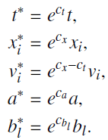
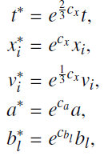


Scale invariance criterion – General formulation II
The scaling of the Euler equations is given by
For a constant energy transfer, we obtain the Kolmogorov-like scaling
Then, a criterion can be derived as follows
It can be used for each term individually, because scaling is linear and “multiplicative”

Slide 8





Scale invariance criterion – Examples
Example 1: Pressure gradient in Euler equation
→
Example 2: Continuity equation complies with scale invariance of the Euler equations
c_{p} - c_{ρ}
c_{x}, c_{t}

Slide 9


Scale invariance criterion for geophysical fluids I (Schaefer-Rolffs, Eur. J. Mech. B Fluids 74, 92-98, 2019)
Quasi-geostrophic regime: Coriolis term significant, and enstrophy cascade
Scaling includes a rotation defined by
The enstrophy cascade yield such that and , leading to
The scale invariance criterion for quasi-geostrophic motion then is
Example: Pressure gradient
→
c_{t}
c_{x}

Slide 10

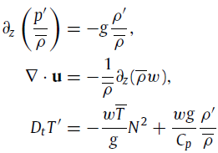

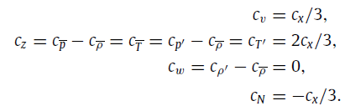
Scale invariance criterion for geophysical fluids II
Anelastic regime: Decomposition of temperature, pressure, and density in primitive equations
→
Assuming constant energy cascade, hence
Entangled scaling factors, finally leading to
Scale invariance criterion remains as in general case,
Further: scaling of z in accordance with aspect ratio of stratified turbulence,

Slide 11






Scale invariance criterion – Applications I
Classic Smagorinsky
DSM
c_{t}
c_{t}
c_{t} = c_{x} = 0
c_{x}
c_{t} = c_{x} = 0
c_{t}
c_{t}
c_{x}
c_{x}

Slide 12









Scale invariance criterion – Applications II
Criterion also applicable for a passive tracer equation
Only a dynamic approach with ensures scale invariance
Application to vertical diffusion in anelastic horizontal momentum equation
→
From it follows and
Finally, due to , we have , leading to the conclusions:
  a vertical mixing length cannot be constant to ensure scale invariance
  one possible realization might be , where is a constant

Slide 13



Motivation: How can I improve my parameterization?

Slide 14
Summary
Parameterizations do not necessarily follow the consistencies of the basic equations, e.g.,
the classic Smagorinsky model violates the scaling symmetry of the Euler equations
A "test of consistency" can help to improve parameterization in order to reduce possible
sources of error
A systematic approach is presented in terms of a scale invariance criterion
Results: In a passive tracer equation only a dynamic tracer mixing length is scale-invariant;
in a stratified atmosphere, a possible form of the vertical mixing length may be

Slide 15
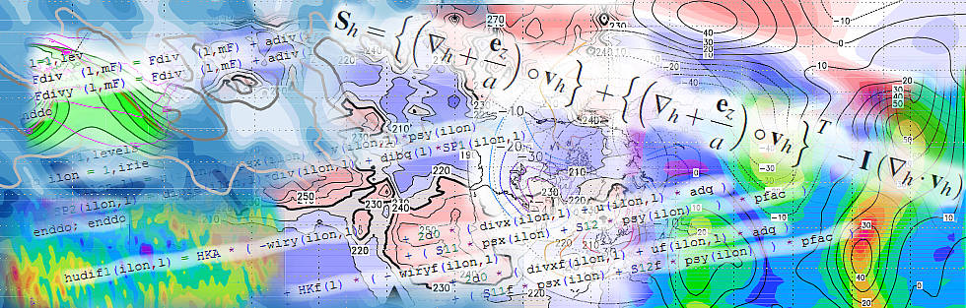
Thank you for your attention!
Questions?

Slide 16
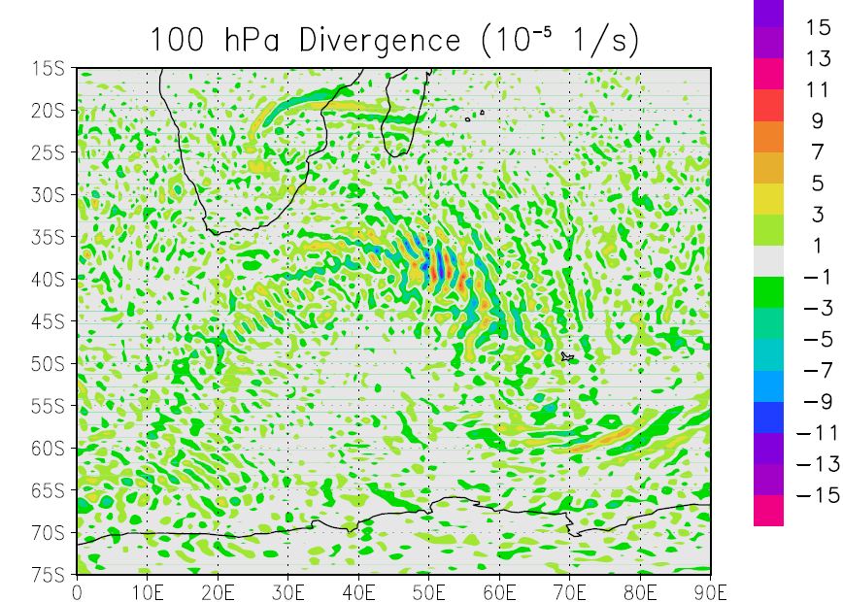
However: Turbulent diffusion parameterizations are a special case
Following these thoughts, the question raises whether a turbulence scheme
  may act on energy similar to a viscosity term, but
  in mathematical sense scale like the advection term?
In this case, does that mean that the energy transfer should be constant even where the
scheme is significant (hence, no apparent viscous subrange visible in resolved scales)?
However, if there is no damping of
spectral modes towards the resolution,
Gibbs wiggles may occur as numerical
artefacts
Still in discussions how to solve this
issue best

