Slide 1
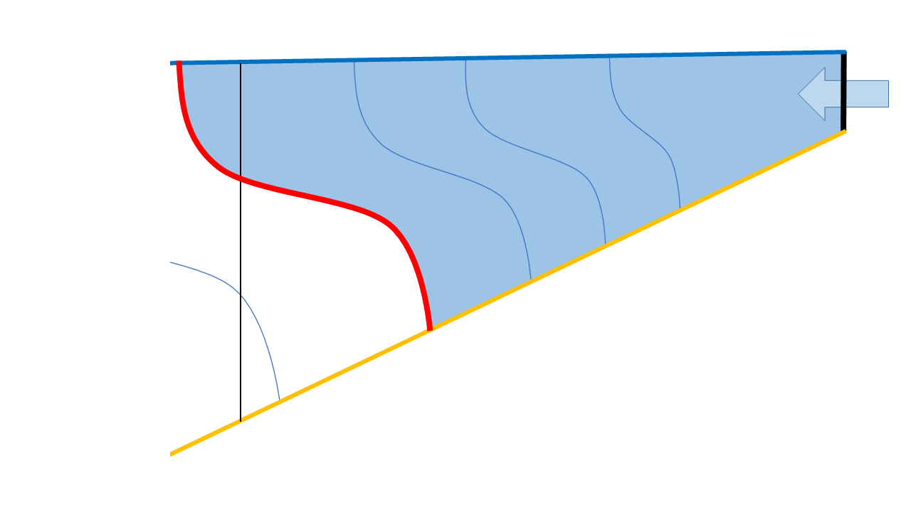
Diagnosing diahaline mixing in ocean models
(of estuaries)
Hans Burchard, Ulf Gräwe, Knut Klingbeil, Nicky Koganti, Xaver Lange, Marvin Lorenz
Leibniz Institute for Baltic Sea Research Warnemünde, Germany

Slide 2
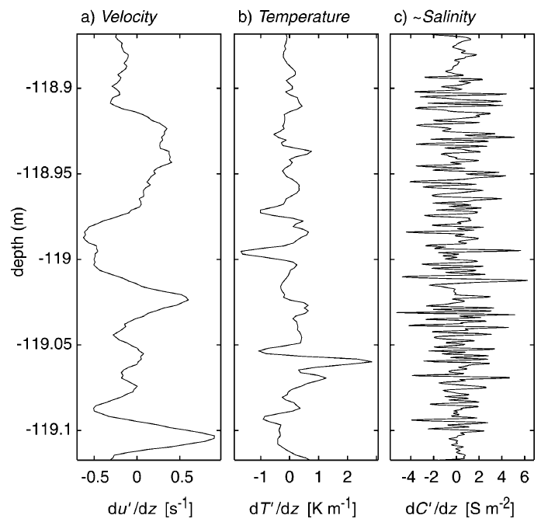

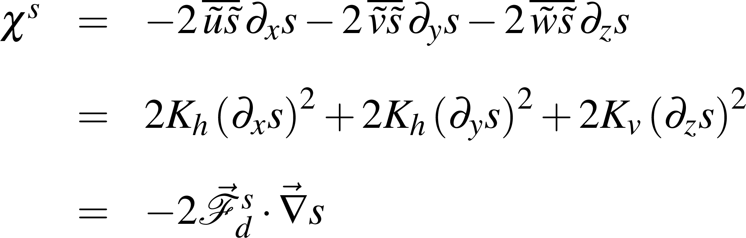
Small-scale mixing
What is salinity mixing?
Instantaneous salinity equation:
Salinity mixing is defined as salinity variance dissipation.
Reynolds averaging:
Nash & Moum (2002)
Micro-structure salinity-variance equation:
Burchard & Baumert (1995)
Burchard & Bolding (2001)
stirring
mixing

Slide 3
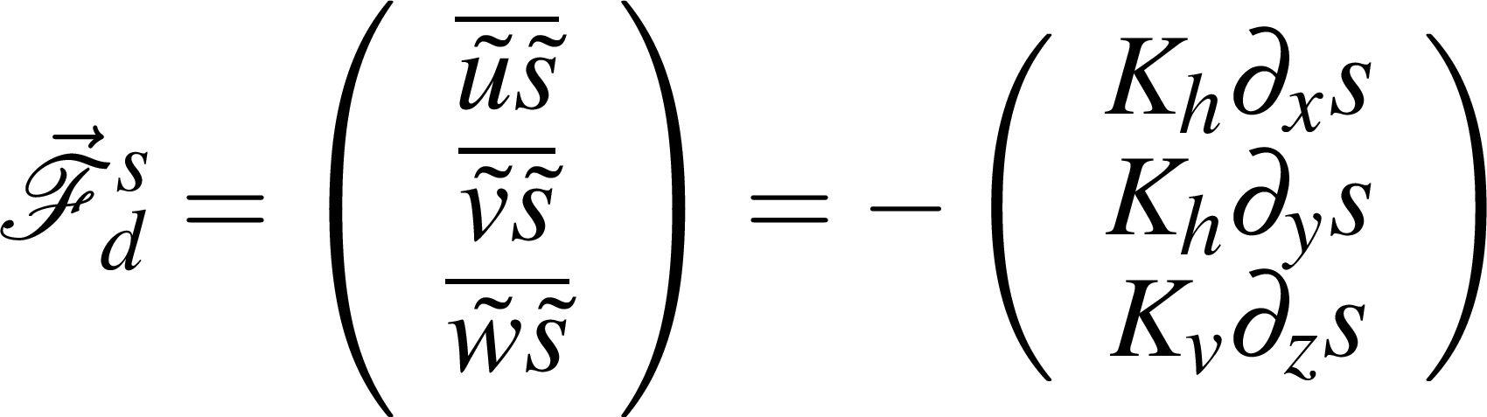
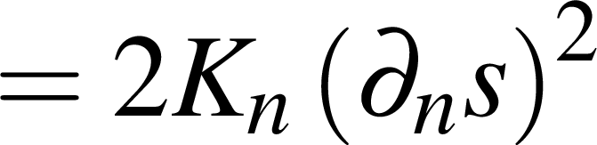
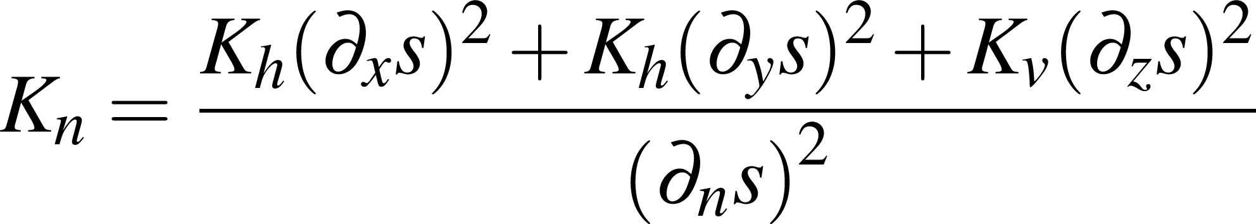
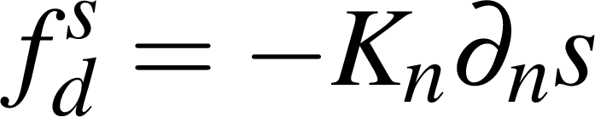
Turbulence closure for numerical models
Down-gradient (eddy diffusivity) assumption:
diahaline salinity gradient
Mixing (=stirring) per unit volume:
Diahaline diffusivity:
Diahaline turbulent flux:

Slide 4
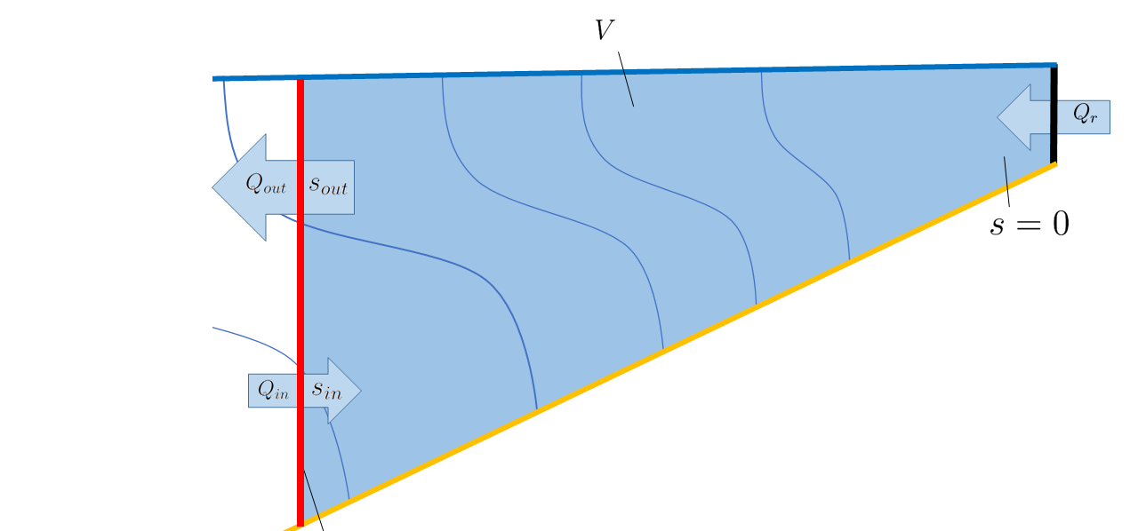
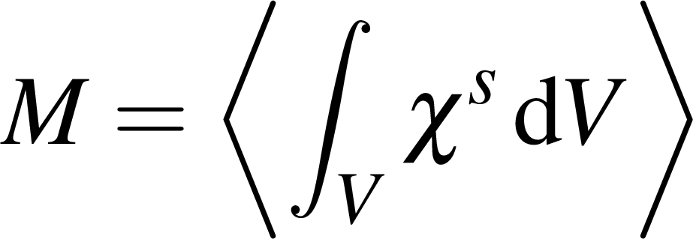
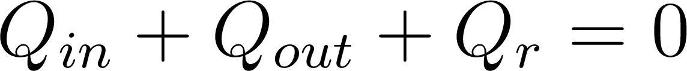
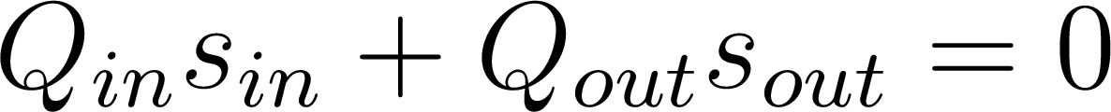
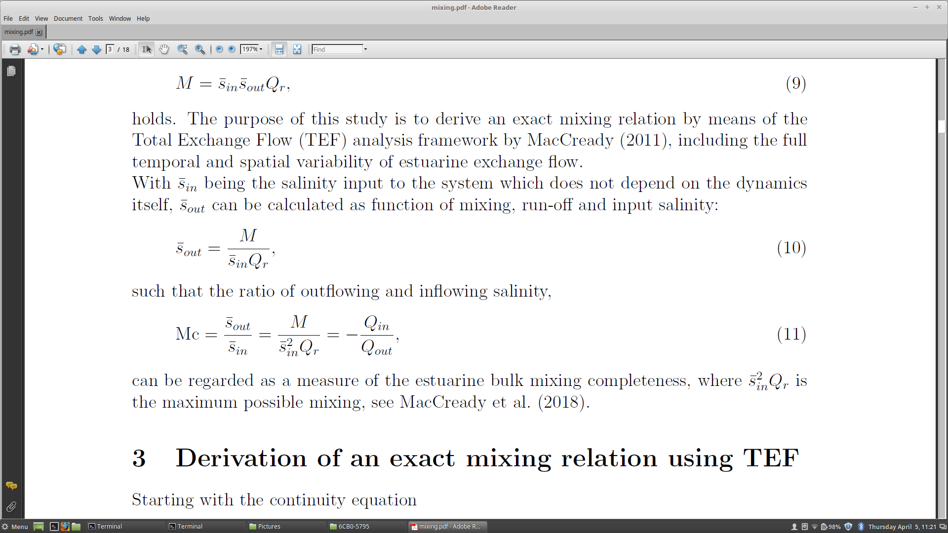
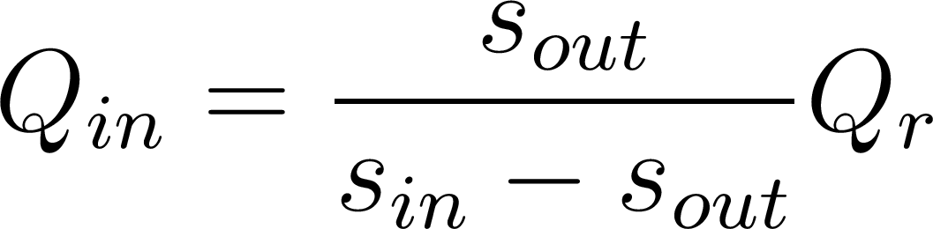
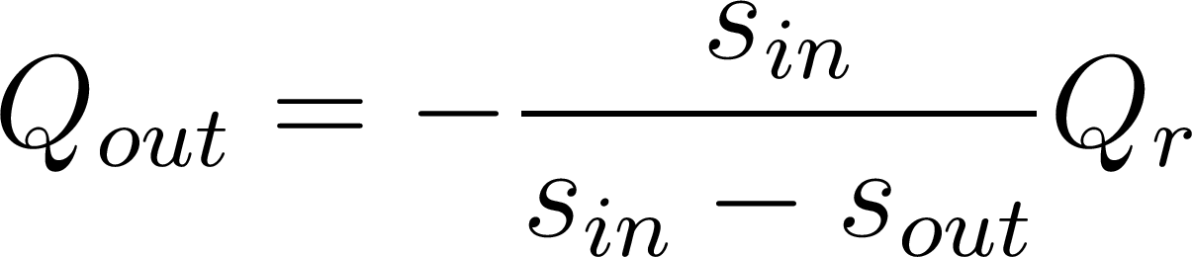
Long-term averaged box estuary
Long-term averaged box estuary
Classical Knudsen volume and salt relations:
New mixing relation:
Mixing
MacCready et al. (2018)
Knudsen (1900)

Slide 5
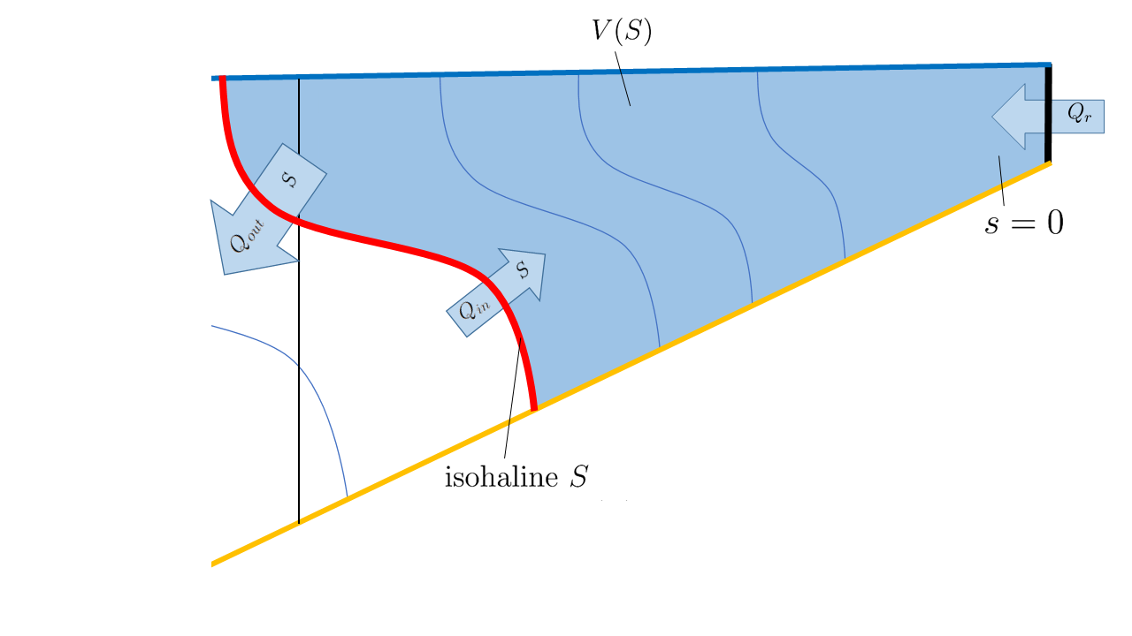
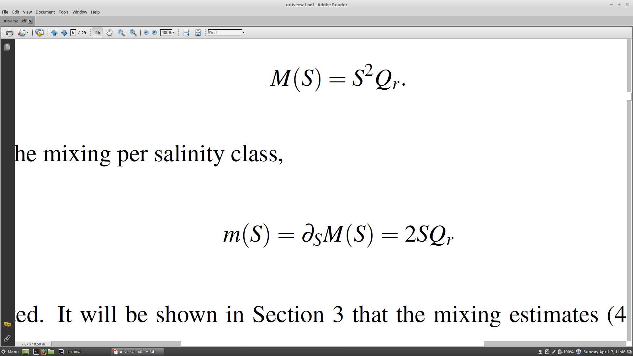
Volume-integrated mixing for fixed isohaline S
Very new estuarine mixing theory
: exact mixing for long-term averaged conditions.
Mixing per salinity class:
Burchard (2020)

Slide 6
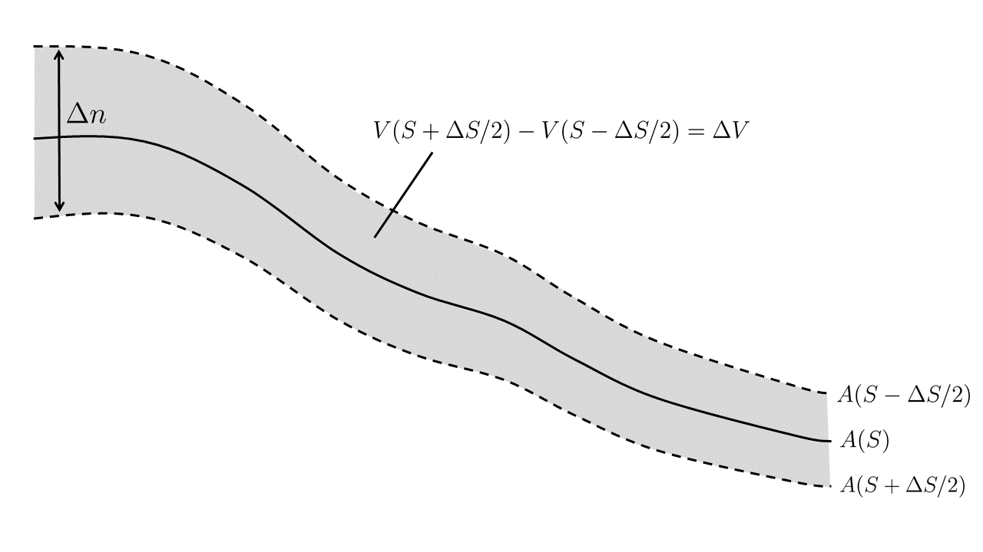
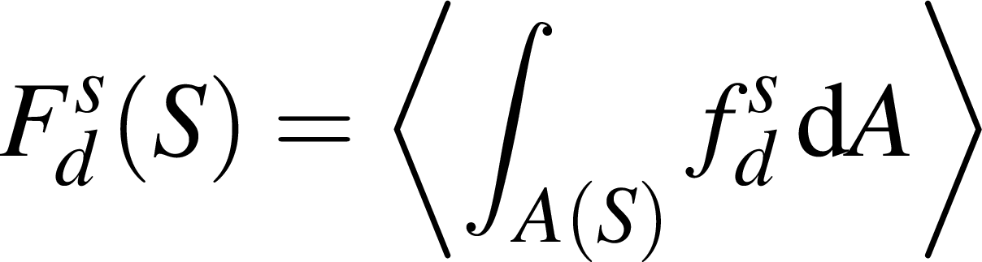
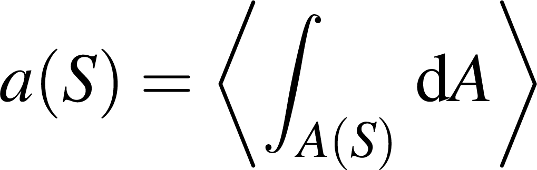
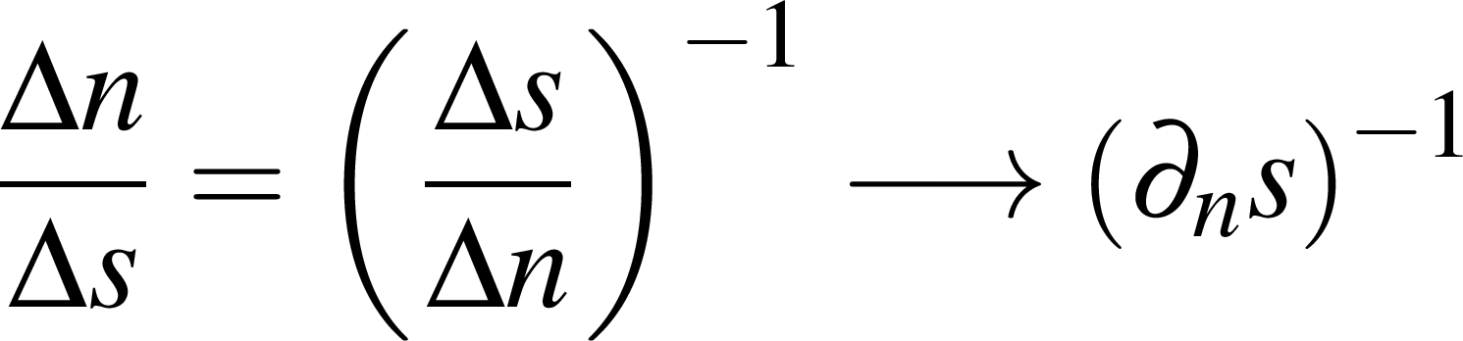
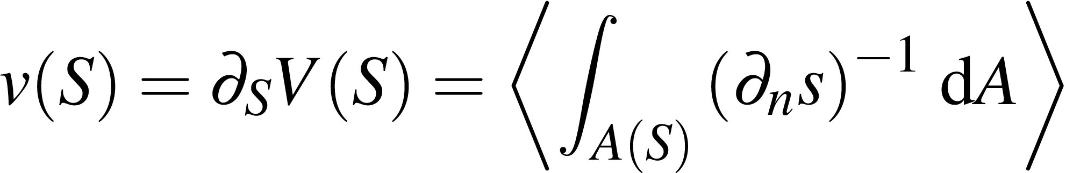
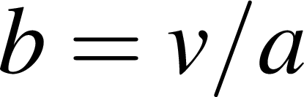
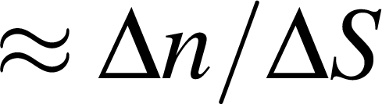
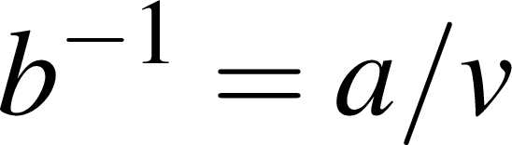
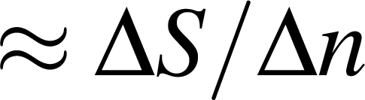
Some definitions on isohaline surfaces and volumes
Diahaline transport:
low salinity
Isohaline area:
high salinity
local thickness per salinity class:
Volume per salinity class:
Mean thickness per salinity class: ( )
Mean salinity gradient: ( )
Burchard et al. (in prep.)

Slide 7
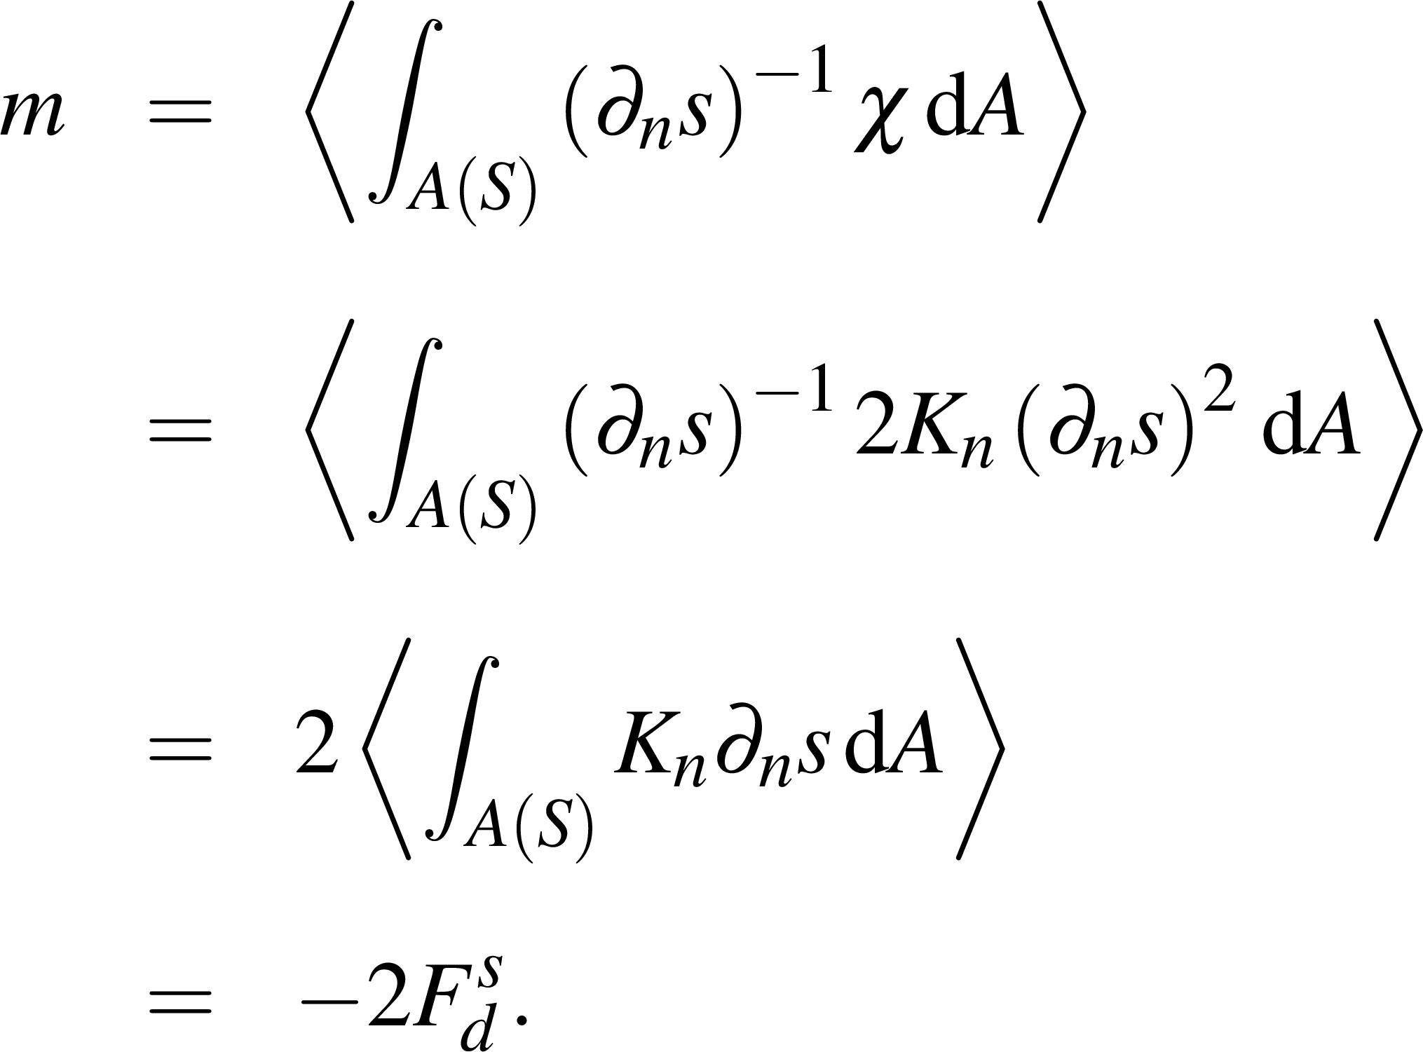
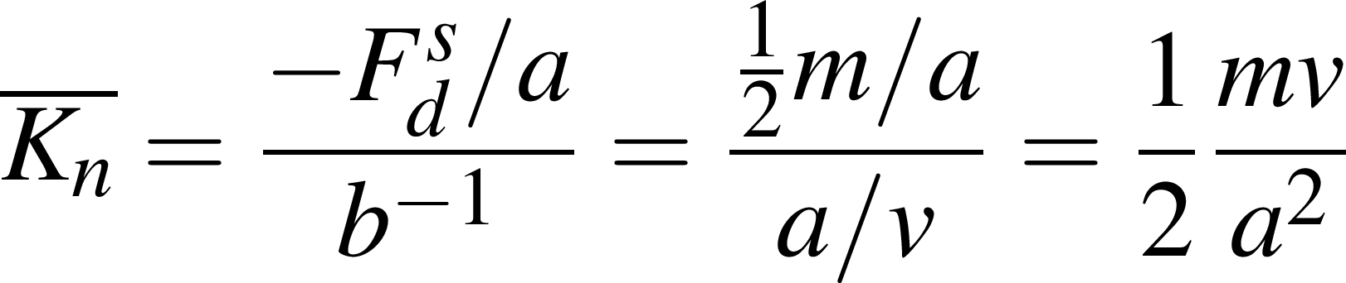
Some thought about diahaline salinity fluxes
Mixing per salinity class is determined by diahaline flux:
Effective diahaline diffusivity:
Burchard et al. (in prep.)

Slide 8
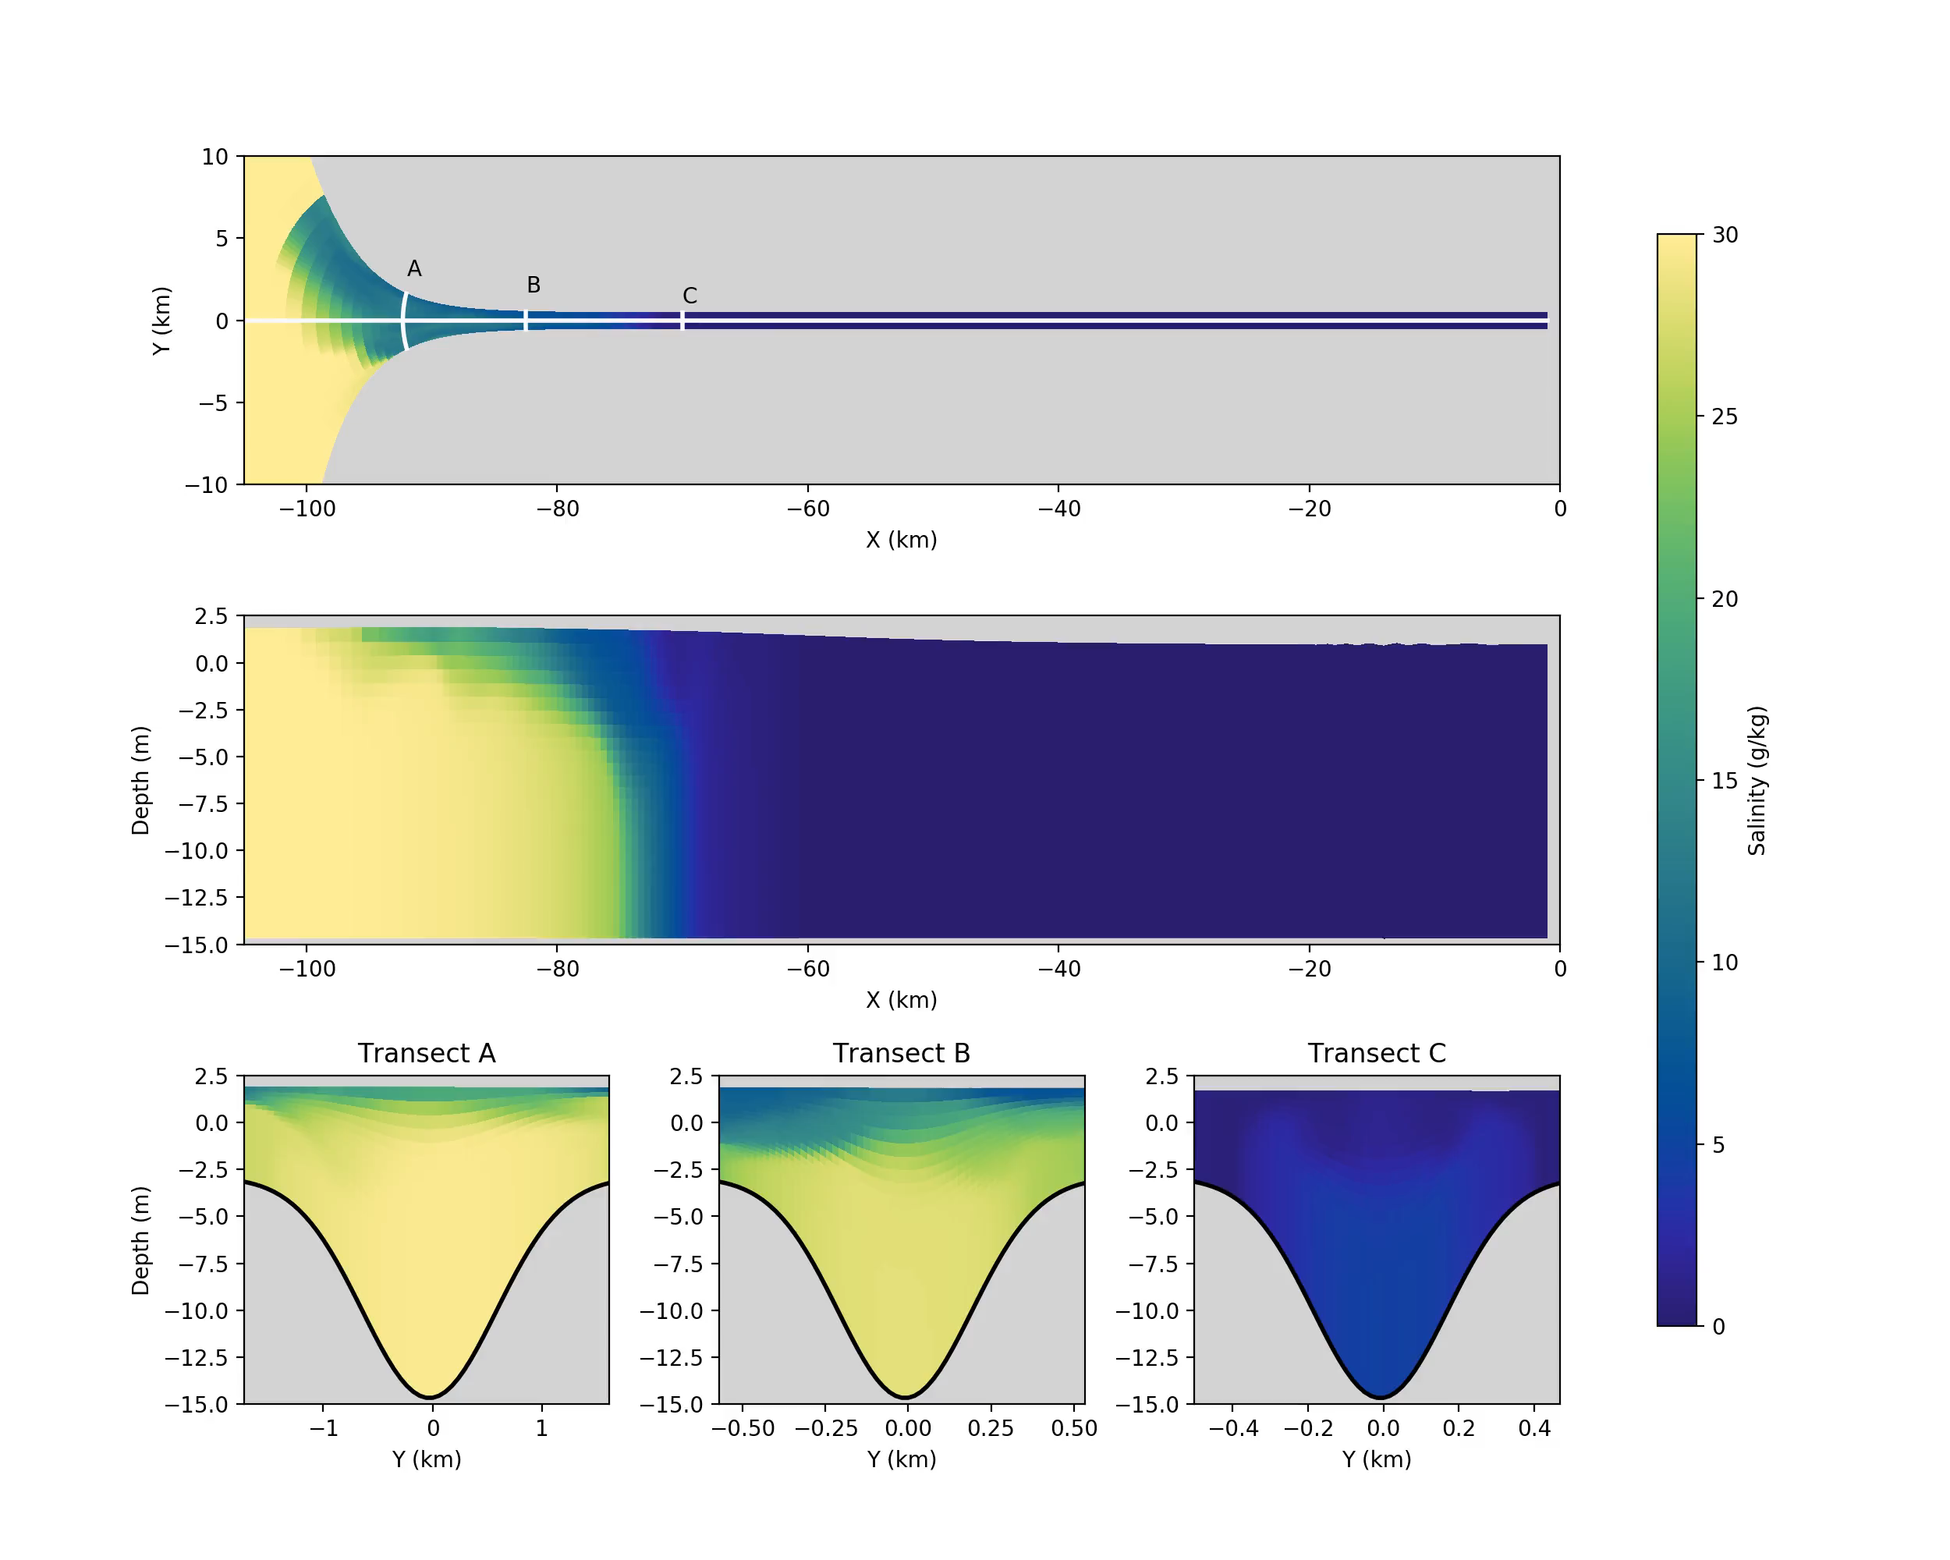
3D estuary, very first results
Burchard et al. (in prep.), simulation and analysis by Nicky Koganti (IOW)

Slide 9
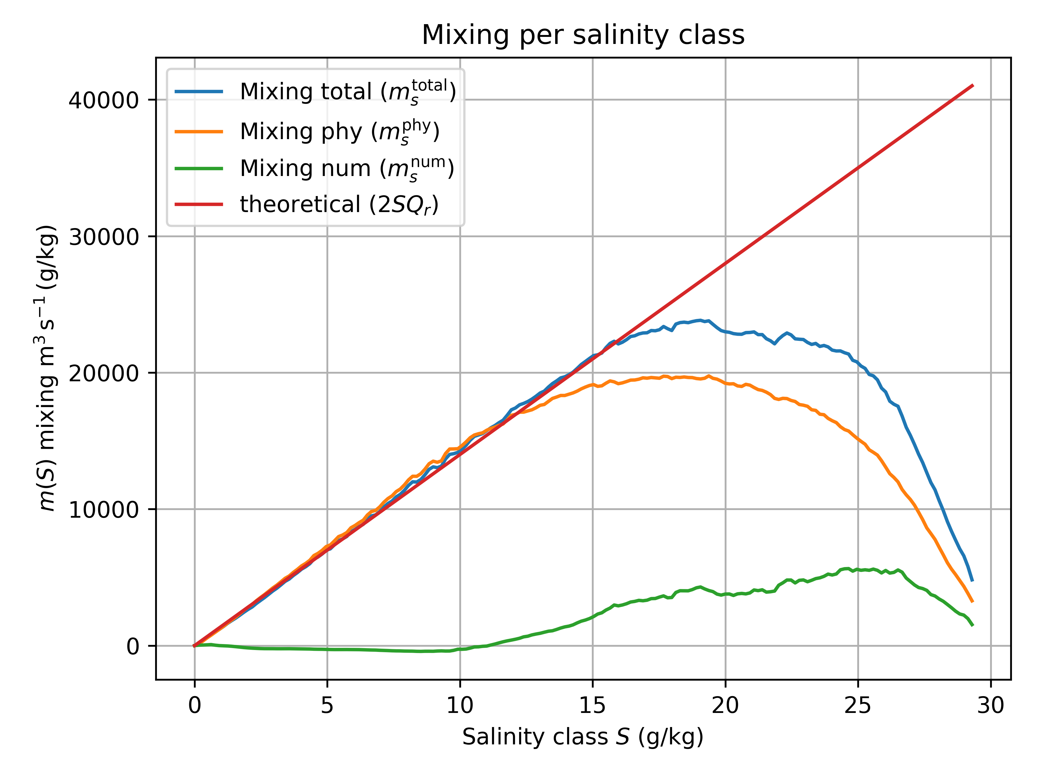
3D estuary, very first results
Mixing per salinity class
use Klingbeil et al. (2014)
to calculate those
Burchard et al. (in prep.)

Slide 10
3D estuary, very first results
Mixing per salinity class
Burchard et al. (in prep.)

Slide 11
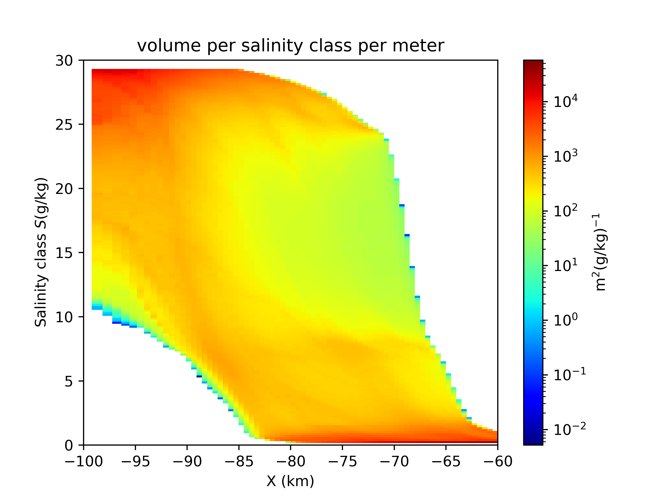
3D estuary, very first results
Mixing per salinity class
Volume per salinity class and metre
Burchard et al. (in prep.)

Slide 12
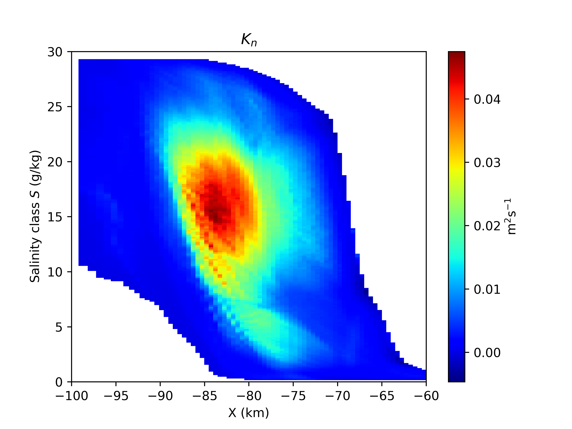
3D estuary, very first results
Effective diahaline diffusivity K_{n}
Burchard et al. (in prep.)

Slide 13
Conclusions
Conclusions
Calculating the mixing per salinity class, m(S), provides a useful parameter to analyse estuarine mixing.
Long term averages of the mixing per salinity class should result as m(S)=2SQ_{r} .
With the isohaline volume per salinity class, v(S), and the isohaline area a(S), the effective diahaline diffusivity results as K_{n} = ½ mv/a². This can be calculated for each water column and each salinity class.
We will attempt to extend this method for calculating effective diapycnal diffusivities in the ocean.

Slide 14
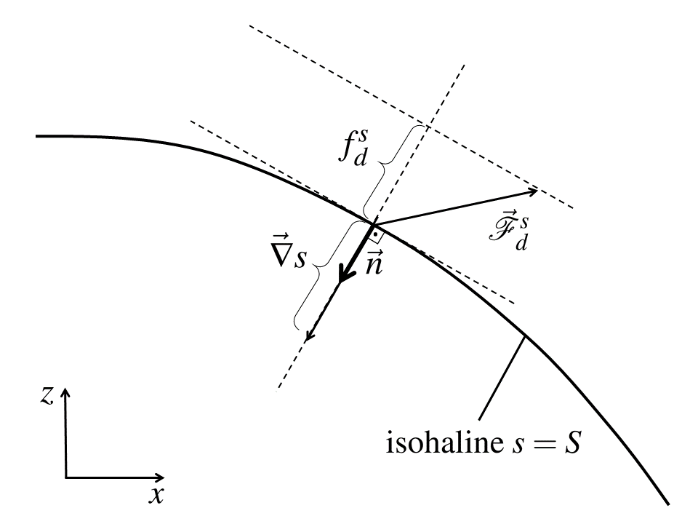
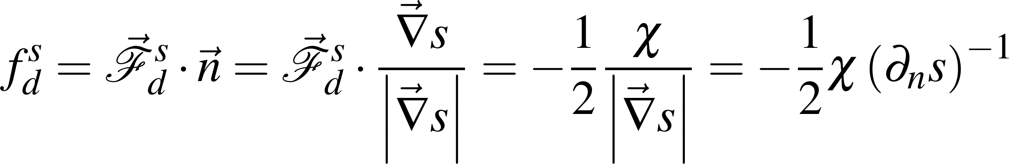
Some thoughts about diahaline salinity fluxes
Some thoughts about diahaline salinity fluxes
diahaline turbulent
salinity flux
low salinity
high salinity
turbulent salinity flux
salinity gradient
Projection of flux vector
to diahaline direction:
Burchard et al. (in prep.)

